Slide 1


Things you must know!
CA Pritam Mahure and Associates

Slide 2
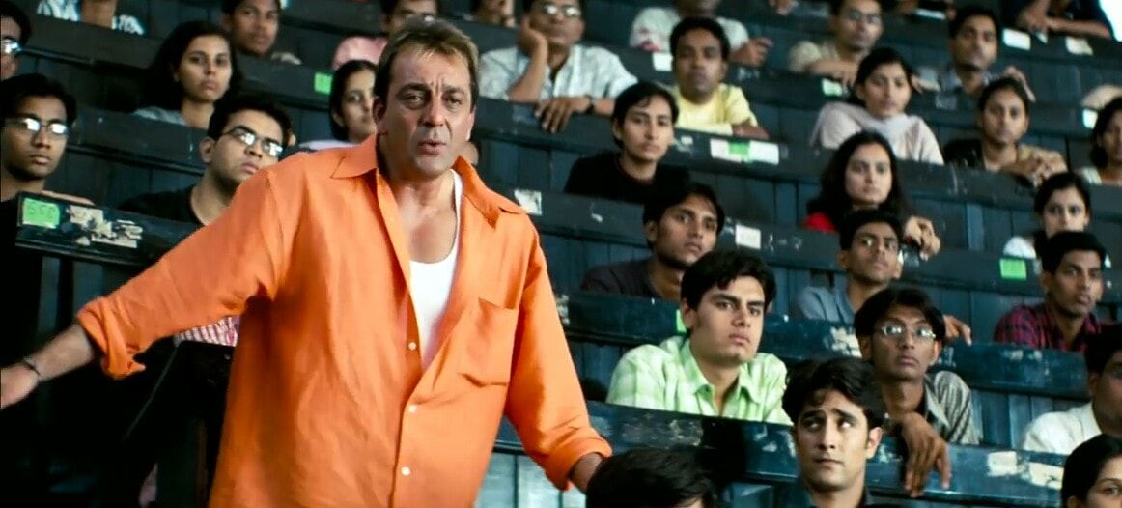
Wo closure ke pehle yeh sab samjhna jaruri hai kya !!!

Slide 3
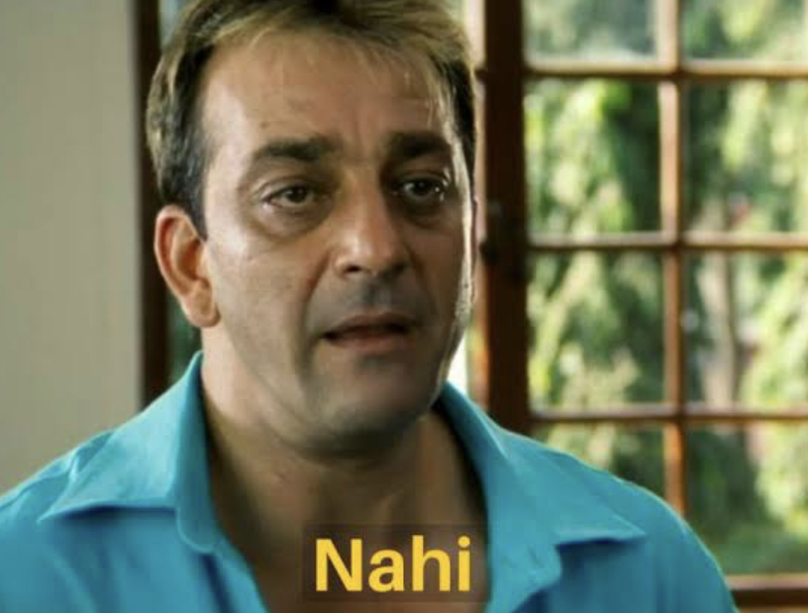

Slide 4
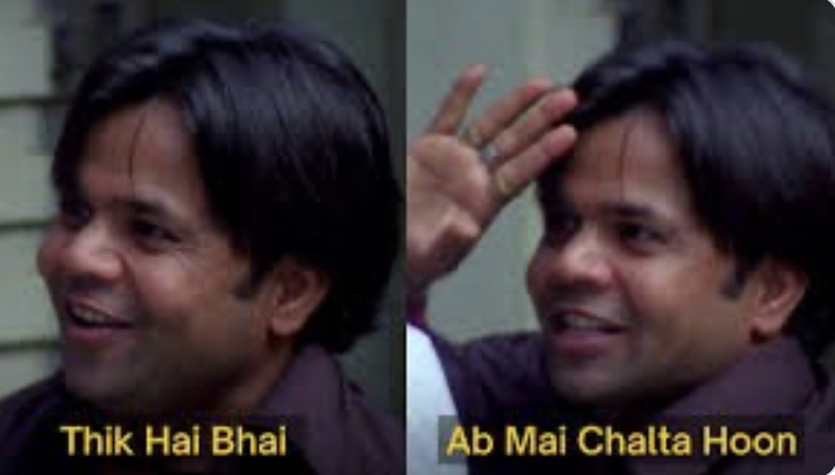

Slide 5
Where was I?
1999-2008
Not having answers!
Felt stuck!
Felt confused!
Made mistakes!
Notes:
Secret – Everyone of us – Every moment of our life
Its not a bug – It’s a feature

Slide 6
What is interesting?
Traveling abroad
Giving lecture
Being Known
Freedom
Wish to do
Need to do
Study
Act on problems
Notes:
Secret – Everyone of us – Every moment of our life
Its not a bug – It’s a feature

Slide 7
What to do in GST?
So much!

Slide 8
What’s there to learn in GST?
So much!
Reader, Writer and Speaker!

Slide 9
New bees?
Just 6.5 years!
Advantage to younger ones!

Slide 10
Point of No ‘Return’!
AI

Slide 11
But its boring!
Everything is!

Slide 12
How’s a day looks like?
Queries to Raids

Slide 13
Wish to start a business?
Can GST help?
Seat at a high table

Slide 14
Can tax professional command respect
Legend Nani Palkhivala
Arun Jaitley ji
Harish Salve ji
Arvind Datar ji
Kapil Sibbal ji

Slide 15
Specialist or General!
Generalise

Slide 16
Audit?
Past or Future

Slide 17
Adversity is ‘the’ biggest opportunity!

Slide 18
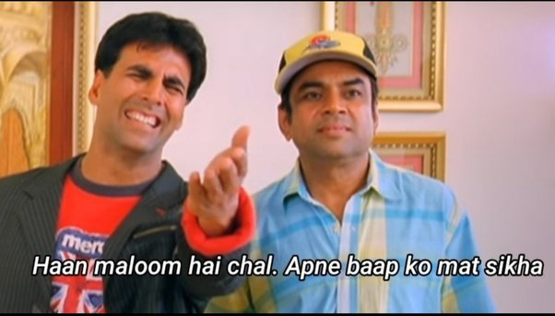

Slide 19
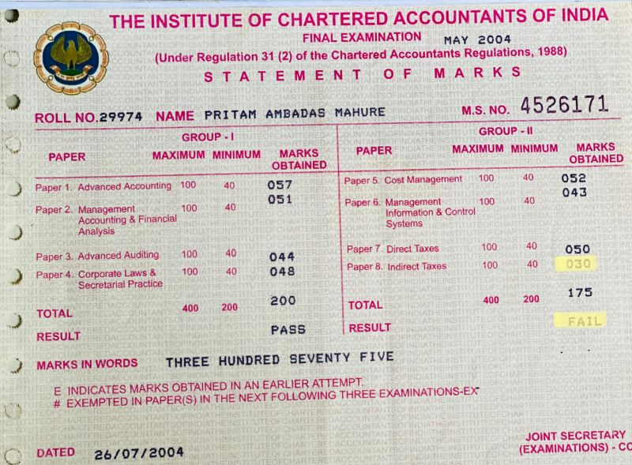
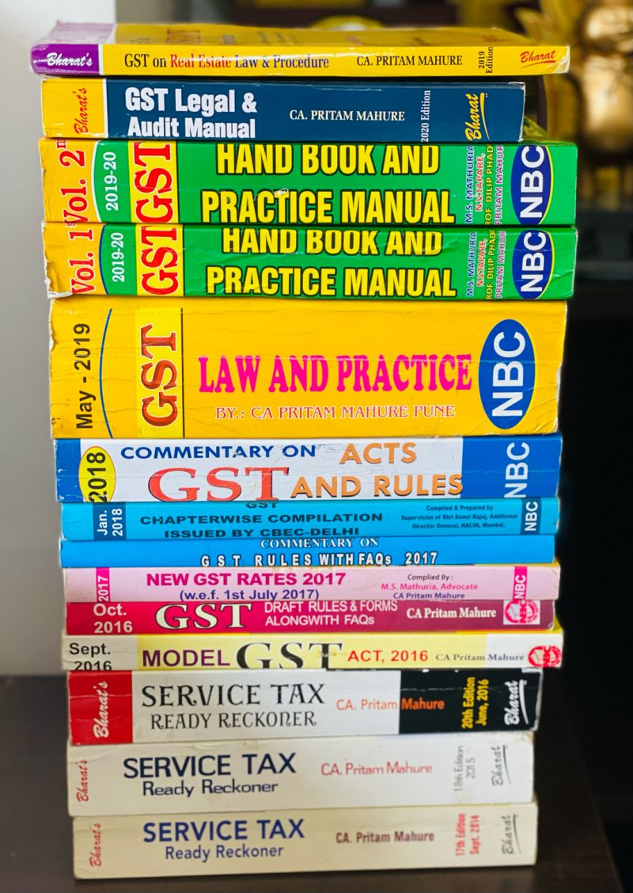
Marks idhar hai!

Slide 20
Failure is an opportunity to be better next time!

Slide 21
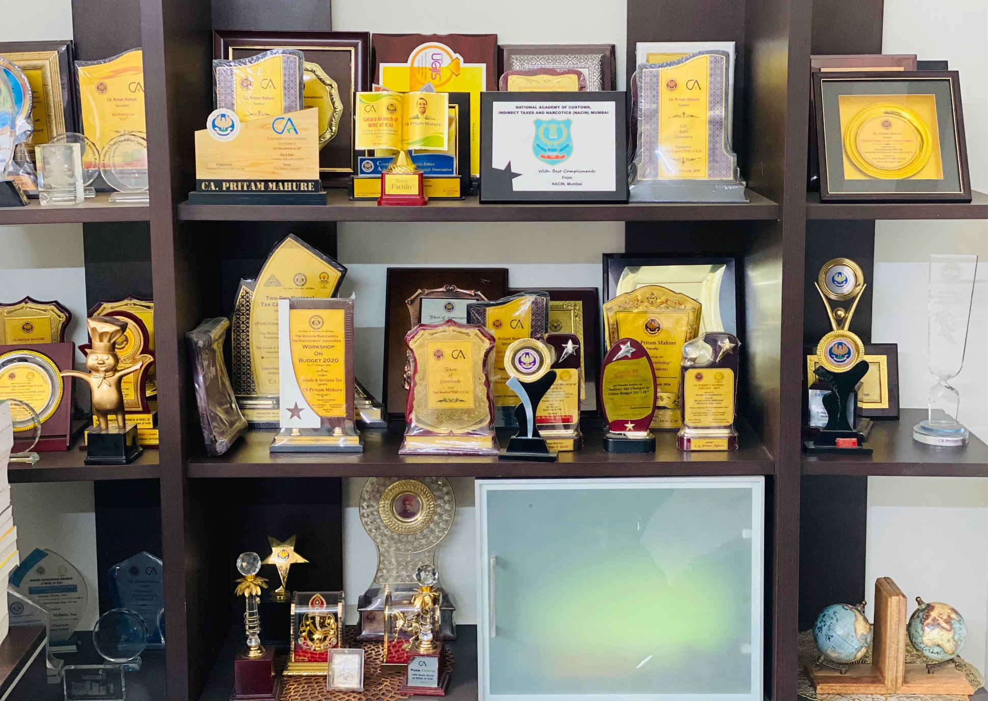
One speech to 100s!

Slide 22
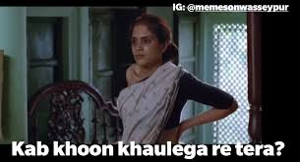
From Bread seller to Breadwinner!
Advice comes in statement not in books!

Slide 23
Life is not a 100 meter race but a 100 year marathon!
So, be patient with results and impatient with efforts!

Slide 24
#Failure!
God sent you #failure to make you #stronger!
Don’t waste the “God sent” opportunity!
Come back stronger and remain so for life!

Slide 25
Where are you investing time!
STD / PCO
No reimbursements!

Slide 26
Stock!
Demat!
Capital?
Must?

Slide 27
Is there a scope for improvement!
Whats your potential!
Whose problem is it?

Slide 28
What’s holding you down?
Country
Colleagues
Team
Clients
Looks
Weight
Gravity
Senior
State
City
Society
Organisation
Money
Friends
Family

Slide 29
Who is standing in between?
You
Present
Better You
Future
Notes:
CRO –
Success - If you want to Claim then don’t clam – Step aside

Slide 30
What is it?
Perceive – Like this
Or Perceive – Like this
Intermittent fasting
Opportunity to prove
Starving
Problem
Opportunity to become one
Work/ burden
No guidance
Opportunity to solve
Lifting weight
Building muscles
Notes:
CRO –
Success - If you want to Claim then don’t clame

Slide 31
Which ‘Likes’ are important
Insta
What you get
What you wish for
Fees
Linkedin
FB
Twitter etc
50k – 5 lacs – 50 lacs - 5 crore
Notes:
Secret – Everyone of us – Every moment of our life
Its not a bug – It’s a feature

Slide 32
Worst brings best in you!
Level
Worst
Level
Best
Notes:
Eg – There is cockroach – There is mouse – there is snake – There is tiger
Pressure makes a diamond

Slide 33
What if!
All advantages
No weakness
Notes:
RAGA

Slide 34
Choice is your!
Choice I
Choice II
Step-up
Step-away
Run-away
Run-towards
Notes:
CRO –
Success - If you want to Claim then don’t clame

Slide 35
Time!
How much time you spend in office?
!

Slide 36
Is Abhimanyu relevant today?
Critical
Legal
Basic
Practical
Super critical
Notes:
Magnet

Slide 37
What you wish for?
Comfort?
Challenging environment?

Slide 38
Rome was not built in a day!
And no one became a professional overnight!
  Do small things, consistently (like being punctual, delivering as committed etc)

Slide 39
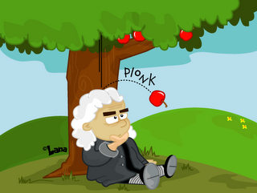
What if!

Slide 40
Busy!
Doing things which don’t matter
Doing things which matter

Slide 41

Drinks!
ALHC

Slide 42
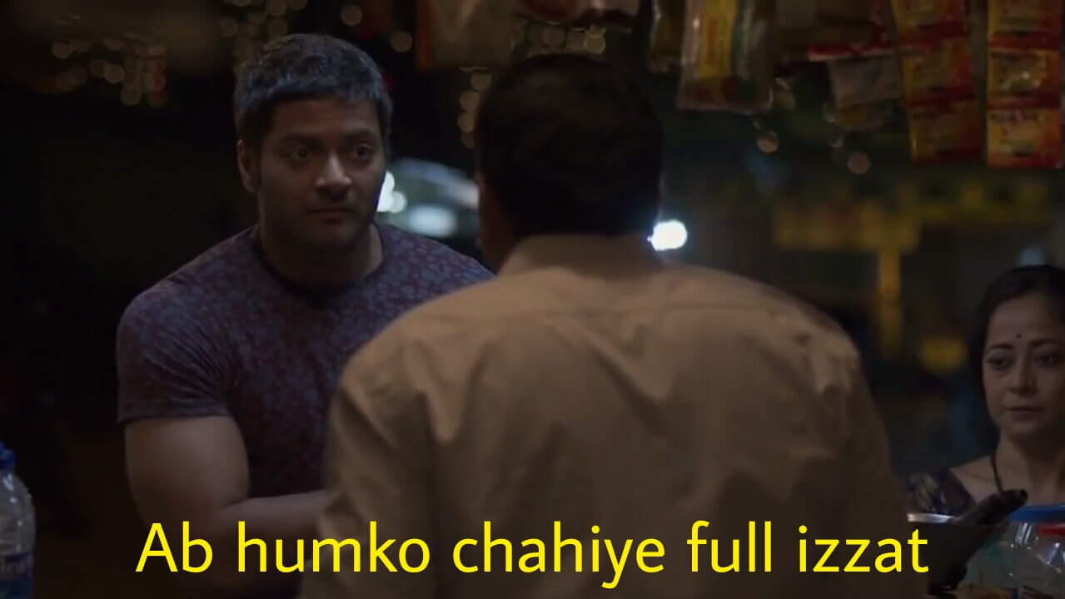

Slide 43
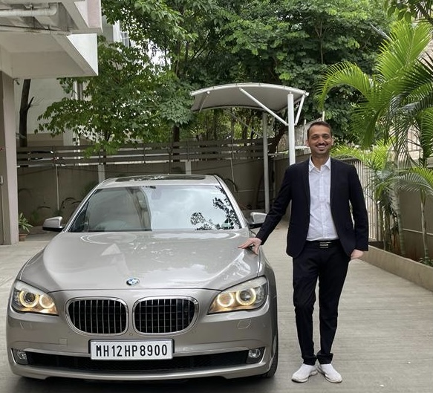
Thank You!
Thank You!
Pritam Mahure and Associates!

