Slide 1

Opportunities in Internal Audit
Pune Branch of WIRC of ICAI
CA Mohit Dhand
+91 8956278566
camohitdhand@gmail.com
27/01/2024

Slide 2
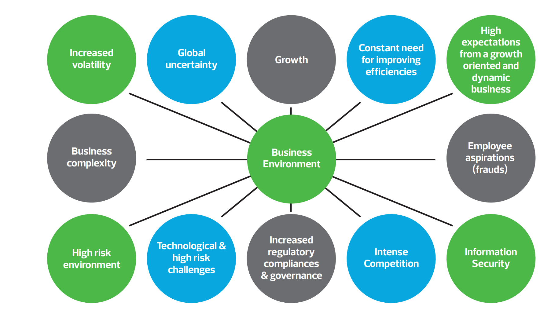
Factors Affecting Business Environment
When the business environment changes, it either evolves to meet the business demand of its new world or it becomes extinct.
In less then a decade, business world has transformed in all the aspects.
In order to meet its governance, control and risk management responsibilities and improving operational efficiencies, the internal audit function plays a pivotal role by providing continual review of business processes and risks, their operating effectiveness and valuable insights that would help the BOD and senior management to discharge their oversight duties more effectively, efficiently and in a timely manner.

Slide 3



Relationship - Risk, opportunity and Internal Audit
RISK
For every risk there is an equal opportunity
Opportunity
Opportunity shadow’s Risk
Internal Audit
Essential provider of both assurance and advisory service
∝
Accelerating Change
As businesses evolve, they open new doors for Internal Auditor in supporting top management’s goals, monitoring enterprise risk, and enhancing regulatory compliance efforts
Notes:
Risk is often thought from inherently negative aspect, every Risk has equal opportunities, There is little doubt that why negative aspects of risk predominates, in recent years we have witnessed multiple threats, like pandemic, supply chain, climate change, labor shortage etc . Opportunities - ESG – is a risk – if not complied there can be financial, regulatory and reputational damage, yet if ESG is followed right, they can do great things. Addressing Key global issues, competitive advantage. QR code mandatory for top 300 medicines –DOP- amendment in drug rules 1945 - will help tracking spurious drugs
IA – like risk itself, IA is misunderstood, suffering with unfavorable perception of often seen as policing body, reporting on what went wrong. However, a more progressive IA Is provider of Assurance and Advisory Service

Slide 4
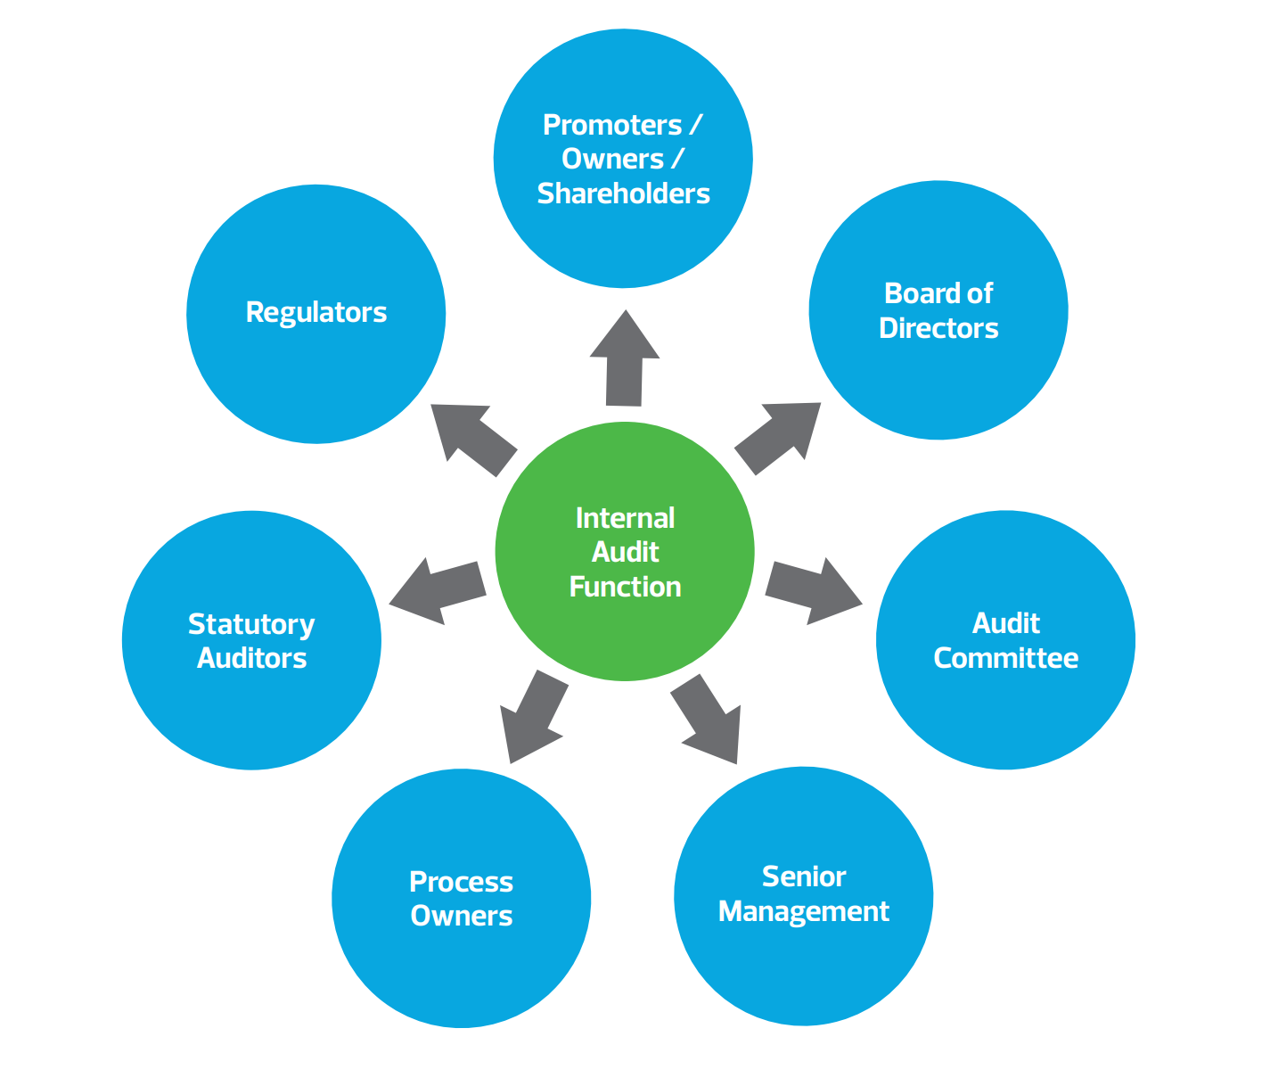
Key stakeholders and Expectations – Converting to Opportunities
Exhibit deep understanding of the organization's industry and business environment, its processes, functions and operations and changes therein.
Evaluate the organization's strategic, operational, financial and compliance risks.
Ensure internal audit plan is aligned to the organization's risk assessment
Provide overall comfort on the state of internal financial controls, its design and operating effectiveness.
Ensure value addition through consulting by identifying and recommending areas for cost reduction, revenue optimization and improvement in operational efficiency.
Employ technology, tools and data analytics throughout the audit cycle to sharpen audit effectiveness and efficiency and elevate audit execution and reporting to the next level.
Use multi-disciplinary team of professionals equipped with requisite skills, industry acumen and experience to deliver customized solutions to maximize returns and minimize risks.
Benchmark organization's current processes with industry best practices and suggest potential improvements.
Provide specific, measurable, achievable, realistic and time bound (SMART) recommendations that address the root cause accurately and in a more meaningful manner.
Focus on delivering results and implementing preventive actions, than simply uncovering problems after they occur.
Ensure audit reports and presentations are clear, succinct, impactful and delivered on timely basis.
IA is uniquely positioned to help the organization navigate risk and change

Slide 5
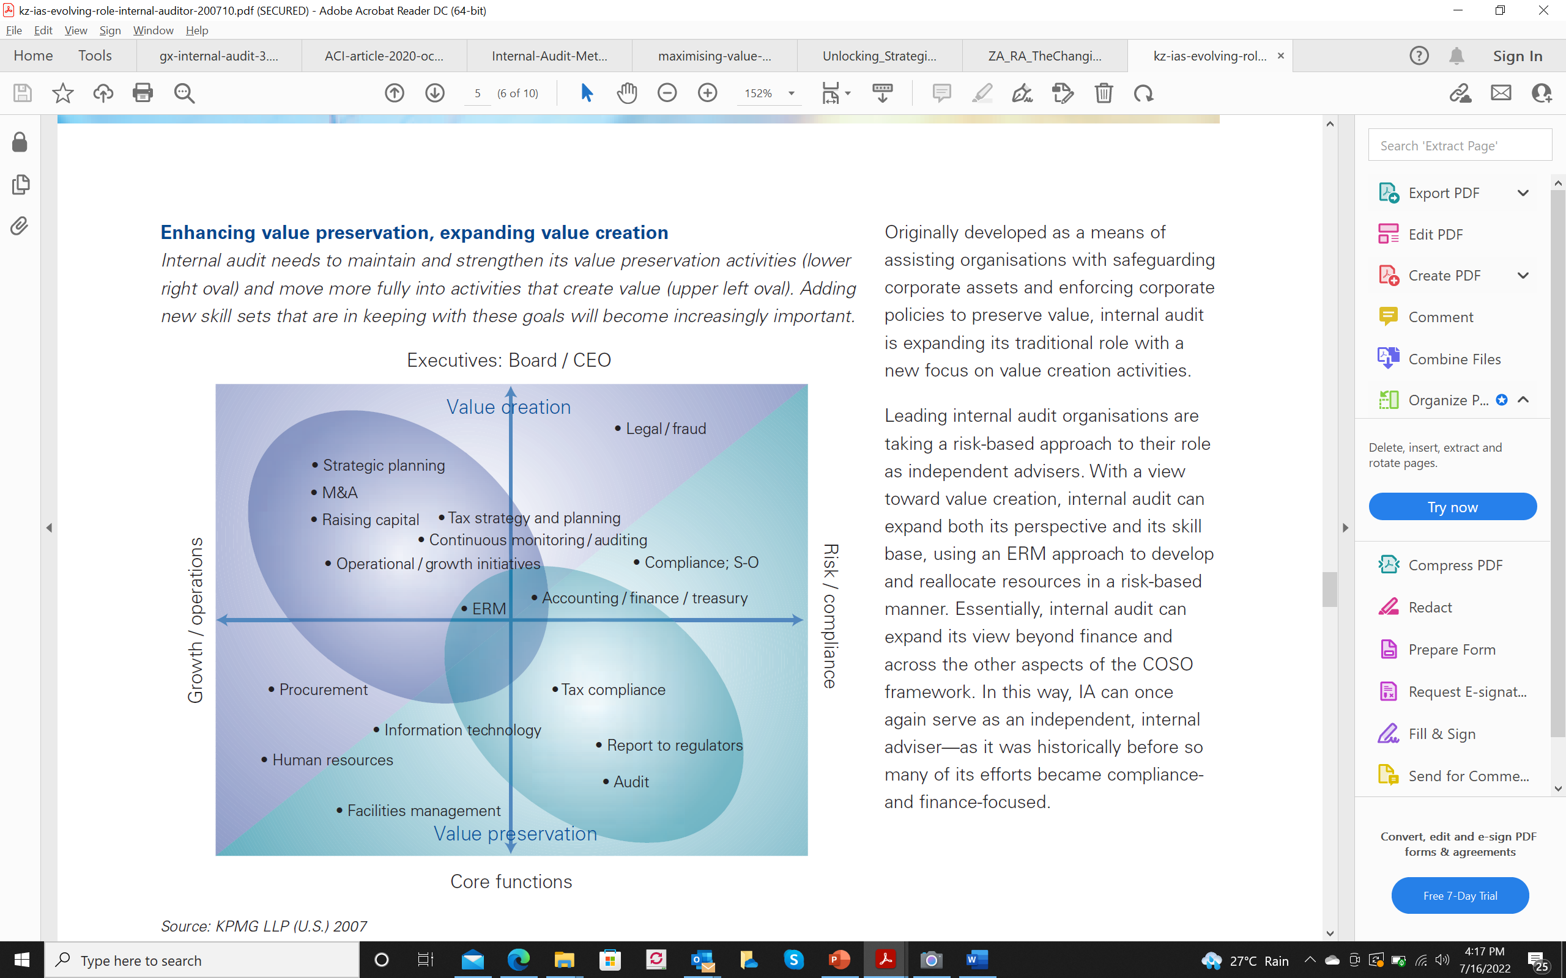
IA Opportunities As – Strategist, Advisor and Facilitator
5
Examples of strategic areas some IA functions are auditing
Management Performance audit
Operational audit
Technology audit
Compliance audit
Environmental audit
Financial audit
Process / SOP Drafting
Analytics
Investigation audit/ Forensic
Digital transformation,
Mergers and acquisitions (M&A)
Research and development (R&D) and product design
Workforce transformation
Inflation
Macroeconomic volatility
Laws and Regulations
Startup and Investment Ecosystem
Risk Audits
Notes:
- When the business environment changes, it either evolves to meet the business demand of its new world or it becomes extint. In less then a generation, business world has transformed in all the aspects.
its a business to understand what people do in the organistion, IA has to communicate with all of them and build Relationship, its all about building relation ship, then only Internal auditor can do a good Job. Even if you are technically very strong, but you cannot put your points across the auditee and convince them, what all you have done is waste. The evolution has not happened only in business and IA, I feel its more on the personality and grooming of IA. Today IA’s more be smarter, good communicator, should be able to build relation ships, continuous learner, creative thinking. IA cannot sit in the room and do the audit, you need to go out, not only talk to company, talk to regulators, talk to stake holders, your colleagues an other actors in the ecosystem. Earlier it was that If the person is introward, non sales personality, send to internal audit team. But now its reverse, you need to sell internal controls and risk management to stake holders, to management. Overall I believe it’s a positive changes happening across for the Internal auditor ecosystem, it’s a great professional carrier, sun rising industry and you get exposure all across the board let it be business, compliance or future strategies.

Slide 6
Evolving Role of Internal Auditor - Opportunities

Slide 7
How should Next Generation IA look like?
MIND SET
Adopt and Change
Innovate
CAPABILITIES
Skill in emerging Technology
Keep up to date
APPROACH
Partner the Business
Move from Observer to Advisor

Slide 8

Shift and Vision
Compliance
Consulting
Value Protection
Value Creation
Service Provider
Solution Provider
Size
Positioning
8

Slide 9
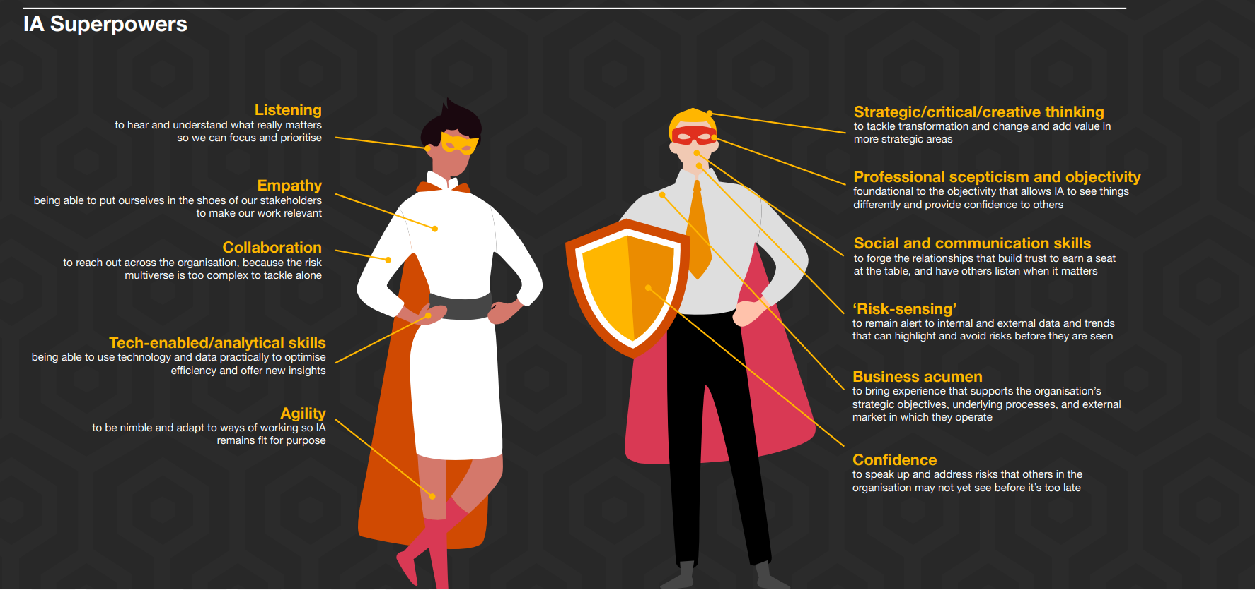
Internal Audit – Superpowers
PWC 2023 Internal Audit Survey Report

Slide 10
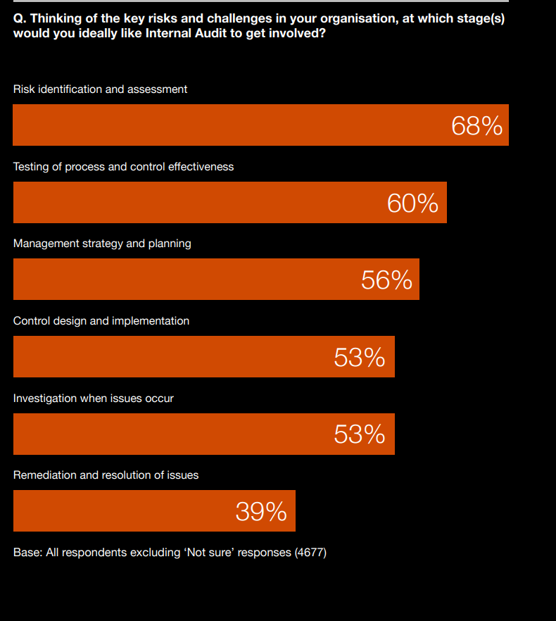
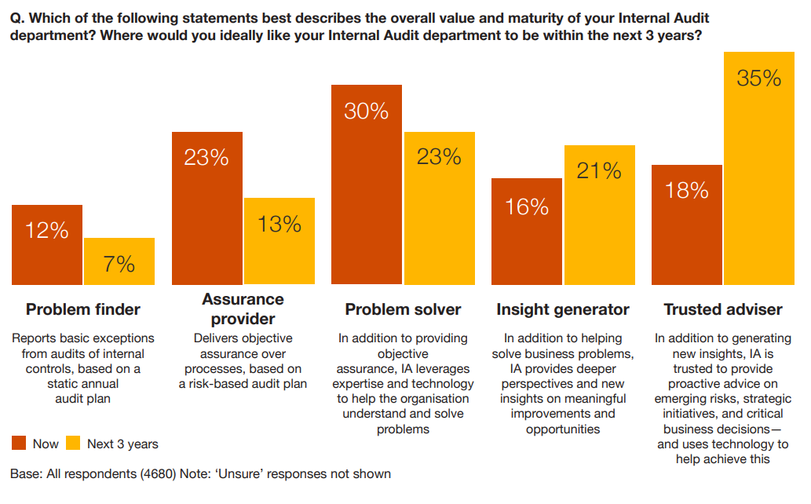
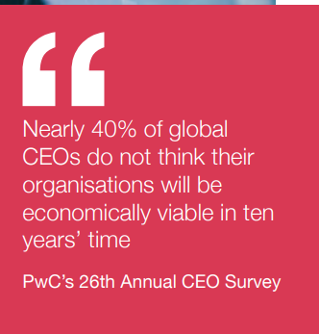
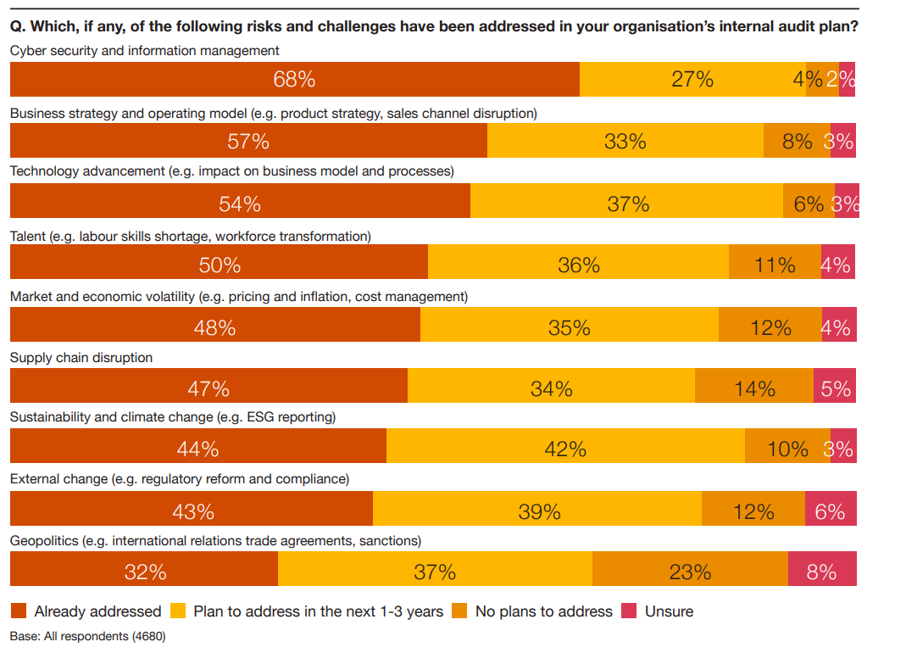
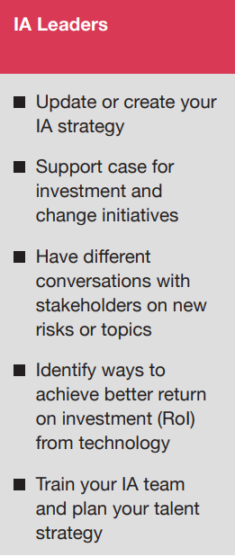
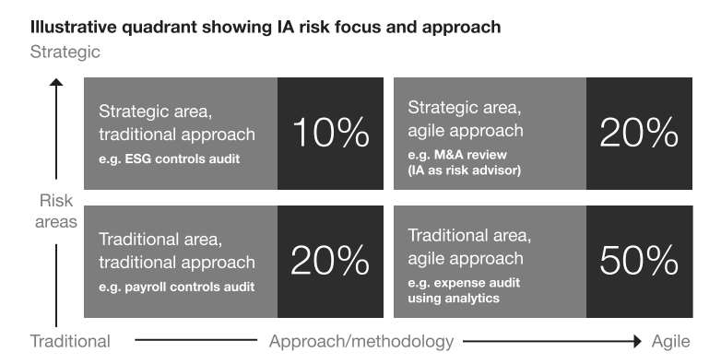
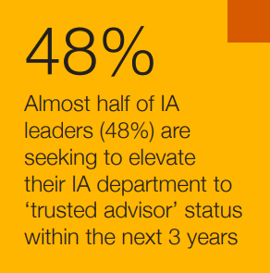
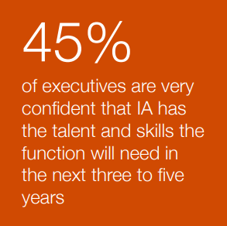
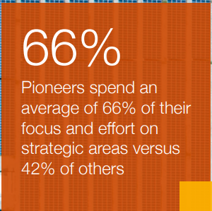
Facts from IA Global Study
Key Findings and Outcome
PwC Global Internal Audit Study 2023

Slide 11








Self Evaluation Puzzle
Am I technically sound fo IA Function?
What is my nature?
What are my interests?
Do I have requisite practical
experience ?
What is my financial objective?
What is my comforts, and I am willing for to go extra mile, out of my comfort zone?
Do I have clarity where I want to be and have work-life balance?

Slide 12




Addressing the Self Evaluation Puzzle
Specialize In an Area
Grow the Firm
And grow to establish a specialized firm or specialized team for IA
Then set-up full fledged IA practice after gaining experience
Start with Pilot Project
Keep Updating
And have own small client to start the IA practice
Keep growing team, Knowledge and Technology

Slide 13







Clientele and Client Acquisition
Empanlements
Speaking in Public Forum
Business Development Initiative
Word of Mouth
Domestic/ Global Networking
Social Media
Study Circles

Slide 14

14
Thank you !
CA Mohit Dhand
+91 89562 78566
camohitdhand@gmail.com

