Slide 1

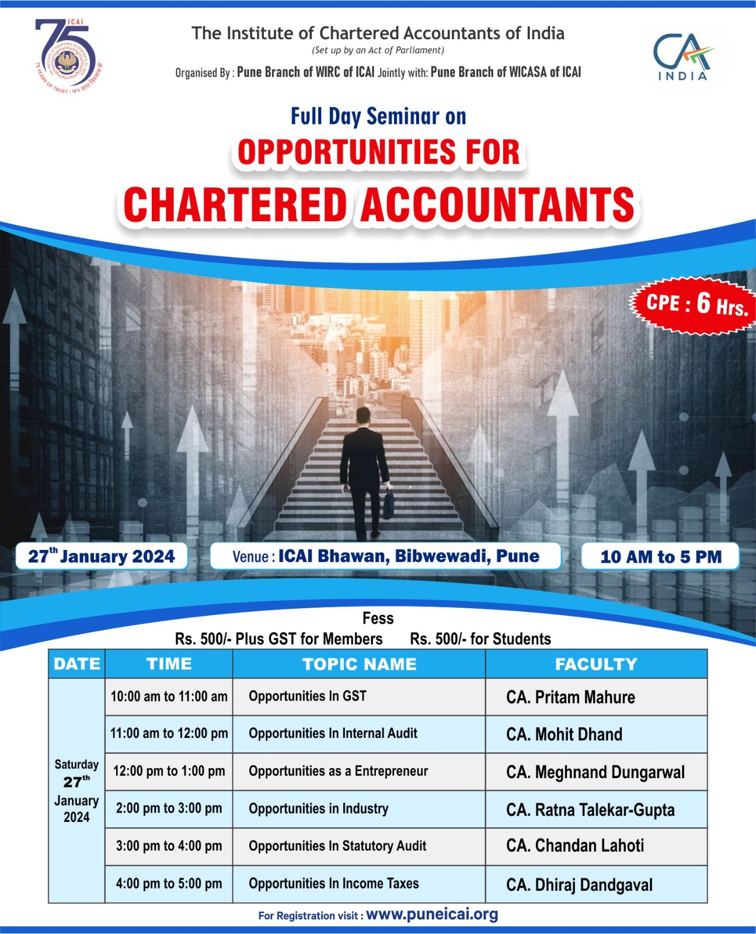
Opportunities in Statutory Audit
January 27, 2024

Slide 2
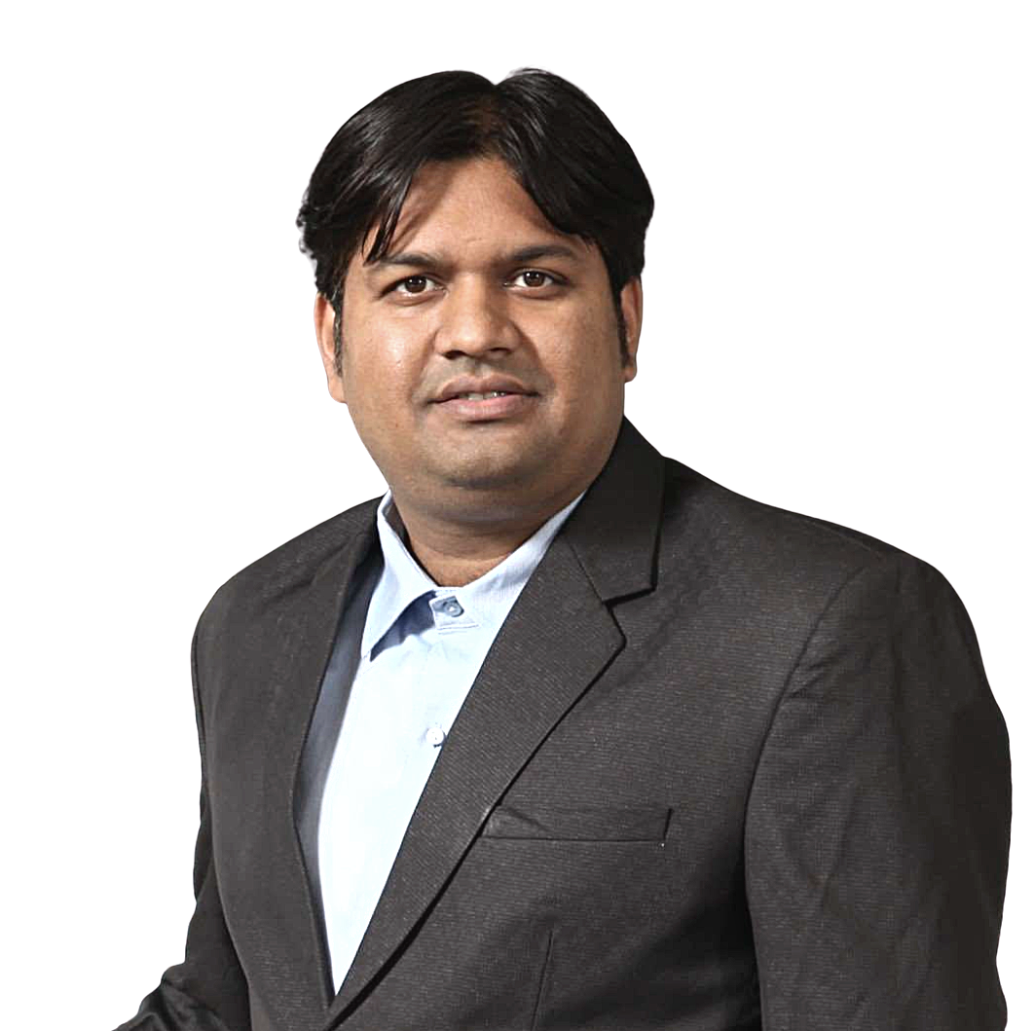



With You Today
CA Chandan Lahoti
PUNE, INDIA
FCA, Counsellor and Mentor
9422582517
chand_Lahoti@yahoo.com
chandan.lahoti@avallp.in

Slide 3

CA Chandan Lahoti

Slide 4
Benefit of working in Stat Domain
Application of AS
Application of Auditing standards
Help due to Documentation
Command in Word/Excel etc
Various Industry knowledge
Income tax and Indirect tax
Process Notes
IT systems
Laws and regulations
Easy adoption by industries later
Better for CA practice or business including Startups
Easy when u shift to different cities
Good recognised when you go for outside India or higher studies
Use of AI during audit
Use and learning of Automation
Habbit of Late sitting
Learn Project management
Relationship & networking
Overall, One would become Jack of All!
CA Chandan Lahoti

Slide 5
What should be covered in Resume
Statutory audit related work which you have done
Ind AS if done
Application of accounting standards practically
Documentation related whatever you have done
Internal audits related work if you have not done major of Statutory audit
Process audit related work
Forensic related work
Tax audit of corporates
CA Chandan Lahoti

Slide 6
What should you prepare for interview or what to take care!!
Know the firm where you have applied,
2-3 Accounting standards and Auditing standards but in detail including practical experience if any
Audit report
CARO
KAM
IFC
Recent updates
NFRA other regulatory bodies
EAC, ITFG, Guidance note
Recollect 2-3 keep things which you have done and was appreciated by senior/Partner during internship
CA Chandan Lahoti

Slide 7
Statutory audit firms in Pune
CA Chandan Lahoti

Slide 8
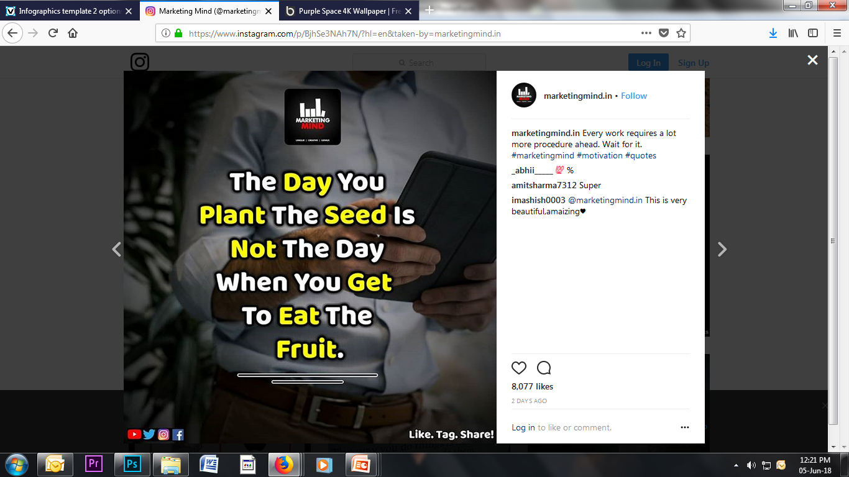
CA Chandan Lahoti

Slide 9

Time for action is now
Make your mark..
Moving Forward to
Start the Career
CA Chandan Lahoti

Slide 10


CA Chandan Lahoti

Slide 11



Thank You!
CA Chandan Lahoti
9422582517
chand_Lahoti@yahoo.com
chandan.lahoti@avallp.in
CA Chandan Lahoti

