Slide 1



Start Ups
& Entrepreneurship
Organised by :
Pune Branch of WIRC of ICAI jointly with
Pune Branch of WICASA of ICAI

Slide 2
Why initiate a Start Ups ?
Benefits
Limitations
Independence
Flexibility
Following your passion
Power & Control
Creative freedom and personal satisfaction
Financial risk
Uncertainty and stress
Time commitment
Undesirable duties
Personal Liability

Slide 3
Why Start up fails?
  1000 days
  Learn from failure
  Customer Feedback
  Team
  Expense management
  Vision & Mission Statement
  Mentor
  Right Location
  Health
  Learning
  Myth

Slide 4
Entrepreneurship
The activity of setting up a business or businesses, taking on financial risks in the hope of profit. Core parameter :
  Who can see the thing beyond
  Innovation
  Growth
  Uniqueness
  Creating value

Slide 5



Types of Entrepreneurs

Slide 6
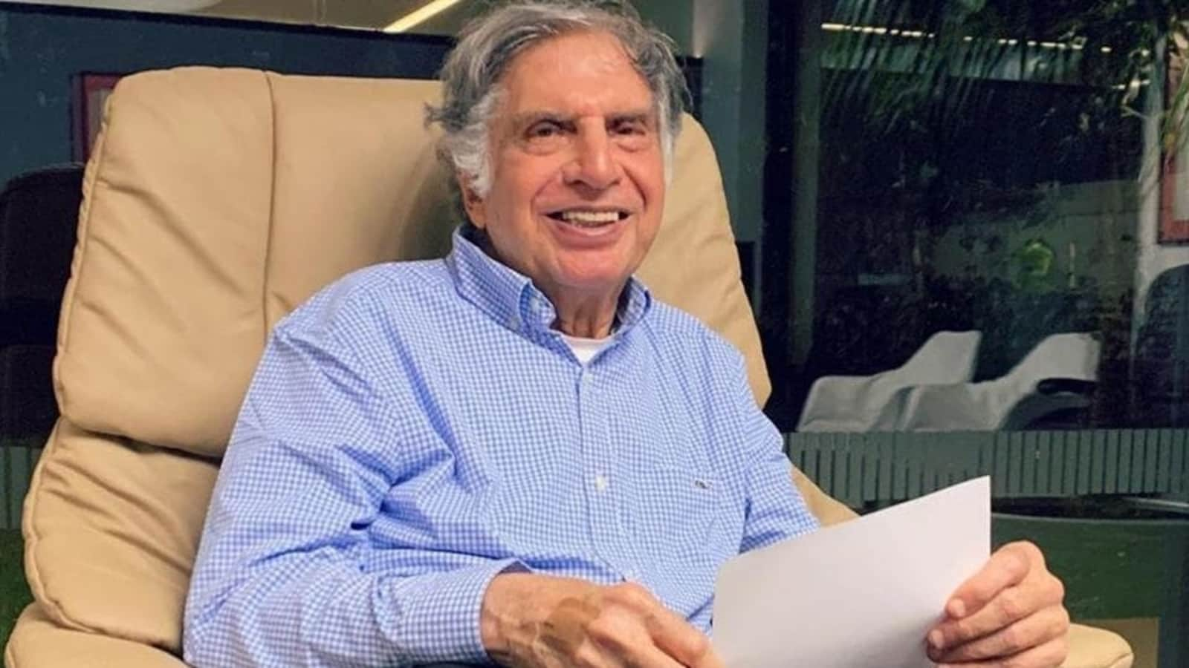
Ratan Tata

Slide 7
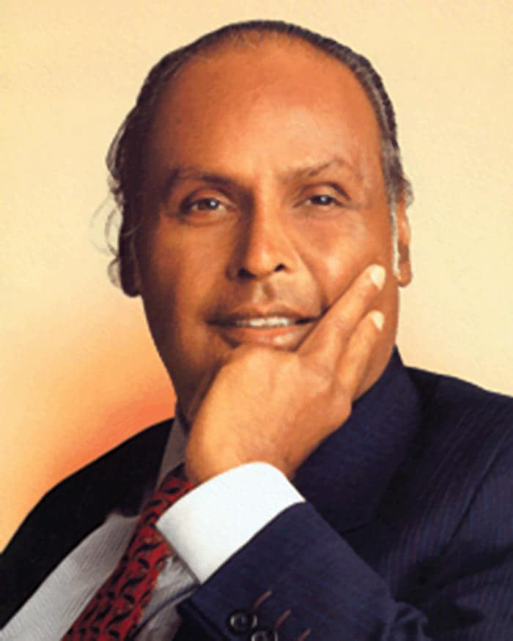
Dhirubhai Ambani

Slide 8
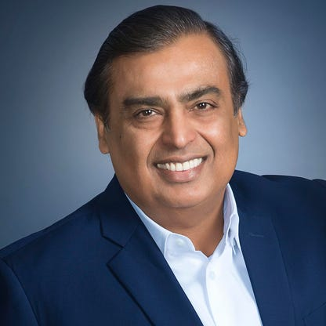
Mukesh Ambani

Slide 9

Jeff Bezos

Slide 10
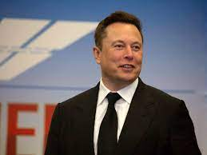
Elon Musk

Slide 11
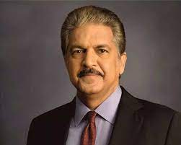
Anand Mahindra

Slide 12
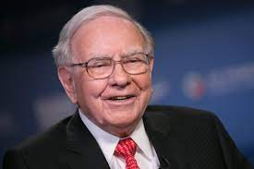
Warren Buffett

Slide 13
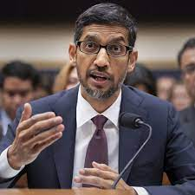
Sundar Pichai

Slide 14

Steve Jobs

Slide 15

Mark Zuckerberg

Slide 16

Bill Gates

Slide 17
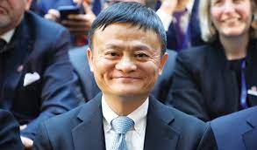
Jack Ma

Slide 18
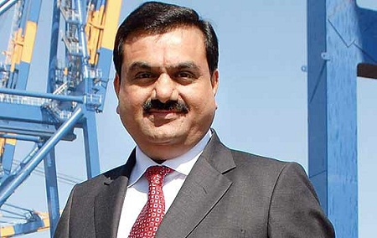
Gautam Adani

Slide 19

Donald John Trump

Slide 20

Michelin Star Vineet Bhatia

Slide 21
What to keep in mind
Why you want to start your business – Carry Your Goal Card
Unique Idea is not required – Execution
Challenges – Licence, Registration, Government Policies
Money / Investment
Face to failure - it is stepping stone Success story Video
Efforts
Delegation
Research & Development

Slide 22
Entrepreneur
Decision
Team formation
Goal and Value
Business Plan for Investor
Characteristics
How to create Brand

Slide 23
1. Characteristics
Self confidence
Conviction and belief
Self Discipline - Habits
Hard work
Consistency
Taking Risk
Open minded
Opportunity Seeker
Be Student

Slide 24
2. Decision
Quick Decision
More often
At right time
Problem dissolver
Best Case Scenario
Worse Case Scenario
Legal Compliance – Incorporation, Licence Certificate
New Technology

Slide 25
3. Goals & Values
Written Plan
Vision & Mission Statement
Quality – Japanese
Empathy
Abundance Mind set
Tax Payment and statutory compliance on time
Same rule for owner and worker –Prepare Do & Don’t of company

Slide 26
4. Market issue
Market, its Size, History and key correct issue
Target Customer base
Competitor
Sales and marketing strategies

Slide 27

5. Business Plan for Investor
Prepare Project Report
Have knowledge about him
Background
Past investment
Size of Investment
Expected profit
Executive Summary

Slide 28

6. Brand Creation
Definition : Story about company
Create Brand Identity
  Choose Brand name
  Create Logo
  Brand Slogan
How to create Brand Image
Brand Registration – Trademark,
Patent, & Copyright

Slide 29

7. Team (1/2)
Diversity
Complimentary – composition
Art of people ability
Share Vision
Work life Balance
Micro manage ( let them to grow)
Experience
Review
Sense of humour

Slide 30
Meetings (2/2)
Strategic
Tactical
Operational
6 Hours
Once in 45 Days
Size
Agenda
2 Hours
14 days/21 Days
Size
Agenda
15 Mins
Everyday
Size
Agenda

Slide 31

Differentiation
Domain
Tools
Methodology
Quality
Innovation
Branding – Price

Slide 32
Business Plan (review and amendment ) Version 1 is better than Version None
What is My business – stick to it
Goal & System
Location
Investment
Customer
Marketing
Branding
Function

Slide 33
Tips Do and Don'ts
Health comes first
Hire staff – 1.25%
Expenses Vs Investment
Manuals
Effective Communication – Short, Simple and Specific
Customer Feedback
Etne mein etna hi milega

Slide 34
Tips Do and Don'ts
80:20 Rule
Do Tactical, Operational and Strategic meeting
Healthy Environment
Start with less dead stock
Invest in yourself

Slide 35
Affirmation
I allow myself to………………..
Message

Slide 36


Slide 37

Contact Details
CA Avani Shah
Avani Shah & Co
Mob : 7984175171
Email : avshah46@gmail.com

