Slide 1

REVERSE
CHARGE
MECHANISM
BY CA NILESH MAHAJAN
28 Feb 2024

Slide 2

WHAT IS
RCM?

Slide 3



FCM
Invoice | ₹ 100
GST | ₹ 18
Recipient
Forward Charge Mechanism
Supplier’s Bank
A
B
Supplier
Government
₹ 100 | Invoice
₹ 18 | GST

Slide 4
RCM
Invoice | ₹ 100
Recipient
Reverse Charge Mechanism
Invoice | ₹ 100
GST@18% | ₹ 18
A
B
Supplier
Government
Supplier’s Bank
₹ 100 | Invoice

Slide 5
WHY
RCM?

Slide 6





Targets sectors where tax collection is challenging
Addresses large numbers of small contributors and unorganized sectors
Encourages tax compliance across a wider base
Facilitates direct tax payment to the government, enhancing transparency and efficiency
Historical context: Implemented in Service Tax since 1997, with partial RCM in 2012

Slide 7

UNDERSTANDING THE TYPE OF LEVY FOR RCM UNDER GST

Slide 8




TWO TYPES OF LEVY FOR RCM UNDER GST
Under Section 9(3) & 5(3) of the CGST & IGST Act
Under Section 9(4) & 5(4) of the CGST & IGST Act
Government on recommendation of the GST Council
Government on recommendation of the GST Council
Specify categories of supply of goods or services or both
Specify class of registered recipient and
Tax on above supply shall be paid on RCM basis by the recipient
Specify categories of supply of goods or services or both
Supply is received from unregistered person

Slide 9

UNDERSTANDING THE FLOW OF TAXABILITY UNDER RCM

Slide 10
WHETHER PARTICULAR INWARD SUPPLY IS NOTIFIED UNDER RCM?
WHETHER THERE IS ANY EXEMPTION PROVIDED TO SUCH INWARD SUPPLY
NO NEED TO PAY GST UNDER RCM
YES
YES
NO
DETEMINE THE RATE AS PER THE RATE NOTIFICATION & PAY THE GST UNDER RCM

Slide 11

UNDERSTANDING THE
SERVICES NOTIFIED
UNDER SEC. 9(3) & 5(3)

Slide 12
GOODS TRANSPORT AGENCY [GTA]
Supplier
Goods Transport Agency [GTA]: Any person who provides service in relation to transport of goods by road and issues consignment note, by whatever name called Goods Transport Agency (GTA)
Scenario - 01
When GTA opts to pay GST under FCM
GTA has been provided an option to opt for payment under forward charge mechanism
12% with Input Tax Credit [‘ITC’]
5% without ITC
Procedures
Declaration to opt payment under FCM is required to be filed on GST portal in Annexure V on or after 01 January but not later than 31 March of preceding FY
Mention declaration on invoice as per Annexure III

Slide 13
GOODS TRANSPORT AGENCY [GTA]
Scenario - 02
When GTA does not opt to pay GST under FCM
Recipient of the GTA services are any of the following located in taxable territory:
Factory
Society
Person registered under GST
Co-op Society
Body corporate
Partnership Firm/AOP
Casual taxable person
Impact
Recipient must be pay GST under RCM @ 5%

Slide 14
GOODS TRANSPORT AGENCY [GTA]
Scenario - 03
No need to pay GST either under RCM or FCM
When recipient falls under any of the following categories:
Government departments, Local authorities, and Governmental agencies who have registered under GST only for the purpose of GST-TDS and not for making a taxable supply of goods & service
Unregistered person including unregistered casual taxable person
When goods transported are of the following nature:
Agricultural produce
Milk, Salt, Food grains
Organic manure
Newspaper/Magazine
Relief material for victims of natural calamities
Défense/military equipment

Slide 15
RENTING OF MOTOR VEHICLE DESIGNED TO CARRY PASSENGERS
Scenario - 01
When to pay under RCM
Supplier
Any person, other than a body corporate
Recipient
Body Corporate
Service
Renting of motor vehicle designed to carry passengers where fuel cost is included along with operator and where supplier has not charged GST at the rate of 12%

Slide 16
RENTING OF MOTOR VEHICLE DESIGNED TO CARRY PASSENGERS
Scenario - 02
When to pay GST under FCM
Any supplier other than body corporate providing renting of ‘motor vehicle designed to carry passengers’ [‘MVDCP’] to body corporate where cost of fuel is included along with operator - GST @ 12%
Any supplier is a body corporate providing renting of MVDCP service & recipient is other than body corporate where cost of fuel is included along with operator
  12% with ITC
  5% without ITC
Any supplier providing renting of MVDCP service to any recipient where cost of fuel is included without operator - GST @18%
Any supplier providing renting of MVDCP service to any recipient where cost of fuel is not included with or without operator - GST @18%

Slide 17
RENTING OF MOTOR VEHICLE DESIGNED TO CARRY PASSENGERS
Scenario - 03
No need to pay GST either under RCM or FCM
When recipients of renting of MVDCP services are:
State Transport Undertaking; or
Local Authority (of an electrically operated vehicle)
and such MVDCP is meant to carry more than 12 passenger
When renting of MVDCP is rented to person providing services of transportation of students, faculty, and staff to an educational institution providing preschool education and education up to higher secondary school or equivalent

Slide 18
SECURITY SERVICES
Scenario - 01
When to pay under RCM
Supplier
Any person, other than a body corporate
Recipient
A registered person, located in the taxable territory
Service
Security services (services provided by way of supply of security personnel)

Slide 19
SECURITY SERVICES
Scenario - 02
When to pay GST under FCM
Supplier
Body Corporate
Recipient
A registered person, located in the taxable territory
Government departments, local authorities, and government agencies having registration only for the purpose of GST-TDS and not for making a taxable supply of goods & service
A registered person paying tax under the composition scheme
Service
Security services (services provided by way of supply of security personnel)

Slide 20
SECURITY SERVICES
Scenario - 03
No need to pay GST either under RCM or FCM
When recipient is educational institution
Meaning of person:
An individual person.
A Hindu Undivided Family (a specific legal entity in India).
A company.
A partnership firm.
A Limited Liability Partnership (LLP).
An association of persons, whether incorporated or not.
A corporation established under a law.
A body corporate (company) outside India.
A cooperative society.
A local authority (like municipal councils).
The Central or a State Government.
A society registered under the Societies Registration Act.
A trust.
Any other artificial juridical person not covered above.

Slide 21
ADVOCATE SERVICES
Scenario - 01
When to pay under RCM
Supplier
An individual advocate including a senior advocate or firm of advocates
Recipient
Any business entity located in the taxable territory
“business entity” means any person carrying out business
Service
Services provided by an individual advocate including a senior advocate or firm of advocates by way of legal services, directly or indirectly
“legal service” means any service provided in relation to advice, consultancy or assistance in any branch of law, in any manner and includes representational services before any court, tribunal or authority.

Slide 22
ADVOCATE SERVICES
Scenario - 02
No need to pay GST either under RCM or FCM
When recipient is
The Central Government, State Government, Union territory, local authority, Governmental Authority or Government Entity
Any person other than Business Entity
Business entity with turnover below threshold limit
An advocate or firm of advocates providing legal services

Slide 23
DIRECTOR SERVICES
Scenario - 01
When to pay under RCM
Supplier
A Director of a Company or a body corporate
Recipient
A Company or a body corporate in taxable territory
Service
Services supplied by director of company or body corporate, which are supplied by him as or in the capacity of director of that company or body corporate shall be taxable under RCM in the hands of the said Company or Body Corporate
TDS deducted under Section 192 of IT Act

Slide 24
DIRECTOR SERVICES
Scenario - 02
When to pay GST under FCM
Supplier
A Director of a Company or a body corporate
Recipient
A Company or a body corporate in taxable territory
Service
Services supplied by director of company or body corporate, which are supplied by him as or in his private or personal capacity such as services supplied by way of renting of immovable property shall be taxable under FCM
TDS deducted under Section 194J of IT Act

Slide 25
RENTING OF RESIDENTIAL DWELLINGS
Scenario - 01
When to pay under RCM
Supplier
Any person
Nature of service & Recipient
Renting of residential dwelling to following:
Registered proprietor for business use or
Registered person other than proprietor for any use

Slide 26
DIRECTOR SERVICES
Scenario - 02
When not to pay GST under either under FCM/RCM
Supplier
Any person
Nature of service & Recipient
Renting of residential dwelling to following:
Registered proprietor for personal residence or
Unregistered person for residential use

Slide 27
SPONSORSHIP SERVICES
Scenario - 01
When to pay under RCM
Supplier
Any person
Nature of service & Recipient
Services provided by way of sponsorship to any body corporate or partnership firm located in taxable territory

Slide 28
SPONSORSHIP SERVICES
Scenario - 02
When not to pay GST under either under FCM/RCM
Supplier
Any person
Nature of service & Recipient
Services by way of sponsorship to any body corporate or partnership firm located in taxable territory of sporting events organized:
By National sport federation
By Association of Indian universities, Interuniversity Sport Board, School Games Federation of India, All India Sports Council for deaf, Paralympic Committee or pecial Olympics Bharat
By Central Civil Services Cultural and Sports Board
As part of national games, by the Indian Olympic Association
Under the Panchayat Yuva Kreeda Aur Khel Abhiyaan Scheme

Slide 29
IMPORT OF SERVICES
Scenario - 01
When to pay under RCM
Supplier
Any person located in a non-taxable territory
Nature of service & Recipient
Any services to any person located in taxable territory other than ‘non-taxable online recipient.’
“Non-taxable online recipient" means any unregistered person receiving online information and database access or retrieval services located in taxable territory.

Slide 30
GOVERNMENT SERVICES
Supplier
Central Government, State Government, Union Territory or Local Authority [CSUL]
Comment:
Determining taxability of services provided by the CSUL under RCM is difficult task due to various exemption and having exception to few of the exemption making it to taxable under FCM
Accordingly, taxability of the services provided by the CSUL can be determined as under:
  Nature of services-based taxability and;
  Recipient based taxability
Both captured in next slide

Slide 31
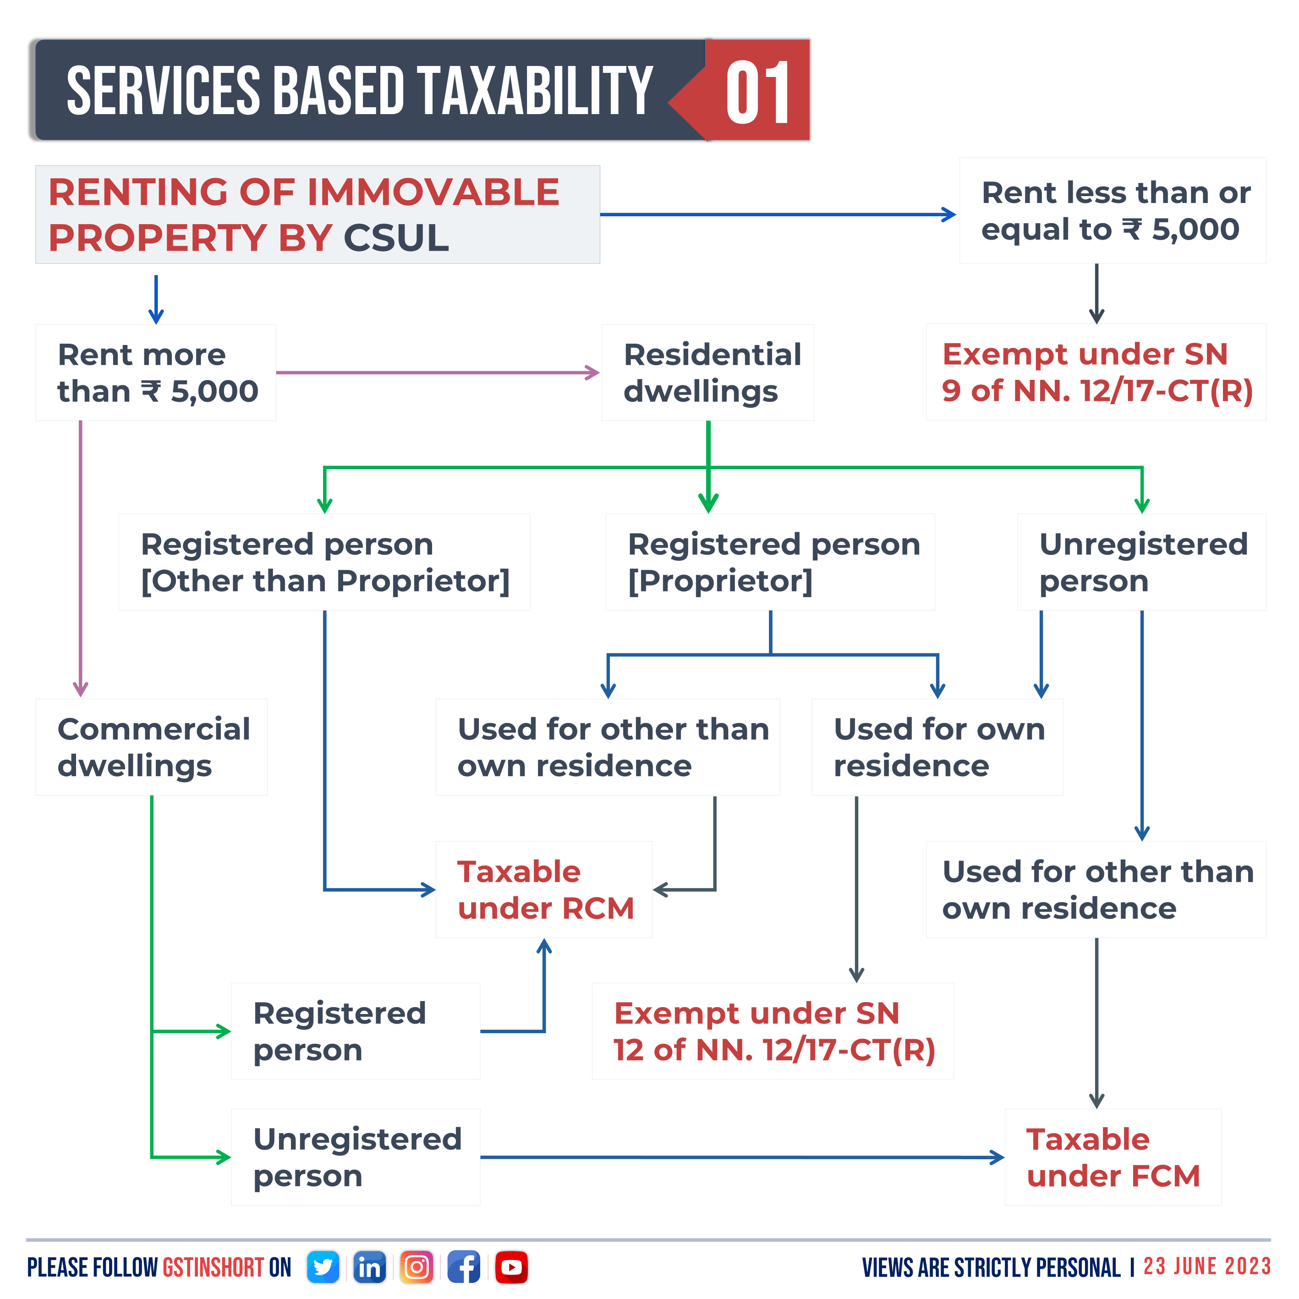

Slide 32
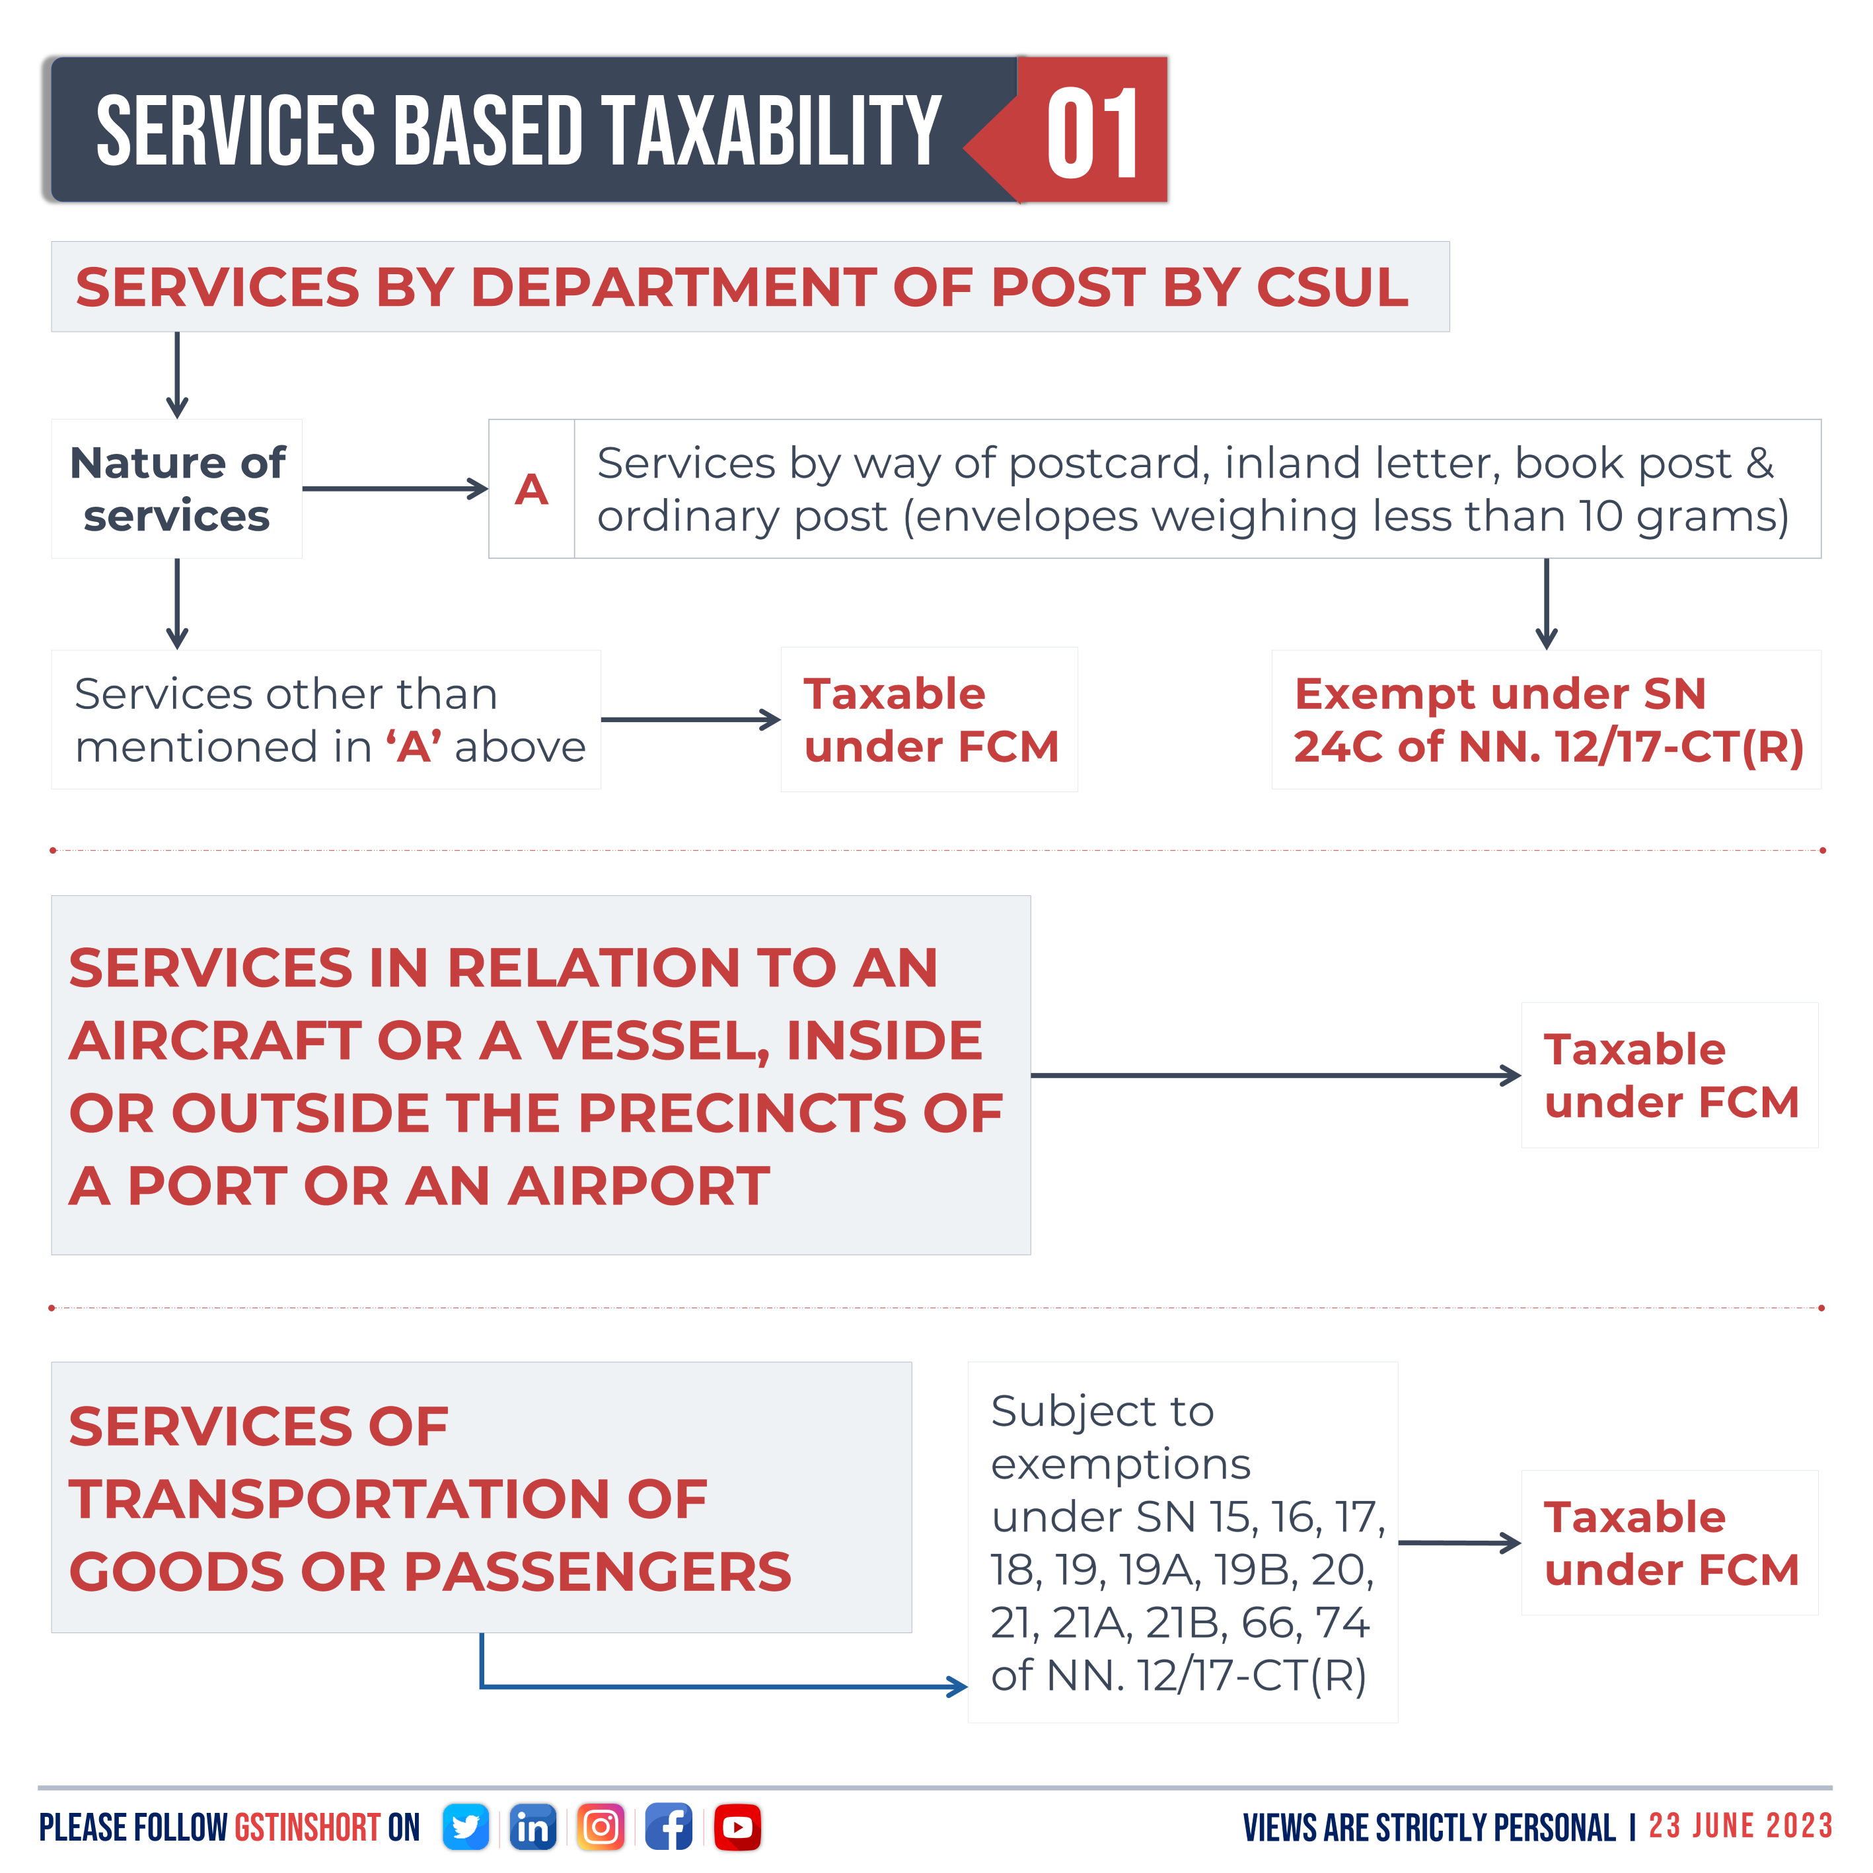

Slide 33
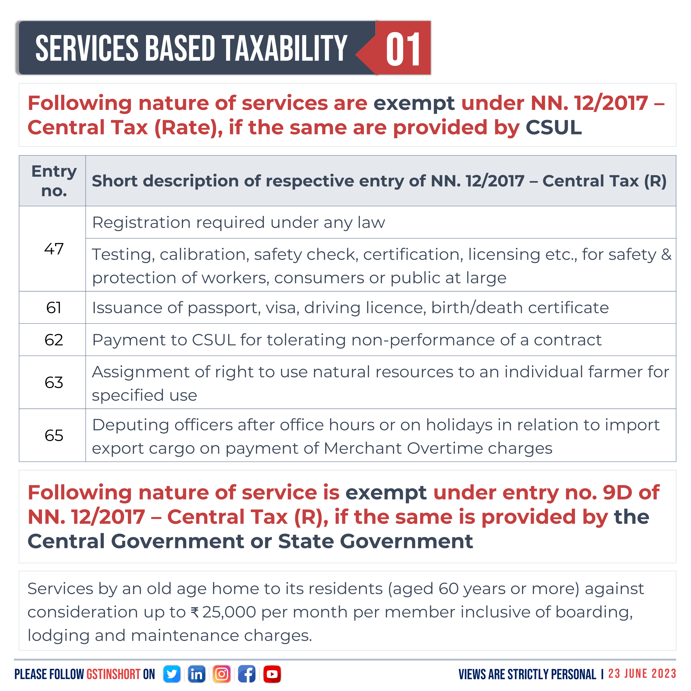

Slide 34
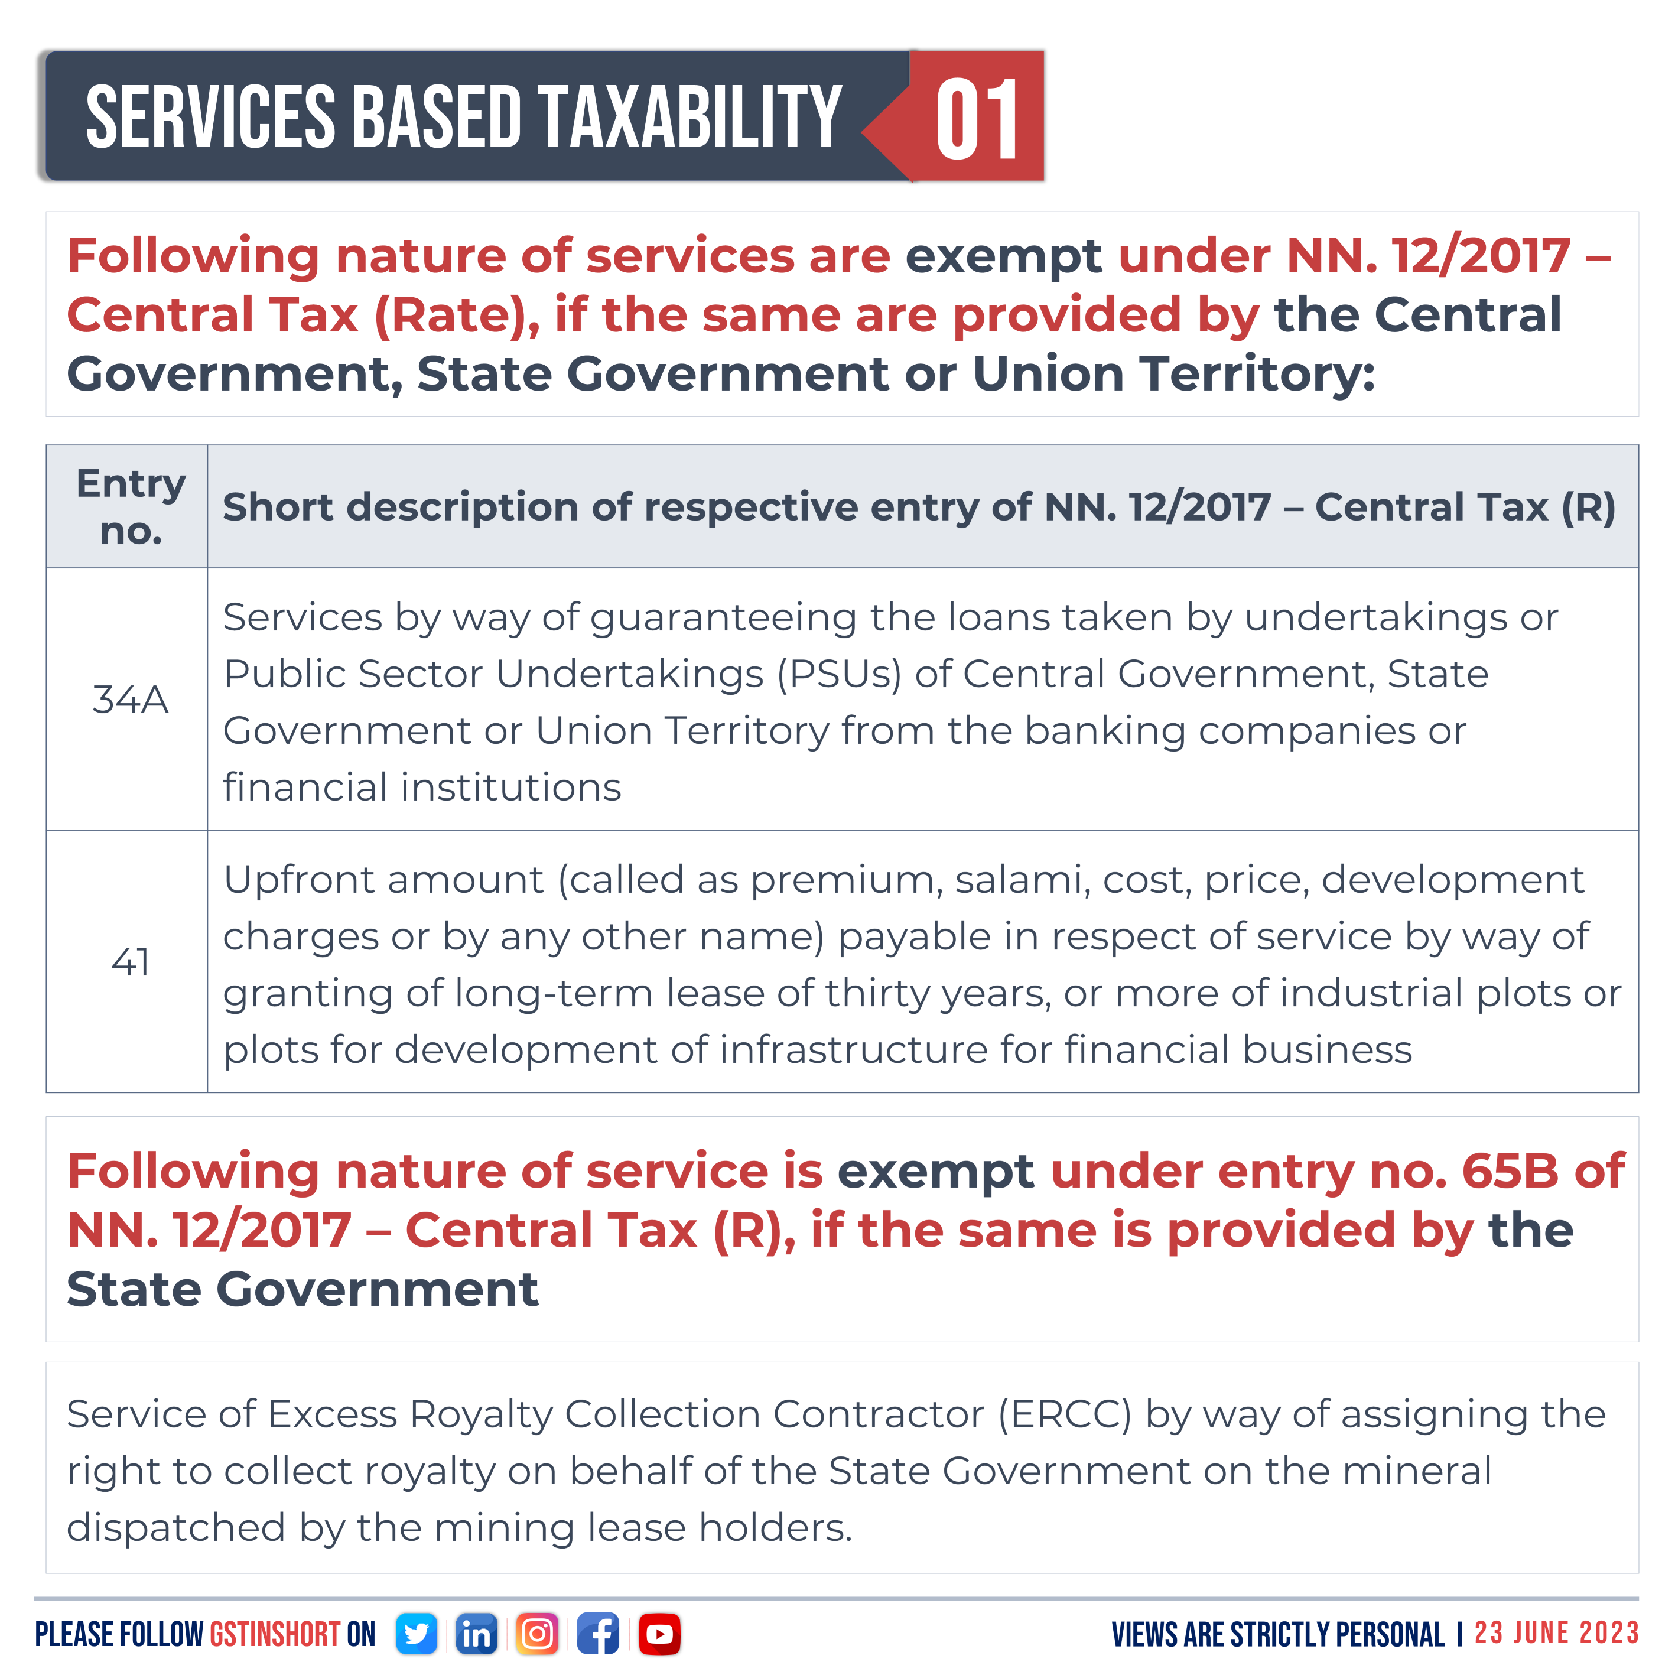

Slide 35
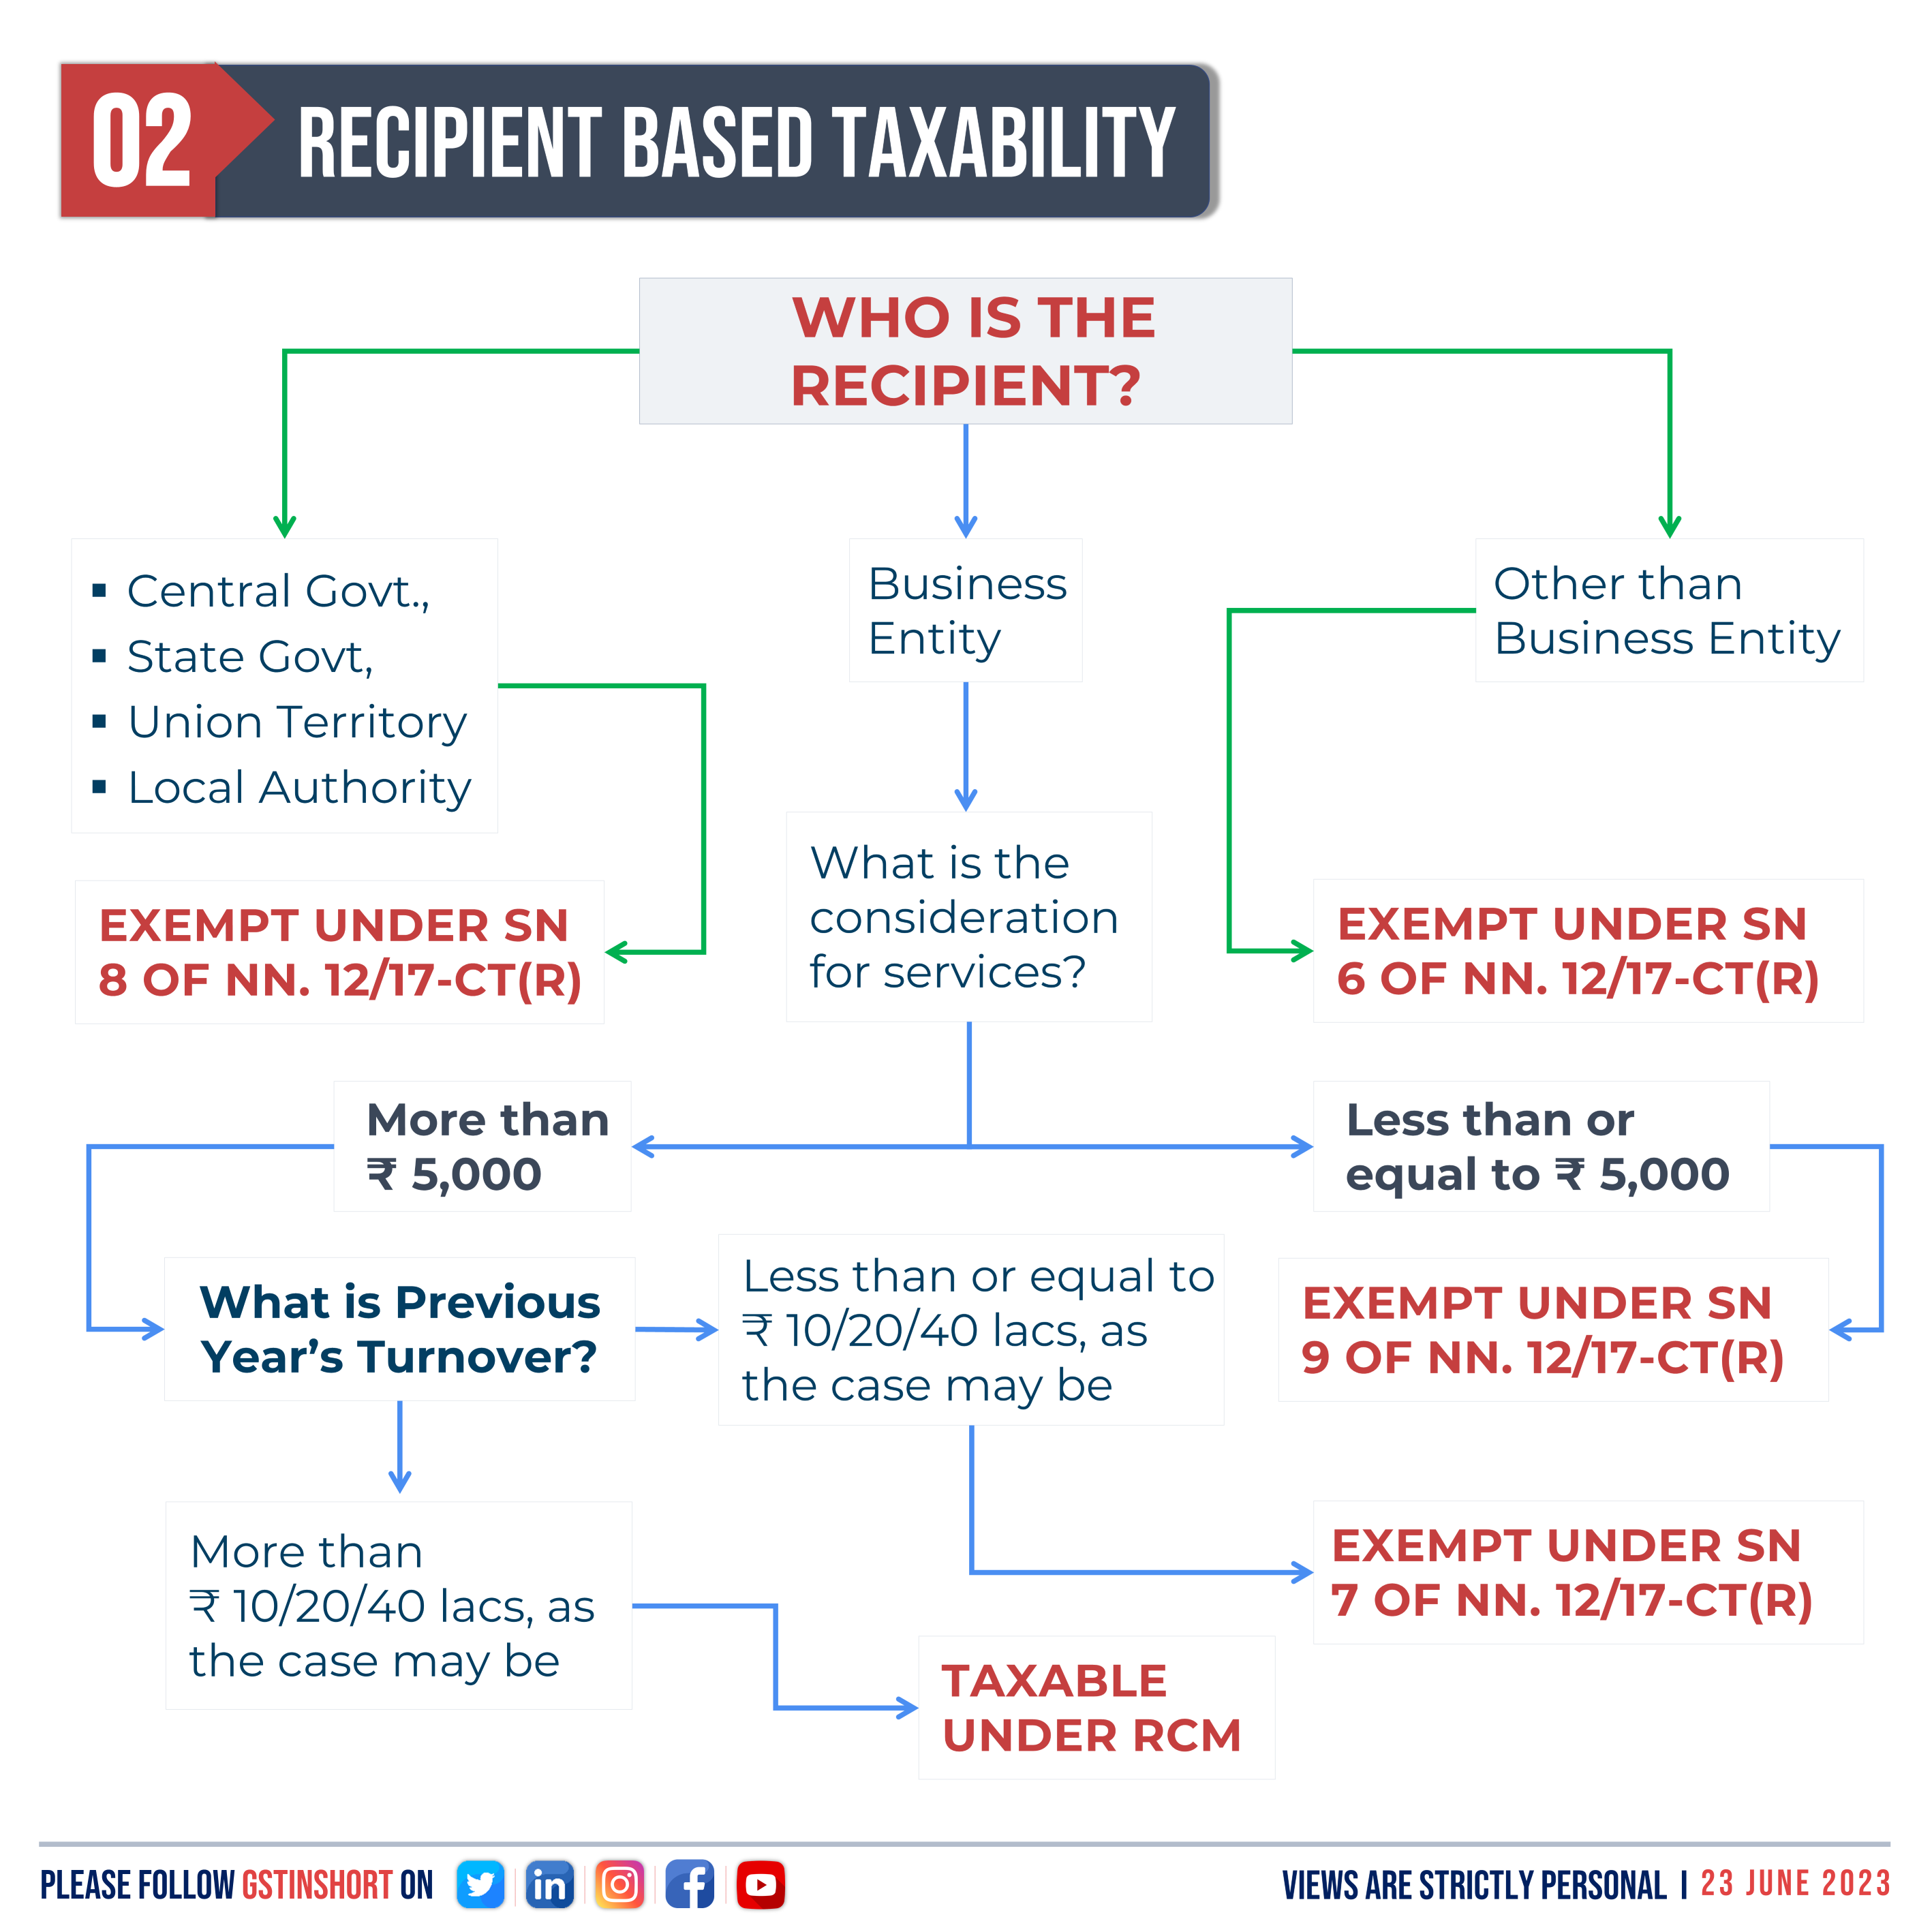

Slide 36
DEVELOPMENT RIGHTS
Scenario - 01
When to pay under RCM
Supplier
Any person
Recipient
Promoter
As per RERA, a promoter is a person who constructs or causes to be constructed an independent building or a building consisting of apartments, or converts an existing building or a part thereof into apartments, for the purpose of selling all or some of the apartments to other persons and includes his assignees
Nature of service & its use
Transfer of development rights or Floor Space Index (FSI) (including additional FSI) for construction of a project [Residential / Commercial]

Slide 37
DEVELOPMENT RIGHTS
Scenario - 02
When not to pay GST under either under FCM/RCM
Supplier
Any person
Nature of service & recipient
Transfer of development rights or Floor Space Index (FSI) (including additional FSI) for construction of a residential project by a promoter
Comment
When development rights used for construction of residential apartments and the said residential apartment sold on or before completion certificate.

Slide 38
LONG TERM LEASE OF LAND (30 YEARS OR MORE)
Scenario - 01
When to pay under RCM
Supplier
Any person
Recipient
Promoter
Nature of service & its use
Long term lease of land (30 years or more) by any person against consideration in the form of upfront amount (called as premium, salami, cost, price, development charges or by any other name) and/or periodic rent for construction of a project by a promoter.

Slide 39
ARBITRAL TRIBUNAL SERVICES
Scenario - 01
When to pay under RCM
Supplier
An Arbitral Tribunal.
Recipient
Any business entity located in the taxable territory

Slide 40
ARBITRAL TRIBUNAL SERVICES
Scenario - 02
When not to pay GST under either under FCM/RCM
Supplier
An Arbitral Tribunal.
Recipient
When recipient falls in any of the following:
Other than business entity
Business entity with turnover below threshold limit
Central Govt., State Govt., Local Authority, Governmental Authority, Government entity

Slide 41
OTHER SERVICES COVERED UNDER RCM
Services supplied by an insurance agent to any person carrying on insurance business located in taxable territory
Services supplied by a recovery agent to a banking company or a financial institution or a non-banking financial company located in taxable territory
Supply of services by the members of Overseeing Committee to RBI
Services provided by business facilitator (BF) to a banking company located in taxable territory
Services provided by an agent of business correspondent (BC) to business correspondent (BC) located in taxable territory
Services supplied by individual Direct Selling Agents (DSAs) other than a body corporate, partnership or limited liability partnership firm to bank or non-banking financial company (NBFCs)

Slide 42
OTHER SERVICES COVERED UNDER RCM
Supply of services by a music composer, photographer, artist or the like by way of transfer or permitting the use or enjoyment of a copyright covered under clause (a) of sub-section (1) of section 13 of the Copyright Act, 1957 relating to original dramatic, musical or artistic works to a music company, producer or the like
Supply of services by an author by way of transfer or permitting the use or enjoyment of a copyright covered under clause (a) of sub-section (1) of section 13 of the Copyright Act, 1957 relating to original literary works to a publisher
Services of lending of securities under Securities Lending Scheme, 1997 (“Scheme”) of Securities and Exchange Board of India (“SEBI”), as amended

Slide 43
UNDERSTANDING
GOODS NOTIFIED
UNDER SEC. 9(3) & 5(3)

Slide 44
Tariff item, sub-heading, heading or Chapter | Description of supply of Goods | Supplier of goods | Recipient of supply
0801 | Cashew nuts, not shelled or peeled | Agriculturist | Any registered person
14049010 | Bidi wrapper leaves (tendu) | Agriculturist | Any registered person
2401 | Tobacco leaves | Agriculturist | Any registered person
3301 24 00, 3301 25 10, 3301 25 20, 3301 25 30, 3301 25 40, 3301 25 90 | Following essential oils other than those of citrus fruit namely: - (a) Of peppermint (Mentha piperita); (b) Of other mints : Spearmint oil (ex-mentha spicata), Water mint-oil (ex-mentha aquatic), Horsemint oil (ex-mentha sylvestries), Bergament oil (ex-mentha citrate), Mentha arvensis | Any unregistered person | Any registered person]

Slide 45
Tariff item, sub-heading, heading or Chapter | Description of supply of Goods | Supplier of goods | Recipient of supply
5004 to 5006 | Silk yarn | Any person who manufactures silk yarn from raw silk or silkworm cocoons for supply of silk yarn | Any registered person
5201 | Raw cotton | Agriculturist | Any registered person]
- | Supply of lottery. | State Government, Union Territory or any local authority | Lottery distributor or selling agent.
Any Chapter | Used vehicles, seized and confiscated goods, old and used goods, waste and scrap | Central Government [excluding Ministry of Railways (Indian Railways)], State Government, Union territory or a local authority. | Any registered person
Any Chapter | Priority Sector Lending Certificate | Any registered person | Any registered person

Slide 46
UNDERSTANDING OF
SERVICES NOTIFIED
UNDER SEC. 9(4) & 5(4)

Slide 47
SHORTFALL IN MEETING 80% CRITERIA BY PROMOTER
Scenario - 01
When to pay GST RCM
Supplier
Unregistered Person
Nature of service
Any goods or services [other than development rights, long term lease of land or FSI] when promoter fails to meet minimum 80% of purchases from Registered Persons.
Recipient
Promoter
Comment
A promoter is supposed to ensure minimum 80% of procurements of input and input services [except specified ones such as development rights, FSI, electricity, diesel etc] from registered persons when supplying residential apartments. In case of shortfall to meet 80%, the same needs to be discharged under RCM.

Slide 48
CEMENT PURCHASE BY PROMOTER
Scenario - 01
When to pay GST RCM
Supplier
Any person
Nature of service
Cement [HSN - 2523]
Recipient
Promoter

Slide 49
CAPITAL GOODS PURCHASE BY PROMOTER
Scenario - 01
When to pay GST RCM
Supplier
Any person
Nature of service
Any capital goods used for construction of project with tax rates of 1% and 5%
Recipient
Promoter

Slide 50
THANK YOU !

