Slide 1

“GST KI PATHSHALA” – Compliance Training for Articles in CA Offices
Day 5 - “Precaution to be taken in GST Return filing”
On 1st March 2024
By CA Rajesh.R. Agrawal

Slide 2
Why File Returns ?
Mode for transfer of information to tax administration
To declare tax liability for a given period
Furnish details about the taxes paid in accordance with that return
Compliance verification program of tax administration
Providing necessary inputs for taking policy decision
Management of audit and anti-evasion programs of tax administration

Slide 3
GSTR-1 Statement of Outward Supplies
Basic details – GSTIN, Name, period, Turnover in last Financial Year
Invoice level details
B2B supplies, interstate and intrastate, interstate B2C supplies more than Rs. 2.5 lakh
GSTIN of recipient
Invoice details – Number, date, Value, HSN/SAC, Taxable value
Tax – IGST, CGST, SGST – Rate and Tax amount
Place of Supply (relevant for interstate supplies)
Details of supplies to customers
HSN/SAC
Place of Supply
Aggregate value
Tax – IGST, CGST, SGST – Rate and tax amount

Slide 4
Statement of Outward Supplies
Credit and Debit Notes – linkage to original invoice
Document number
Original Invoice Number
Deferential amount and deferential tax
Reverse Charge
Details of exports – with and without payment of tax
Invoice details, Shipping Bill/Bill of Export, tax details
Details of exempt, Nil rated and Non-GST supplies
Interstate and Intrastate B2B and B2C supplies
Tax paid on advances and adjustment of advances
Amendment of any of the above details filed in previous months

Slide 5
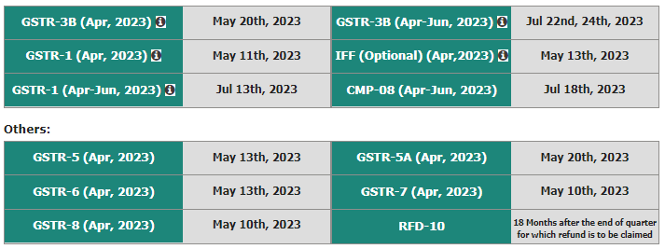








Returns & Due Date in GST
GSTR 3B
GSTR 1
GSTR-9C
GSTR-9
Monthly return
20th and 22nd
Payment of tax
Late fee
Interest
Monthly Filing
Applicable if Turnover above 5 crore
Turnover Reconciliation as per Audited and GST
Additional Liability
GST Ratewise
Exemption from filing annual return in FORM GSTR-9/9A for FY2021-22 for AATO up to Rs.2 crores.
HSN wise Quantity data
Quarterly filing if turnover upto 1.5 crore
IFF facility

Slide 6
Due Dates for filing GST Returns
GSTR 1 :
11th day of next month for monthly return filers 13th day of next month for quarterly return filers
GSTR 3B :
20TH Day of next month (for monthly return filers)
Opting for the QRMP scheme
For category X states/UT: 22nd Jul 2022
For category Y states/UT: 24th Jul 2022
The tax filers from 15 States/ UTs, i.e., Chhattisgarh, Madhya Pradesh, Gujarat, Daman and Diu, Dadra and Nagar Haveli, Maharashtra, Karnataka, Goa, Lakshadweep, Kerala, Tamil Nadu, Puducherry, Andaman and Nicobar Islands, Telangana and Andhra Pradesh will now be having the last date of filing GSTR-3Breturns as 22nd of the month without late fees.
Taxpayers from the 22 States/UTs of Jammu and Kashmir, Ladakh, Himachal Pradesh, Punjab, Chandigarh, Uttarakhand, Haryana, Delhi, Rajasthan, Uttar Pradesh, Bihar, Sikkim, Arunachal Pradesh, Nagaland, Manipur, Mizoram, Tripura, Meghalaya, Assam, West Bengal, Jharkhand and Odisha having annual turnover below Rs 5 crore in previous financial year will now be having last date of filing the GSTR-3B as 24th of the month without late fees.

Slide 7
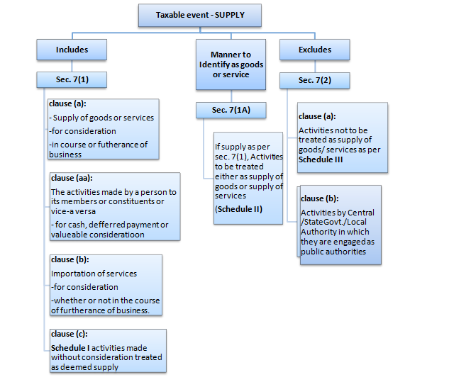
The Definition of supply is broadly categorized into following:

Slide 8
Valuation
SECTION 15(1) of the CGST Act - Value of taxable supply
“The value of a supply of goods or services or both shall be the transaction value, which is the price actually paid or payable for the said supply of goods or services or both where the supplier and the recipient of the supply are not related and the price is the sole consideration for the supply”
Price actually paid or payable for supply
Supplier and recipient are not related persons
Price is the sole consideration for the supply
If above all the conditions are fulfilled the transaction value will be the taxable value else value of taxable supply has to be determined based on the ‘Valuation Rules’

Slide 9
Classification - Tax Rate is based on the HSN / SAC of the Goods / Services
Calculation of GST = Value (Valuation) * Tax Rate (Classification)
Valuation Provision in GST govern by Section 15 read with rules made thereunder
Section 15(1) – Transaction Value
Section 15(2) – Inclusions
Section 15(3) – Exclusions
Rule 27 to Rule 31 of CGST
Primary GST slab rates are Nil, 5%, 12%, 18% & 28%
Commission, packing charges, inspection or certification charges, installation and testing, weighment charges, etc.

Slide 10
Section 15(2) – The value of supply shall include —
(a) Any taxes, duties, cesses, fees and charges levied under any law for the time being in force other than this Act, the State Goods and Services Tax Act, the Union Territory Goods and Services Tax Act and the Goods and Services Tax (Compensation to States) Act, if charged separately by the supplier; (Circular No. 76/50/2018-GST dated December 31, 2018 – TCS under Income Tax Act is not to be included)
(b) Any amount that the supplier is liable to pay in relation to such supply but which has been incurred by the
recipient of the supply and not included in the price actually paid or payable for the goods or services or both;
(c) Incidental expenses, including commission and packing, charged by the supplier to the recipient of a supply and any amount charged for anything done by the supplier in respect of the supply of goods or services or both at the time of, or before delivery of goods or supply of services;
(d) Interest or late fee or penalty for delayed payment of any consideration for any supply; and
(e) Subsidies directly linked to the price excluding subsidies provided by the Central Government and State Governments.
Explanation. — For the purposes of this sub-section, the amount of subsidy shall be included in the value of supply of the supplier who receives the subsidy.

Slide 11
Section 15(2) – Inclusions
Circular No. 76/50/2018-GST dated December 31, 2018 – TCS under Income Tax Act is not to be included.
Amount incurred by the recipient, which supplier is liable to pay e.g. Moulds and dies owned by Original Equipment Manufacturer sent free-of-cost to component manufacturer for supply of goods
Incidental expenses and amount charged for activities done at the time of or before delivery e.g. Commission, packing charges, inspection or certification charges, installation and testing, weighment charges, etc.
Any amount by whatever name called, collected additionally than the original value of supply in respect of delayed payment including Interest/ late fee/ penalty for delayed payment of any consideration
Subsidies directly linked to the price (excluding subsidies provided by the Central/ State Government)

Slide 12
Section 15(3) – The value of the supply shall not include any discount which is given —
(a) before or at the time of the supply if such discount has been duly recorded in the invoice issued in respect of such supply; and
(b) after the supply has been effected, if —
(i) such discount is established in terms of an agreement entered into at or before the time of such supply and specifically linked to relevant invoices; and
(ii) input tax credit as is attributable to the discount on the basis of document issued by the supplier has been reversed by the recipient of the supply.

Slide 13
Section 15(3) – Exclusions
1. Discount on or before supply to be duly recorded in the invoice and exclude from the valuation 2. Post supply discount pre-decided as per the agreement between supplier and the recipient before the time of supply, and recipient has reversed the ITC. In terms of the legislative provisions, specific scenarios have been prescribed for issuing of Credit Notes for adjusting corresponding GST. One of the important conditions for the said adjustment is that such discount is established in terms of an agreement entered into at or before the time of such supply

Slide 14
GSTR-3B Simplified Summary Return
GSTR-3B is a self-declared summary GST return filed every month (quarterly for the QRMP scheme).
Taxpayers need to report the summary figures of Outward Supplies, ITC claimed, Liability under RCM and net tax payable in GSTR-3B.
A separate GSTR-3B must be filed for every GSTIN
The GST liability must be paid on or before the date of filing GSTR-3B, earlier of its due date
The GSTR-3B once filed cannot be revised, adjustment with the future return is permissible to rectify the error / mistake
Even in case of a Zero liability, GSTR-3B must be compulsorily filed as Nil Return

Slide 15
Who should file GSTR-3B?
Section 37 Furnishing details of outward supplies (1) Every registered person, other than an Input Service Distributor, a non-resident taxable person and a person paying tax under the provisions of section 10 or section 51 or section 52, shall furnish, electronically, [subject to such conditions and restrictions and] in such form and manner as may be prescribed, the details of outward supplies of goods or services or both effected during a tax period on or before the tenth day of the month succeeding the said tax period and such details [shall, subject to such conditions and restrictions, within such time and in such manner as may be prescribed, be communicated to the recipient of the said supplies] :
Every person who is registered under GST must file GSTR-3B.
Following registrants do not have to file GSTR-3B :
Taxpayers registered under the Composition Scheme
Input service distributors
Non-resident suppliers of OIDAR service
Non-resident taxable persons

Slide 16
GSTR-3B vs GSTR-2B: Comparison
Reconciliation of GSTR-2B (ITC statement for the month) with GSTR-3B is must to:
Avoid notices and interest liability due to excess Input Tax Credit claims in GSTR-3B
Be informed if any genuine Input Tax Credit is missed out and also accounting is pending
Nudge the supplier to upload the invoice details in the GSTR-1, if not uploaded
Stay GST compliant and improve the GST compliance rating

Slide 17
Impact on wrong classification
Particulars | Goods | Services
Description | Ice cream and other edible ice, whether or not containing cocoa | (ii) Supply of ‘restaurant service‘ other than at ‘specified premises
Not. No. | 1/2017-CT | 11/2017-CT
Rate | 18% | 5%
Heading / SAC | 2105 00 00 | Heading 9963 (Accommodation, food and Beverage services)
CIRCULAR NO. 164 /20 /2021-GST: Ice cream parlors sell already manufactured ice-cream and they do not have a character of a restaurant. Ice-cream parlors do not engage in any form of cooking at any stage, whereas, restaurant service involves the aspect of cooking/preparing during the course of providing service. Thus, supply of ice- cream parlor stands on a different footing than restaurant service. Their activity entails supply of ice cream as goods (a manufactured item) and not as a service, even if certain ingredients of service are present.

Slide 18
Conditions – Section 16(2)&(3)
He is in possession of a tax invoice or debit note issued by a supplier registered under this Act, or such other tax paying documents as may be prescribed
The details of the invoice or debit note referred to in clause (a) has been furnished by the supplier in the statement of outward supplies and such details have been communicated to the recipient of such invoice or debit note n the manner specified u/s 37
He has received the goods or services or both
The details of ITC in respect of the said supply communicated to such registered persons u/s 38 has not been restricted.
The supplier has actually paid the tax charged in respect of the supply to the government.
He has furnished the return under section 39
If the goods against an invoice are received in lots or instalments, the registered person shall be entitled to take credit upon receipt of the last lot or instalment

Slide 19
Proviso to Section 16(2) – Payment beyond 180 days
Correspond
-ing credits availed by the registered person would be added to his output tax liability, with interest @18% in next month
Once the recipient makes the payment of value of goods and/or services along with tax, he will be entitled to avail the credit again without any time limit
Interest will be paid from the date of availing credit till the date when the amount added to the output tax liability is paid
In case part- payment has been made, proportion ate credit would be allowed
Registered person receives goods or avails services
Fails to make payment to supplier within 180 days
Exception - Supplies on which tax is payable under reverse charge

Slide 20
Conditions for Order of Utilization of ITC
Rule 88A. Order of utilization of input tax credit.-
Input tax credit on account of integrated tax shall first be utilised towards payment of integrated tax, and the
amount remaining, if any, may be utilised towards the payment of central tax and State tax or Union territory tax, as the case may be, in any order:
Provided that the input tax credit on account of central tax, State tax or Union territory tax shall be utilised towards payment of integrated tax, central tax, State tax or Union territory tax, as the case may be, only after the input tax credit available on account of integrated tax has first been utilised fully
SECTION 49A. Utilisation of input tax credit subject to certain conditions. —
Notwithstanding anything contained in section 49, the input tax credit on account of central tax, State tax or Union
territory tax shall be utilised towards payment of integrated tax, central tax, State tax or Union territory tax, as the case may be, only after the input tax credit available on account of integrated tax has first been utilised fully towards such payment.
SECTION 49B. Order of utilisation of input tax credit. — Notwithstanding anything contained in this Chapter and subject to the provisions of clause (e) and clause (f) of sub-section (5) of section 49, the Government may, on the recommendations of the Council, prescribe the order and manner of utilisation of the input tax credit on account of integrated tax, central tax, State tax or Union territory tax, as the case may be, towards payment of any such tax

Slide 21
How to Submit Return Online
Login to gst.gov.in
Select services tab
Go to return tab under services
Click Returns Dashboard
Fill up the required information
Click prepare online
Click on monthly return GSTR 3b
Select relevant financial year and return period
Complete the process with DVC or EVC Verification
Save GSTR 3B
Verify GSTR 3B

Slide 22
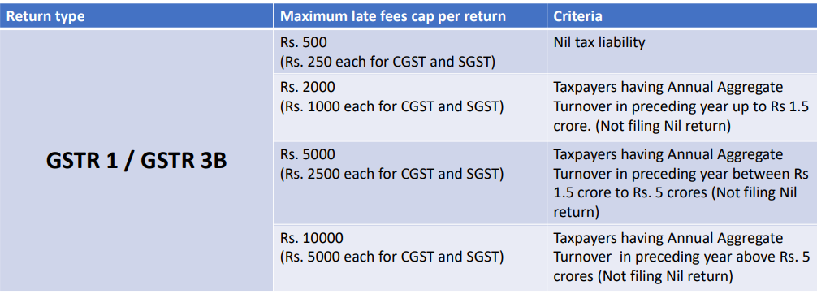
Late Fees
• As per the latest amendments of the GST Act, GST late filing penalty has been reduced to Rs. 25 per day under the CGST law and Rs. 25 per day under the SGST law, making it a total of Rs. 50 per day for both intra and interstate supplies.
• Filing a NIL return is mandatory even if no GST payments were made to the Income Tax department :Rs. 20 per day, i.e., Rs. 10 per day under CGST and Rs. 10 per day under SGST, by the recent GST amendments

Slide 23
What is TDS under GST?
Tax Deducted at Source (TDS) is one of the ways to collect tax based on certain percentages on the amount payable by the receiver on goods/services. The collected tax is a early revenue for the government.
Liability to deduct TDS under GST and TDS rate
Rate of TDS:
Value for TDS
If total value under contract above Rs. 2.50 Lacs
Payment of TDS & Return
Within 10 days after the end of the month in which such deduction is made
1% CGST/SGST each
Certificate
Within 5 days from date of crediting TDS to govt.
IGST 2%

Slide 24
There are total 15 parameters (Parameter 0069 to 0083) based on which GST department is issuing notices for scrutiny of returns are as follows:
1. In-eligible ITC claimed from non-genuine taxpayers (NGTPs) whose RC is canceled ab-initio 2. Excess outward tax in GSTR-1 compared to GSTR-9 /GSTR-3B 3. Excess Outward tax in E-Way Bills Compared to GSTR-3B 4. In-eligible ITC claimed from GSTR-3B Non-filers 5. Excess ITC claimed in GSTR-9/3B which is not confirmed in GSTR-2A or 8A of GSTR-9 6. In-eligible ITC claimed from RC is canceled suppliers 7. Less turnover is shown in GSTR-1 compared to GSTR-8 (TCS) 8. Less turnover is shown in GSTR-3B compared to GSTR-7 (TDS) 9. Less RCM liability disclosed in GSTR 9/3B/4 than shown by suppliers in GSTR-1 10. ITC claims after the last date of availing of ITC as per section 16(4) GSTR-3B 11. ITC on purchase invoices uploaded by the supplier in GSTR-1 filed after the last date of availing - 16(4) 12. Interest on delayed payments made with GSTR 3B 13. Excess IGST on imports shown in GSTR_6E vs. ICEGATE data 14. Excess ISD ITC availed in GSTR9_6G Vs GSTR 2A_ISD 15. Excess RCM ITC GSTR9_6CDF than liability shown in GSTR 9_4G

Slide 25
Thank you…

