Slide 1
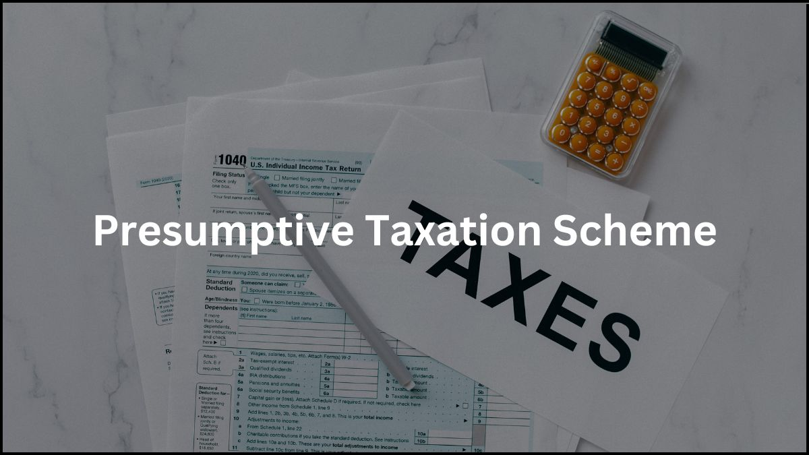

Presumptive Taxation

Slide 2

Brief History of Presumptive Taxation
Finance Act 1994
Supply of labour for construction work
Finance Act 2016:
Finance Act 2009
Scope of 44AD expanded to:
Profession covered in 44AA(1)
Commission / Brokerage
Agency
44ADA Introduced:
Business of civil construction
Plying, hiring, leasing goods carriages
Section 44AD and 44AE Introduced for :
All business except:
Applicability of presumptive taxation to profession covered in 44AA(1)
Clarification provided in Finance Act, 2012

Slide 3
List of Sections providing for Presumptive Taxation
44AD
All Businesses except specified Businesses
44ADA
Specified Professionals
44AE
Transport - Plying, Hiring, Leasing of Goods Carriages
44B
Shipping Business
44BB
Exploration of Mineral Oils
44BBA
Operation of Aircrafts
44BBB
Foreign Company in engaged in business of Civil constructions, etc

Slide 4
Significance
Significance of Presumptive taxation
Presumptive income is introduced with a view to simplify the determination of business income for small tax payers
The Income-tax Act requires a person engaged in business or profession to maintain regular books of account and further get the accounts audited.
Minimizing the compliance cost and undue hardship caused to the taxpayer
A person adopting the presumptive taxation scheme can declare income at a prescribed rate

Slide 5
Provisions at a glance
Section 44AD
“Notwithstanding anything to the contrary contained in sections 28 to 43C, in the case of an eligible assessee engaged in an eligible business,a sum equal to eight per cent of the total turnover or gross receipts of the assessee in the previous year on account of such business or, as the case may be, a sum higher than the aforesaid sum claimed to have been earned by the eligible assessee, shall be deemed to be the profits and gains of such business chargeable to tax under the head ‘Profits and gains of business or profession’”

Slide 6
Provisions at a glance
Provision to Section 44AD
Provided that this sub-section shall have effect as if for the words "eight per cent", the words "six per cent" had been substituted, in respect of the amount of total turnover or gross receipts which is received by an account payee cheque or an account payee bank draft or use of electronic clearing system through a bank account or through such other electronic mode as may be prescribed during the previous year or before the due date specified in sub-section (1) of section 13 in respect of that previous year.

Slide 7
Provisions at a glance
Eligible Assessee
Any business other than the following:
<Rs. 2 Crores or
Individuals
HUF
Partnership Firm (Other than LLP)
Total Turnover/ Gross Receipts
Profession covered in 44AA(1)
Commission/ Brokerage
Agency
Plying, hiring or leasing goods carriages
Eligible Business
Resident, who is
<3 Crores (from AY 2024-25, provided specific conditions are met)

Slide 8
Provisions at a glance
Section 44ADA
“Notwithstanding anything contained in sections 28 to 43C, in case of an assessee, being an individual or a partnership firm other than a limited liability partnership as defined under clause (n) of sub-section (1) of section 2 of the Limited Liability Partnership Act, 2008 (6 of 2009), who is a resident in India, and is engaged in a profession referred to in sub-section (1) of section 44AAand whose total gross receipts do not exceed fifty lakh rupees in a previous year, a sum equal to fifty per cent of the total gross receipts of the assessee in the previous year on account of such profession or, as the case may be, a sum higher than the aforesaid sum claimed to have been earned by the assessee, shall be deemed to be the profits and gains of such profession chargeable to tax under the head ‘Profits and gains of business or profession’.”

Slide 9
Provisions at a glance
Eligible Assessee
Resident, who is engaged in eligible profession referred to in Section 44AA(1)
Firm (Other than LLP)
Individual
HUF
Gross Receipts
<75 Lakhs (from AY 2024-25, provided specific conditions are met)
<Rs. 50 Lakhs or

Slide 10

Recent amendments
Section 44AD
Threshold extended to INR 75 Lakhs**
Section 44ADA
Threshold extended to INR 3 Crores**
**Provided The amount (or aggregate of amounts) received during the previous year, in cash/bearer or crossed cheque/draft, does not exceed 5% of the total turnover or gross receipts
Whether the turnover limit should be seen Assessee wise or business wise?
Guidance note issued by ICAI on Tax Audit
Notes:
If you declare income u

Slide 11
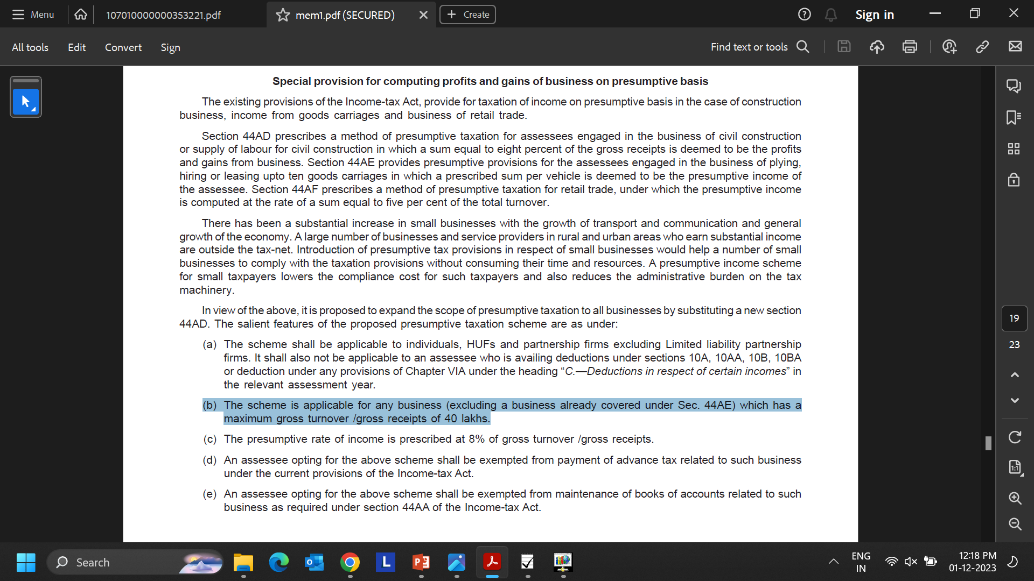
Eligible Assessee
Extract of Memorandum of Finance Act, 2009
Section 72:
Provided that where the whole or any part of such loss is sustained in any such business as is referred to in section 33B which is discontinued in the circumstances specified in that section, and, thereafter, at any time before the expiry of the period of three years referred to in that section, such business is re-established, reconstructed or revived by the assessee, so much of the loss as is attributable to such business shall be carried forward to the assessment year relevant to the previous year in which the business is so re-established, reconstructed or revived, and—
(a) it shall be set off against the profits and gains, if any, of that business or any other business carried on by him and assessable for that assessment year; and

Slide 12
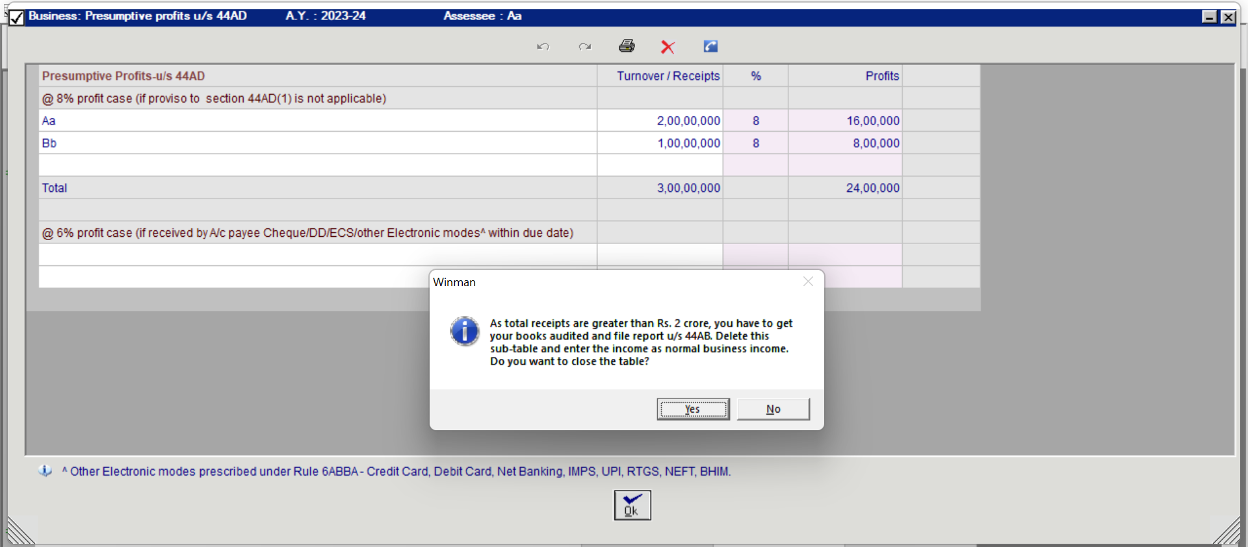
Practical Difficulties
Eligible Assessee

Slide 13
Turnover/ Gross receipts
Examples of Receipts which are included in Turnover
GST, Cess and other levy (if the same is included in sale price)
Sale of unusable empties and packages
Service charges charged for delivery
Examples of Receipts which are not included in Turnover
Sale of PPE
Advance, deposits, retention received from customers
Security, retention, or other deposits received from Employee
Interest income
Value of Inventory
No definition provided in the Act
Guidance to be obtained from GN issued by ICAI
Turnover or gross receipts should be determined in accordance with the method of accounting generally followed

Slide 14
Provisions at a glance
Section 44AD(6)
The provisions of this section, notwithstanding anything contained in the foregoing provisions, shall not apply to—
a person carrying on profession as referred to in sub-section (1) of section 44AA;
a person carrying on any agency business.
a person earning income in the nature of commission or brokerage; or

Slide 15

Certain Issues
Mr. X is earning income in the nature of commission. He also runs a grocery store. Can Mr. X opt for presumptive taxation u/s 44AD in respect of income from grocery store?
Mr. P being a doctor also runs a business of a pharmacy shop. Will he be eligible to opt for presumptive taxation u/s 44AD in respect of the Pharmacy shop?
“Earns”
“Earning”
Further, can he opt for presumptive taxation u/s 44AD, if he does not earn any commission income in the year in which he is opting for presumptive taxation?

Slide 16
Certain Issues
Certain Issues
Profession covered u/s 44AA(1)
1.Legal
2.Medical
3.Engineering
4.Architectural profession
5.Profession of accountancy
6.Technical consultancy
8.Other notified professionals
7.Interior Decoration
Mr. A, a recruitment agent earns professional income on which payer deducts tax u/s 194J.Can Mr. A offer income u/s 44AD?
Shri Arthur Bernard Sebastine Pais, Vs. Deputy Commissioner of Income-tax [ITA No.1683/Bang/2019]
Film Artist
Company Secretary
Profession of IT
Profession of authorized representative
Thus, if an Assessee does not carry on the specified profession he can offer his income/receipts on presumptive basis u/s 44AD. Moreover subsection 6 to Section 44AD also emphasis this fact by clearly excluding assesses carrying on the specified profession as per section 44AA(1) from the gambit of section 44AD.

Slide 17
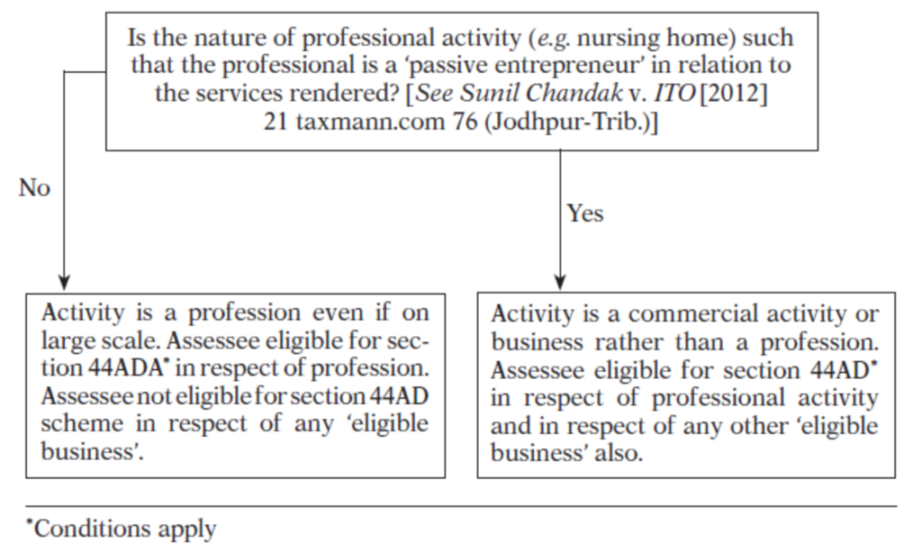
Certain Issues
Mr. C, being a doctor, runs a nursing home. Can he opt for presumptive taxation u/s 44AD?
Sunil Chandak v. ITO
[2012] 21 taxmann.com 76/136 ITD 324 (Jodh. - Trib.)

Slide 18
Applicability at a glance
Is resident assessee engaged in a profession referred to in section 44AA(1) of the Act?
Is the assessee carrying on a agency business or earning commission commission or or brokerage income?
Is assessee an 'eligible assessee‘ i.e. resident individual/ HUF/firm but not LLP
Is assessee disqualified under sub-section (4) of section 44AD?
Is the business carried on by the assesse an 'eligible business'
Assessee eligible for section 44AD scheme
Yes
No
Yes
No
No
Yes
Yes
Is the nature of activity such that professional is a 'passive entrepreneur' in relation to the services rendered?
Yes
No
No
Assessee can avail section 44ADA scheme. Assessee not eligible for section 44AD scheme.
Assessee cannot avail section 44AD scheme
Yes
No

Slide 19
Certain Issues
The Commissioner Of Income Tax vs Sri J.H. Gotla (SC)
Can a person opt for presumptive taxation u/s 44AD, if he is earning income from futures and options?
Where the plain literal interpretation of a statutory provision produces a manifesty unjust result which could never have been intended by the legislature, the court might modify the language used by the legislature so as to achieve the intention of the legislature and produce a rational construction.
Intention behind introduction of Section 44AD must not be lost sight of.
Can a person earning income from intraday trading opt for presumptive taxation u/s 44AD?
Anandkumar v. ACIT [2020] (122 taxmann.com 252) (Madras)

Slide 20
Opt out provisions
Section 44AD
(4) Where an eligible assessee declares profit for any previous year in accordance with the provisions of this section and he declares profit for any of the five assessment years relevant to the previous year succeeding such previous year not in accordance with the provisions of sub-section (1), he shall not be eligible to claim the benefit of the provisions of this section for five assessment years subsequent to the assessment year relevant to the previous year in which the profit has not been declared in accordance with the provisions of sub-section (1).
(5) Notwithstanding anything contained in the foregoing provisions of this section, an eligible assessee to whom the provisions of sub-section (4) are applicable and whose total income exceeds the maximum amount which is not chargeable to income-tax, shall be required to keep and maintain such books of account and other documents as required under sub-section (2) of section 44AA and get them audited and furnish a report of such audit as required under section 44AB.

Slide 21
Opt out provisions
Section 44ADA
4) Notwithstanding anything contained in the foregoing provisions of this section, an assessee who claims that his profits and gains from the profession are lower than the profits and gains specified in sub-section (1) and whose total income exceeds the maximum amount which is not chargeable to income-tax, shall be required to keep and maintain such books of account and other documents as required under sub-section (1) of section 44AA and get them audited and furnish a report of such audit as required under section 44AB

Slide 22
Audit Applicability
Scenario | Turnover | Income from eligible Business | Applicability of Sec 44AD(5) | Applicability of Sec 44AA | Applicability of Sec 44AB
1st Year of Operations | 50 Lakh | 5% | O | P | O
44AD opted for in previous year | 50 Lakh | 5% | P | P | P
44AD opted for in previous year | 50 Lakh | -1% | O | P | O
Professional u/s 44ADA | 30 Lakh | 20% | NA | P | P
Professional u/s 44ADA | 30 Lakh | -1% | NA | P | O

Slide 23
Certain Issues
Mr. O, has disclosed income u/s 44AD in the AY 2022-23. During AY 2023-24 the turnover exceeds the limit prescribed under section 44AD. Whether he will be eligible to opt for 44AD in AY 2024-25 if turnover falls back within the limit?
Mr. Q, is engaged in the business of construction. He declared income u/s 44AD for AY 2022-23. During AY 2023-24 he has claimed a deduction u/s 80IB in respect of a building constructed by him. Can he still be eligible to claim the benefit of 44AD in AY 2024-25?
Section 44AD applies only to eligible Assessees earning income from eligible business
44AD(4) will not apply in case of assesses/businesses not covered by 44AD

Slide 24
Certain Issues
CIT v. Surinder Pal Anand [2010] 192 Taxman 264 (PUNJ. & HAR.)
Once under the special provision, exemption from maintenance of books of account has been provided and presumptive tax at the rate of 8 per cent of the gross receipt itself is the basis for determining the taxable income
Can 8% of Gross receipts claimed as income be challenged by the AO?
Putting the above analysis, in converse, it can be easily inferred that the same is also true for the expenditure of the assessee. If 8 per cent of gross receipts are 'deemed' income of the assessee, the remaining 92 per cent are also 'deemed' expenditure of the assessee.
Nand Lal Popli v. DCIT [2016] 71 taxmann.com 246 (Chandigarh - Trib.)

Slide 25
Certain Issues
Can addition u/s 68 be made where the Assessee has declared income u/s 44AD?
Sumit Gahlot v. Income-tax Officer [2023] 152 taxmann.com 185 (Jodhpur - Trib.)
Section 68: Where any sum is found credited in the books of an assessee maintained for any previous year, and the assessee offers no explanation about the nature and source thereof or the explanation offered by him is not, in the opinion of the Assessing Officer, satisfactory, the sum so credited may be charged to income-tax as the income of the assessee of that previous year
Since the assessee is admittedly not required to maintain the books of account, there is no basis for invoking the provision of section 68.

Slide 26
Certain Issues
Anandkumar v. ACIT [2020] (122 taxmann.com 252) (Madras)
Admittedly, the assessee has not done any sales nor rendered any services but has been receiving remuneration and interest from the partnership firms which amount has already been debited in the profit and loss account of the firms. Therefore, the revenue was right in their contention that remuneration and interest cannot be treated as gross receipt.
Miss. M is earning remuneration and salary from a partnership firm. Can she opt for presumptive taxation u/s 44AD and declare income at 8% of the gross receipts?
Perizad Zorabian Irani
v. PCIT [2022] 139 taxmann.com 164 (Bombay)
Section 28: The following income shall be chargeable to income-tax under the head "Profits and gains of business or profession",—
(v) any interest, salary, bonus, commission or remuneration, by whatever name called, due to, or received by, a partner of a firm from such firm

Slide 27
Certain Issues
In case of non-deduction of TDS,will disallowance u/s 40(a)(ia) be attracted if the Assessee discloses his income u/s 44AD?
Whether Assessee is liable to deduct TDS if he discloses his income u/s 44AD/ 44ADA?
The provisions of presumptive taxation only override Section 28 to 43C and not the provisions of TDS
Therefore, the Assessee declaring income u/s 44AD, 44ADA, or 44AE is liable to deduct TDS
Section 40.
“Notwithstanding anything to the contrary in sections 30 to 38, the following amounts shall not be deducted in computing the income chargeable under the head "Profits and gains of business or profession",
“(a)(ia) thirty per cent of any sum payable to a resident, on which tax is deductible at source under Chapter XVII-B and such tax has not been deducted or, after deduction, has not been paid on or before the due date specified in sub-section (1) of section 139”
where assessee was engaged in civil construction, its case was covered under section 44AD; and if it had disclosed profits more than 8 per cent of gross receipts as provided in section 44AD, no separate addition could be made under section 40(a)(ia)
ITO v.
Mark Construction [2012] 23 taxmann.com 398 (Kol.)

Slide 28
Certain Issues
Will disallowance u/s 43B apply if assesse has offered income to tax u/s 44AD?
Krishna Kumar Agrawal v. ITO [2023] 147 taxmann.com 48 (Raipur - Trib.)
Decision in favour:
In our considered view, now when the assessee had disclosed his income u/s.44AD of the Act, therefore, no disallowance of the aforesaid amount was called for in his hands. As the disallowance u/s.43B presupposes raising of a claim for deduction, therefore, now when in the case before us the assessee had not sought any deduction of bank interest of Rs. 23,21,099/-, there could have been no justification in disallowing the same.
There are conflicting decisions by various tribunals, in this regard.
Decision against the Assessee:
Good Luck Kinetic v. ITO [IT Appeal No. 26 (PAJ) of 2013, dated 15-6-2015]
The non-obstante clause in section 43B has far wider amplitude because it uses the words "notwithstanding anything contained in any other provisions of this Act". Therefore, even assuming that the deduction is permissible or the deduction is deemed to have been allowed under any other provisions of this Act, the control placed by the provisions of section 43B in respect of the statutory liabilities still holds precedence over such allowance. This is because the dues to the crown have no limitation and have precedence over all other allowances and claims.
“43B. Notwithstanding anything contained in any other provision of this Act, a deduction otherwise allowable under this Act”

Slide 29
Certain Issues
What will be the applicability of Section 43CA, if income is declared u/s 44AD?
View 1
View 2
Difference will be added to the turnover and 8% of such difference shall be taxed
Entire difference may be added to the income since 43CA is a deeming provision.
Section 43CA: Where the consideration received or accruing as a result of the transfer by an assessee of an asset (other than a capital asset), being land or building or both, is less than the value adopted or assessed or assessable by any authority of a State Government for the purpose of payment of stamp duty in respect of such transfer, the value so adopted or assessed or assessable shall, for the purposes of computing profits and gains from transfer of such asset, be deemed to be the full value of the consideration received or accruing as a result of such transfer:

Slide 30

Certain Issues
Can an Assessee who is declaring income u/s 44AD claim set off of unabsorbed depreciation?
Can an Assessee who is disclosing income u/s 44AD and has two businesses, one of which is eligible u/s 44AD claim set off of losses from the ineligible business against income form the eligible business?
Section 32(2): Where, in the assessment of the assessee, full effect cannot be given to any allowance under sub-section (1) in any previous year, owing to there being no profits or gains chargeable for that previous year, or owing to the profits or gains chargeable being less than the allowance, then, subject to the provisions of sub-section (2) of section 72 and sub-section (3) of section 73, the allowance or the part of the allowance to which effect has not been given, as the case may be, shall be added to the amount of the allowance for depreciation for the following previous year and deemed to be part of that allowance, or if there is no such allowance for that previous year, be deemed to be the allowance for that previous year, and so on for the succeeding previous years.
Section 44AD overrides provisions of section 28 to 43C
Set off of business loss is governed by section 72
Therefore, the Assessee can claim set off of losses from the ineligible business against income form the eligible business

Slide 31
Provisions at a glance
Section 44AE
Notwithstanding anything to the contrary contained in sections 28 to 43C, in the case of an assessee, who owns not more than ten goods carriages at any time during the previous year and who is engaged in the business of plying, hiring or leasing such goods carriages, the income of such business chargeable to tax under the head "Profits and gains of business or profession" shall be deemed to be the aggregate of the profits and gains, from all the goods carriages owned by him in the previous year, computed in accordance with the provisions of sub-section (2).

Slide 32
Provisions at a glance
Calculation of income u/s 44AE
(i) being a heavy goods vehicle, shall be an amount equal to one thousand rupees per ton of gross vehicle weight or unladen weight, as the case may be, for every month or part of a month during which the heavy goods vehicle is owned by the assessee in the previous year or an amount claimed to have been actually earned from such vehicle, whichever is higher;
(ii) other than heavy goods vehicle, shall be an amount equal to seven thousand five hundred rupees for every month or part of a month during which the goods carriage is owned by the assessee in the previous year or an amount claimed to have been actually earned from such goods carriage, whichever is higher.

Slide 33
Differences between the various sections
Particulars | Section 44AD | Section 44ADA | Section 44AE
Eligible Assessee | Resident Individual/ HUF/ Firm (excluding LLP) | Resident Individual/ Firm (excluding LLP) | Any Assessee owing maximum 10 vehicles
Applicability to Non resident | Not Applicable | Not Applicable | Applicable
Turnover/ Gross Receipts | Up to Rs. 3 crore (provided specific conditions are met) | Upto Rs.50 lakhs | NA
Eligible Business/ Profession | Any business except: | Professions as referred in section 44AA | Engaged in the business of plying, hiring, leasing of goods carriage, etc
 | 1. Section 44AE
 | 2. Agency Business
 | 3. Commission and Brokerage Business
Presumptive Income | Turnover/ Gross Receipts * 8% (If payment is made through A/c payee cheque or other electronic modes, etc than 6%) | Gross Receipts*50% | Heavy goods vehicles (vehicles > 12 tons): Rs. 1000 per ton of gross vehicle weight for every month or part of the month Other Vehicle: Rs. 7500 for every month or part of the month
Partner's remunaration, salary, interest as per section 40(b) | Not deductible | Not deductible | Deductible
Preparation of Books of Accounts | Not required if Assessee opts for the respective section and turnover is upto the prescribed limit
 | (Further, if income disclosed is less than as computed under respective section than the maintenance of books along with its audit is compulsory

Slide 34


