Slide 1
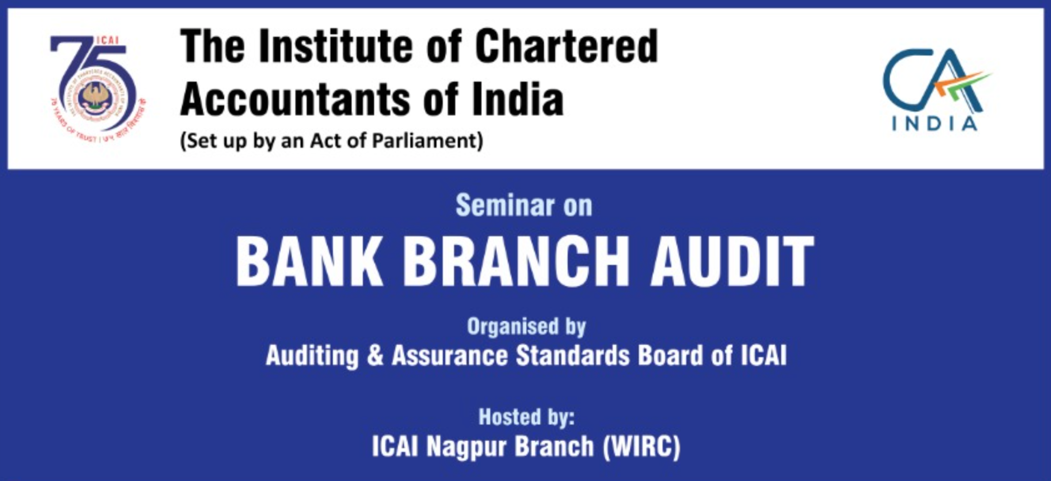
Advances to MSME & Priority Sector
CA. Maheshwar Marathe,
Pune
PUNE 24rd March 2024

Slide 2
Master direction on Priority Sector Lending
(updated upto 27 JULY 2023)
TO
All Commercial Banks including Regional Rural Banks,
Small Finance Banks, Local Area Banks
Primary (Urban) Co-operative Banks other than Salary Earners’ Banks

Slide 3

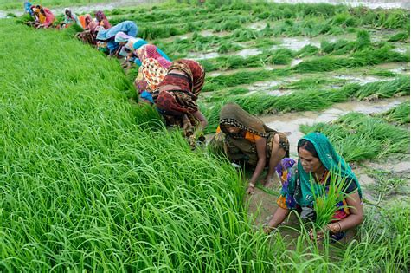


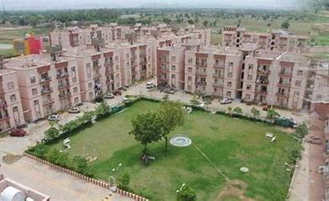

What is Priority?
i. Agriculture
ii. Micro, Small and Medium Enterprises
iii. Export Credit
iv. Education
v. Housing
vi. Social Infrastructure
vii. Renewable Energy
viii. Others

Slide 4
Why priority?
By empowering underserved groups, financial institutions can improve living conditions and increase the accessibility of financial services for those on the margins. It can enhance economic well-being while also fostering social harmony and inclusivity. PSL promotes social justice and togetherness by assisting small companies and helping people rise out of poverty
Serve the unserved

Slide 5
RBI advisory to banks
Special dispensation for timely and adequate credit .
Priority not a CSR, to be funded as normal business operations.
Lend directly to beneficiaries not through intermediaries.
Market players take risks and innovate

Slide 6
PSL Growth (lk Cr)
PSL in last 10 years
MSE Growth
Year | Number of Accounts | Amount Outstanding
 | (Lacs) | (₹ Lk Cr)
2014 | 126 | 8.51
2015 | 138 | 9.66
2022 | 261 | 16.05
FY | PSBs | Others | Total
2014 | 16.2 | 5.6 | 21.7
2015 | 17.5 | (27%)6.3 | 23.8
2022 | 26.5 | 18.9 | 45.4
2023 | 28.6 | (44%)22.0 | 50.6
Now set to double in 5 years

Slide 7
TARGETS
Categories | Domestic commercial banks | Regional Rural Banks
Total Priority Sector | 40% of ANBC or CEOBE wei is higher | 75% of ANBC or CEOBE wei is higher; (Lending to Medium Entp, Social Infra and Renewable Energy limited to 15% of ANBC.
Agriculture | 18% of ANBC or CEOBE, wei is higher; out of which 10% for Small and Marginal Farmers (SMFs)
Micro Entp | 7.5% of ANBC or CEOBE, wei is higher
Advances to Weaker Sections | 12% of ANBC or CEOBE, wei is higher | 15% of ANBC or CEOBE, wei is higher

Slide 8
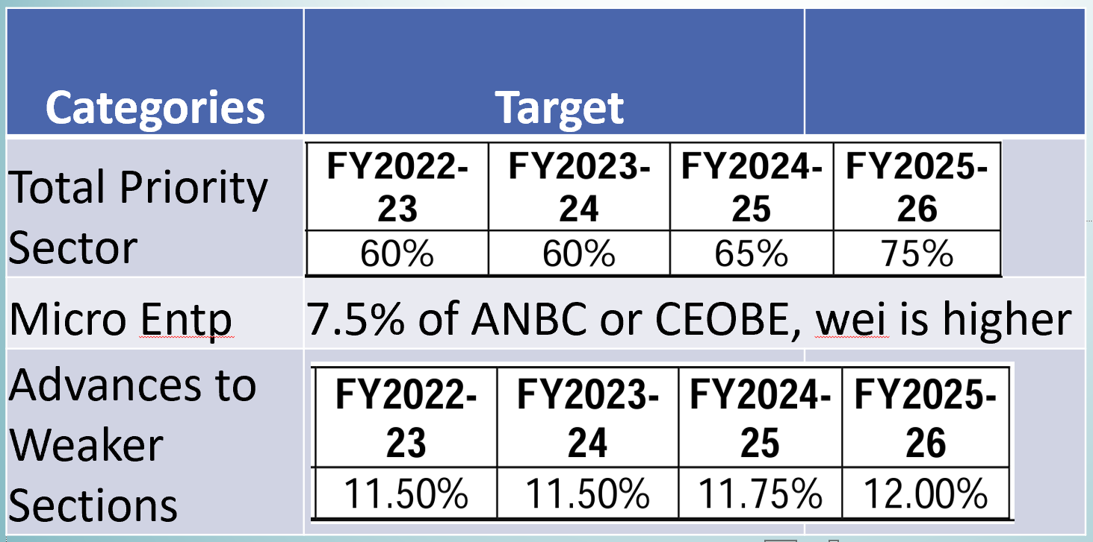
UCB Targets
Adjusted Net Bank Credit (ANBC)
Credit equivalent of Off Balance Exposure (CEOBE)
Contingent liabilities/off-balance sheet items do not form part of priority sector achievement

Slide 9
Target Breach?
Non-achievement of priority sector targets and sub-targets will be taken into account while granting regulatory clearances.
Shortfall to be fulfilled by contribution to the Rural Infrastructure Development Fund - RIDZ
incremental priority sector credit where the credit flow is comparatively lower - RWA certificate
PSL exposure | Limit | Risk weight | Districts
Lower PSL p.c. | Rs. 6000 | 125% | Gadchiroli
Higher PSL p.c. | RS. 25000 | 90% | Aurangabad, Mumbai, Mumbai Suburban, Nagpur, Nasik, Pune
Others | Others | 100% | Others

Slide 10
Before the audit
Ask for Branch profile to know the scope
Check the composition of advances, potion of PSL
Check how PLS accounts are identified, PSL tagging is done
Know the certificates to be signed
Fix the samples from each category of PSL

Slide 11
Agricultural Advance
Overall 18% and
10% to Small and Marginal Farmers (SMFs)

Slide 12
Agriculture
Includes
Farm Credit (Agriculture and Allied Activities)
Lending for Agriculture Infrastructure and Ancillary Activities.
Types
Farm Credit - Individual farmers
Farm Credit - Corporate farmers, FPCs
Agriculture Infrastructure
Ancillary Services
Lending for on-lending

Slide 13
Farm Credit - Individual farmers
Traditional/non-traditional plantations, horti allied activities.
MTL LTL for agri allied activities. (Purchase of agri implements, machinery)
Loans for pre and post-harvest activities viz. spraying, harvesting, grading
Loans to distressed farmers indebted to non-institutional lenders.
Loans under the Kisan Credit Card Scheme. - KCC
Loans to SMFs for purchase of land for agricultural purposes.
Pledge/WRs, 12 mths - ₹75 lakh against NWRs, ₹50 lakh in other cases.
installation of stand-alone Solar Agriculture Pumps
Installation of solar power plants on barren land

Slide 14
Small and Marginal Farmer (10%)
Farmers with landholding of up to 1 hectare (Marginal Farmers).
Farmers with a landholding of more than 1 up to 2 hectares (Small Farmers).
Landless agricultural labourers, tenant farmers, oral lessees and share-croppers whose share of landholding is within the limits prescribed for SMFs.
Loans to SHGs groups of individual SMFs directly engaged in Agriculture and Allied Activities, provided banks maintain disaggregated data of such loans.
Loans up to ₹2 lakh to individuals solely engaged in Allied activities without any accompanying land holding criteria.
Loans to FPOs/FPC of individual farmers and co-operatives of farmers directly engaged in Agriculture and Allied Activities where the land-holding share of SMFs is not less than 75%

Slide 15
Farm Credit - Corporate farmers, FPCs
1. Loans to following activities with aggregate limit of ₹2 cr/borrower
Traditional/non-traditional plantations, horti allied activities.
MTL, LTL for agri allied activities (e.g. purchase of agri implements, machinery)
Loans for pre and post-harvest activities viz. spraying, harvesting, grading, transporting.
2. Pledge/WRs, 12 mths - ₹75 lakh against NWRs, ₹50 lakh in other cases.
3. Loans up to ₹5 cr per borrower to FPOs/FPCs undertaking farming with assured marketing of their produce at a pre-determined price.

Slide 16
Agriculture Infrastructure
Loans for agriculture infrastructure - limit of ₹100 crore per borrower
Loans for construction of storage facilities (warehouse, market yards, godowns and silos) including cold storage units
Soil conservation and watershed development.
Plant tissue culture and agri-biotechnology, seed production, production of bio-pesticides, bio-fertilizer, and vermi composting.
Loans for construction of oil extraction/ processing units for production of bio-fuels, their storage and distribution infrastructure along with loans to entrepreneurs for setting up Compressed Bio Gas (CBG) plants. - Gobardhan

Slide 17
Ancillary Services
Loans up to ₹5 crore to co-operative societies of farmers for purchase of the produce of members
Loans up to ₹50 crore to Start-ups, as per definition of Ministry of Commerce (DPIIT), that are engaged in agriculture and allied services.
Loans for Food and Agro-processing up to an aggregate sanctioned limit of ₹100 crore per borrower from the banking system.
Outstanding deposits under RIDF and other eligible funds with NABARD on account of priority sector shortfall.

Slide 18
Lending by banks to NBFCs and MFIs for on-lending in agriculture
Bank credit extended to registered NBFC-MFIs and other MFIs (Societies, Trusts etc.) which are members of RBI recognised SRO for the sector, for on-lending to individuals and also to members of SHGs / JLGs will be eligible for categorisation as priority sector advance under respective categories of agriculture
Bank credit to registered NBFCs (other than MFIs) towards on-lending for ‘Term lending’ component under agriculture will be allowed up to ₹ 10 lakh per borrower

Slide 19
Kisan Credit Card (KCC) - Interest Subvention Scheme (ISS)
Available to - Short term crop loans and short term loans for Allied Activities (including animal husbandry, dairy, fisheries, bee keeping etc.)
Overall limit of ₹3 lakh
Period: IS will be on loan amount from drawal to actual repayment or up to the due date fixed by banks, wei earlier, subject to a max 1 yr.
Quantum:
Lending rate to farmers - 7%
Rate of Interest Subvention to Lending Institutions - 1.50%
Additional interest subvention of 3% (prompt repayment incentive)-

Slide 20
Additional interest subvention of 3% (prompt repayment incentive-PRI)
An additional interest subvention of 3% per annum
To farmers repaying in time
Period - From the date of disbursement to actual date of repayment or due date wei earlier, subject to a max 1 year.
This implies effective RIO of 4% for those repaying promptly
This benefit would not accrue to those farmers who repay their agri loans after one year of availing such loans.

Slide 21
Total benefit under subvention scheme
Overall limit of ₹3 lakh per annum subject to a maximum sub-limit of ₹2 lakh per farmer involved only in allied activities.
Crop loan component will take priority and the residual amount will be considered towards allied activities – Max 2lks.
Illustration
- Overall KCC limit - ₹3 lakhs
Limit under Crop loan - ₹0.5 lakh & Sub-limit for allied – ₹2.5 lk
Total benefit quantum?
- IS and PRI benefit will be available on overall ₹2.5 lakhs i.e. ₹0.5 lakh - Crop loan + ₹2 lakhs – allied activity.

Slide 22
Warehousing and Natural calamity
To discourage distress sale by farmers ISS under KCC will be available to SMFs for a further period of upto 6 months post the harvest of the crop against negotiable warehouse receipts (NWR)
In natural calamities, ISS for that year will be made available to banks for the first year on the restructured loan amount.
Such restructured loans will attract normal rate of interest from the second year onwards.
In Severe Natural Calamities, ISS + PRI for will be available to banks for first 3 yrs/entire period (max of 5 yrs) on the restructured amount.
For hassle-free benefits, Aadhar linkage, DBT platform mandatory.

Slide 23
Certification
Formats I - Claim for 1.50% Interest Subvention on Short-term Crop Loans/warehouse receipts/ Loans restructured natural/ severe natural calamities (separate claim on each head)
Formats II - One-time claim for 3% Prompt Repayment Incentive (PRI) for timely repayment of Short-term Crop Loans/Loans restructured due to severe natural calamities (separate claim on each head)
Formats III - Claim for 1.50% Interest Subvention on Short-term Loans to farmers for allied activities.
Formats IV - One - time claim for 3% Prompt Repayment Incentive (PRI) for timely repayment of short-term loans to farmers for allied activities.

Slide 24
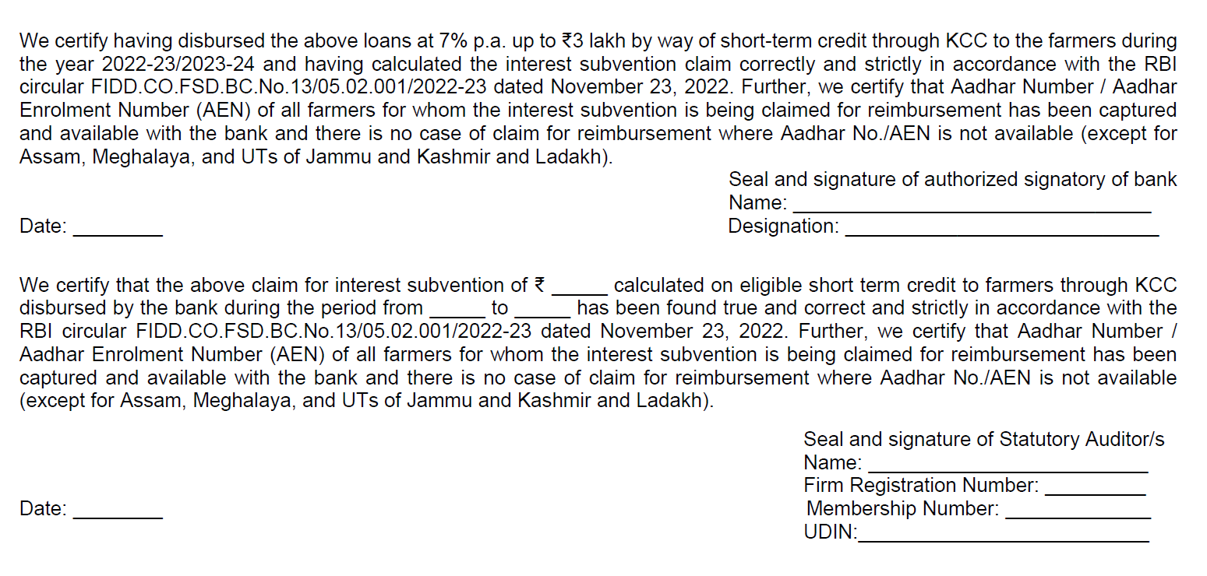
Certificate of IS

Slide 25
Common mistakes in certification
Verification of eligible borrowers list for period of subversion – clerical mistakes, mistakes in Excel formulas etc.
Date of repayment Vs due date Vs year end – wrong date, period

Slide 26
FAQ - Agri
Any limit on loan to SMF
NO (limit is on land holding)
Loan to landless individuals in allied activities eligible as PLS SMF?
YES – Upto 2lks
How to monitor credit cap of ₹100 crore from banking system?
Declaration/Crilc/cibil/BS
Limit is borrowerwise?
NO facilitywise

Slide 27
FAQ….
If more than 100cr, entire exposure out of PSL?
YES
Loans to transporter eligible under Agri?
YES if used exclusively for food/agro or is for Own farm produce
PRI available for NWR or Natural calamity?
NO

Slide 28
Agri: PSL Vs IRAC
Crop season linked asset classification norms – Only farm credit eligible
PSL Para 8.1 and 8.2 VS IRAC Annexure – 2
Interest subvention
Only STL, Crop + Ancillary, Max loan cap

Slide 29
Housing Finance

Slide 30
Housing - Priority
Loans to individuals up to ₹35 lakh in metro (population > 10 lk) [Cost not more than 45 lks]
₹25 lakh in other centres for purchase/construction of a dwelling unit per family [Cost not more than 30 lks]
Housing loans to own employees not priority
Loans up to ₹10 lakh in metro, up to ₹6 lakh in other for repairs
SRA, Affordable – carpet not more than 60 sqmtrs
Loans to HFCs for on-lending, up to ₹20 lakh for individual borrowers
Outstanding deposits with NHB on account of priority sector shortfall.

Slide 31
What qualifies?
Acquisition Of Land - Bank finance can be granted only for purchase of a plot, provided a declaration is obtained from the borrower that he intends to construct a house on the said plot, with the help of bank finance or otherwise, within such period as may be laid down by the banks themselves.
Upfront disbursal/80:20 - Disbursal of housing loans sanctioned to individuals should be closely linked to the stages of construction of the housing project and upfront disbursal should not be made in cases of incomplete/under-construction/green field housing projects

Slide 32
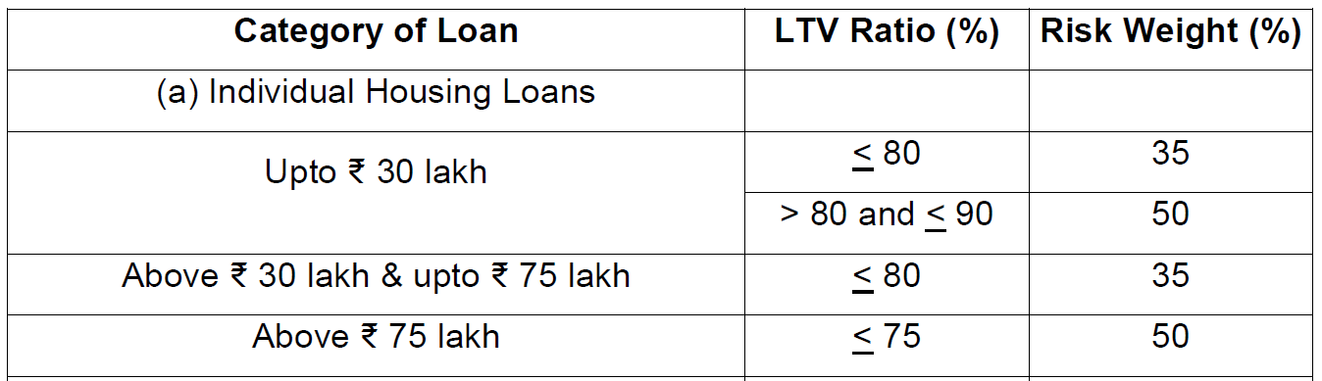
Loan to Value (LTV) and Risk Weights (RWs) prescribed

Slide 33
Export Credit
SCBs - Incremental export credit over corresponding date of the preceding year, up to 2% of ANBC or CEOBE whichever is higher, subject to a sanctioned limit of up to ₹ 40 crore per borrower.
Export credit includes pre-shipment and post-shipment export credit

Slide 34
Interest Equalization Scheme - EXPORTS
Interest Equalization Scheme for Pre and Post Shipment Rupee Export Credit (‘Scheme’)
3% for MSME manufacturer exporters exporting under any HS lines
2% for manufacturer exporters and merchant exporters exporting under 410 HS lines (Edible products of animal origin)
Banks shall reduce the interest rate charged to the eligible exporters upfront
Banks, while issuing approval to the exporter, will furnish
Prevailing interest rate,
Interest subvention being provided,
Net rate being charged to each exporter
Monthly claim by bank duly certified by external auditor.

Slide 35
With effect from FY 2023-24
The banks which have priced the loans covered under this scheme at an average interest rate of greater than Repo Rate + 4% prior to subvention would be subjected to certain restrictions under the scheme.
Non compliance by banks will result in restricting and debarment from the scheme.

Slide 36
Education
Loans to individuals for educational purposes, including vocational courses, not exceeding ₹ 20 lakh will be considered as eligible for priority sector classification.
Loans currently classified as priority sector will continue till maturity.

Slide 37
Social Infrastructure
Bank loans up to a limit of ₹5 crore per borrower for setting up
schools,
drinking water facilities and
sanitation facilities including
construction/ refurbishment of household toilets and water improvements at household level, etc. and
Loans up to a limit of ₹10 crore per borrower for building health care facilities including under ‘Ayushman Bharat’ in Tier II to Tier VI centres

Slide 38
Renewable Energy
Bank loans up to a limit of ₹30 crore to borrowers for purposes like
solar based power generators,
biomass-based power generators,
wind mills,
micro-hydel plants and
for non-conventional energy based public utilities, viz., street lighting systems and remote village electrification etc.,
For individual households, the loan limit will be ₹10 lakh per borrower.

Slide 39
Weaker Sections
Small and Marginal Farmers
Artisans, village and cottage industries - individual limits up to ₹1 lakh
Beneficiaries under Government Sponsored Schemes
Scheduled Castes and Scheduled Tribes
Beneficiaries of Differential Rate of Interest (DRI) scheme
Self Help Groups
Distressed farmers indebted to non-institutional lenders
Distressed persons, upto ₹1 lakh to prepay their debt to non-institutional lenders
Individual women beneficiaries up to ₹1 lakh per borrower
Persons with disabilities
Minority communities as may be notified by Government of India from time to time.

Slide 40
Advances to MSME
(Sublimit of 7.5% to Micro)

Slide 41
Definition
The definition of MSMEs will be as per Government of India (GoI), Gazette Notification S.O. 2119 (E) dated June 26, 2020 – Amendment to MSMED Act.
Further, such MSMEs should be engaged in the manufacture or production of goods, in any manner, pertaining to any industry specified in the First Schedule to the Industries (Development and Regulation) Act, 1951 or engaged in providing or rendering of any service or services.
Trading activity – wef. 2nd JULY 2021

Slide 42
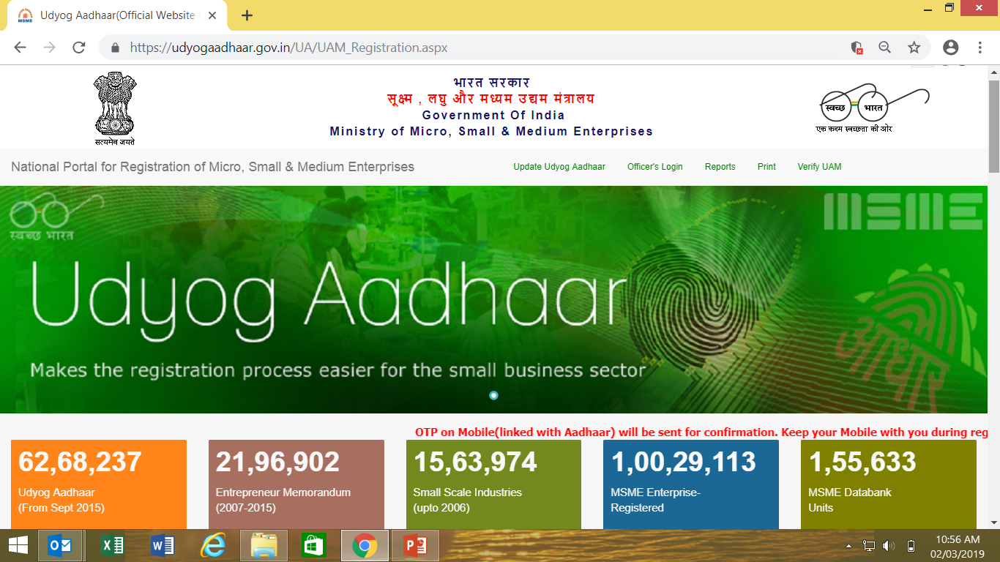
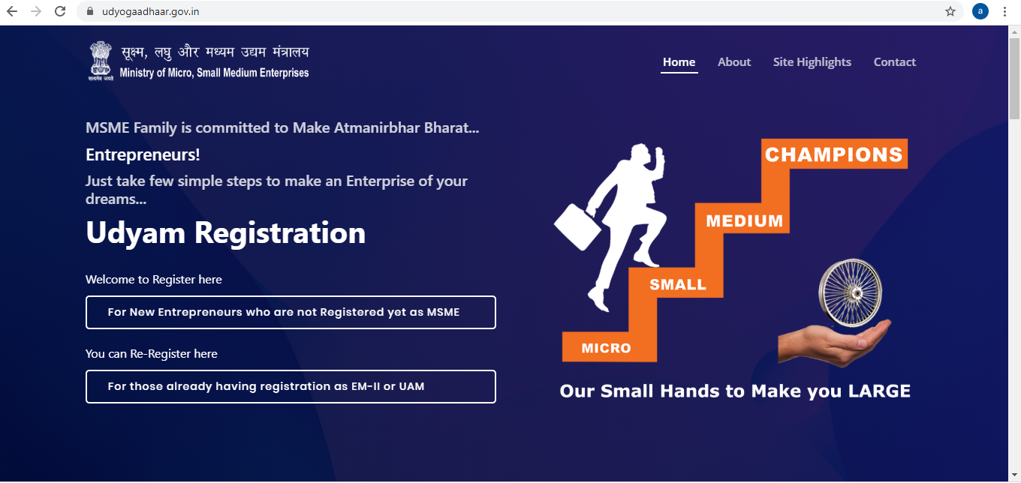
Registration Process
IS NOW
www.udyogaadhaar.gov.in
www.udyamregistration.gov.in
30th June 2022 – last date

Slide 43
Old definition
Type of Unit | Manufacturing | Service
 | P&M | Equipment
Micro | 25 Lk | 10 Lk
Small | 5 Cr | 2 Cr
Medium | 10 Cr | 5 Cr

Slide 44
New Definition of MSME – w.e.f - 1st July, 2020
Manufacturers & service providers | MICRO | SMALL | MEDIUM
Investments in Plant & Machinery or Equipment | Upto Rs. 1 crore | Upto Rs. 10 crores | Upto Rs. 50 crores
Turnover | Upto Rs. 5 crores | Upto Rs. 50 crores | Upto Rs. 250 crores

Slide 45
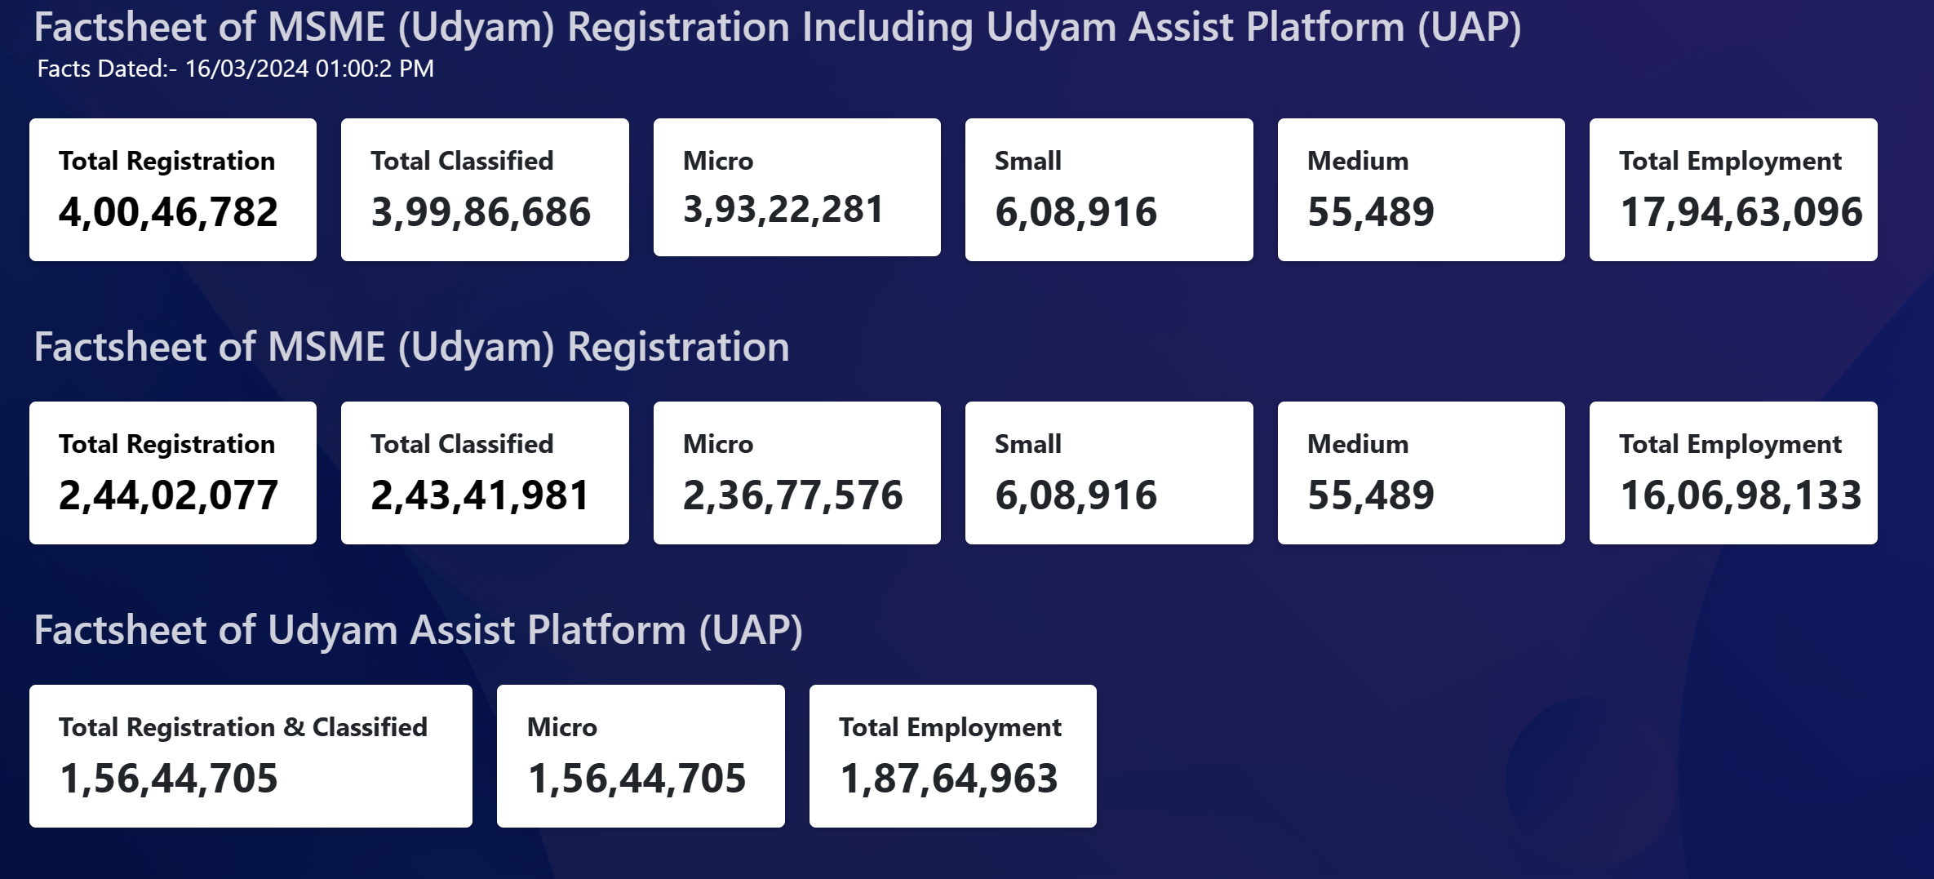
Micro Entp – 7.5%
Udyam Assist Certificate shall be treated as micro enterprises for the purpose of PSL

Slide 46
MSME Products….
Loans up to ₹50 crore to Start-ups,.
Loans to entities involved in supply of inputs and marketing of output of artisans, village and cottage industries. – Vishwakarma
Loans to co-operatives of producers in the decentralized sector viz. artisans, village and cottage industries.
Loans to NBFC-MFIs for on-lending to MSME sector.
Credit outstanding under General Credit Cards (Artisan CC, Laghu Udyami Card, Swarojgar CC, Weaver’s Card etc).
Overdraft to Pradhan Mantri Jan-Dhan Yojana (PMJDY) account holders qualify as lending to Micro Enterprises.
Outstanding deposits with SIDBI and MUDRA Ltd. on account of priority sector shortfall.

Slide 47
MSME Products
All loans to units in the KVI sector will be eligible for classification under sub-target of 7.5% prescribed for Micro Enterprises sector.
‘With Recourse’ Factoring transactions by banks which carry out the business of factoring departmentally wherever the ‘assignor’ is a Micro, Small or Medium Enterprise would be eligible for classification under MSME category on the reporting dates.
Factoring transactions pertaining to MSMEs taking place through the Trade Receivables Discounting System (TReDS) shall also be eligible for classification under priority sector.

Slide 48
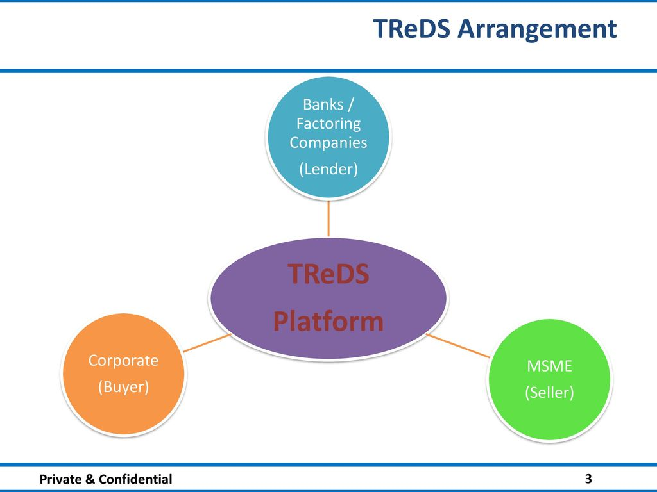
TReDS
TReDS is an electronic platform facilitating the financing of trade receivables of MSMEs through multiple FIs. These receivables can be due from corporates and other Buyers, including Govt. Depts & PSUs.

Slide 49
FAQ
? Whether the MSME liable to pay to the financier in case the buyer defaults in repayment?
Ans: No. The transactions processed under TReDS are “without recourse” to the MSMEs.
? Are there charges for registration?
Ans: No, all three platforms have free registration facility.
? Is this compulsory for all buyers
Ans: Its compulsory for all PSU and corporates with turnover > 500 Crores

Slide 50
TReDS platforms business
FY – 2020 - 11.17k cr
FY – 2021 - 17.08k cr
FY – 2022 - 40.3k cr
FY – 2023 - 150k cr+
RXIL INVOICE MART M1XCHANGE

Slide 51
Compliance under MSMED Act
At Bank Branch
Or as a CSA

Slide 52
Udyog Vs Udyam
Definition (Limits) changed after 14 long years. .
Increased limit of Invt in Plant & Machinery (4 Times for Mnf to 10 times for Services)
Added criteria linked to Turnover
No distinction between Manufacturer & Service Provider.
Gross Block Vs WDV
One PAN one URN
Investment definition – Exclusive Vs. Inclusive
Udyam assist is Micro Entp

Slide 53
Disclosure requirements
Sec 22: Any buyer required to get his accounts audited under any law for the time being in force, such buyer shall furnish the 5 point info in his annual statement of accounts,
SN | PARTICULATS | Principle Amt. RS. | Interest Amt. Rs.
1 | Interest & Principle paid beyond due date (During the year) | 800000 | 100000
2 | Interest & Principle o/s (Year end) | 1600000 | 150000
3 | Interest due for principle paid beyond due date (Out of 2 above, but relating to 1 above) | - | 80000
4 | Balance Interest accrued for principle unpaid (2-3) | - | 70000
5 | Status of Interest up to reporting date (As on date of signing of balance sheet) | - | 40000

Slide 54
Income Tax Act
Clause 22 of 3CD - Amount of interest inadmissible under section 23 of MSMED Act 2006
Identify the MSE suppliers
Verify if credit period is < 45 days
If there is delay whether entity has provided interest
If Yes – Report the same
If not – Reporting? Mention NIL

Slide 55
Section 43B
(h) any sum payable by the assessee to a micro or small enterprise beyond the time limit specified in section 15 of the Micro, Small and Medium Enterprises Development Act, 2006,”; -shall be allowed (irrespective of the previous year in which the liability to pay such sum was incurred by the assessee according to the method of accounting regularly employed by him) only in computing the income referred to in section 28 of that previous year in which such sum is actually paid by him.
Provided that nothing contained in this section shall apply in relation to any sum which is actually paid by the assessee on or before the due date of ITR except clause (h)

Slide 56
Audit Procedure
Documentation of verification process adopted “to verify how auditee has identified its MSE suppliers”.
Correspondence with suppliers, replies received?
If a supplier has printed his udyam on invoice - straight way classify.
Any claim is received through SAMADHAAN?
Audit conclusion on findings & Reporting of non compliance
No identification procedure done – Qualify.
Procedure done MSEs identified but no interest provided - Qualify
MSEs identified and Interest provided – Compliance done.
MRL - NIL MSEs identified, Total delay in payment, Interest provision and calculation thereof.

Slide 57
Classification of MSMEs - Min of MSME Vs RBI
Min of MSME – Oct 2022
In case of an upward change in terms of investment and consequent re-classification, an enterprise shall continue to avail of all non tax benefits of the category it was in before the re-classification, for a period of three years from the date of such upward change.
RBI – Dec 2023
All enterprises are required to register online on the Udyam Registration portal and obtain ‘Udyam Registration Certificate’. For PSL purposes banks shall be guided by the classification recorded in the Udyam Registration Certificate (URC)

Slide 58
MSME - FAQ
Whether the continuity of the PSL status for 3 years is still applicable to MSMEs?
NO
New funding to Udyog Adhaar holder possible?
NO, it has expired
Trading activity any limit on funding to be PSL?
NO
Funding to School more than 5 cr, is it social infra or MSME?
MSME
Can the account be reconned in both Social + MSME?
NO

Slide 59
अमृत काल के दायित्व निर्वहन के लीये शुभकामना Thank you camarathe@cmrs.in 8055566683
2024 - 4.0
2030 - 7.0
2035 - 10.0
2047 - 35.0

