Slide 1
Implications of Sec 43B(h) of Income Tax Act,1961

Slide 2
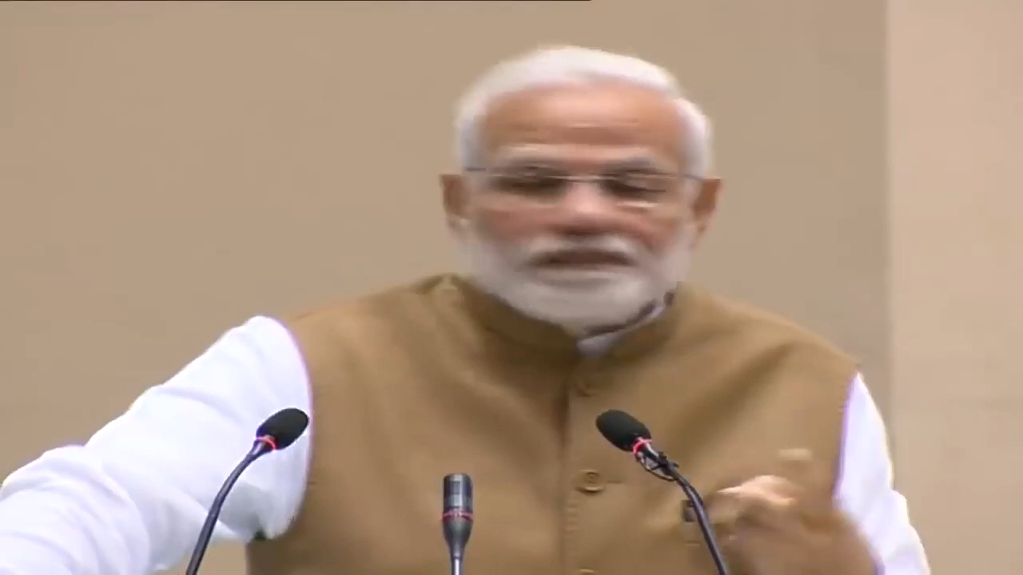
PM Narendra Modi’s speech on MSMEs

Slide 3

Moreover, to support MSMEs in timely receipt of payments, I propose to allow deduction for expenditure incurred on payments made to them only when payment is actually made. -FM’s Budget Speech

Slide 4
Sec 43B –”Certain deductions to be only on actual payment”
(h)any sum payable by the assessee to a micro or small enterprise beyond the time limit specified in section 15 of the Micro, Small and Medium Enterprises Development Act, 2006 (27 of 2006) will be disallowed.

Slide 5
Explanation 4 to Section 43B states-
(e) "micro enterprise" shall have the meaning assigned to it in clause (h) of section 2 of the Micro, Small and Medium Enterprises Act, 2006 (27 of 2006);
(g) "small enterprise" shall have the meaning assigned to it in clause (m) of section 2 of the Micro, Small and Medium Enterprises Development Act, 2006 (27 of 2006).

Slide 6
Clause (h) and (m) of Section 2 of Micro, Small and Medium Enterprises Development Act, 2006 (27 of 2006) (MSMED Act) state as under;
(h) "micro enterprise" means an enterprise classified as such under sub-clause(i) of clause (a) or sub-clause (I) of clause (b) of sub- section (1) of section 7
(m) "small enterprise" means an enterprise classified as such under sub-clause(ii) of clause a) or sub-clause (ii) of clause (b) of sub- section (1) of section 7

Slide 7
Both the sections refer to enterprise which is defined in section 2(e) as under:
(e) "enterprise" means an industrial undertaking or a business concern or any other establishment, by whatever name called, engaged in the manufacture or production of goods, in any manner, pertaining to any industry specified in the First Schedule to the Industries (Development and Regulation) Act, 1951 or engaged in providing or rendering of any service or services;
National Projects Construction Corpn. Ltd. v. CWT
[1969] 74 ITR 465 (Delhi)

Slide 8
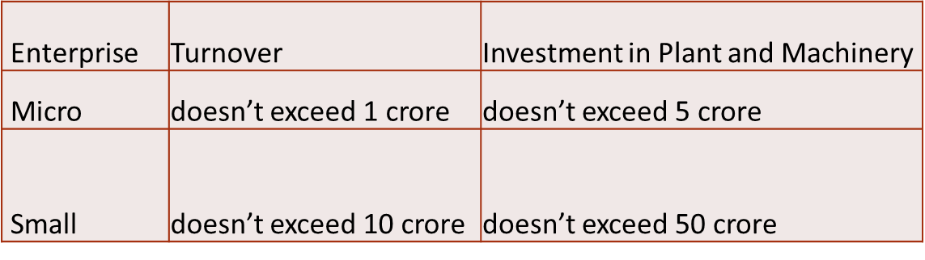
Classification of enterprise will be made on the basis of Turnover and Investment in Plant & Machinery
Section 7(1) amended by Notification No.F. No. 21(5)/2019-P&G/Policy (Pt-IV)] dated 26.06.2020
(Notification No. 5/2(2)/2021-E/P & G/Policy (E – 19025) dated 02.07.2021
For Regn in FY 2023 – 24 data of FY 2021 – 22)

Slide 9
Will traders be covered?...............NO
As per the Office Memorandum No 5/2(2)/2021-E/P & G/Policy (E-19025) dated 02.07.2021 issued by The Ministry of Micro, Small and Medium Enterprises, Retail trades are included in the definition of MSMEs and they are allowed to be registered on Udyam Registration Portal.
However, benefits to Retail and Wholesale trade MSMEs are to be restricted to Priority Sector Lending only(clarified by OM No 1/4 (1)/2021-P & G/Policy)dated 01.09.2021

Slide 10
CHAPTER V
Delayed Payment to Micro and Small Enterprises
Section 15 of MSMED Act,2006
Where any supplier, supplies any goods or renders any services to any buyer, the buyer shall make payment therefor on or before the date agreed upon between him and the supplier in writing or, where there is no agreement in this behalf, before the appointed day: Provided that in no case the period agreed upon between the supplier and the buyer in writing shall exceed forty-five days from the day of acceptance or the day of deemed acceptance.

Slide 11
As per Section 2(n): "supplier" means a micro or small enterprise, which has filed a memorandum with the authority referred to in sub-section (1) of section 8, and includes,—
(i)the National Small Industries Corporation, being a company, registered under the Companies Act, 1956;
(ii)the Small Industries Development Corporation of a State or a Union territory, by whatever name called, being a company registered under the Companies Act, 1956;
(iii)any company, co-operative society, trust or a body, by whatever name called, registered or constituted under any law for the time being in force and engaged in selling goods produced by micro or small enterprises and rendering services which are provided by such enterprises;

Slide 12
Section 2(d) defines buyer as under:
"buyer" means whosoever buys any goods or receives any services from a supplier for consideration.
Section 16 of MSMED Act-Rate at which interest is payable
Where any buyer fails to make payment of the amount to the supplier, as required under section 15, the buyer shall, notwithstanding anything contained in any agreement between the buyer and the supplier or in any law for the time being in force, be liable to pay compound interest with monthly rests to the supplier on that amount from the appointed day or, as the case may be, from the date immediately following the date agreed upon, at three times of the bank rate notified by the Reserve Bank.

Slide 13
Section 17 of MSMED Act-Recovery of amount due
For any goods supplied or services rendered by the supplier, the buyer shall be liable to pay the amount with interest thereon as provided under section 16.

Slide 14
Section 22 of MSMED Act,2006
Where any buyer is required to get his annual accounts audited under any law for the time being in force, such buyer shall furnish the following additional information in his annual statement of accounts, namely:
(i)the principal amount and the interest due thereon (to be shown separately) remaining unpaid to any supplier as at the end of each accounting year;
(ii)the amount of interest paid by the buyer in terms of section 16, along with the amounts of the payment made to the supplier beyond the appointed day during each accounting year;

Slide 15
iii)the amount of interest due and payable for the period of delay in making payment (which have been paid but beyond the appointed day during the year) but without adding the interest specified under this Act;
(iv)the amount of interest accrued and remaining unpaid at the end of each accounting year; and
(v)the amount of further interest remaining due and payable even in the succeeding years, until such date when the interest dues as above are actually paid to the small enterprise,
for the purpose of disallowance as a deductible expenditure
under section 23.

Slide 16
Section 23 of MSMED Act-Interest not to be allowed as deduction from income
Notwithstanding anything contained in the Income-tax Act, 1961 (43 of 1961), the amount of interest payable or paid by any buyer, under or in accordance with the provisions of this Act, shall not, for the purposes of computation of income under the Income-tax Act, 1961, be allowed as deduction.

Slide 17
Section 27 of MSMED Act- Penalty for Contravention
Sub clause 2 of Section 27 states –
Where a buyer contravenes the provisions of section 22, he shall be punishable with a fine which shall not be less than rupees ten thousand.

Slide 18
Particulars | 44AD | 44ADA | 44AE
Eligible assessee | Assessee engaged in Business | Assessee engaged in Profession | Assessee engaged in the business of plying, hiring or leasing goods carriages
Turnover/Condition | turnover or gross receipts does not exceed 2/3 crore rupees | gross receipts do not exceed 50/75 lakh rupees | Assessee who owns not more than 10 goods carriages at any time during the previous year
Deemed Profit | 8/6 % of turnover/gross receipts | 50 % of gross receipts | a)heavy goods vehicle- Rs.1000 per ton or amount actually earned from such vehicle , whichever is higher. b)other than heavy goods vehicle-Rs.7,500 for every month/part of the month or amount actually earned, whichever is higher

Slide 19
Will Section 43B(h) be applicable to buyer who opts for Presumptive Taxation?
Sub-clause (1) of Section 44AD,44ADA and 44AE state as under:
‘Notwithstanding anything to the contrary contained in sections 28 to 43C’ of the Act…
Hence, this section will not be applicable to buyers who opt for presumptive taxation.

Slide 20
Practical issues
Who’s responsibility is it to communicate, whether Supplier is Udyam registered or not?
What if payments are not done bill-wise by the buyer i.e. consolidated payments are done?
Does disallowance attract if provisions are made instead of crediting individual accounts of the trade creditors/suppliers?
What will be the date of actual payment if payments are settled via cheque by the buyer i.e. date of handing over of cheque or date of realization of cheque?

Slide 21
What if Supplier is registered under Udyam but fails to inform it to the buyer?
OM No.2(28)/2007-MSME(Pol), dated 26-08-2008, which clarifies that- it is advisable that the Micro or Small Enterprises should mention/get printed……
Interplay of sec 2(n)(iii){supplier} and Chapter V heading
Traders will not get covered by clause h of 43B, which is clarified by the Office Memorandum 5/2(2)/2021. Although there does not appear to be any legal basis in MSMED Act for the Office Memorandum and Wholesale & Retail Trade are treated as distribution services under GATT/WTO, the above position will prevail till any Trader/Traders body challenges the OM in Court and gets it quashed

Slide 22
Will setting off of dues against receivable/payable from the same party be counted as actual payment?
What if Trader gets converted to manufacturer/service provider or vice versa during the financial year?
What is written agreement for ascertaining due date of payment?
What if the agreed credit period between buyer and supplier is for more than 45 days?

Slide 23
What if Udyam registration is obtained during the financial year, say 30th Sept, will clause (h) apply to all the transactions in the said financial year or only transactions after 30th Sept?
What if Udyam registration is given up during the financial year, say 30th Sept, will clause (h) apply to all the transactions in the said financial year or only transactions after 30th Sept?

Slide 24
Supreme Court Judgement in Silpi Industries v Kerela State Road Transport Corporation – dated 29.06.2021.
  Silpi Industries was denied any relief for the reason that it was not registered by submitting the memorandum under section 8 of the MSMED Act on the date of supply of goods and services.
  bills , only after registration shall be covered.
  any registration obtained under the MSMED Act is prospective in nature
Delhi High Court in Ramky Infrastructure Private Limited v Micro and Small Enterprises Facilitation Council
  Registration not compulsory – Section 8 says ‘ may’

Slide 25
Will the GST component be disallowed if the sum payable to MSE attracts Section 43B(h) disallowance?
Can disallowance be attracted under section 43B(h) for dues outstanding in relation to capital expenditure?
  100% of capital expenditure under Section 35AD
  100% of capital expenditure on scientific research
  Lemnisk (P.) Ltd. v. Dy. CIT 141-95 (Bang-Trib)…depreciation
Cheques issued within 45 days but there is no bank balance and cleared within 90 days, whether the disallowance will be attracted?

Slide 26
Should an outstanding as on 31.03.24 which is due post 31.03.24 be subjected to disallowance if not paid in time in subsequent year?
Advance Paid ……?
Is the delayed payment interest a cost of purchase(as in GST)?
Should the interest on delayed payment be subjected to TDS u/s 194A?

Slide 27
Meaning of “actual payment” for Section 43B(h)
Will Section 43B(h) apply if any charitable trust is making payment to an MSME?
Will Section 43B(h) apply to an assessee who is also a Udyam Registered Micro or Small Enterprise?
Can disallowance under Section 43B(h) be made while computing book profit for MAT purposes?

Slide 28
How to verify if the Udyam Number furnished by the supplier by printing on the invoice or otherwise is genuine?
Can it be inferred from the Udyam Number printed on the supplier's invoice that he is a micro or small enterprise?
Should terms mentioned on the invoice or purchase order be treated as an agreement?
Is it mandatory for the supplier to update the details of turnover and investment on the Udyam Registration Portal?
As per Para 8 of Notification no 2119(E),failure to update the relevant information will render the enterprise liable for suspension of its status.

Slide 29
Liable to pay v accrual
Buyer vis-à-vis supplier

Slide 30

THANK YOU

