Slide 1
Topic – “HOW TO HANDLE Search AND INVESTIGATION IN GST” BY PUNE branch of Wirc of icai Saturday day,13th April 2024 – 03:00 PM – 05:00 PM
Presented By
J.K. MITTAL (Advocate)
Co-Chairman, National Council (Indirect Taxes), ASSOCHAM
LL.B.,F.C.A., F.C.S.
NEW DELHI
Ph: 011- 22447420, 011-22461071,72,76
Email: jkmittalservicetax@gmail.com
jkmittalgst@gmail.com

Slide 2
Presented By
J.K. MITTAL (Advocate)
Co-Chairman, National Council (Indirect Taxes), ASSOCHAM
LL.B.,F.C.A., F.C.S.
NEW DELHI
Ph: 011- 22447420, 011-22461071,72,76
Email: jkmittalservicetax@gmail.com
jkmittalgst@gmail.com
Twitter @mittaldelhi
LinkedIn JK Mittal
Facebook Jai Mittal

Slide 3
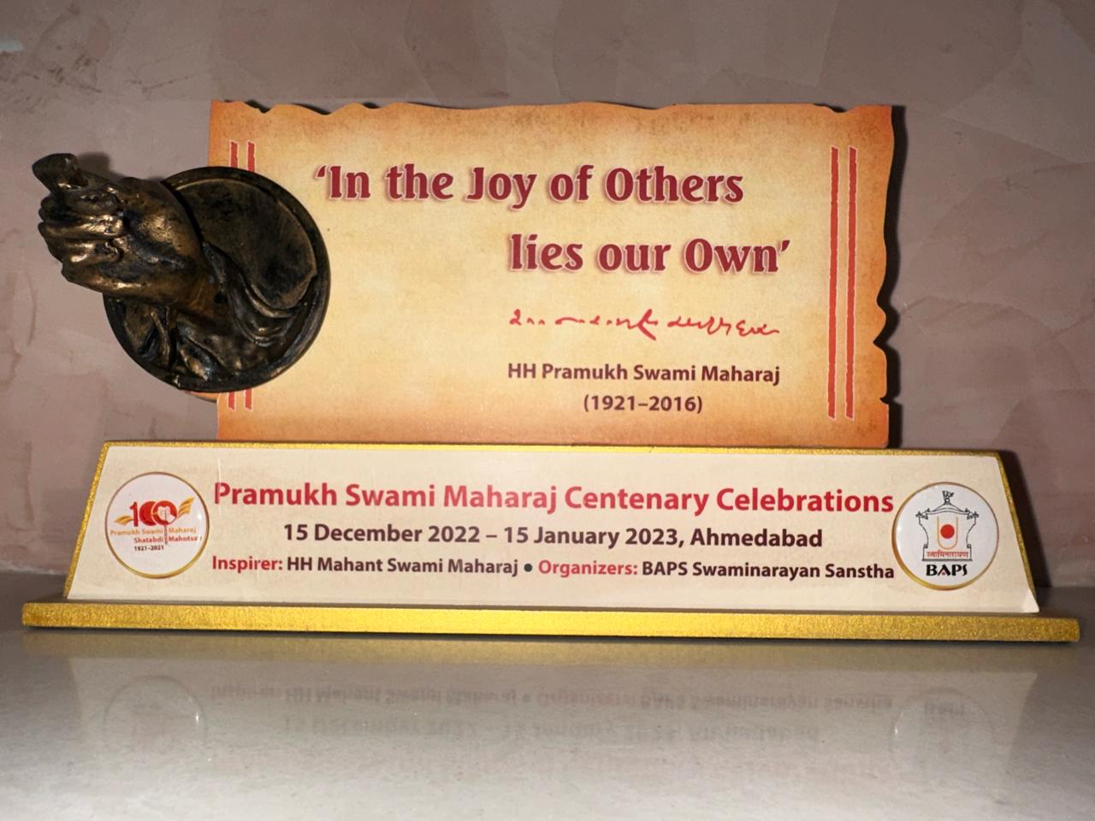
Presented By
J.K. MITTAL (Advocate)
Co-Chairman, National Council (Indirect Taxes), ASSOCHAM
LL.B.,F.C.A., F.C.S.
NEW DELHI
Ph: 011- 22447420, 011-22461071,72,76
Email: jkmittalservicetax@gmail.com
jkmittalgst@gmail.com
Twitter @mittaldelhi
LinkedIn JK Mittal
Facebook Jai Mittal

Slide 4
Section 67. Power of search and seizure
Section 67. Power of inspection, search and seizure.—
(1) Where the proper officer, not below the rank of Joint Commissioner, has reasons to believe that—
(a) a taxable person has suppressed any transaction relating to supply of goods or services or both or the stock of goods in hand, or has claimed input tax credit in excess of his entitlement under this Act or has indulged in contravention of any of the provisions of this Act or the rules made thereunder to evade tax under this Act; or
(b) any person engaged in the business of transporting goods or an owner or operator of a warehouse or a godown or any other place is keeping goods which have escaped payment of tax or has kept his accounts or goods in such a manner as is likely to cause evasion of tax payable under this Act,
he may authorise in writing any other officer of central tax to inspect any places of business of the taxable person or the persons engaged in the business of transporting goods or the owner or the operator of warehouse or godown or any other place.

Slide 5
Section 67. Power of search and seizure
Section 67
****
(2) Where the proper officer, not below the rank of Joint Commissioner, either pursuant to an inspection carried out under sub-section (1) or otherwise, has reasons to believe that any goods liable to confiscation or any documents or books or things, which in his opinion shall be useful for or relevant to any proceedings under this Act, are secreted in any place, he may authorise in writing any other officer of central tax to search and seize or may himself search and seize such goods, documents or books or things:
Provided that where it is not practicable to seize any such goods, the proper officer, or any officer authorised by him, may serve on the owner or the custodian of the goods an order that he shall not remove, part with, or otherwise deal with the goods except with the previous permission of such officer:
Provided further that the documents or books or things so seized shall be retained by such officer only for so long as may be necessary for their examination and for any inquiry or proceedings under this Act.
xxxx
(10) The provisions of the Code of Criminal Procedure, 1973 (2 of 1974), relating to search and seizure, shall, so far as may be, apply to search and seizure under this section subject to the modification that sub-section (5) of section 165 of the said Code shall have effect as if for the word “Magistrate”, wherever it occurs, the word “Commissioner” were substituted.

Slide 6
Section 67. Power of search and seizure
QUESTIONS need to be discussed/ raised?
Difference between inspection u/s 67(1) and search u/s 67(2)
Can a search be carried out for alleged evasion of GST?
Can during search cash can be seized or taken away by GST officers?
Can GST officer insist for on the spot payments of GST/ reversal in ITC?
Can GST officer issue on the spot summons to the taxpayers?
Can GST officer during search record a statement?
Can GST officer rank of Dy. Commissioner or Superintendent or Intelligence Officer has the power to make form opinion - reason to believe for seizure of goods, documents etc.?
Can copy of reasons to believe recorded to carry out search and seizure be obtained?

Slide 7
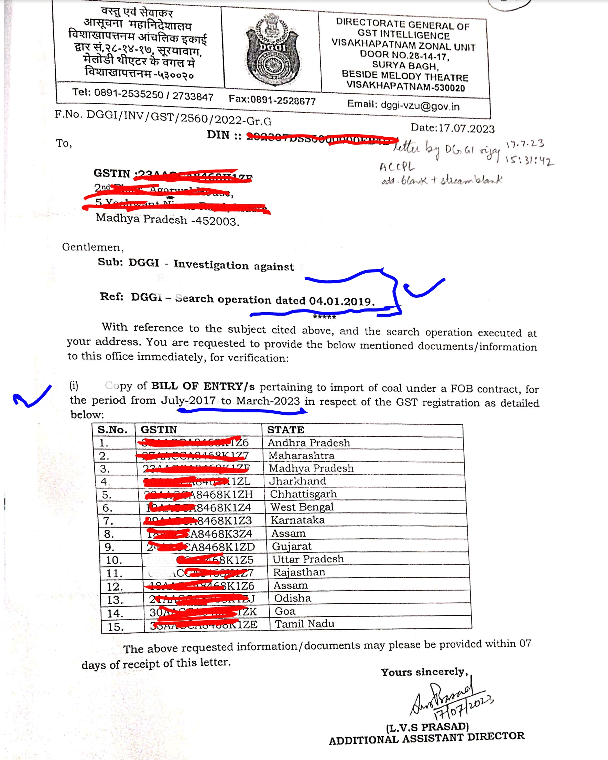

Slide 8
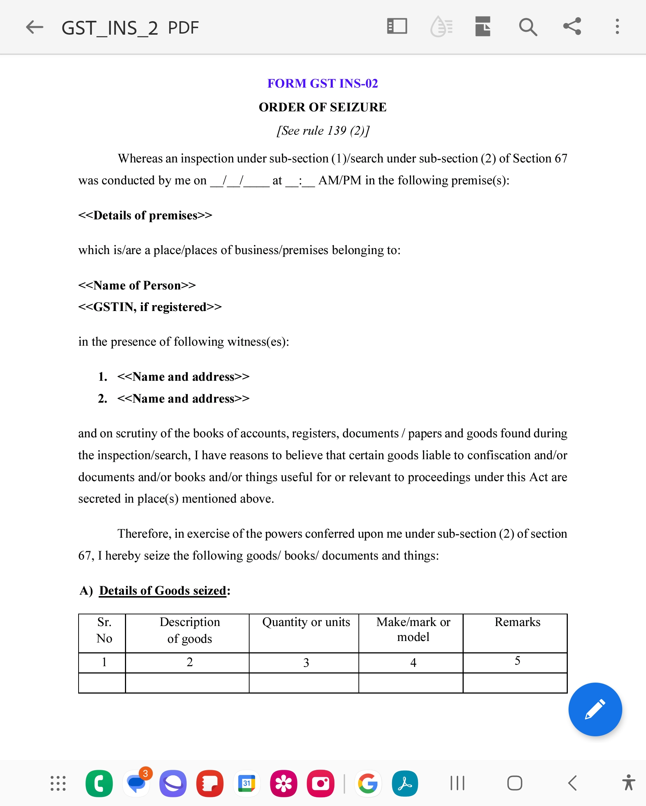

Slide 9
Section 100 in The Code Of Criminal Procedure, 1973
(4) Before making a search under this Chapter, the officer or other person about to make it shall call upon two or more independent and respectable inhabitants of the locality in which the place to be searched is situate or of any other locality if no such inhabitant of the said locality is available or is willing to be a witness to the search, to attend and witness the search and may issue an order in writing to them or any of them so to do.
(5) The search shall be made in their presence, and a list of all things seized in the course of such search and of the places in which they are respectively found shall be prepared by such officer or other person and signed by such witnesses; but no person witnessing a search under this section shall be required to attend the Court as a witness of the search unless specially summoned by it.
(6) The occupant of the place searched, or some person in his behalf, shall, in every instance, be permitted to attend during the search. and a copy of the list prepared under this section, signed by the said witnesses, shall be delivered to such occupant or person.
(7) When any person is searched under sub- section (3), a list of all things taken possession of shall be prepared, and a copy thereof shall be delivered to such person.

Slide 10
Search – Section 165 Cr.p.c. SHALL APPLY
State of U.P. v Lavkush Kumar and Others 1986 (26) E.L.T. 922 (All.), [para 16] Section 165 Cr.P.C. are mandatory to be followed for search, non-compliance renders his action of carrying out search illegal
165. Search by police officer.—(1) Whenever an officer in charge of a police station or a police officer making an investigation has reasonable grounds for believing that anything necessary for the purposes of an investigation into any offence which he is authorised to investigate may be found in any place within the limits of the police station of which he is in charge, or to which he is attached, and that such thing cannot in his opinion be otherwise obtained without undue delay, such officer may, after recording in writing the grounds of his belief and specifying in such writing, so far as possible, the thing for which search is to be made, search, or cause search to be made, for such thing in any place within the limits of such station.
(5) Copies of any record made under sub-section (1) or sub-section (3) shall forthwith be sent to the nearest Magistrate empowered to take cognizance of the offence, and the owner or occupier of the place searched shall, on application, be furnished, free of cost, with a copy of the same by the Magistrate. [As per section 67(10) CGST Act, 2017, in section 165(5), the word “Magistrate” shall be substituted with the word “commissioner”].

Slide 11
Release of documents seized- can taxpayers approached to court? Yes.
In ITO v. Seth Bros., (1969) 2 SCC 324 (para 10), the Supreme Court has observed that
“10…..The aggrieved party may undoubtedly move a competent Court for an order releasing the documents seized. In such a proceeding the Officer who has made the search will be called upon to prove how the documents seized are likely to be useful for or relevant to a proceeding under the Act. If he is unable to do so, the Court may order that those documents be released.”

Slide 12
Search is invasion of privacy
In the case Mapsa Tapes Pvt. Ltd. v Union of India 2006 (201) E.L.T. 7 (P&H.) it was observed that the power of search and seizure affects not only the right of possession and enjoyment of property but also the privacy of a citizen. The said decision of the High Court is affirmed by the Supreme Court by Order dated 15.02.2008 – Union of India v Mapsa Tapes Pvt. Ltd. – 2008 (225) ELT (SC). In Deepak Khandelwal v Commissioner of CGST (East) (2023) 9 Centax 244 (Del.), it is held that “47…..It is necessary to bear in mind that power of search and seizure is a drastic power; it is invasive of the rights of a taxpayer and his private space. Conferring of unguided or unbridled power of this nature would fall foul of the constitutional guarantees. It necessarily follows that such power must be read as circumscribed by the guidelines that qualify the exercise of such power, and the intended purpose for which it has been granted….”

Slide 13
DGCEI Manual-2004 applies to search under GST:
The Ministry of Finance in the aforesaid Instructions No. 01/2020-21. [GST-investigation], dated 02.02.2021 has also stated that “the instructions contained in the Central Excise Intelligence and Investigation Manual (2004), which hold good even in GST regime, are hereby, re-iterated for compliance by DGGI/ file formations.”

Slide 14
Search under GST only can be authorised for limited purposes:
For alleged tax evasion – power is of inspection and not of search
In Deepak Khandelwal v Commissioner of CGST (East) (2023) 9 Centax 244 (Del.), it is held that 16. It is apparent from the above, the power of inspection under Sub-section (1) of Section 67 of the Act is conferred to unearth any evasion of tax or any attempt to evade tax. Sub-section (1) of Section 67 of the Act is not a provision for recovery of tax or for securing the same.” Thus, to find out evasion, power is given under section 67(1), which only limited to inspection and not to search and seizure.

Slide 15
Can officer carry our search merely on the communication received from other officer, without his own independent opinion -no.
In the matter of R.J. Trading Co. V Commissioner of CGST, Delhi North reported in 2021 (55) G.S.T.L. 277 (Del.),
the search and seizure conducted by CGST Delhi North Commissionerate was declared unlawful by observing that “12….The request of Joint Commissioner (AE), Gautam Budh Nagar conveyed through the communication dated 5-3-2021, was only to ascertain as to whether RJT, which was the L2 supplier of M/s. Mridul Tobie Inc., was in existence. There was no independent application of mind by the Additional Commissioner, CGST Delhi North Commissionerate” to carry out search and seizure.

Slide 16
Whether CASH CAN BE SEIZUED DURING SEARCH? No.
Section 67(2) Where the proper officer, not below the rank of Joint Commissioner, either pursuant to an inspection carried out under sub-section (1) or otherwise, has reasons to believe that any goods liable to confiscation or any documents or books or things, which in his opinion shall be useful for or relevant to any proceedings under this Act, are secreted in any place, he may authorise in writing any other officer of central tax to search and seize or may himself search and seize such goods, documents or books or things;
Second proviso to section 67(2): “Provided further that the documents or books or things so seized shall be retained by such officer only for so long as may be necessary for their examination and for any inquiry or proceedings under this Act.”
Section 2(52) “goods” means every kind of movable property other than money and securities but includes actionable claim, growing crops, grass and things attached to or forming part of the land which are agreed to be severed before supply or under a contract of supply;

Slide 17
Whether CASH CAN BE SEIZUED DURING SEARCH? No.
M/S Vijay Steelcon Private Limited v Pr. Comm. CGST East in W.P.(C) 13034/2021 Order dated 18.11.2021
“16….As far as the power to seize cash is concerned, the same need not be adjudicated by us in the present petition for the reason that it is an admitted fact that on the basis of the representation/letter dated 24.03.2021 referred hereinabove, the cash amount so seized was released in favour of the petitioner. The said question, therefore, in the present petition is merely of an academic importance and is, therefore, left open to be adjudicated in an appropriate case.”
Arvind Goyal CA v. Union of India, 2023 SCC OnLine Del 765 -seeking refund along with interest on Rs. 1,22,87,000/- taken away illegally by the Respondents on 04.12.2020 during search at the Petitioner’s premises as well as seeking compensation for deprivation the Petitioner and his family members from his property (taking away Cash of Rs. 1,22,87,000/- as well as mobile phone and laptop) without authority of law in violation of Article 300A to the Constitution of India.
Final order dated 19.01.2023- Hon’ble Court directing refund of cash with accrued interest by holding that cash taken illegal and without authority of law. The High Court intend to take further action, directed to the concerned officers be present in the Courts.

Slide 18
Whether CASH CAN BE SEIZUED DURING SEARCH? No.
In Writ Petition No.8204/2020 (Smt. Kanishka Matta Vs. Union of India and Others) - 1 -
Indore, dated 26/08/2020 2020 (42) G.S.T.L. 52 (M.P.), the prayer is made to release the cash amounting to Rs.66,43,130/- seized from the petitioner vide Panchnama dated 30/05/2020 from the residential premises of the petitioner and her husband. The High Court in para 25 held that “the material available in the case diary and also keeping in view Section 67(2) of the CGST Act, 2017, this Court is of the opinion that the authorities have rightly seized the amount from the husband of the petitioner and unless and until the investigation is carried out and the matter is finally adjudicated, the question of releasing the amount does not arise.”
The High Court in para 19 observed that
“19-The word “things” appears in Section 67(2) of the CGST Act, 2017 is to be given wide meaning
the High Court in the aforesaid case has not considered the definition of “goods” under GST. As per section 2(52) of the said Act wherein the term “goods” has been defined as specifically excludes the money from the definition of goods. Therefore, as per section 67(2), officer can seize ‘goods, documents or books or things’, hence once money is excluded from the ‘goods’, it would not be appropriate to ‘assume’ that ‘things’ will includes the cash...”

Slide 19
Cash cannot be seized
In Deepak Khandelwal v Commissioner of CGST (East) (2023) 9 Centax 244 (Del.) it is held that “56…Cash or other assets, which are not required in species in aid of any proceedings, but represent unaccounted wealth, cannot be seized under Section 67 of the Act.”
In this decision, the Delhi High Court disagee with the decision of Madhya Pradesh High Court in Kanishka Matta Vs. Union of India and Others 2020 (42) G.S.T.L. 52 (M.P.), in which it was held that cash can be seized by treating the same falls within the meaning of “things”.

Slide 20
Sanwaria Sweets Pvt. Ltd. v UOI 2019 (24) G.S.T.L. 193 (Raj.) ORDERED FOR RETURN OF ORIGINAL SALE DEED
The Hon’ble Rajasthan High Court by judgment dated 17.12.2019 in Sanwaria Sweets Pvt. Ltd. v UOI 2019 (24) G.S.T.L. 193 (Raj.) Considering the submissions that after repeal of Central Excise Act with introduction of GST, there is no power to initiate fresh proceedings, it was held that considering that proceeding is in continuation of the proceedings initiated prior to GST Law, it was held to be valid, as Subsequent search was not fresh proceedings and it was saved under Section 174 of Central Goods and Services Tax Act, 2017. [para 21]
“21……So far as the question of relevance of the documents seized by the respondents, most of which were original title deeds/sale deeds of the immovable properties, is concerned, we find that certain incriminating material was found from drawer of the table in the cabin of Mr. Natwar Lal Sharda, Managing Director of the petitioner-company, which shows that he is the real owner of the unregistered factory and actual beneficiary of the business in Village Belinga, District Bastar, Chhattisgarh. Merely because some of the files that were seized by the search team contained original sale/title deeds of the immovable properties and the same were eventually returned back would not be sufficient to vitiate the entire action of the respondents because the material suggests that the officials of the respondents in doing so acted bona fide. Mere use of the word, “resumed” in place of “seized” at certain places in the panchnama would not in any manner invalidate the action of the respondents in ultimately seizing certain documents in the course of investigation” [Review PetitionNo. 113/2019 is pending particularly for the observations made above in red fonts]

Slide 21
during Search, Goods seized – can such action be challenged in court - YES.
KISHORE KUMAR ARORA V UNION OF INDIA & ANR. 2022 (64) G.S.T.L. 197 (Del.)
The High Court held that
“7.1 A careful perusal of the provisions of Section 2(6) would show that, while ascertaining the aggregate value of taxable supplies, what needs to be, inter alia, excluded are Central tax, State tax, Union Territory tax, Integrated tax and cess”
9.2. We are, therefore, inclined to agree with Mr Mittal that the respondents had no jurisdiction to issue the impugned show cause notice and/or pass the impugned orders.
9.4. The consequential relief which the petitioner has sought would also have to be given effect to. Accordingly, the respondents are directed to refund Rs.18,69,400/-, deposited by the petitioner, along with interest @6% (simple) per annum. Interest will run from the date the aforementioned amount was deposited with the respondents, up until the date of payment.
9.5. Needless to add, the respondents will process the refund expeditiously, though not later than two weeks from today.
9.6. Insofar as the relief qua compensation is concerned, the same is declined. However, liberty is given to take recourse to an appropriate remedy that may be available to the petitioner, albeit as per law.
10. At this stage, Mr Mittal says that the petitioner’s premises remain sealed. In view of our conclusion, the respondents will ensure that the subject premises are de-sealed forthwith.

Slide 22
Whether during Search on-the-spot collection/ deposit of tax justified in law. No.
Section 67(2) Where the proper officer, not below the rank of Joint Commissioner, either pursuant to an inspection carried out under sub-section (1) or otherwise, has reasons to believe that any goods liable to confiscation or any documents or books or things, which in his opinion shall be useful for or relevant to any proceedings under this Act, are secreted in any place, he may authorise in writing any other officer of central tax to search and seize or may himself search and seize such goods, documents or books or things;
Issues
Whether the Revenue Authority can recover the amount of tax during the search or inspection procedure under undue harassment, coercion and by pressurizing the assessees?
2. When the Search is permissible under section 67(2)?
Cases pending on this issues:
Bhumi Associate v UOI R/Special Civil Application No. 3196 of 2021 and Niraj Cement Structurals LTd. v UOI R/Special Civil Application No. 4760 of 2021 pending in Gujarat High Court.
Interim order: Niraj Cement Structurals Ltd. v UOI R/Special Civil Application No. 4760 of 2021 - The Hon’ble Gujarat High Court also in R/Special Civil Application No. 4760 of 2021 by interim order dated 12.03.2021 directed that “no coercive recovery from the petitioners”
See Instruction no. 01/2022-23 [GST Investigation], DATED 25.05.2022

Slide 23
Search and seizure power under GST cannot be used a tool to recovery of tax:
In Dabur India Ltd. v. State of U.P., (1990) 4 SCC 113 [Para 31] the Supreme Court observed that “31. … We would not like to hear from a litigant in this country that the government is coercing citizens of this country to make payment of duties which the litigant is contending not to be leviable. Government, of course, is entitled to enforce payment and for that purpose to take all legal steps but the government, Central or State, cannot be permitted to play dirty games with the citizens of this country to coerce them in making payments which the citizens were not legally obliged to make. If any money is due to the government, the government should take steps but not take extra-legal steps or manoeuvre….”

Slide 24
Whether during Search on-the-spot collection/ deposit of tax justified in law. No.
Decisions:
(a) In Digipro Import & Export Pvt. Ltd. V UOI 2017 (350) E.L.T. 145 (Del.), the Hon’ble Delhi High Court deprecate the practice of cheque collected on the spot and termed it as illegal as no provision under Central Excise Act, 1944 or Rules or CBEC circulars authorizes officers to collect such differential duty liability during search or survey.
(b) In Gullu’s v Commissioner Of Trade & Taxes 2016 (334) E.L.T. 396 (Del.) Hon’ble Delhi High Court, directed the Department not to take any coercive steps and to return cheque so obtained, and Commissioner was also directed to issue instructions that no amount be collected forcibly as a pretext of collecting tax during search/survey in future.

Slide 25
Tax pad during search – voluntary or not
In M/s. Vallabh Textiles v Senior Intelligence Officer and Ors. (2022) 1 Centax 241 (Del.) [Para 31, 32, 35] while considering the matter whether the amount deposited during search proceedings was voluntary act or not, held that when the amount is deposited on DRC-03, then “31.2. The proper officer thereafter, is required to issue an acknowledgment, accepting the payments made by the person in prescribed form i.e. GST DRC-04.” It is also observed that “31.3 This is also required to be done [i.e. the acknowledgment of acceptance of payment] where tax, interest and penalty are ascertained by the proper officer, under Rule 142(1A).” it is further held that “32. Clearly, the facts which have emerged, disclosed that although payments were made in the prescribed form i.e., GST DRC-03, no documents has been placed on record by the official respondents/ revenue, demonstrating acknowledgement of having accepted the payment.” In these facts and circumstances, the Hon’ble High Court has concluded in para 32.1 and para 35 that the deposits made is not voluntarily and also took a note that entire payments were made when the search was in progress and such payments are not aligned with the provisions of Section 73(5) or Section 74(5) of the CGST Act, 2017.

Slide 26
“reasons to believe” based on tangible materials
The Supreme Court in Radha Krishan Industries v State of Himachal Pradesh 2021 SCC OnLine SC 334 in matter related to GST, for attachment of bank account under section 83 of the Act, taken note of the fact that “52…Section 83 of the HPGST Act uses the expression “opinion” as distinguished from “reasons to believe”. However for the reasons that we have indicated earlier we are clearly of the view that the formation of the opinion must be based on tangible material which indicates a live link to the necessity to order a provisional attachment to protect the interest of the government revenue.”
The Supreme Court in this case clearly expressed its views that “51…..the Commissioner must in the formation of the opinion act on the basis of tangible material on the basis of which the formation of opinion is based in regard to the existence of the statutory requirement…”

Slide 27
“reasons to believe” reasons to be recorded in file
in J Sekar v UOI 2018 (361) E.L.T. 689 (Del.); 2018 SCC OnLine Del. 6523, while examining the matter related to the PMLA Act, has made useful observations regarding the expression “reasons to believe”. The High Court observed that “72. Reasons to believe cannot be a rubber stamping of the opinion already formed by someone else. The officer who is supposed to write down his reasons to believe has to independently apply his mind. Further, and more importantly, it cannot be a mechanical reproduction of the words in the statute. When an authority judicially reviewing such a decision peruses such reasons to believe, it must be apparent to the reviewing authority that the officer penning the reasons has applied his mind to the materials available on record and has, on that basis, arrived at his reasons to believe. The process of thinking of the officer must be discernible. The reasons have to be made explicit. It is only the reasons that can enable the reviewing authority to discern how the officer formed his reasons to believe.”

Slide 28
“reasons to believe” reasons to be recorded in file
In the case of Union of India v. Magnum Steel Ltd. - (2023) 4 Centax 106 (S.C.) [02-03-2023], the Supreme Court while examine the order passed by the High Court, wherein the Madhya Pradesh High Court had quashed the initiation of search and seizure proceedings and all consequential proceedings, launched against the respondent/assessee., note that “3..the file itself did not contain any material to disclose what was placed before the officer - nor was there any noting on it to link the nature of the materials (however briefly) with the decision to search to legitimize the search proceedings.”

Slide 29
For seizure, opinion to be formed by the Proper Officer and not by the authorized officer and before the search is carried out
The Supreme Court, in State of Rajasthan v. Rehman, 1978 (2) E.L.T. 294 (S.C.); (1960) 1 SCR 991, while referring to section 165 of Cr.P.C. in context of central excise search matter, it is held that “8…..(ii) he should record in writing the grounds of his belief and specify in such writing as far as possible the things for which the search is to be made;” Similarly, in Commissioner of Commercial Taxes ... vs Ramkishan Shrikishan Jhaver And reported in AIR 1968 SC 59 while referring to section 165 of Cr.P.C. in context of Sale Tax search matter “17…..(iv) he must specify in such writing so far as possible the thing for which search is to be made. After he has done these things, he can make the search.”

Slide 30
Under Central excise Act, 1944
Section 14. Power to summon persons to give evidence and produce documents in inquiries under this Act.—(1) Any Central Excise Officer duly empowered by the Central Government in this behalf, shall have power to summon any person whose attendance he considers necessary either to give evidence or to produce a document or any other thing in any inquiry which such officer is making for any of the purposes of this Act. A summons to produce documents or other things may be for the production of certain specified documents or things or for the production of all documents or things of a certain description in the possession or under the control of the person summoned.
(2) All persons so summoned shall be bound to attend, either in person or by an authorised agent, as such officer may direct; and all persons so summoned shall be bound to state the truth upon any subject respecting which they are examined or make statements and to produce such documents and other things as may be required:
Provided that the exemptions under sections 132 and 133 of the Code of Civil Procedure, 1908 (5 of 1908) shall be applicable to requisitions for attendance under this section.
(3) Every such inquiry as aforesaid shall be deemed to be a “judicial proceeding” within the meaning of section 193 and section 228 of the Indian Penal Code, 1860 (45 of 1860).
. Officers empowered not below the rank of Superintendent of Central Excise vide Notification No. 9/99-CE (N.T.), dated 10-2-1999.

Slide 31
Summons – provisions
Section 70. Power to summon persons to give evidence and produce documents.—(1) The proper officer under this Act shall have power to summon any person whose attendance he considers necessary either to give evidence or to produce a document or any other thing in any inquiry in the same manner, as provided in the case of a civil court under the provisions of the Code of Civil Procedure, 1908 (5 of 1908).
Issues:
Who can issue summons?
Whether power to summons itself is power of conducting inquiry?
What are the circumstances when summons can be issued?
Who is the proper officer for empowering to issue summons?

Slide 32
Essentials of issuing summons
any provisions of law of such purported inquiry;
said officer under the said law, is competent to conduct said inquiry;
“inquiry” must exist/ precede issuance of summons;
section 70 itself cannot be ignition point of inquiry;
Section 70(1) is like a machinery provisions which is for collection of evidence in an ‘inquiry’, therefore, it cannot be read as substantive provisions to conduct an inquiry;
“whose attendance he considers necessary” - J. Sekar v UOI 2018 (361) E.L.T. 689 (Del.); 2018 SCC OnLine Del. 6523– “72.. more importantly, it cannot be a mechanical reproduction of the words in the statute.”
in the same manner, “as provided in the case of a civil court” under the provisions of CPC, 1908. As per CPC- “Every summons shall be accompanied by a copy of the plaint or, if so permitted, by a concise statement”.
“document” is preceded by “a” as opposed to the words “documents”

Slide 33
Summons – judgments
Canon India (P.) Ltd vs Commissioner of Customs 2021 (376) ELT 3 (SC); 2021 SCC OnLine SC 200 “14…when the statute directs that “the proper officer” can determine duty not levied/not paid, it does not mean any proper officer but that proper officer alone.”
In Menka Gambhir v UOI AND ORS. 2020 SCC OnLine Cal 995 : (2020) 373 ELT 604 : (2020) 2 Cal LT 158, while considering the section 108 of the Customs Act, 1962 for issuance of summons, held that:
“30. Thus the necessary elements of a valid summons under Section 108 are:
(a) a gazetted officer must conduct the inquiry himself;
(b) the same officer must consider the attendance of the summoned necessary; and
(c) the attendance must be before the same officer.”
EBIZ.com Pvt. Ltd. v UOI, 2016 (338) ELT 562 (Del.) [para 5]; eBiz.Com Pvt. Ltd v UOI reported in 2016 (44) STR 526 (Del.) [ para 77] - Summons to prepare reconciliations/ create other documents not backed by law, cannot be issued.

Slide 34
Thanks to all
WISH FOR GOOD HEALTH

