Slide 1
Indian Stock Market Performance
17 August 2024

Slide 2
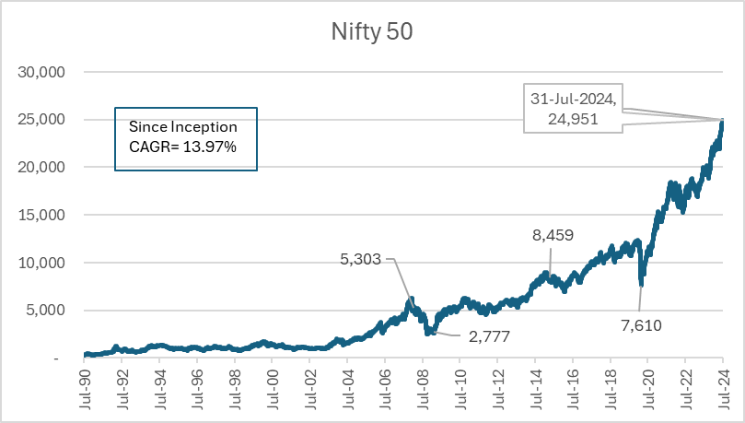
Nifty Returns Since Inception…

Slide 3
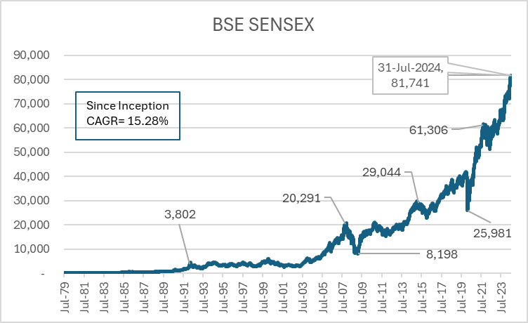
Sensex Returns Since Inception…

Slide 4
Sensex Returns For Financial Year

Slide 5
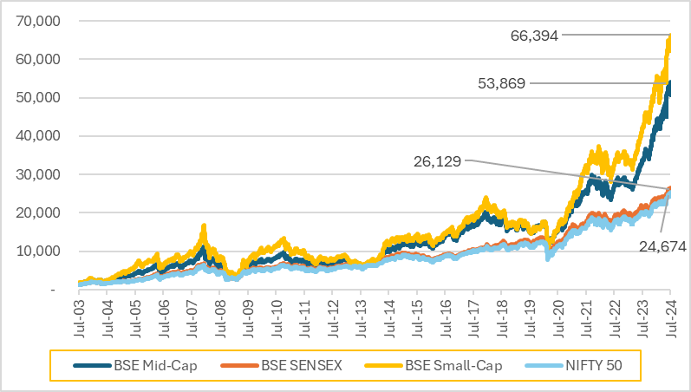
Rs. 1,000 invested in April 2003

Slide 6
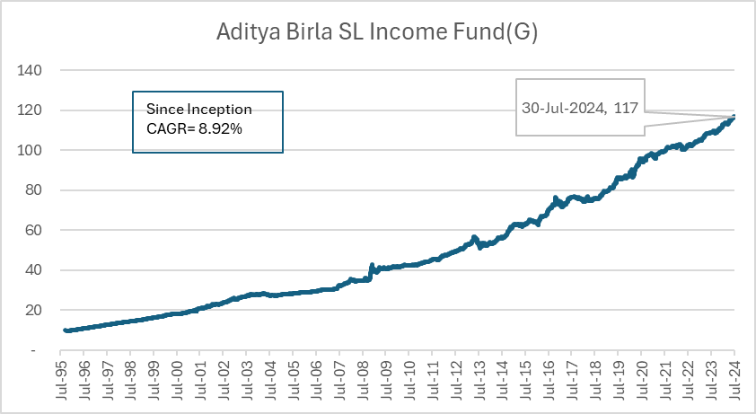
Debt Fund Returns

Slide 7
What about investing on a random day?

Slide 8
What about recent performance?
Equity Mutual Fund Category average returns as of 31 July 2024

Slide 9
Hybrid Mutual Fund Category average returns as of 31 July 2024

Slide 10
Returns are ok but
What about Risk?
Private & Confidential

Slide 11
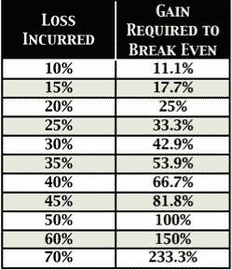
Importance of Risk Management
The following chart shows how much of a gain you would require to make back a given loss:
Private & Confidential

Slide 12
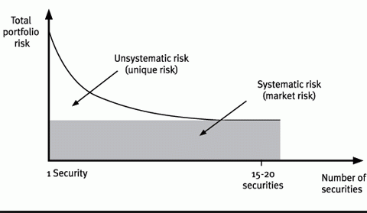
Systematic vs. Unsystematic Risk
Private & Confidential

Slide 13
Types of Risks
  Common Types of Risks for Debt as well as Equity
Concentration risk
The risk of loss because your money is concentrated in 1 investment or type of investment. When you diversify your investments, you spread the risk over different types of investments, industries and geographic locations.
Liquidity Risk
The risk of being unable to sell your investment at a fair price and get your money out when you want to. To sell the investment, you may need to accept a lower price.

Slide 14
Risks in Fixed Income
  Default Risk
The risk that the company that issued the bond will run into financial difficulties and won’t be able to pay the interest or repay the principal at maturity. You can evaluate credit risk by looking at the credit rating of the bond.
Downgrade Risk
The risk that the credit rating of the security is downgraded resulting in mark to market losses.
Reinvestment risk
Reinvestment risk is the probability that an investor will be unable to reinvest cash flows (e.g., coupon payments) at a rate comparable to the current investment's rate of return.
Interest rate risk
It is the risk of losing money because of a change in the interest rate. For example, if the interest rate goes up, the market value of bonds will drop.

Slide 15
Risks for Investor
Longevity Risk The risk of outliving your savings. This risk is particularly relevant for people who are retired or are nearing retirement.
Horizon Risk :-The risk that your investment horizon may be shortened because of an unforeseen event, for example, the loss of your job. This may force you to sell investments that you were expecting to hold for the long term. If you must sell at a time when the markets are down, you may lose money.
Leverage Risk:- Leverage (investing using borrowed capital) extrapolates Positive as well as Negative Outcome.
Inflation Risk
The risk of a loss in your purchasing power. Inflation risk is particularly relevant if you own cash or debt investments like bonds.
Shares offer some protection against inflation because most companies can increase the prices they charge to their customers. Share prices should therefore rise in line with inflation.
Real estate also offers some protection because landlords can increase rents over time.
Gold is considered as hedge against inflation.

Slide 16
Ways to Manage Risk

Slide 17
Diversification
Eliminating unsystematic risk.
Combining assets with low correlation with each other leads to true diversification benefit.
Example
  In recession- Equity Prices are down on growth concerns but bond prices go up as interest rates come down.
  If Steel Prices go up, Steel Companies will see increase in profit but Automobile companies will see increase in costs.

Slide 18
Some numbers on Diversification!
In last 15 years, if you would have invested 100% of your money in Nifty then you would have earned 12.53% returns.
But, Risk, measured by standard deviation would have been highest in this case.
If you would have invested in any combination of Nifty and Liquid fund with annual rebalancing, then you would have earned better risk adjusted returns.

Slide 19
Key Strategy Considerations for Individual Investors
Safety
Returns
Liquidity
Identify Short, Medium & Long Term Needs
Long Term Money –> Appreciating Assets
What is Safe in Short Term
may be Very Costly in Long Term
14/02/2019

Slide 20

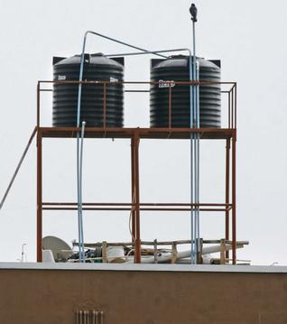

Short, Medium, Long Term Needs
14/02/2019

Slide 21
Mathematics of Personal Investment
Wealth = Amount Invested x (1+ Rate of Return)^n
Sounds Familiar!- This is Compound Interest formula which we all learn in school
A=P(1+r/100)^n
Everything directly proportional
The More you Invest higher the Wealth
The Higher the Return on Investment higher the Wealth
Sooner You start investing and Longer You stay invested higher the Wealth
Higher the Amount invested - Higher the Wealth
Higher Rate of return - Higher the Wealth
Higher the Time Period - Higher the Wealth

Slide 22
Behavioural Finance
But why it is said that “Investing is Simple but not Easy”.
Link to connect “Theory to Practice”
Private & Confidential

Slide 23
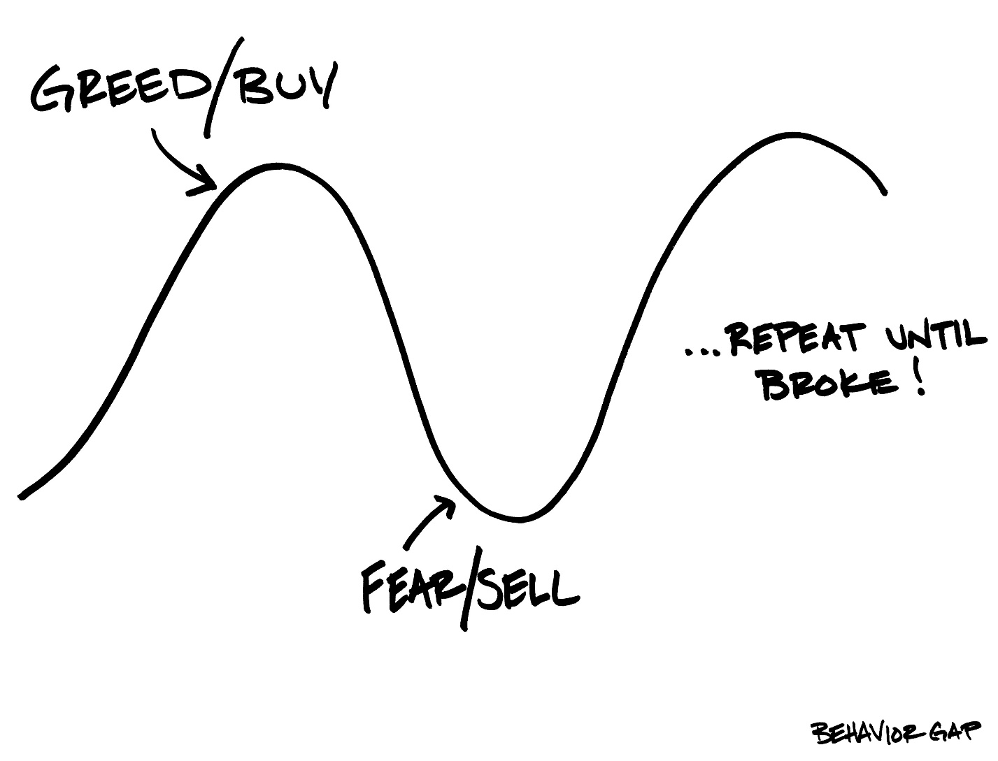
Avoiding “Big Mistake”

Slide 24

Where You are investing?

Slide 25
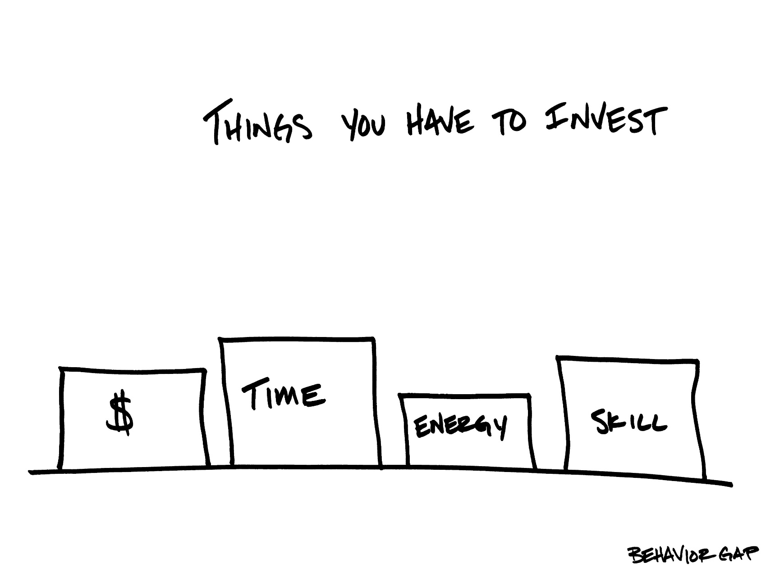
What you need to invest?

Slide 26
What to do?
Know yourself – Risk Profile and investment objectives.
Keep reasonable Expectations
Your important goals are 20 - 40 years away. Have long term orientation
Outperforming Average is difficult and very few can consistently do it.
Stay diversified across asset classes.
Invest in Regulated products
When in doubt seek professional advise from Registered Advisors

Slide 27
Happy to take your Questions!!

Slide 28
Thank You
This document is prepared for information purpose only. In no circumstance should it be used or considered as an offer to sell or a solicitation of any offer to buy or sell the securities mentioned in it. While due care has been taken in compiling the above information, Scripbox.com India Pvt. Ltd. is not responsible for any direct or indirect loss caused by relying on the same. We are not tax experts. This Document is prepared from investment point of view. Please consult your Tax Advisor before taking investment decisions based on information containing in this document.

