Slide 1
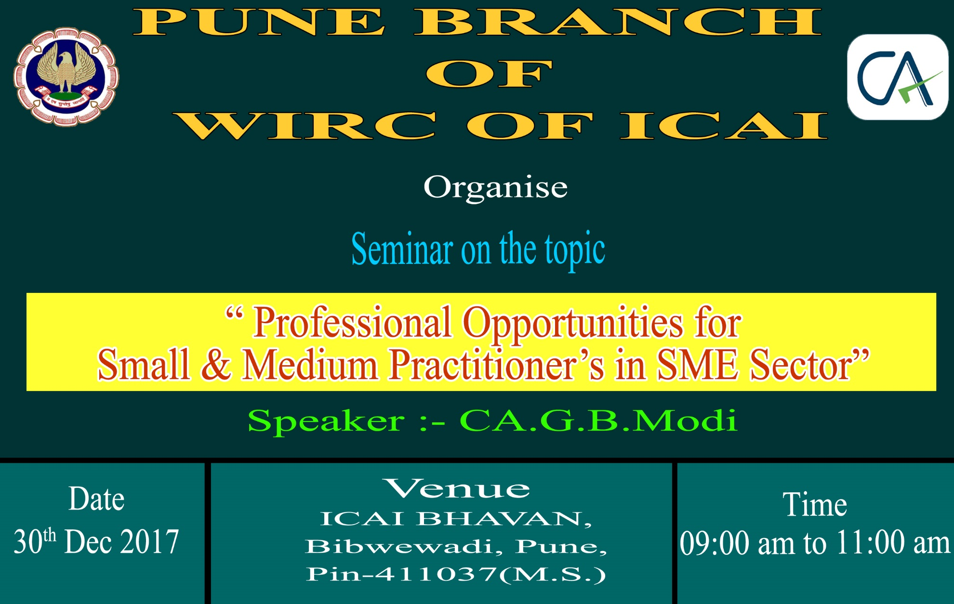

Slide 2
Professional Opportunities for SMP’s in SME Sector
Presented By CA G.B.Modi

Slide 3
Following Policies will be covered In Todays seminar
Sr.No | Name of Scheme
1 | Maharashtra Package Scheme of Incentives- 2013
2 | Pradhan Mantri Kisan Sampada Yojna (Central Govt. /MOFPI)
3 | Venture Capital Assistance For Agro Industries (Central Govt. MIAGRI)
4 | Cold Storage (Central Govt. NHB)
5 | India BPO Promotion Scheme (Central Govt. MeitY)
6 | Maharashtra Electronics Policy 2016
7 | Maharashtra IT/ITES Policy 2015
8 | Maharashtra Textile Policy 2016

Slide 4

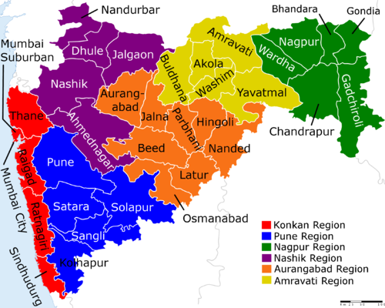
PACKAGE SCHEME OF INCENTIVES
2013
GOVERNMENT OF MAHARASHTRA

Slide 5



Slide 6
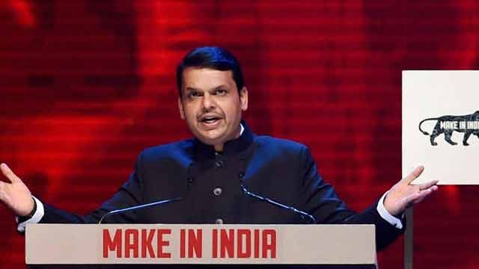
CM Devendra Fadnavis talks of ‘Make In Maharashtra’ for industrial growth
Devendra Fadnavis promised to set up a committee to fast track the projects which are inordinately delayed due to non-clearance from ministry of environment.

Slide 7


Slide 8
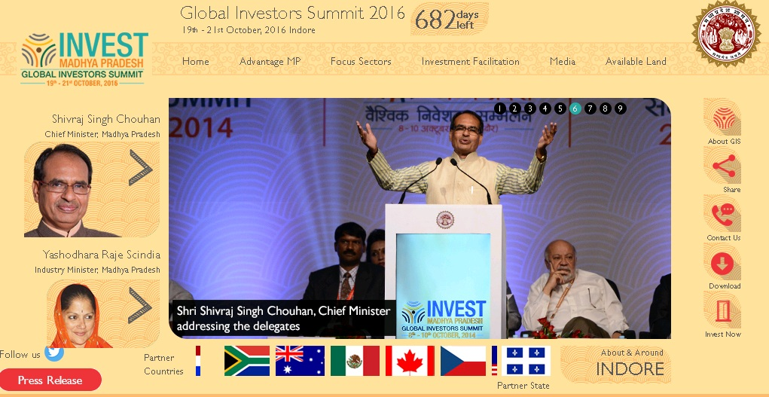

Slide 9


Slide 10



Slide 11


Slide 12
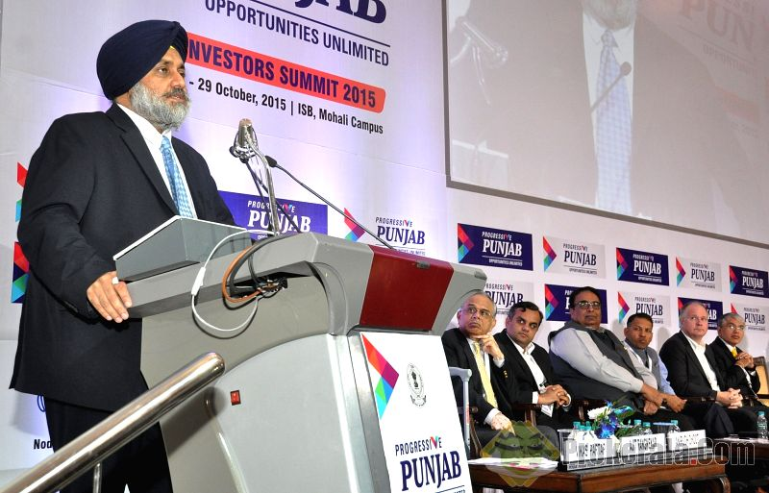


Slide 13



Slide 14


Slide 15


Slide 16
PERIOD OF OPERATION
The 2013 Scheme, as may be amended by the Government from time to time, shall remain in operation from:-
1st April, 2013
to
31st March, 2018

Slide 17
CLASSIFICATION OF AREAS FOR PSI-2013
For the purposes of the PSI- 2013, detailed Taluka wise classification of different areas of the State as Group, A /B/ C/ D/ D + etc., on the basis of their level of industrial development is as follows –
Group A
Denotes Industrially developed areas.
Group B
Denotes Areas where some industrial development has taken place, but are less developed than the areas under Group A.
Group C
Denotes Areas, which are less developed than those covered under Group B.
Group D
Denotes the lesser-developed areas of the State, not covered under Group A Group B/Group C.

Slide 18
Group D+
Denotes the least developed areas, not covered under Group A/Group B/Group C/Group D.
No Industry District
Denotes District having no industries and not covered under Group A / B/ C / D & D+.
Naxalism Affected Area
Denotes Area affected by naxalism, as described in GR No NAVIKA-2008/C.R.209/Ka. 1416 Dated 31.5.2009.

Slide 19
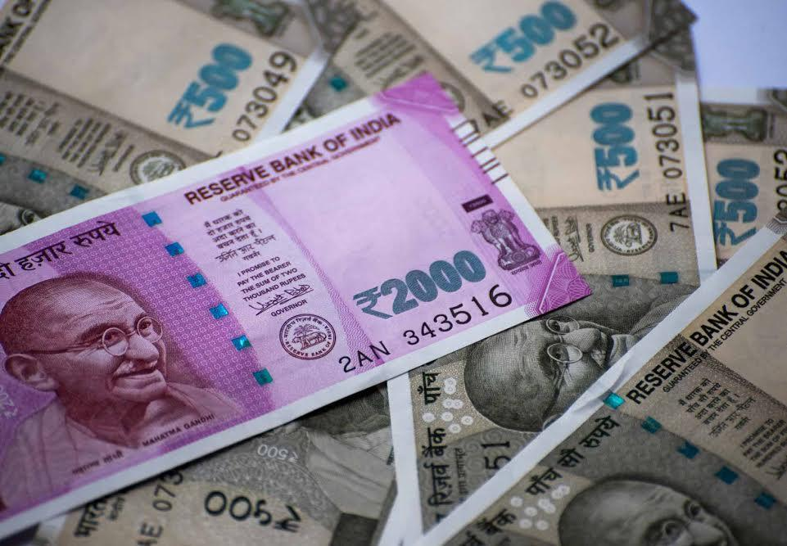

FINANCIAL INCENTIVES FOR MSMEs/LSIs UNDER PSI-2013

Slide 20
FINANCIAL INCENTIVES FOR MSMEs/LSIs UNDER PSI-2013
New MSME/LSI Units will eligible for BASKET OF INCENTIVES which includes:-
Industrial promotion subsidy
Interest Subsidy
Power tariff Subsidy
The total quantum of incentives will be linked to the Fixed Capital Investment.
The total quantum of incentives excluding the incentives of :-
exemption of electricity duty and
Waiver of stamp duty

Slide 21
Talulka/Area | Ceiling as % of Fixed Capital Investment |  | No. of Years
Micro, Small & Medium Enterprises |  | LSI | Micro, Small & Medium Enterprises | LSI
A | --- | --- | 7 | 7
B | 20 | --- | 7 | 7
C | 40 | 30 | 7 | 7
D | 70 | 40 | 10 | 7
D+ | 80 | 50 | 10 | 7
No Industry District | 90 | 70 | 10 | 7
Naxalism Affected Area | 100 | 80 | 10 | 7

Slide 22
Example – 1 SSI/MSI
Eligible subsidy according to location
Taluka / Area | Ceiling as % of Fixed Capital Investment | Cost of Project Rs 10 Crore | Eligible Amount of Subsidy | No. of Year | Per Year Subsidy
A | Nil | 10 Cr | Nil | Nil | Nil
B | 20 % | 10 Cr | 2 Cr | 7 Year | 28.57 Lac
C | 40 % | 10 Cr | 4 Cr | 7 Year | 57.14 Lac
D | 70 % | 10 Cr | 7 Cr | 10 Year | 70 Lac
D+ | 80 % | 10 Cr | 8 Cr | 10 Year | 80 Lac
No Industry District | 90 % | 10 Cr | 9 Cr | 10 Year | 90 Lac
Naxalism Affected Area | 100 % | 10 Cr | 10 Cr | 10 Year | 10 Lac

Slide 23
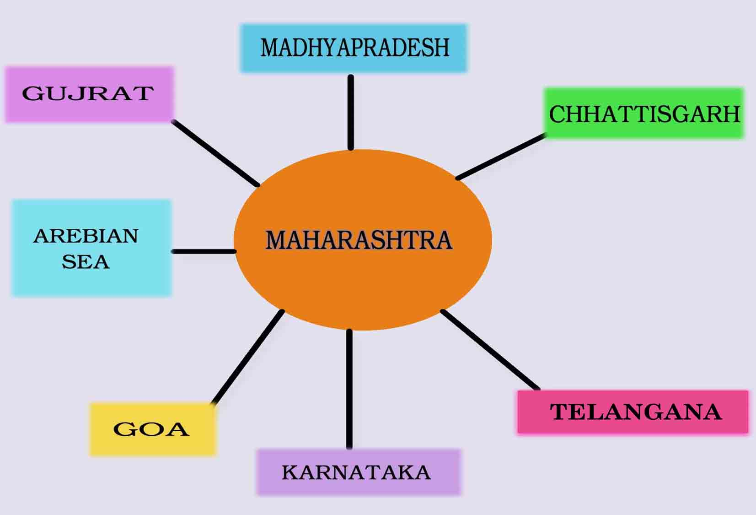

Slide 24
COVERAGE UNDER THE PSI - 2013
The following categories of Eligible Industrial Units in the Private Sector, Co-operative Sector, Central Public Sector, State Public Sector/ Joint Sector shall be eligible to be considered for incentives under the PSI- 2013 :-
Industries listed in the First Schedule of the Industries (Development and Regulation) Act, 1951, as amended from time to time.
Manufacturing Enterprises as defined in the Micro, Small and Medium Enterprises Development Act, 2006. (MSMED Act, 2006).
Information Technology Manufacturing Units registered with the Directorate of Industries or the Maharashtra Industrial Development Corporation (MIDC) or the Development Commissioner, Santacruz Electronic Export Processing Zone (SEEPZ) or Software Technology Parks of India (STPI) in the State.

Slide 25
COVERAGE UNDER THE PSI - 2013
Bio-technology Manufacturing Units as specified by the Government from time to time, which are outside the purview of any registering authority mentioned above.
Cold Storages.
Mechanized Food/Agro Processing Industries in the following sectors:
Dairy, Fruit and Vegetable Processing.
Grain Processing.
Fish Processing.
Consumer foods including Packed foods.
Non alcoholic beverages from fruits and vegetables.
Central Public Sector Units.

Slide 26
EXPANSION/ DIVERSIFICATION PROJECT
An investment shall be regarded as Expansion Project or a Diversification Project, as the case may be, if an Existing / New Unit in any of the areas covered under.
Group “B”,
Group “C”,
Group “D”,
Group D+,
Naxalism Affected Areas
No-Industry- Districts,
Made, on or after the date 1st April, 2013, an additional fixed capital investment in additional production / manufacturing facilities for manufacture of the same product / products as of the Existing /New Unit or for manufacture of different products, as the case maybe provided it satisfies the following conditions, namely.

Slide 27
EXPANSION / DIVERSIFICATION PROJECT
The said additional Fixed Capital Investment for expansion / diversification of the Existing/ New Unit should exceed 25 per cent of the Gross Fixed Capital Investment of the Existing / New Unit immediately prior to setting up of the additional production /manufacturing facilities, as on the last day of the previous financial year, subject to a minimum additional fixed capital investment of Rs. 5 crores in case of non-MSMEs and Rs. 25 Lacks, in case of MSMEs.
In the case of Expansion or Expansion-cum-Diversification but not mere Diversification “per se”, the said additional Fixed Capital Investment should result in increase of existing installed capacity by at least 25 percent; and
Such Expansion / Diversification should increase the employment in the non-supervisory category at least to the extent of 10 percent of the pre expansion/diversification level of such employment and 80 percent of such additional employment should be from amongst local persons.

Slide 28
EXEMPTION FROM ELECTRICITY DUTY
All Eligible New Units in Group C, D, and D+ areas and No-Industry District(s) and Naxalism affected Area will be exempted from payment of Electricity Duty during eligibility period not exceeding 15 years.
In Group A and B areas:-
100% Export Oriented Units (EOUs),
Information Technology Manufacturing Units and
Bio-Technology Manufacturing units will also be exempted from payment of Electricity Duty for a period of 7 Years.
Necessary Notification under the provisions of the Electricity Duty Act 1958 will be issued separately by the Energy Department.

Slide 29
WAIVER OF STAMP DUTY
New Units as well as Units undertaking Expansion/ Diversification (including Mega and Ultra Mega Projects) will be exempted from payment of Stamp duty during the Investment period in Group “C, D, D+ Talukas, No Industry Districts and Naxalism affected areas.
In Group A and B areas, stamp duty exemption would be available as given below:
BT Manufacturing and IT Manufacturing Units in Public Parks : 100%
BT Manufacturing and IT Manufacturing Units in Private Parks : 75%
Mega Projects - 50% for first conveyance deed only
Explanation: Eligible New/Expansion Units of PSI-2007 will also be eligible for Stamp Duty Exemption during their investment period.
Necessary Notification under the provisions of the Bombay Stamp Act 1958 will be issued separately by the Revenue & Forest Department.

Slide 30
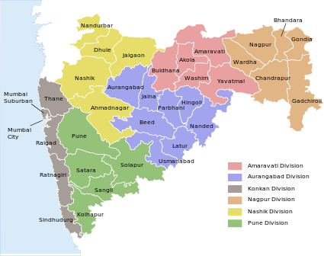
POWER TARIFF SUBSIDY

Slide 31
POWER TARIFF SUBSIDY
Eligible New Micro, Small and Medium Enterprises (MSME) will be eligible for power tariff subsidy.
The subsidy will be to the tune of Rs 1/- per unit for the Units located in
Vidarbha,
Marathwada,
North Maharashtra and the Districts of
Raigad, Ratnagiri ,Sindhudurg in Kokan Region
And
Rs 0.50 per unit for the Units in other areas of the State for a period of 3 years from the date of commencement of commercial production, for the energy consumed and paid.
The Units in Group “A” areas will however not be eligible for this incentive.

Slide 32
INCENTIVES FOR STRENGTHENING MSMEs AND LSIs
The followings incentives shall be admissible to the MSMEs and LSIs so as to promote :-
Quality Competitiveness
Research & Development
Technology Upgradation
Water & Energy Conservation
Cleaner Production Measures and Credit Rating –

Slide 33
New MSMEs and Expansion thereof in all categories of areas will be eligible for following incentives
INCENTIVES FOR TECHNOLOGY UP-GRADATION
5% subsidy on capital equipment for Technology Up –gradation, subject to a maximum of Rs.25 lacs
What is Technology Upgradation :
Technology up-gradation would ordinary mean induction of state of the art or near state of the art technology.
It would also mean a significant step up from the present technology level to substantially higher one involving improved environmental of improved packaging techniques as well as anti-pollution measures and energy conversation machinery.
Further, the units in need of introducing facilities for in-house testing and on-line quality control would qualify for assistance.
Types of Units covered under the scheme:
Units holding eligibility certificate under PSI-2007 and to which assistance is sanctioned under Credit Link capital subsidy scheme (CLCSS) of MSME or Technology Up-Gradation Fund Scheme for Textile and jute Industries (TUFS) or Technology Mission on cotton (TMC) Scheme of Ministry of Textile, Govt.of India during the period 01/04/2007 to 31/03/2011 shall be considered eligible for receipt of Technology up-gradation incentives.

Slide 34
New MSMEs and Expansion thereof in all categories of areas will be eligible for following incentives
SUBSIDY ON CLEANER PRODUCTION MEASURES
25% on capital equipment for cleaner production measures ,limited to Rs.5 Lakhs
Types of Unit Covered under the scheme :
Unit holding eligible certificate under PSI-2007 and who has filed valid application with the implementing agency after issue of eligibility certificate within 6 months from expiry of the period of eligibility certificate as defined under PSI-2007.
Failure to file valid application within the prescribed period shall render the application invalid.
The above subsidies are paid one time.

Slide 35
INCENTIVES FOR STRENGTHENING MSMEs AND LSIs
New MSMEs and Expansion thereof in all categories of areas will be eligible for following incentives –
75 % subsidy on the expenses incurred on quality certification limited to Rs. 1 Lakh.
25% subsidy on capital equipment for cleaner production measures ,limited to Rs.5 Lakhs
75 % subsidy on the expenses incurred on patent registration limited to Rs. 10 Lakh for the National patents and Rs. 20 lakh for the International patents.

Slide 36
INCENTIVES FOR STRENGTHENING MSMEs AND LSIs
Incentives for Credit Rating of MSMEs in all categories of areas –
75% of the cost of carrying out Credit Rating by Small Industries Development Bank of India/ Government accredited Credit Rating Agency, limited to Rs. 40,000.
New MSMEs, LSI and Expansion thereof will be eligible for the following incentives in all categories of areas –
75% of cost of water audit limited to Rs. 1.00 lakh.
75% of cost of energy audit limited to Rs. 2.00 lakh.
50% of the cost of Capital Equipment under the measures to conserve/recycle water, limited to Rs. 5 lakh
50% of the cost of Capital Equipment for improving energy Efficiency, limited to Rs. 5 lakh.

Slide 37
FIXED ASSETS
The term Fixed Assets shall mean and include :
Land / area in effective possession for a minimum further period equivalent to sum of Eligibility Period and Operative Period, prescribed under the scheme and as required for the project.
Building, i.e. any built-up area used for the Eligible Unit including administrative building, residential quarters, industrial housing and accommodation for all such facilities as are required for the manufacturing processes.
Plant and Machinery, i.e. Tools and equipment including handling and haulage equipment or tools as are necessarily required and exclusively used for sustaining the working of the Eligible Unit.

Slide 38
FIXED ASSETS
The cost of development of the location of the Eligible Unit, such as fencing, construction of roads and other infrastructure facilities which the Eligible Unit has to incur under the project.
Installation charges and pre-operative expenses capitalized.
Technical know-how including cost of drawings and know-how fees.
The amount paid to the Electricity Distribution Company for supply of power to the Eligible Unit, or to the Maharashtra Industrial Development Corporation (MIDC) for development of infrastructure for the Eligible Unit, or to any other Government Agency for similar purpose.

Slide 39
FIXED ASSETS
For Mega Project/Ultra Mega Project –
The Tooling acquired by the Mega Project / Ultra Mega Project may be located at the premises of various ancillary units of the Mega Project within the State, limited to maximum 40% of the total plant and machinery of the Mega Projects/ Ultra Mega Project.
If Mega Project / Ultra Mega Project wants to support certain captive process vendors who may put up investment purely and entirely for the purpose of carrying out certain processes in the overall manufacturing process of the Mega Project/ Ultra Mega Project, the investment made by such captive process vendors would also qualify for being counted towards the fixed capital investment of the Mega Project / Ultra Mega Project subject to the following conditions–

Slide 40
FIXED ASSETS
Such Mega Project/ Ultra Mega Project shall furnish a list of such captive process vendors which it wants to support.
Such captive process vendors are located in the same industrial area or higher classified Taluka where the Mega Project / Ultra Mega Project Unit is situated (e.g. if the Mega Project is located in B area, then the captive process vendors should be from the same classified area or from C, D, D+ area or No Industry Districts)
Such captive process vendors should be engaged in a part of the manufacturing process (and not components or independent products) of only one Mega Project/ Ultra Mega Project. )
Such captive process vendors shall not be entitled to any benefits under Package Scheme of Incentives even though it may be putting up investment in its own name.

Slide 41
GROSS FIXED CAPITAL INVESTMENT
Gross Fixed Capital Investment shall, in the case of New Fixed Assets, mean and include the value of new Fixed Assets acquired at site and duly paid for. Provided that –
Only new Fixed Assets as per the Project Scheme accepted by the Implementing Agency, based on the project appraisal done by the lender who has given term loan for the Project or by the Scheduled Commercial Bank / SICOM in case of projects financed by Non- Banking Finance Company/Credit Society/self-financed project, which are acquired by an Eligible Unit / Enterprises within the relevant period shall be considered. (The Land cost prior to submission of valid application shall be considered for Fix Capital Investment).
The value for which imported second hand fixed assets (Used imported machinery) are acquired or the value thereof as certified by an approved valuer, whichever is less, subject to the condition that the assets shall have residual performing life of a minimum 10 years as certified by an approved valuer, shall also be considered towards Gross Fixed Capital Investment.
The investment in intangible assets including pre- operative expenses, interest capitalized, technical know-how, deposits paid for utility services etc. shall be considered only to the extent of 10% of the total project cost for the purpose of incentives.

Slide 42
GROSS FIXED CAPITAL INVESTMENT
Fixed Assets acquired by an Eligible Unit and forming part of the Gross Fixed Capital Investment cannot be disposed of / sold / shifted / written off except with the prior written permission of the Implementing Agency. The Implementing Agency may ordinarily grant such permission if it is satisfied that the overall production capacity and existing employment strength of the Eligible Unit will not thereby suffer and that the Eligible Unit has definite Plans /proposals for replacement of the Fixed Assets being disposed of / sold / written off either by similar Fixed Assets or by Fixed Assets with better output / higher production capacity with or without change in the finished product/s. However, shifting of assets will be permitted only if the contemplated shifting is to a place in an equivalent or lesser-developed area of the State (e.g. from Group 'C' to 'C‘or 'D' area, but not from Group 'C' to 'B' area .)
The Gross Fixed Capital Investment at:-
The end of each year will be computed as Gross Fixed Capital Investment at the beginning of the year, plus additions as per the approved Project Scheme made, if any, to the Gross Fixed Capital Investment during the year, less the original value of any Fixed Assets of the Eligible Unit shifted disposed of / sold / written off, if any, during the year.

Slide 43
GROSS FIXED CAPITAL INVESTMENT
If the admissible Gross Fixed Capital Investment as endorsed in the EC is reduced as a result of any shift / disposal / sale / write off / replacement of the Fixed Assets, the ceiling as endorsed in the EC shall be reduced proportionately and if the incentives availed by the Eligible Unit exceed the ceiling revised as a result of shifting / disposal / sale / write off / replacement, the benefits availed in excess of such revised ceiling shall stand recoverable/refundable forthwith with interest at the rate of 12% from the date of such excess availment till the date of actual payment.
Any increase in the Gross Fixed Capital Investment as a result of replacement of any of the Fixed Assets earlier considered under the EC shall not have any additional incentives.

Slide 44

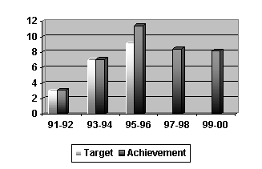
YEARLY CAP FOR THE INCENTIVES

Slide 45
YEARLY CAP FOR THE INCENTIVES
The amount of incentives to be disbursed to the MSMEs and LSI Units every year will be limited to the total quantum of incentives divided by the number of years as per the applicable Eligibility period with the provision of carrying forward the differential between the actual sanctioned amount for a given year and the yearly disbursement limit.
For Mega Projects/ Ultra Mega Projects, if the E.C. Period is more than 10 years, the yearly limit on disbursement amount shall be equal to 1/10 of the total quantum of incentives
OR
Industrial Promotion Subsidy sanctioned for that year whichever is less.
The Carry forward principle will be applicable. The balance quantum of incentives will be allowed to be availed of after 10 years with yearly cap as above. Proportionate quantum of incentives will be calculated for a part of the year.

Slide 46
YEARLY CAP FOR THE INCENTIVES
Example 1: If the unit is eligible for the total quantum of Rs.1000 and the E.C. period is 10 years, then actual incentives disbursed to such unit, shall not exceed Rs.100 (1000/10) in a given year even though the amount of total incentives sanctioned for that year is more than Rs. 100. The difference (yearly sanctioned amount minus yearly disbursement limit) can be carried forward for the Subsequent years of E. C. period, such that the actual disbursement of incentives is not more than Rs.100 in any year.
Example 2: If the unit is eligible for the total quantum of Rs.1000 and the E.C. period is 10 years, then actual incentive disbursed to such unit, shall not exceed Rs.100 (1000/10) or the incentives sanctioned (say Rs.70) for that year whichever is less ( i.e. Rs.70). The difference (i.e.Rs.30) can be carried forward for the further E. C. period. In the next year, if the total incentives sanctioned are Rs. 140, then the unit will be eligible for disbursement of Rs. 100 (i.e. yearly maximum disbursement limit) and Rs. 30 towards the carried forward amount .

Slide 47


PROCEDURE FOR APPLICATION UNDER PSI-2013

Slide 48
APPLICATION FOR ELIGIBILITY
An application for eligibility under the PSI 2013 Scheme shall be submitted to the Implementing Agency by an Eligible Unit only after it has taken all the Effective Steps but not later than the 31st March, 2018. It shall be supported by documentary evidence with regard to completion of the Effective Steps.
For claiming eligibility under the PSI-2013, any New/Expansion/ Diversification, Eligible Unit shall commence the commercial production and also acquire the fixed assets at site, having paid for the same, and paid for it within the investment period.
The Investment Period for Micro, Small and Medium manufacturing Enterprises will be three years, and for the LSI units, four years.
For Mega Projects /Ultra Mega Projects, the Investment period will be five years from the date of application or such greater period as may be approved by the “High Power Committee” or the “Cabinet Sub Committee” on case to case basis.

Slide 49
APPLICATION FOR ELIGIBILITY
The Investment Period will be counted from the date of submission of application to the Implementing Agency or the date suggested by the Eligible Unit. However, this date should be within this Scheme Period and the assets acquired prior to and beyond the investment period will not be considered eligible for incentives, However, the Land cost prior to submission of valid application shall be considered for Fix Capital Investment.
Delay in commencement of commercial production will entail proportionate curtailment of incentives and the Eligibility Certificate period.

Slide 50
APPLICATION FOR ELIGIBILITY
If a Unit has completed all Effective steps but not started the production before the 1st April, 2013 and has not filed an application with the Implementing Agency under PSI 2007, such unit can submit the application under PSI - 2013.
However, the incentives applicable to such Eligible Unit shall be as per PSI- 2007 or PSI - 2013 , whichever is lower. For such unit , the investment made within the investment period from the date of application only will be considered for Incentives.

Slide 51
APPLICATION FOR ELIGIBILITY
In respect of a Mega Project, where customized package has been approved by the High Power committee or the Infrastructure Committee / Cabinet Sub Committee under PSI - 2007, but the Unit has completed/ not completed the effective steps within the period of PSI - 2007 and has not applied to the Directorate of Industries for Eligibility Certificate as per PSI – 2007, such Mega Project will be eligible for approved customized package only.
However, the Unit should complete the effective steps and file an application with the Implementing Agency within the operative period of PSI -2013, but before starting the commercial production.
An application for eligibility shall be submitted to the Implementing Agency on or before the date of commencement of commercial production. If there is any delay, the E.C. period and entitlement will be curtailed proportionately.

Slide 52
EFFECTIVE DATE OF ELIGIBILITY CERTIFICATE
In An Eligibility Certificate (EC) under the PSI-2013 will be issued by the Implementing Agency after ascertaining that the Eligible Unit has complied with the provisions of the Scheme and has commenced its commercial production.
The EC will be issued with effect from the date of commencement of commercial production by the Eligible Unit. The date of commencement of commercial production will be determined by the Unit, supported by the relevant extract of the Excise Register or, in case Excise Duty is not applicable, by the first sale bill issued by the Unit in respect of such production or as may be Specifically permitted by the Government of Maharashtra in respect of Mega Projects. For the purpose of the EC, the date of commencement of commercial production shall be deemed to be the first day of the month following the month in which such production has commenced.
The Implementing Agency shall send a copy of the Eligibility Certificate to all the concerned agencies offering various incentives e.g. concerned Electrical Inspector, Sales Tax Officer.

Slide 53


Slide 54
Operational Guidelines for implantation of Scheme for Creation / Expansion of food processing & Preservation Capacities
Objectives
The main objective of the Scheme is creation of processing and preservation capacities and modernization / expansion of existing food processing units which will help in increasing the level of processing value addition and thereby lead to reduction of wastage and enhancement of farmer’s income.

Slide 55
Operational Guidelines for implantation of Scheme for Creation / Expansion of food processing & Preservation Capacities
Indicative list of eligible processing activities
The processing units undertake a wide range of processing activities which result in value addition, enhancing shelf life of the products and reduction of wastage. An indicative list of processing activities which may be undertaken by the processing units is given below. Sorting, grading, washing, peeling, cutting, sizing; Balancing, crushing, extraction, pulping; Drying, de-husking, de-hulling, splitting, depoding, deseeding, colour sorting, pulverization, extrusion, freeze drying / dehydration, frying, etc; Pasteurization, homogenization, evaporation, concentration, etc. Packaging facilities like canning, aseptic packaging, vacuum packaging, bottling, edible packaging, labelling, any other specialized packaging etc. Chemical preservation, pickling, fermentation or any other specialized facility required for preservation activities etc. Individual Quick Freezing (IQF), blast freezing, plate freezing, spiral quick freezing etc. Controlled temperature transport like coolers / refrigerated / insulted / ventilated transport. All other processing / preservation / transport / storage facilities etc. adjunct to value

Slide 56
Operational Guidelines for implantation of Scheme for Creation / Expansion of food processing & Preservation Capacities
Indicative list of eligible processing activities
Addition and shelf life enhancement of food products would be eligible. Standalone activities like temperature controlled transportation/ storage facilities etc. will not be considered under this scheme. The project should include and result in creation/ increase in processing capacity. Note: The above list is only illustrative and not exhaustive list of food processing activities food processing Industry and several innovative processing technologies industry is fast growing industry and several innovative processing technologies are being developed day by day which will also be considered under this scheme with recommendations of technical committee.

Slide 57
Operational Guidelines for implantation of Scheme for Creation / Expansion of food processing & Preservation Capacities
Eligible Sectors
Food processing sectors eligible under the Scheme includes – Fruits & Vegetable processing / Milk Processing Meat/ poultry / fish processing, Ready to Eat/ Ready to Cook Food Products/ Breakfast Cereals / Snacks / Bakery and other food products. Grains / pulses, oil seed milling and processing based on modern technology. Modern Rice milling, preference will be given to Eastern (Odisha, W.Bengal, Bihar & Jharkhand) & Not Eastern States. Other agri-horti products include spices, coconut, soybean, mushroom processing, honey processing etc. Fruits/Honey based wines. Natural Food flavors, Food additives/ food extracts & colors, oleoresins (not synthetic), guar gum, cocoa products etc. Processing plants that makes food products fit for human and animal consumption to be set up in Mega Food Parks. The activities related to manufacture of aerated water, packed drinking water and carbonated drink will not be considered for financial assistance under the Scheme For the proposals under grain milling sector (i.e Rice, Pulse, Flour milling) 15% of the total allocated budget may be utilized each year for release of grant.

Slide 58
Operational Guidelines for implantation of Scheme for Creation / Expansion of food processing & Preservation Capacities
Eligible Organizations
Organization such as Central and Stet PSUs/ Joint Ventures / Farmer Producer Organizations (FPOs) NGOs/ Cooperatives / SHG’s / Public and Pvt. Companies / limited liability Partnerships, corporate entity/ Proprietorships firms engaged or propose to engage in creation / expansion / modernization of food processing and preservation capacities would be eligible for financial assistance under the scheme.
Grant in aid to any eligible organization, including its subsidiary company / Group Company or any other company / entity wherein any of the same person / persons are holding controlling stake, would be limited to one unit.

Slide 59
Operational Guidelines for implantation of Scheme for Creation / Expansion of food processing & Preservation Capacities
Preference to the proposals
The order of preference for selection of projects will be as under:
Allocation of food processing units shall be done on the basis of notional State-wise allocation. The State-wise allocation of units is provided at Appendix ‘A’. The allocation of the units shall be done through EOI.
The proposals for creation / expansion/ modernization of food processing & preservation unit in Mega Food Parks assisted by the Ministry will be given preference within the State allocation.
In order to approve the proposal for financial assistance within a State, preference will be given to the units being set up in the Mega food parks in that State, irrespective of the merit order of the proposals.
ILLUSTRATION : In case the proposal to be located in Mega Food Park gets 60 marks and proposal to be located in no-mega food park location get 70 marks in the same state, in such a scenario both are meeting the benchmark criterion of minimum 60 marks (refer Appendix -J), however, preference will be given to the proposals to be located in Mega Food Parks)

Slide 60
Operational Guidelines for implantation of Scheme for Creation / Expansion of food processing & Preservation Capacities
Preference to the proposals
In case of lack of suitable proposals with in a State, MoFPI would reserve the right to allocate such proposals to the other States with preference to units proposed in MFPs of that State.
(Illustration : For example total 9 proposals are to be considered from Haryana State. In response to EOI, if only 3 eligible proposals are received which are to be located in Mega Food Park and 3 eligible proposals are received for non-mega food park locations, then total 6 eligible proposals will be considered of Haryana State and remaining 3 proposals will be received, which are to be located in Mega Food Park of respective States)

Slide 61
Operational Guidelines for implantation of Scheme for Creation / Expansion of food processing & Preservation Capacities
Pattern of Assistance:
The scheme envisages financial assistance to food processing units in the form if grant-in-aid as under: 35% of the eligible project cost subject to a maximum of Rs. 5.00 crore in General Areas; 50% of the eligible project cost subject to a maximum of Rs. 5.00 crore in North Eastern States including Sikkim and Difficult areas including Himalayan States (Himachal Pradesh, J&K& Uttarakhand), State Notifies ITDP areas and Islands.

Slide 62
Operational Guidelines for implantation of Scheme for Creation / Expansion of food processing & Preservation Capacities
Project Management Agency (PMA):
MOFPI will engage professional agencies as PMAs to assist in implementation of the scheme.
Project Management Agencies will be selected on bidding basis for examination, evaluation and monitoring of the proposals. They will paid professional fees as per lowest quoted rate. Roles and responsibilities of the PMA are given in Appendix - M.

Slide 63
Operational Guidelines for implantation of Scheme for Creation / Expansion of food processing & Preservation Capacities
Ineligible Components
The following items will not be eligible for calculation of the grant for the unit.
Ineligible items of civil works
Compound wall Administrative Office Building, Labour quarters for employees/workers, any other civil work not directly related to the production and processing. Cost of land shall not be considered as part of eligible project cost.

Slide 64
Operational Guidelines for implantation of Scheme for Creation / Expansion of food processing & Preservation Capacities
Ineligible Components
The following items will not be eligible for calculation of the grant for the unit.
Ineligible list of Plant & Machinery :
Fuel, consumable, spares and stores. Computers, AC with ducting and allied office furniture. Personal Transport vehicles. Second hand/old machines/refurbished machinery. All types of service charges, carriage and freight charges, pre-operative expenses. Expenditure on painting of machinery. Other ineligible items: Stationery items. Consultancy fee, Margin Money, working capital and contingencies shall not be considered as part of eligible project cost for calculating grant in aid
This is only an illustrative list and not exhaustive list of ineligible items. The Inter Ministerial Approval Committee (IMAC) will be the final authority to decide on the admissibility of the grant and the eligibility or otherwise of the items for this purpose.

Slide 65
Operational Guidelines for implantation of Scheme for Creation / Expansion of food processing & Preservation Capacities
Ineligible Components
The following items will not be eligible for calculation of the grant for the unit.
Eligible Project Cost:
Includes the cost of plant & machinery and Technical civil work except for ineligible items as mentioned in paras 8.1 & 8.2 above. Cost of "Utilities" essential for the plant i.e. Water pipeline, DG Set, Boiler, Solid waste treatment plant, ETP etc. will be considered under eligible project cost subject to restriction of above cost being maximum 25% of the total project cost.

Slide 66
Operational Guidelines for implantation of Scheme for Creation / Expansion of food processing & Preservation Capacities
Receipt of applications :
The procedure for receipt of applications is as follows:
Applications under the scheme will be invited through Expression of Interest (EoI). An applicant is initially required to submit their loan application to the bank for appraisal and sanction of the Term loan for the project. The application for financial assistance in the prescribed format need to be submitted online and subsequently hard copy has to be sent by the applicant directly to MoFPI within stipulated time as prescribed in EoI notice.

Slide 67
Operational Guidelines for implantation of Scheme for Creation / Expansion of food processing & Preservation Capacities
Receipt of applications :
The proposals have to meet the following basic eligibility criteria to be considered under the scheme:
Before submitting the grant application, applicant shall ensure fulfillment of following eligibility criteria to avail grant in aid under the scheme: The promoter's capital/equity investment on the project should not be less than 20% of the total project cost in case of General areas and 10% of the total project cost in case of NER & Difficult areas. (not applicable to Govt. proposals). Availing term loan from bank/Financial Institution minimum 20% of the total project cost. Only those proposals shall be eligible in which sanction of term loan has been accorded by the Nationalized Banks/ Private Bank/ Scheduled Banks/ FI after the date of advertisement of EoI of this scheme. Date of commercial production should not be prior to the date of submission of application to the Ministry. Proposal should have eligible project cost more than Rs. 3 (three) crore. {Ref. para 8.3 for eligible project cost} The subsidiary company/ related company / group company of the applicant company has not already availed the grant in aid under this scheme. {refer para 4 (ii)}. Applicants / Promoters who have availed assistance under any other scheme of the Ministry and apply again under this scheme, then in such cases the previous project (s) should have achieved completion and commenced commercial operation/ production and successfully completed at least one year before the date of advertisement of EoI of this scheme.

Slide 68
Operational Guidelines for implantation of Scheme for Creation / Expansion of food processing & Preservation Capacities
Receipt of applications :
The proposals have to meet the following basic eligibility criteria to be considered under the scheme:
The applicant fulfilling the above eligibility criteria under the scheme is required to submit the online application in the prescribed format (Appendix-B) attaching therewith complete documents as prescribed in the guidelines at para 12 with continuous numbering on all attached documents in hard copy.
On receipt of the complete application by the Ministry, an acknowledgement receipt of the application will be sent on registered email ID to the applicant for future reference .
Ministry does not any responsibility for any proposal pending / delayed at any level, which could not be submitted to Ministry within the prescribed time limit of EoI. Such proposals shall not be considered.
Applicant shall thoroughly examine and ensure all the documents to be uploaded / forwarded with the application are in conformity with the scheme guidelines. Incomplete information, deficient documents etc. submitted by the applicant along with application will lead to rejection of proposals.
Whenever required the applicant would submit the original documents to MoFPI for further processing of the application.

Slide 69
Operational Guidelines for implantation of Scheme for Creation / Expansion of food processing & Preservation Capacities
Receipt of applications :
The proposals have to meet the following basic eligibility criteria to be considered under the scheme:
Mere submission of application with required documents against the EoI does not confer any right on the applicant for claim of grant in aid under the scheme. The grant in aid will be sanctioned on merit and preference criteria based on evaluation of the proposals as per the assessment criteria laid down in the guidelines of the scheme. Grant will be released subject to availability of funds under scheme to the approved projects as per merit order and preference as laid down herein.

Slide 70
Operational Guidelines for implantation of Scheme for Creation / Expansion of food processing & Preservation Capacities
Procedure of approval of applications/ Project proposals for financial assistance:
The proposals found prima facie eligible based on the criteria as per para 9 (i) will be evaluated as per the assessment criteria at Appendix –I of these guidelines. Project Management Agencies (PMAs) will be appointed to examine, evaluate and monitor the project proposals during their implementation. The applications complete in all respect will be evaluated by the PMA based on the assessment criteria. The proposals evaluated by the PMA will be examined by the Technical committee for recommending merit based on marks and preference. The proposals recommended by the Technical committee will be placed before the Inter Ministerial Approval Committee (IMAC). Details of TC and IMAC is at Appendix-K. As per the decision of the IMAC, approval/ rejection/ modification/ revision in proposal or project components, if any, will be communicated to the Applicant with suitable instructions.

Slide 71
Operational Guidelines for implantation of Scheme for Creation / Expansion of food processing & Preservation Capacities
Procedure for Disbursement of grant:
Grant will be disbursed through bank that has sanctioned term loan for the project. Grant will ne credit linked but not back ended and will be released in two installments cash @50% of grant in the following manner:

Slide 72
Operational Guidelines for implantation of Scheme for Creation / Expansion of food processing & Preservation Capacities
Procedure for Disbursement of grant:
Release of 1st Installment :
The first installment of grant would be released after the firm has utilize 50% of the term loan as well as 50% of promoter's contribution and on production of the following documents by the applicant. Duly notarized Surety Bond - To be executed by the beneficiary company on Non-Judicial stamp paper of not less than Rs. 100/- (Appendix-F). Bank Certificate certifying that they have released 50% of term loan and the required expenditure has been made on the project (Appendix-D). CA Certificate - for actual expenditure incurred on the project as per the means of finances (Appendix-H). Jt. inspection report of PMA & Bank - Inspection report verifying the actual physical progress made by the project on the ground, matching the expenditure claimed in CA certificate (Appendix-C). NOC from Pollution Control Board (consent to establish). PFMS Registration - Controller General of Accounts (CGA) registration of firm under agency type "private sector companies" and under the scheme name "National Mission on Food Processing (SAMPADA) CS (9535)".

Slide 73
Operational Guidelines for implantation of Scheme for Creation / Expansion of food processing & Preservation Capacities
Procedure for Disbursement of grant:
Release of 1st Installment :
The applicant / Bank needs to create one dedicated bank (Escrow) account with respect to the Promoter(s) contribution and term loan for implementation of the project. Details of these bank accounts are to be provided in the ECS mandate form as provided in Appendix-L so as to transfer the grant in same account.
Compliance of any other Terms & Conditions mentioned in the approval letter of the grant in aid issued by the Ministry.

Slide 74
Operational Guidelines for implantation of Scheme for Creation / Expansion of food processing & Preservation Capacities
Procedure for Disbursement of grant:
Release of 2nd Installment :
The second installment of the grant would be released only after confirming the commencement of commercial production through joint physical verification by the PMA & bank and submission of documents specified below regarding utilization of 1st installment of grant and 100% of Term Loan as well as 100% of Promoter's contribution as per the approved means of finances.

Slide 75
Operational Guidelines for implantation of Scheme for Creation / Expansion of food processing & Preservation Capacities
Procedure for Disbursement of grant:
Release of 2nd Installment :
Chartered Accountant Certificate - Actual expenditure incurred on the project as per the approved means of finance and 100% utilization of Promoters contribution and 100% of Term Loan (Appendix-H). Bank Certificate - certifying that they have released 100% of term loan and Bridge loan if any and 1st installment released has been credited in dedicated account and request to conduct joint inspection (Appendix-E). Statement of Expenditure / utilization of funds released: Indicating the details of the payments made towards implementation of the project (Appendix-I). Chartered Engineer Certificates- certifying the Item wise and cost wise details of Technical civil works completed duly certified by Chartered Engineer (Civil) and Item wise and cost wise details of Plant & Machinery installed duly certified by Chartered Engineer (Mechanical). NOC of Pollution Control Board - (consent to Operate). Valid copy of License issued under FSS Act, 2006. Joint inspection report of PMA and Bank- Inspection report verifying the actual physical progress of the project at the ground including commercial production (Appendix-N).

Slide 76
Operational Guidelines for implantation of Scheme for Creation / Expansion of food processing & Preservation Capacities
Procedure for Disbursement of grant:
Release of 2nd Installment :
Compliance of any other Terms & Conditions mentioned in the approval letter of the grant in aid issued by the Ministry.
Before release of 2nd (final) installment of grant in aid, eligible grant in aid for the project will be recalculated based on the appraised / actual cost, whichever is less, for the already approved items and grant will be released accordingly

Slide 77
Operational Guidelines for implantation of Scheme for Creation / Expansion of food processing & Preservation Capacities
Procedure for Disbursement of grant:
Other Conditions:
The decision of the Ministry in all matters relating to eligibility, acceptance or rejection of the applications, mode of selection, grant approved and imposition of penalty will be final and binding on the applicant.
In case the banks/ FIs utilize the amount released, in contravention of the scheme guidelines, the Bank/ FIs shall be liable to refund such amount to the Government along with interest at PLR of the said bank. In case of a dispute about the correctness of the said demand, the matter shall stand referred to the Competent Authority of Arbitrators as established by the Government of India.

Slide 78
Operational Guidelines for implantation of Scheme for Creation / Expansion of food processing & Preservation Capacities
Document required to be submitted at the time of submitting the application by applicant :
(application required to be submitted online and following documents need to be uploaded with application in pdf format)
Application in the prescribed format (Appendix-B). (fillable application template will be available in online platform of the Ministry)
Detailed Project Report (DPR) (indicating financial and technical profile of the promoter (s), domain expertise available with firm, raw material availability in the area, arrangements for raw material procurement, marketing strategy of proposed products, process flow diagram of proposed products with production capacity per day, technology proposed for the various in progress line, financial estimates with key financial parameters, P & I statement, employment generation (Direct, Indirect), number of farmers to be benefitted & farmer linkages etc.)
Bank appraisal and techno-economic viability report. (The copy of DPR stamped by the bank will not be acceptable as bank appraisal)

Slide 79
Operational Guidelines for implantation of Scheme for Creation / Expansion of food processing & Preservation Capacities
Document required to be submitted at the time of submitting the application by applicant :
Sanction letter of term loan from bank / financial institutions. (Clearly indicating the amount of term loan approved and sanctioned)
Certificate of incorporation / registration of the organization, Memorandum and Articles of Association and Bye laws of the society (if applicable)/ partnership deed etc.
Latest Annual Report and Audited Statement of Accounts, in case of expansion/ modernization proposals / cases. This will not be applicable for new entrepreneur.
Item wise and cost wise details of Technical civil works envisaged duly certified by Chartered Engineer (Civil).
Item wise and cost wise details of Technical civil works envisaged duly certified by Chartered Engineer (Civil).
Item wise and cost wise details of Technical civil works envisaged duly certified by Chartered Engineer (Civil).

Slide 80
Operational Guidelines for implantation of Scheme for Creation / Expansion of food processing & Preservation Capacities
Document required to be submitted at the time of submitting the application by applicant :
An undertaking to be furnished by the applicant as per Appendix-G
Notarized English version of land allotment/ownership document (in case it is any of the regional languages)
IEM registration/ Entrepreneur's Memorandum etc.

Slide 81
Operational Guidelines for implantation of Scheme for Creation / Expansion of food processing & Preservation Capacities
Implementation and monitoring of the projects sanctioned:
The implementation schedule for the projects would be 18 months from the date of the issue of approval letter. In exceptional circumstances, for the reasons beyond the control of the promoter (s), the implementation period may be extended with approval of IMAC. In case of non-adherence of time lines, a penalty of 1% of the quantum of installment amount due to for release for that installment, will be imposed for each month's delay beyond the stipulated timeline. The maximum amount of penalty, however, shall not exceed 10% of the installment to be released to the project. It will also be binding on the applicant to allow inspection/ physical verification of the unit at any time by representatives of Ministry. Promoter would be required to prominently display on the front of the project building / vehicles stating that the "Project is assisted by the Ministry of Food Processing Industries, Government of India".

Slide 82
Operational Guidelines for implantation of Scheme for Creation / Expansion of food processing & Preservation Capacities
Recall of Grant
The Ministry will have the authority to recall the grant- If the project is not completed in time within the approved project period including extension if any, then the grant-in-aid released to the applicant, will have to be refunded to the Ministry of Food Processing Industries forthwith but not later than 30 days after a notice is given by MOFPI in this regard. If the assisted project stops its commercial operations within three (3) years from the date of commencement of commercial production of the project. MoFPI will have the discretion to recall the grant, if during such period, it comes to the notice of the Ministry that the grant has been availed by manipulating / concealment of information / facts or that the grant has been utilized for purpose other than those for which it was sanctioned.

Slide 83
Operational Guidelines for implantation of Scheme for Creation / Expansion of food processing & Preservation Capacities
Jurisdiction of Court
Any dispute arising out of selection of proposals and implementation of approved project under this scheme guideline will be subject to Courts / Tribunals having jurisdiction over Delhi.

Slide 84
Venture Capital Assistance For Agro Industries
Presented By,
CA. G.B.Modi, B.com, FCA (Dhule)
Email:- gbmodi@hotmail.com
Mob:- 09422285096

Slide 85

SMALL FARMERES AGRIBUSINESS CONSORTIUM (SFAC)
VENTURE CAPITAL SCHEME FOR AGRIBUSINESS DEVELOPMENT

Slide 86

VENTURE CAPITAL SCHEME
FOR
AGRIBUSINESS DEVELOPMENT
FOR
XII TH PLAN (2012-2017)

Slide 87
SFAC is a registered society. under the Department of Agriculture and Corporation, with a mandate to catalyze private investment in setting up agribusiness Project for increasing rural income and employment.
SFAC scheme for Agribusiness Development provides:
Interest free Venture Capital to Set up agribusiness project
And
Project Development Facility (PDF) To assist
1.Individuals,
2.Producer groups/ orgnisation
for preparation of detailed project report.
The scheme envisages Single-window approach for extending venture Capital along with bank term loan/working capital to the beneficiary.

Slide 88


Slide 89
Objectives
The main objectives of the scheme are :-
To facilitate setting up of agribusiness ventures in close association with banks.
To catalyse private investment in setting up agribusiness project and there by providing and assured market to producers for increasing rural income and employment.
To strengthen backward linkages of agribusiness projects with producers.
To assist farmers, producer groups / companies and agriculture graduates to enhance their participation in the value chain.

Slide 90


SALIENT FEATURES OF THE SCHEME

Slide 91
ELIGIBILITY CRITERIA
Assistance Under the Scheme is available to:-
Individual
Farmers
Farmer Producer Companies / Farmer Producer Organisations
Partnership / Proprietary Firms
Self-help Groups
Companies
Agripreneures
Units in Agri-export Zones
Agriculture Graduates individually or in Groups.

Slide 92


QUALIFYING PROJECTS

Slide 93
A project should be in agriculture or allied sector or related to agriculture services. Poultry and dairy projects are also covered under the scheme.
The project should provide an assured market to farmers /producers groups.
The project should encourage farmers to diversify into high value crops.
The project should be accepted by banks / financial institutions for grant of term loan.

Slide 94


ILLUSTRATIVE LIST OF SECTOR & PRODUCTS

Slide 95
Sr.No. | Sector | Product
1 | Plantation | Virgin Coconut Oil, Low Fat Desiccated Coconut Powder, Shell Charcoal, Coconut Parings, Coconut Vinegar,
2 | Horticulture | Mango Pulp, Tomato Paste, Banana Paste, Papaya Juice, Guava Juice, Tomato Puree, Gherkin, Chillies, Squash Processing, Wine(Pure Grapes), Cashew Kernels, Capsicum, Cucumber, Broccoli, Tomato, Cold Chain (Apple), Fresh Grapes, Pineapple slice, Fruit Jam, Walnut Kernels, Concentrates of Apple Apricot, plum, Carrot, Peach, Pear, Dehydrated Onion, Dehydrated Garlic, Onion, carbonated fruit beverage prepared from fruits like mango, litchi, pineapple, orange, Canned pineapple Slice, Pineapple pulp, green chilly, pickle,
3 | Horticulture- Vegetables Processing | Sweet Corn, Baby Corn, Green Peas, Mushroom, Fruit Pulp,
4 | Medicinal & Aromatic Plants | Active Pharmaceutical Ingredients- Vincristine, Vinblasine, vinorelfine

Slide 96
Sr.No. | Sector | Product
5 | Fruit Processing | Mango, Guava Pulp
6 | Fisheries | Marketing of raw fish, tandoori, Fish, Biryani, Smoked and fried fish, Ornamental Fishes
7 | Processing of Medicinal & Aromatic Crops | Processing and manufacturing of Aloevera Product
8 | IQF Processing | Vegetables and fruit, Frozen Peas, Sweet Corn, Frozen Mango Pulp, Frozen Mix Vegetables, ready to eat Snacks- VadaPav, Burger, Punjabi Samosa, PavBhaji, French Fries, Frozen cauliflower, Frozen Carrot.
9 | Apiculture | Honey, Polleu, Propolis & Equipment's
10 | Food & Fruit Processing | Mango Juice/Pulp, Fig Spread Jam, Awala Drink, Mineral Water, Frozen Fruit, Vegetables, Canned Fruit, Jam, Jelly, Pickle, Squash, Fruit Juice, Sauce.
11 | Forest Product | Bamboo Mates & Bamboo Corrugated Sheet
12 | Cashew Processing | Processed cashew, CSNL Liquid & Husk & Cake
13 | Coconut Processing | Desiccated Coconut Powder, by Product Charcoal & Testa (Paring)

Slide 97
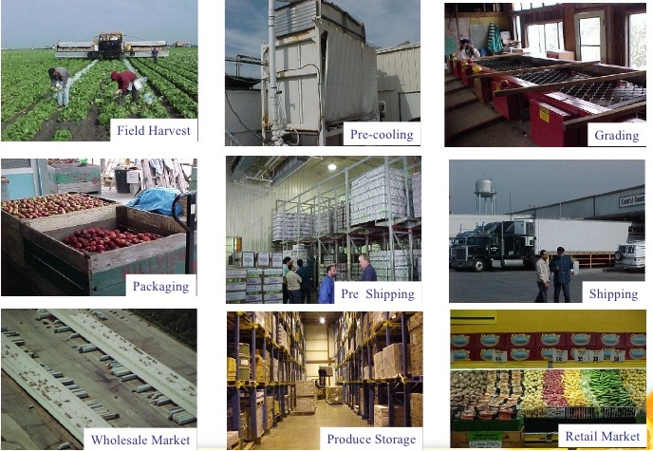
ILLUSTRATIVE LIST OF ACTIVITY

Slide 98
Sr. No. | Activity
1 | Manufacturing of herbal extracts and aromatic oils.
2 | Processing sweet corn and baby corn and other English Producing vegetables viz. Broccoli, Lettuce, Cauliflower, Peas etc.
3 | Integrated Coconut Processing Unit
4 | Fruit pulp Manufacturing unit of especially mango pulp.
5 | Processing & export life saving anticancer drug.
6 | Cashew Processing.
7 | Processing of raw cashew nuts
8 | Production / Sale of grapes wine
9 | Cultivation, Processing and Export of Gherkin.
10 | Established of grape juice based wine production unit
11 | Processing and Preservation of fruits & vegetables with state of art technology
12 | Trout Fish Canning & Preservation
13 | Processing & Manufacturing of aloe Vera & allied products

Slide 99
Sr. No. | Activity
14 | Infrastructure facility for pre-cooling, grading, pack house & cold storage for grapes
15 | Setting up processing/ grading and packing walnut/ walnut kernels nut
16 | Setting up processing/ grading and packing walnut/ walnut kernels nut
17 | Cut flower production ( under controlled condition ), value addition & marketing
18 | Dehydration of onions, garlic & other vegetables
19 | Manufacturing bamboo mat corrugated sheets
20 | Processing of Pineapple, passion fruit
21 | Manufacturing of desiccated coconut powder
22 | Processing of coconut for production of virgin coconut oil & coconut vinegar
23 | Aqua Technology Park
24 | Processing of honey
25 | Frozen fruits & vegetables processing with IQF technology
26 | Pre-cooling pack house & cold storage unit & processing of raisin(Bedana)

Slide 100

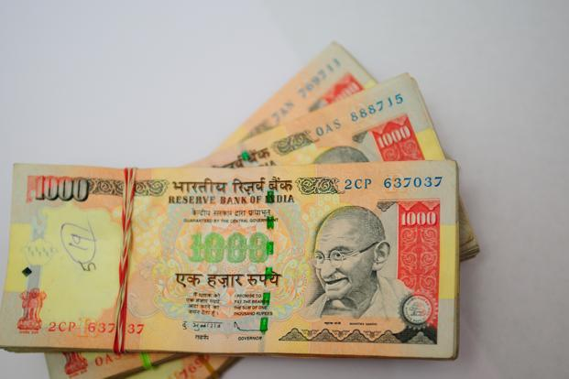
VENTURE CAPITAL ASSISTANCE

Slide 101
SFAC provides interest-free venture capital to agribusiness projects by way of soft loan to supplement the financial gap worked out by the sanctioning authority of term Finance with respect to the cost of the project.
The quantum of SFAC venture capital Assistance will be the lower of the following:
26% of the promoters equity.
Rs.50.00 lakhs (maximum).
However, for agribusiness projects set up in the North-Eastern Region, Hilly States, (Uttarakhand, Himachal Pradesh , Jammu & Kashmir) and in all cases in any part of the country where the projects is promoted by Farmer producer Orgnisation, the quantum of venture capital will be the lower of the following:
40% of the promoters equity
Rs. 50.00 lakhs

Slide 102


ELIGIBLE COST OF PROJECT

Slide 103
Minimum Rs.15.00lakh (Rs.10.00 lakh for hilly and North Eatern States and backward districts.)
Maximum upto Rs. 500.00 lakh.
Higher venture Capital Assistance can be considered by SFAC to deserving projects on merit provided:
Provision for higher VCA has been appraised and approved by the sanctioning authorityof term loans, subject to a maximum of Rs. 3.00 crore.
The total cost of project is not more than Rs.10.00 crore.
The projects are located in the North Eastern Region (NER) and other pre-identified district declared backward by the Backward Regions Grant Fund Scheme.
The benificiary will repay the venture capital in lump sum to SFAC after full repayment of the banks term loan as per the original schedule or earliar..

Slide 104
PROJECT DEVELOPMENT FACILITY

Slide 105
Consultants/ Agency promoted by public sector banks.
Consultants/Agency promoted by state governments.
Registered Consulting firms promoted by a group of professional.
Individual consultants/ proprietary firms.
However, the applicant organisation/ individual must be a qualified expert with a minimum of post graduate degree level qualification approved by UGC/AICTE. Institute of Chartered Accounts of India, as the case may be; from any of the following categories of expertise:
Agriculture, Horticulture, Agribusiness, Agro processing, Food Processing, Engineering, Fisheries, Poultry & Dairy, Management, Finance, Rural Management.
Chartered Accountants.

Slide 106


ILLUSTRATIVE LIST OF ESSENTIAL DOCUMENTS REQUIRED FOR PROCESSING THE VCA PROPOSAL

Slide 107
Application Format (available of SFAC website).
Promoters request letter addressed to the managing director, SFAC, New on original letterhead of firm / company
Sanction letter of sanctioning Authority addressed to recommending branch.
Bank approval appraisal/process note bearing signature of sanctioning authority.
Potential impact on small farmer producers
Social impact
Environmental Impact
Risk Analyze and
Replication Factor

Slide 108
Specific recommendation with amount of VCA on banks original letterhead with date and dispatch number duly signed by the Branch Manager on each page.
Implementation schedule confirmed by the bank.
Up-to date statement of account of term loan and cash credit (if sanctioned).
Equity certificate a) CA Certificate in case of partnership or proprietorship firm (b)form -2, form-5 and form-23 field with ROC for company.
List of farmers (backward linkage) confirmed by promoter and bank.
Affidavit of promoter that they have not availed VCA in the past from SFAC.
Field inspection report of bank official as on recent date.

Slide 109

OTHER SCHEME OF SFAC

Slide 110
Equity Grants & Credit guarantee fund scheme for farmer production companies.
Promotion of Farmer Production Organisation (FPOs)

Slide 111
Schedule of rates payable to empanelled consultants under Schemes implemented by SFAC
During the XII Plan, SFAC is implementing the following:
Central Sector Schemes which involve the use of consultants for preparation of applications / Detailed Project Reports (DPRs) / documents:
Venture Capital Assistance Scheme for Agribusiness Development.
2. Equity Grant & Credit Guarantee Fund Scheme for Farmer Producer Companies.

Slide 112
The schedule of fee payable to consultants for various activities under these schemes is summarized below
Venture Capital Assistance Scheme
for
Agribusiness Development
However, in every case where an empanelled consultant takes up the work of preparing documentation under any scheme, prior approval of SFAC will have to be obtained in writing.
All State SFACs and empanelled consultants are requested to take note for compliance.

Slide 113
Category | Project Size | Total Fees in Lakh
I | Rs.10.00 lakh to Rs.25.00 lakh | Rs.25,000.00
II | Rs.25.00 lakh and upto Rs.1.00 crore | Rs.50,000.00
III | Rs.1.00 crore and upto Rs.3.00 crore | Rs.75,000.00
IV | Rs.3.00 crore and upto Rs.5.00 crore | Rs.1,00,000.00

Slide 114
Terms of payment of all Categories
Stage | % of Fees
I | 20% after submission of DPR and Other documents to the bank
II | 40% after sanction of term loan by bank / Financial Institution with provision of VCA.
III | 40% after sanction and disbursement of VCA by SFAC.

Slide 115
Equity Grant and Credit Guarantee Fund Scheme for
Farmer Producer Companies
However, in every case where an empanelled consultant takes up the work of preparing documentation under any scheme, prior approval of SFAC will have to be obtained in writing.
All State SFACs and empanelled consultants are requested to take note for compliance.

Slide 116
For preparing applications under Equity
Grant Fund on behalf of FPC:
The total fee of Rs.15,000/- will be payable in two instalments; 50% after application has been submitted to SFAC and is accepted for processing.
The remaining 50% will be paid upon sanction of equity grant by SFAC.
However, if for technical reasons the Equity Grant is declined, the consultant will be paid only 50% of the second instalment.

Slide 117
For preparing DPRs under Credit Guarantee Fund
for submission to bank
The total fee payable is Rs.25,000/-_ which includes all the assistance required by the FPC for preparation of Detailed Project Report (DPR), submission of documentation to the bank and execution of documents.
The fee will be payable in the following manner:
-25% on submission of completed application to the bank.
-50% on issue of sanction letter by the bank &
- 25% on completion of documentation and disbursal by bank.

Slide 118
Cold Storage Subsidy From National Horticulture Board
Presented By,
CA. G.B.Modi, B.com, FCA (Dhule)
Email:- gbmodi@hotmail.com
Mob:- 09422285096

Slide 119
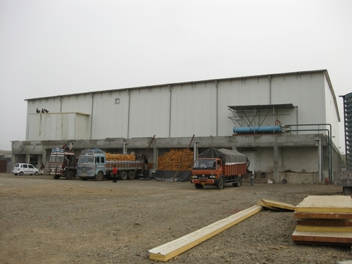
CAPITAL INVESTMENT SUBSIDY SCHEME FOR CONSTRUCTION /EXPANSION/MODERNIZATION OF COLD STORAGES/STORAGES HORTICULTURE PRODUCE
www.industrialsubsidy.com

Slide 120
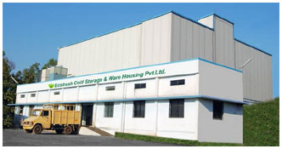
Making Application for a Letter of Intent under the scheme“ Capital Investment Subsidy Scheme for Construction / Expansion / Modernization of Cold Storages / Storages"
www.industrialsubsidy.com

Slide 121
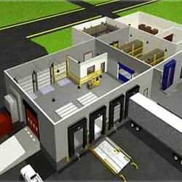
COMPONENTS
Credit linked projects relating to cold storages including controlled atmosphere (CA) and modified atmosphere (MA) stores, pre-cooling units, other storages for onion, etc., their modernization are eligible for assistance under this component.
www.industrialsubsidy.com

Slide 122

PATTERN OR ASSISTANCE
The assistance will be as credit linked back-ended subsidy @35% of the capital cost of project in general areas and 50% in case of Hilly & scheduled areas for a maximum storage capacity of 10000 MT per project.
www.industrialsubsidy.com

Slide 123
GENERAL CONDITIONS FOR COLD STORAGE PROJECTS
Multi-chamber cold storage with mezzanine floors of RCC
AND OR
wooden structure for products not requiring pre-cooling, temperature range 0 degree Celsius plus to 16 degree Celsius or above with fin-coil cooling system, with control system for humidity (RH 80% to 95% in general and 65%-70% for onion & garlic or appropriate level for seed storage etc) and appropriate handling of stored commodity with safety system against accidents of fire, leakage of refrigerant etc.
Minimum of two chambers, standard insulation material, with civil structure, insulations and cooling system as per prescribed standards-
www.industrialsubsidy.com

Slide 124
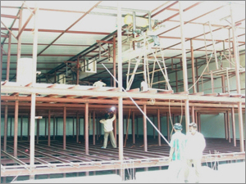
CAPITAL COST PER TON:-
@Rs 8,000 per MT
FOR 5000 MT @Rs 8,000 per MT =4 CRORE
SUBSIDY@35% ON 4 CRORE =1.4 CRORE
SUBSIDY@50% ON 4 CRORE =2.00CRORE
www.industrialsubsidy.com

Slide 125
Cold Storage Units Type1 Basic Type With Single Temperature Zone
www.industrialsubsidy.com

Slide 126
Sr.no. | Capacity | Rate Per MT In RS | Project Amount | Subsidy In RS (Lac)
 |  |  |  | 35% | 50%
1 | Up to 5000 MT | 8000 | 400 | 140 | 200
2 | 5001 MT to 6500 MT | 7600 | 494 | 172.9 | 247
3 | 6501 MT To 8000 | 7200 | 576 | 201.6 | 288
4 | 8001 To 10000 | 6800 | 680 | 238 | 340
www.industrialsubsidy.com

Slide 127
Cold Storage Unit Type 2 with Multiple
Temperature Zones And Basic Material Handling
www.industrialsubsidy.com

Slide 128
Sr.no. | Capacity | Rate Per MT In RS | Project Amount | Subsidy In RS Lac
 |  |  |  | 35% | 50%
1 | Up to 5000 MT | 10000 | 500 | 175 | 250
2 | 5001MT to 6500MT | 9500 | 617.5 | 216.12 | 308.75
3 | 6501 MT To 8000 | 9000 | 720 | 252 | 360
4 | 8001 To 10000 | 8500 | 850 | 297.5 | 425
www.industrialsubsidy.com

Slide 129
Cold Storage Units Type 2 With Add On Technology For Controlled Atmosphere
www.industrialsubsidy.com

Slide 130
Sr.no. | Capacity |  | Rate Per MT In RS | Project Amount | Subsidy In RS
 |  |  |  |  | 35% | 50%
1 | 5000 MT | 10000 |  | 500 Lac | 175 Lac | 250 Lac
www.industrialsubsidy.com

Slide 131
Technology Induction And Modernization Of Cold Chain
www.industrialsubsidy.com

Slide 132
Sr.no. | Capacity | Rate Per MT In RS | Project Amount | Subsidy In RS
 |  |  |  | 35% | 50%
1 | 5000 MT | 2500 | 25 Lac | 8.75 Lac | 12.5 Lac
www.industrialsubsidy.com

Slide 133
India BPO Promotion Scheme (IBPS)
SOFTWARE TECHNOLOGY PARKS OF INDIA
Department of Electronics and Information Technology (DeitY),
Ministry of Communications and IT,
Government of India

Slide 134
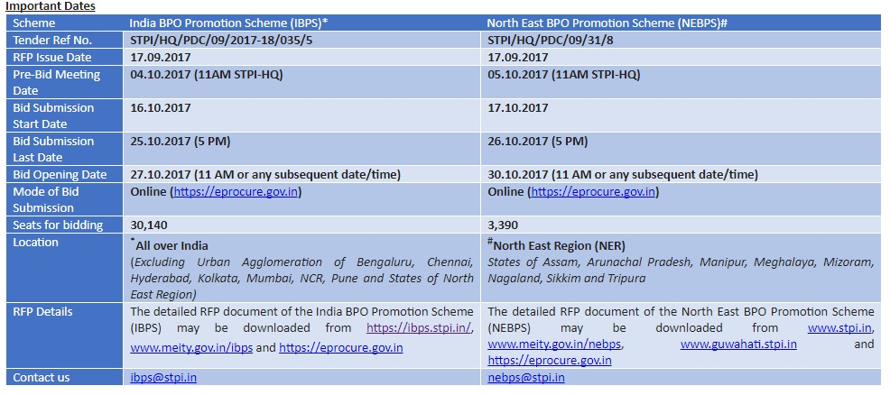

Slide 135
INTRODUCTION
The Department of Electronics and IT (DeitY), Ministry of Communications and IT,
Government of India has notified the “India BPO Promotion Scheme (IBPS)” under Digital India
Programme, which provides financial support in the form of Viability Gap Funding to eligible
Companies, with the following objectives:
(i) Creation of employment opportunities for the youth, by promoting the IT/ITES Industry particularly by setting up the BPO/ITES operations.
(ii) Promotion of investment in IT/ITES Sector in order to expand the base of IT Industry
and secure balanced regional growth.

Slide 136
SALIENT FEATURES OF IBPS
The IBPS aims to incentivize establishment of 48,300 seats in respect of BPO/ITES operations across the country (excluding Urban Agglomeration of certain cities and the States of North East Region viz. Assam, Arunachal Pradesh, Manipur, Meghalaya, Mizoram, Nagaland, Sikkim and Tripura as per Appendix-J), distributed among each State in proportion of State’s population as in Appendix-K. IBPS provides the following financial supports in the form of Viability Gap Funding (VGF) to eligible Companies:
Capital Support:
Up to 50% of one time expenditure incurred on admissible items (Appendix-E) subject to an upper ceiling of Rs. 1 Lakh/Seat.
Special Incentives:
The following special incentives will be provided within the ceiling of
total financial support i.e. Rs. 1 Lakh/seat:

Slide 137
ELIGIBILITY CRITERIA
The bidder (any Indian company not restricted to BPO/ITES company) would be required to meet the following conditions:
The bidder must be registered in India under The Companies Act, 1956 or The Companies Act 2013 (as amended till date), as applicable.
The bidder must be willing a setup a new BPO/ITES operations, with a minimum of 100 seats (minimum 50 seats in case of Hilly Region) at one location. However, the bidder would be at liberty to bid for a maximum 5000 seats at multiple locations (cities/States) across the country. Maximum seat per bidder in a State/UT).

Slide 138
ELIGIBILITY CRITERIA
The bidder should have achieved a minimum average annual turnover during last 3 financial years, as per total number of seats applied under IBPS, detailed as follows:
A bidder with higher turnover can always apply for minimum numbers of seats e.g. a bidder having average annual turnover during last 3 financial years as ₹40 crore can apply for minimum 100 seats (minimum 50 seats in case of Hilly Region) and maximum 2,000 seats across States.
Number of seats/bidder across States/UTs* | Minimum Average Annual Turnover of last 3 FYs (Rs. in Crore)
50 [Available in HP, J&K, and UK only ] | 1
100 | 2
Up to 500 | 5
Up to 1000 | 15
Up to 2000 | 40
Up to 5000 | 150

Slide 139
Based on the above Seat-slab, the eligible seat-slab among each State and maximum number of seats per bidder in a State is as under:
State/UTs | Total Seats in a State/UT | Max. seats per bidder for each State/UT | Eligible Seats Slabs available for Bidding
Goa, Andaman & Nicobar, Chandigarh, Dadra & Nagar Haveli, Daman & Diu, Lakshadweep, Puducherry | 100 each | 100 | SS1
Himachal Pradesh | 300 | 100 | SS0, SS1
Madhya Pradesh | 3200 | 1000 | SS1, SS2, SS3, SS4, SS5
Maharashtra | 3900
Bihar | 4600
UP | 8800
West Bengal | 3400
Rajasthan | 3000

Slide 140
PERFORMANCE AND EXIT MANAGEMENT
Upon completion of the agreement period or upon termination of the agreement for any reasons, the Successful bidder shall comply with the following:
In the event of the BPO Unit not being able to claim Capital Support within 6 months from the date of commencement of its operations, the BPO Unit will not be eligible for any support whatsoever and the IPA/Agreement shall be deemed to have been cancelled/ terminated except extension of 3 months as per Para 8(i) above.
In the event of the BPO Unit not being able to achieve minimum employment target of 50%, within 6 months from the date of commencement of its operations, the Unit shall not be eligible for any support whatsoever and the IPA/Agreement shall be deemed to have been cancelled/ terminated. The BPO Unit will be obligated to furnish quarterly performance report, inter-alia,
indicating the average monthly employment in the Unit. At the stage of release of Bank Guarantee, average employment of last two years will be calculated. In the event of the BPO Unit not meeting the employment target (based on which the capital support was released), the STPI would be at liberty to invoke the Bank Guarantee.

Slide 141
ELECTRONICS POLICY
INDUSTRIES DEPARTMENT

Slide 142
Applicability
Incentives/ benefits covered under this policy will be applicable to all areas of the state.
For the purpose of Package Scheme of Incentives-2013 (issued by State Government vide Resolution no. PSI-2013/(CR-54)/IND-8 dated 1st April 2013) areas of State are classified as Group, A/B/C/D/D+/No industry district a Naxalism affected area, on the basis of their level of industrial development; the same classification is adapted for this policy.
The Industrial units which are approved under the “Modified Special Incentive Package Scheme” (M-SIPS) of Department of Electronics & Information Technology, Government of India, will be eligible for incentives under this scheme.
The Industrial units which are not covered under the (M-SIPS) Scheme of Government of India will be eligible for regular incentives under the Industrial Policy-2013.

Slide 143
Strategies
Creating ecosystem for globally competitive ESDM sector through:
Fiscal incentives.
Facilitating setting up projects like Lithium ion battery, LED manufacturing etc.
Rationalizing and establishing industry-friendly stable tax system.
Incentivisation of Technology transfer, R&D and IPR creation.
Encouraging industry associations in vendor and dealer network development.
Making available 24 x 7 uninterrupted quality power.
Create electronics development fund for ESDM sector.

Slide 144
Promotion of Exports
Incentives to EOU.
• To encourage coordination and tie up with global electronics cities in the leading countries and engage with top ESDM companies to proactively invite investments in the State.

Slide 145
Human Resource Development
Electronics manufacturing industries require skilled manpower to be competitive. The State Government will focus on imparting the necessary skills to ensure availability of a quality labour pool required for the sector. This will involve in:
Suitably designing the syllabus at institutes as per requirement to make available trained and skilled manpower.
Creation of an institutional mechanism for the faculty development in various ESDM related subjects.

Slide 146
Incubation centers/manufacturing park
Government will promote setting up of incubation centers for ESDM related sectors in association with Academic Institutions/Industry. MIDC will provide infrastructure for such incubation centers at nominal cost.
A parcel of land up to 100 acres will be kept reserved in DMIC project at Aurangabad for setting up of electronics
manufacturing park under the Greenfield Electronic Cluster scheme of Govt of India.

Slide 147
Handling e-waste
Facilitating environment-friendly e-waste handling policies by creating a mechanism with industry to streamline the implementation of e-waste (Management and Handling) rules, 2011 including restriction on usage of hazardous substances.
To constitute a high level committee with due representation from the industry for marketing the State's offers based on its competencies and thereby attract investments into the State.

Slide 148
Fiscal Incentives
Fiscal incentives shall be extended to eligible ESDM units under the umbrella of package Scheme of Incentives (PSI). A basket of incentives will be offered to eligible Micro, Small, Medium manufacturing enterprises (MSME) and Large manufacturing enterprises (LE) covering the incentives under paras 4.1 to 4.3, the total quantum of which will be limited to a ceiling of 100% of FCI or eligibility period of 10 years, whichever is earlier. The incentives mentioned in paras 4.4 to 4.6 would be available in addition to the basket of incentives above.
ESDM units in A and B category areas with minimum Fixed Capital Investment (FCI) equal to Rs. 250.00 crores or minimum employment of 500 people and units in rest of the state with minimum FCI of Rs.100.00 crores or providing employment to 250 people will be accorded Mega project status. The quantum of incentives for mega projects shall be decided as per the provisions of IE&LD GR No. PSI-2013/C.R.- 54/ Ind-8 dated April 1, 2013 and any subsequent GRs or Guidelines issued based on the decisions in the Cabinet Sub-Committee or High Power Committee.
Admissible investment period for ESDM units will be extended by 3 years in Category A and B areas and by 5 years in other parts of state compared to what is available under prevailing Package Scheme of Incentives.
The incentives, if any, offered by Government of India or any of its agencies or local bodies shall be over and above the incentives offered under this policy.

Slide 149
Industrial Promotion Subsidy (IPS)
All eligible MSMEs and LEs in category A and B area will be offered IPS equal to [VAT on local sales minus ITC (Input Tax Credit) or zero whichever is more + CST payable + 75% of ITC] and in other parts of state [VAT on local sales minus ITC or zero whichever is more + CST payable + 100% of ITC] on eligible finished products.
Note - Modalities regarding disbursement of incentives, related to VAT & CST, will be modified accordingly when GST is made applicable to the state.

Slide 150
Interest Subsidy
All new/expansion units will be eligible for interest subsidy on term loans availed from Banks and Public Financial Institutions for acquisition of fixed assets for the eligible project. For the purpose of this assistance, bank’s prime lending rate or the rate of interest actually charged, minus penal interest if any, whichever is less, will be taken as the effective interest rate.
The quantum of interest subsidy will be calculated at effective rate of interest, after deducting the interest subsidy receivable under any Govt. of India scheme or 5% per annum, whichever is less, provided that minimum 7% effective interest per annum is borne by the industrial unit. Overall Ceiling of the interest subsidy shall be up to the Quantum of VAT + CST collected during that year. If any unit in ‘A’ & ‘B’ category area maintains permanent employees more than 1000 and in other category area maintains permanent employees more than 500, then for such units 50% more interest subsidy than their eligible interest subsidy will be offered.

Slide 151
Power Tariff Subsidy
Eligible new ESDM units will be eligible for power tariff subsidy to the tune of Rs. 1/- per unit for a period of 3 years in category A and B areas and 5 years in other parts of state, subject to ceiling stipulated in para 4.7.

Slide 152
Exemption from Electricity Duty
Eligible new ESDM units will be exempted from paying Electricity Duty for 15 years.

Slide 153
Waiver of Stamp Duty
Eligible ESDM units will be exempted from payment of stamp duty during the investment period, for acquiring land and for term loan purposes. Subject to condition that, units shall be required to submit NOC from competent Authority of Directorate of Industries.

Slide 154
Incentives for strengthening MSMEs
Following incentives will be admissible to eligible MSMEs:
25% one time subsidy on capital equipment for technology Upgradation, limited to Rs. 25 lakh.
25% one time subsidy on capital equipment for cleaner production measures, limited to Rs. 5 lakh.
75% subsidy on the expenses incurred on patent registration limited to Rs.10 lakh for national patents and Rs. 25 lakh for the international patents.
Assistance for a maximum of three industry standard quality certifications, at a rate of 50% of cost of quality certification within the overall ceiling of Rs. 6 lakh in 5 years. The amount of assistance will include :
i) Fees charged by certification agency.
ii) Consulting fees and training charges.
iii) Cost of testing equipment as suggested by BIS.
iv) Calibration charges of equipment.

Slide 155
Incentives for strengthening MSMEs
One time incentives for credit rating of MSMEs
75% of the cost of carrying out credit rating by Small Industries Development Bank of India/Government accredited Credit Rating agency, limited to Rs. 50,000.

Slide 156
Anchor Units
In order to ensure that the right ecosystem develops in the state, the Government of Maharashtra has to actively work towards attracting an ‘anchor unit’ in the sector. The anchor unit will further attract other players in the sector and also encourage MSME units to set up operations around it. Special Incentive package on a case-to-case basis will be given to first two anchor units (with investment more than Rs.150 crores) in each of the Electronic Manufacturing Cluster notified by Government of India and package of incentives shall be decided as per the provisions of IE&LD GR No. PSI-2013/C.R.- 54/ Ind-8 dated April 1, 2013 and any subsequent GRs or guidelines issues based on the decisions in the Cabinet Sub-Committee or High Power Committee.

Slide 157
Other Incentives
Support to R&D institutions / Testing Facilities / Incubation and Innovation centres.
In order to give impetus to Research and Development, need-based support will be provided to R&D institutions set up with the approval of the State Government.
• Apart from new and existing R&D institutions, testing facilities, incubation and innovation centers will also be covered. The assistance will be given up to 50% of the project cost excluding land and building subject to maximum 25 crores.
• One time assistance for contract / sponsored research work from any ESDM industrial unit / ESDM industries association to recognized R&D institution / technical college approved by AICTE, will be considered at 50% of the project cost, subject to maximum of Rs. 50 lakh.

Slide 158
Market Development Support
Assistance to MSME units for participation in International trade fairs outside India at the rate of 50% of total rent, literature and display material cost subject to a ceiling of Rs. 3 lakh, once in a year. The unit should not participate in an individual capacity, but only as a part of the industry association which would participate in such trade fairs. The assistance will be by way of reimbursement. MSME units shall have to apply within six months from the date of participation for the assistance.
• Assistance to industry associations at 50% of total rent subject to a ceiling of Rs.10 lakh for participation in international trade fair as Maharashtra Pavilion outside India for participation by minimum 5 units. Such
assistance shall be in the form of reimbursement and will be extended only once in a year.
• Viability gap support to industry associations for organizing national seminars / exhibitions in Maharashtra subject to a ceiling of Rs.10 lakh and for organizing International seminar / exhibition in Maharashtra subject to a ceiling of Rs. 25 lakh.
• Assistance for setting up of Convention Centre / Trade Centre by industry associations at the rate of 50% of project cost up to Rs.10 crores excluding land cost.

Slide 159
Electronics Development Fund
State Government will set up an Electronics Development Fund for the development of ESDM sector in the State. An initial corpus of Rs. 50 crores will be created for this purpose. It will be fund of funds. It will be invested through other professionally managed Early Stage Angel Funds and Venture Funds.

Slide 160
Human Resource Development
Manpower with proper skill and knowledge is key to success of any industry and electronics industry is no exception. The Government will take following measures to create a pool of skilled manpower for the ESDM sector:
• Appropriate infrastructure to train people at operator level would be created by upgrading ITI/technical/ vocational schools.
• Short-term courses and training institutes in after-sales service support would be promoted through Public-Private partnership.
• Capacity creation and curriculum Upgradation in technical education especially in ESDM field would be made a continuous process.
• ESDM units can also use in-house training facility for imparting training to outside candidates.

Slide 161
Initiatives for simplification of relevant legislations
Electronics units will benefit from-
• Relaxations under the Shops and Establishment Act with regard to working hours, work shifts and employment of women, with her consent to work in shifts. Provided safety of women employee will be responsibility of concerned management.
• Exemption from maintaining physical records for attendance and salary.
• Option for self-certification and filing of consolidated annual returns under 13 Acts administered by the
Labour Department.

Slide 162
Initiatives for simplification of relevant legislations
ESDM Industry will be declared as essential service under ‘Maharashtra Essential Services and Maintenance Act’. Government would make necessary amendments in the Act to include ESDM industry in the list of essential services.
Provision for Electronics units to maintain employee-related records required under various labour laws in electronic form, and to accept returns in electronic form will be made in line with the progress of computerization in the Labour Department.
Electronics units not discharging process effluent and with less than 100 employees will be exempt from obtaining consent from the Maharashtra Pollution Control Board (MPCB). Such units will be required to submit annual statements to MPCB on the disposal of wastes like electronics wastes, used batteries and used oil. These units will have to be connected to local sewage network.
On the line of relaxation under Contract Labour Act which have been approved for units in SEZs will be considered for all electronics units also, subject to approval of the legislature.
ESDM units will be treated as continuous process industry for the purpose of power supply and there will be continuous supply of electricity through separate / dedicated feeder for 24 hrs. in a week.
A single window clearance system will be created for State Government approvals for ESDM units.
List of ESDM verticals as applicable for MSIPS will apply and only those units notified by Government of India will be eligible for incentives under this Policy. The list of ESDM verticals will get modified whenever Government of India modifies any changes in the Notification dated 27th July, 2012.

Slide 163
Government of Maharashtra
Industries Department
IT/ITES POLICY 2015
Policy Applicability and Validity
The parks / units which have been sanctioned benefits / incentives under this policy, shall continue to enjoy the benefits for a period for which the benefits / incentives are sanctioned even if the policy period is over. The policy will be valid for FIVE years.
The policy will be valid for FIVE years.

Slide 164


Slide 165
Vision, Mission, Objectives and Targets
Vision
“Maharashtra - a globally competitive Information Technology / Information Technology Enabled Services destination that promotes inclusive growth and to establish Maharashtra as an intellectual and knowledge capital of India”.
Mission
To place Maharashtra amongst the most preferred investment destinations for global investors.
through promotional strategies combined with developing a competitive and sustainable investment environment,
thereby making Maharashtra as one of the most favoured economic magnet and Centre of attraction.

Slide 166
Vision, Mission, Objectives and Targets
Policy Objectives
To retain Maharashtra's leadership position in IT/ITES Sector.
To further accelerate investment flow to industrially underdeveloped regions of the state.
To create more employment opportunities for educated youths of all sections of the society across all regions.
Achieving higher level of export turnover resulting in enhanced productivity and augmentation of Gross State Domestic Product (GSDP).
Leveraging Information Technology as a tool for the socio-economical development of the state.
To promote Intellectual Property creation along with original content creation for new product and unique services offering for B to B & B to C.

Slide 167
Vision, Mission, Objectives and Targets
Policy Targets
To attract an investment of Rs. 50,000 crores by the private IT parks and the IT / ITES / AVGC units in the State.
To create new jobs for 1 million persons.
To raise annual exports from IT / ITES / AVGC sector from the State upto Rs. 1,00,000 crores.

Slide 168
Strategic Drivers of the Policy
Dispersal of IT industry to all parts of the State
To attract IT investments across the State and incentivize IT industry at all district headquarters in the State by providing additional incentives and continue to provide usual incentives as per the IT / ITES Policy - 2009 .
Promotion of Focus Sectors:
To promote the development of special fields such as AVGC (Animation, Visual effects, Gaming and Comics) in which the State has particular strengths. Adhaar Card based applications / public service delivery systems and Engineering Research and
Development to be promoted.

Slide 169
Policy Initiatives
A
Incentives & Provisions for IT Parks/IT SEZs / AVGC Parks
IT Park has proved to be an effective tool to develop IT sector by providing adequate quality infrastructure to cluster of IT / ITES units.
Government of Maharashtra encourages Public as well as Private IT Parks throughout the state.
This policy will provide following incentives & provisions.

Slide 170
Policy Initiatives
Incentives & Provisions for IT Parks/ IT SEZs / AVGC Parks
i) Additional FSI and space utilization of IT Parks:
The availability of land is decreasing and the cost of land is constantly increasing which is leading to high cost of built up space. The high cost of space is proving to be a hindrance to the growth of IT Industry. To provide built up space at affordable rates to the entrepreneurs more additional FSI
over the base FSI shall be admissible.

Slide 171
Additional FSI and space utilization of IT Parks
a) Upto 100% additional FSI
to all registered Public and Private IT/ITES Parks / AVGC Parks, IT SEZs or IT Parks in SEZs and to stand-alone IT/ITES units in public IT Park which have been approved by the Directorate of Industries, set up under present and previous IT / ITES policies, shall be made
available with or without premium as follows:
With a premium of 10% of the prevailing ready reckoner rate for all areas in the State other than areas in Pune, Pimpri-Chinchwad, Greater Mumbai, Thane, Navi Mumbai, Kalyan-Dombivali, Mira- Bhayandar, Ulhasnagar municipal corporations and Ambernath municipal council and in No Industry Districts and Naxalism affected areas of the State (as defined in the Package Scheme of Incentives - 2013 of the State).
With a premium of 30% of the prevailing ready reckoner rate in Pune, Pimpri-Chinchwad, Greater Mumbai, Thane, Navi Mumbai, Kalyan- Dombivali, Mira-Bhayandar, Ulhasnagar municipal corporations and Ambernath municipal council areas.

Slide 172
Additional FSI and space utilization of IT Parks
b) Above 100 % and upto 200% additional FSI
to all registered Public and Private IT Parks, AVGC Parks, IT SEZs or IT Parks in SEZs and to stand-alone units in public IT Park which have been approved by the Directorate of Industries, set up under present and previous IT / ITES policies, and which have an access road of minimum 15 metres width, shall be made available
with or without premium as follows:
With a premium of 10% of the prevailing ready reckoner rate for all areas in the State other than areas in Pune, Pimpri-Chinchwad, Greater Mumbai, Thane, Navi Mumbai, Kalyan-Dombivali, Mira- Bhayandar, Ulhasnagar municipal corporations and Ambernath municipal council and in No Industry Districts and Naxalism affected areas of the State (as defined in the Package Scheme of Incentives - 2013 of the State).
With a premium of 30% of the prevailing ready reckoner rate in Pune, Pimpri-Chinchwad, Greater Mumbai, Thane, Navi Mumbai, Kalyan- Dombivali, Mira-Bhayandar, Ulhasnagar municipal corporations and Ambernath municipal council areas.

Slide 173
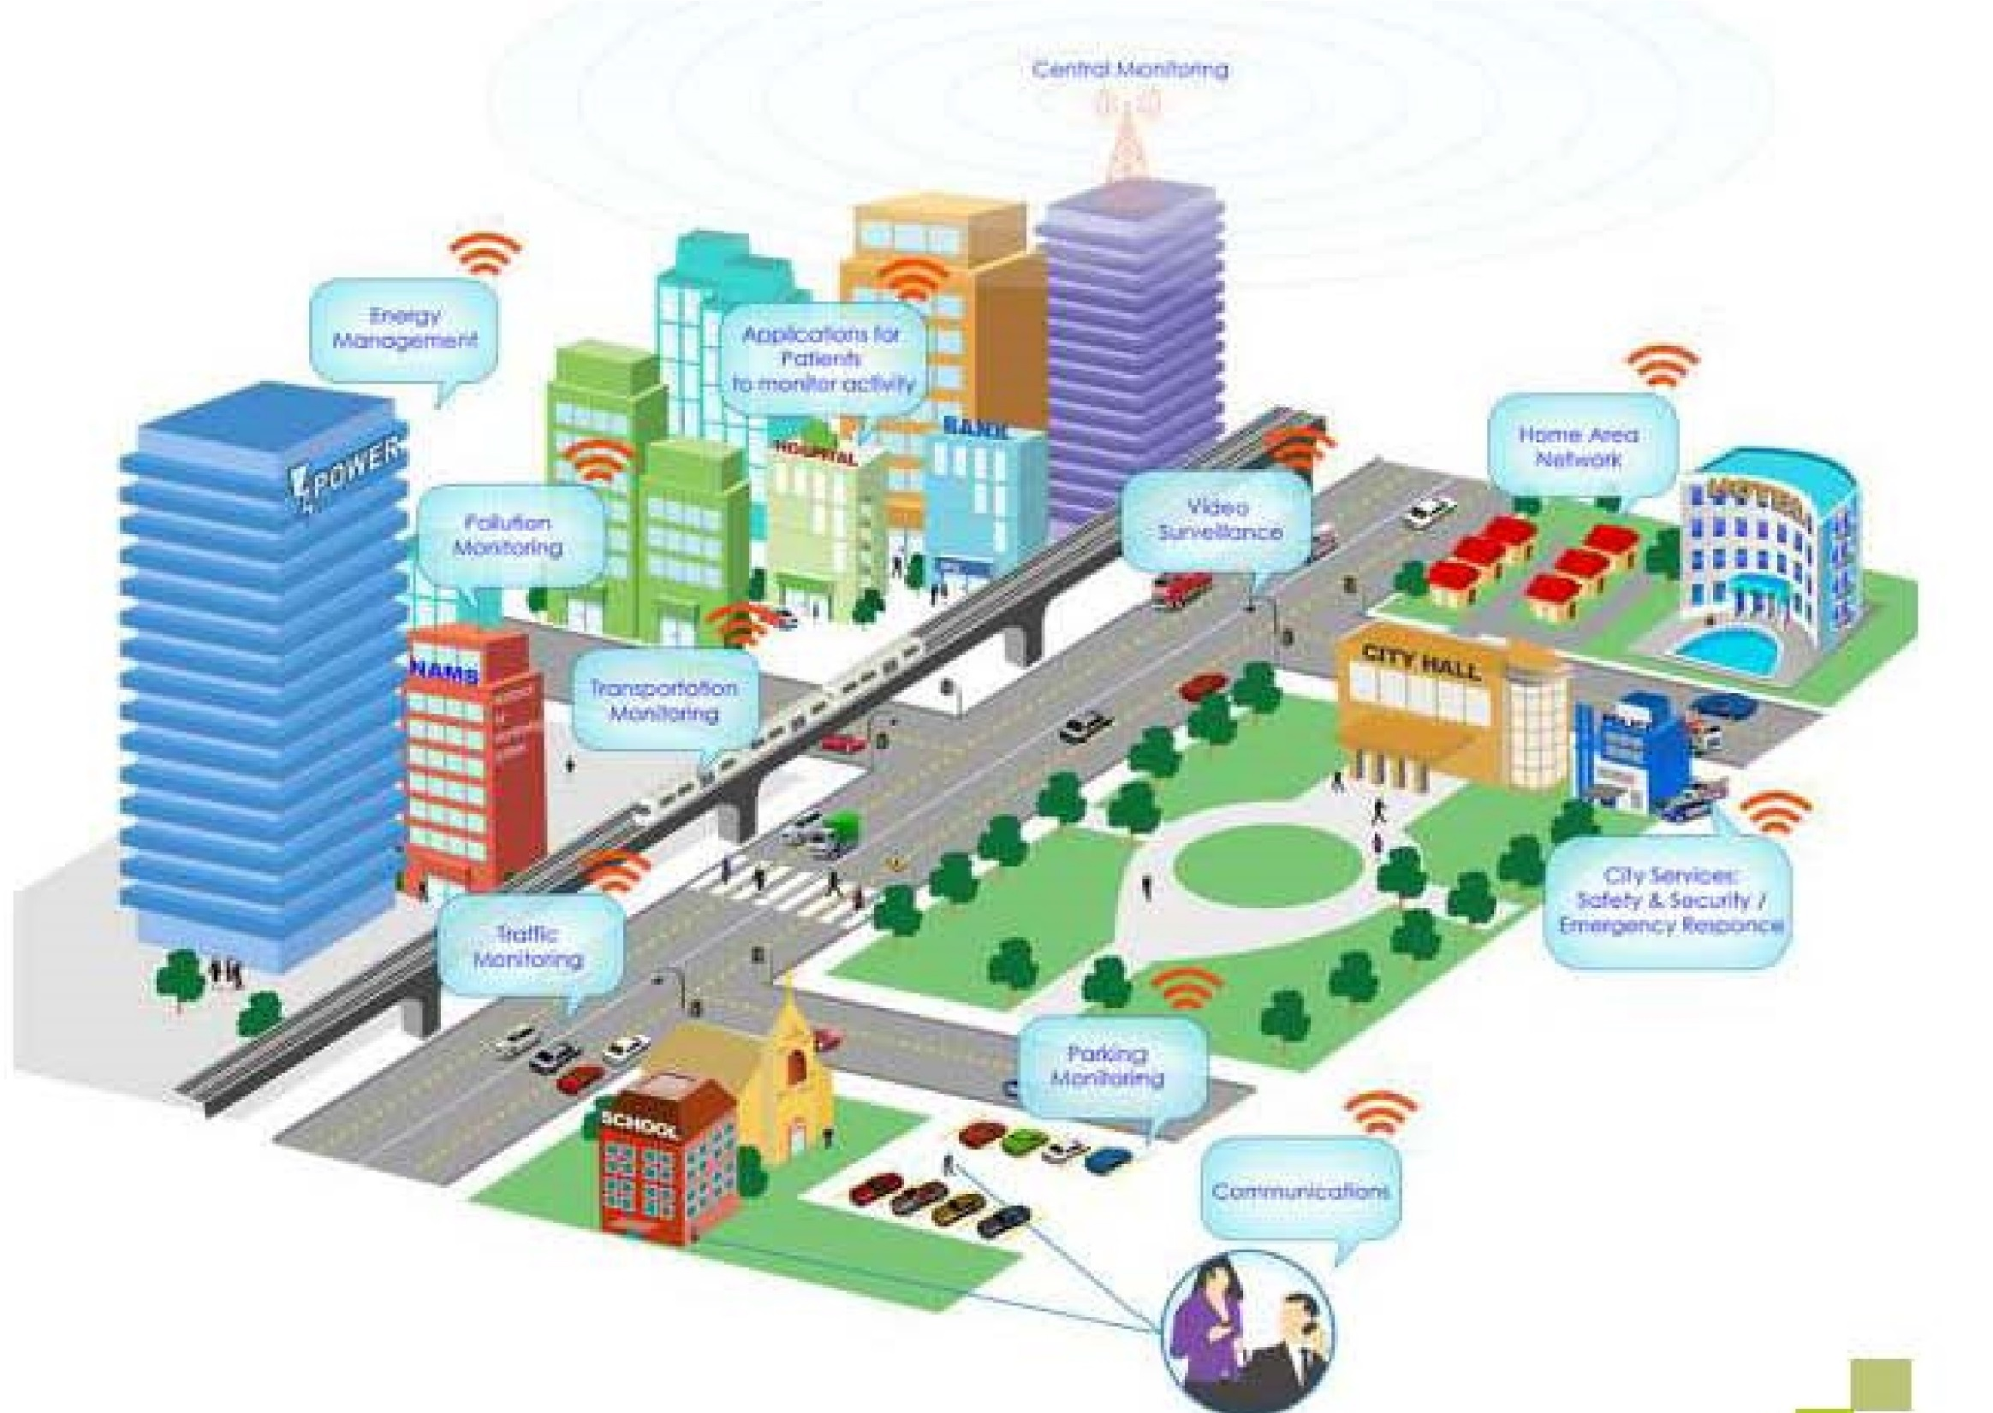

Slide 174
Incentives & Provisions for IT Parks/ IT SEZs / AVGC Parks
ii) Establishment of Integrated IT Township (IITT)
To meet the needs of the IT industry and the workforce there in to provide necessary amenities and accommodation in the vicinity of the IT units, promotion of Integrated IT Townships (IITT) is being introduced in this Policy
Considering the global trend, the IITTs shall be developed as 'Smart Cities”.
for IITTs set up in Pune Metropolitan Region (PMR) and Mumbai Metropolitan Region (MMR) areas that are outside corporation limits of Pune, Pimpri-Chinchwad, Greater Mumbai, Thane, Navi Mumbai, Kalyan-Dombivali, Mira-Bhayandar, Ulhasnagar municipal corporations and Ambernath municipal council, the premium of 20% of the prevailing ready reckoner rate will be applicable.
The IITT can be set up in any part of the State.

Slide 175
Incentives & Provisions for IT Parks/ IT SEZs / AVGC Parks
iii) Electricity Tariff
Power consumed will be charged at industrial rate for the common facilities in the IT Park (such as lobbies, central air conditioning, lifts, escalators, effluent treatment plant, wash rooms etc.) which are used by the units,
excluding support service areas, after the registration is granted to the IT park by the Directorate of Industries and Development Commissioner of the SEZ for an IT SEZ.
A separate meter will have to be provided by the developer to the individual IT / ITES units in the IT parks for leased or purchased premises.
iv) Electricity Power/ Sub Station
Provision of electric power / substation at minimum 6 watt per sq. ft. of total BUA of IT Park will be essential. This provision will also be applicable to existing IT parks.

Slide 176
Incentives & Provisions for IT Parks/ IT SEZs / AVGC Parks
v) Incentives for Development of Infrastructure - Creation of Critical Infrastructure Fund for IT/ITES Industries:
State Government & Planning Authorities shall create a seperate fund viz. “Critical Infrastructure Fund for IT/ITES Industries” from the premium paid for availing additional FSI by the Developers of the Private IT Parks.
And this fund shall be utilized only for creation of Critical Infrastructure for IT/ITES Industries.

Slide 177
B
Fiscal Incentives for IT / ITES Units
All the fiscal incentives proposed in this policy will be provided through a provision under separate budgetary head ( non - plan) for this purpose.

Slide 178
Fiscal Incentives for IT / ITES Units
i) Stamp Duty Exemption:
IT / ITES units, including IT Hardware and Telecom Hardware manufacturing units will be entitled to Stamp Duty exemption as follows:
100% Stamp Duty exemption for the following transactions to new IT/ITES units and expansions of the existing units in C, D, D+, No Industry district areas and Naxalism affected areas of the State:
hypothecation,
pawn,
pledge,
deposit of title deeds,
conveyance,
charge on mortgage property,
lease,
mortgage deed
security bond on mortgage deed.

Slide 179
Fiscal Incentives for IT / ITES Units
i) Stamp Duty Exemption:
b) 100% Stamp Duty exemption for the following transactions to new IT/ITES units and expansions of the existing units in public IT parks (including IT hardware and Telecom hardware manufacturing units),
in A and B areas: hypothecation, pawn, pledge, deeds, conveyance and lease.
c) 75% Stamp Duty exemption for the following transactions to new IT/ITES units and expansions of the existing units in private IT parks (including IT hardware and Telecom hardware manufacturing units), in A and B areas: hypothecation, pawn, pledge, deeds, conveyance, lease
and public assignment lease.
d) 100% Stamp Duty exemption for the following transactions to new IT/ITES units and expansions of the existing units in IT parks in SEZs, IT SEZs (including IT hardware and Telecom hardware manufacturing units), and STPI approved registered units in IT parks of
A and B areas: hypothecation, pawn, pledge, deeds, conveyance, lease and public assignment lease.

Slide 180
Fiscal Incentives for IT / ITES Units
i) Stamp Duty Exemption:
e) 75 % Stamp Duty exemption to assignment leases of IT / ITES units under section 60 and leave and licenses of IT / ITES under section 36 A of the Bombay Stamp Act 1958 (to be read with a, b and c above).
f ) 75% Stamp Duty exemption on merger, de-merger and reconstruction of registered IT / ITES units throughout the State.

Slide 181
Fiscal Incentives for IT / ITES Units
ii) Electricity Duty :
New IT / ITES units registered with the Directorate of Industries will be exempt from payment of Electricity Duty from
the date of commencement of production / activity
for a period of 10 years
for units in IT parks (including IT hardware and Telecom hardware manufacturing units),
in A and B areas and
for 15 years
in other areas of the State classified as per the prevailing Package Scheme of Incentives
at the time of commencement of production / activity of the unit.
The Electricity Duty would be exempt for IT parks developed by IT companies for their own use, ie, single unit parks for the period mentioned above except for the support services. The new IT / ITES units in IT SEZs, new IT / ITES units in IT parks in SEZs, and 100 % exporting IT/ITES units under registration of STPI or other designated competent authority shall be exempted permanently from paying Electricity Duty.

Slide 182
Fiscal Incentives for IT / ITES Units
iii) Electricity Tariff:
IT/ITES units registered with the Directorate of Industries will be supplied power at industrial rates applicable under Maharashtra Electricity Regulatory Commission's (MERC's) tariff orders.
iv) Power Tariff Subsidy:
New IT/ITES units located in areas other than A and B areas classified as per the Package Scheme of Incentives and established in registered IT Park will be eligible to get power tariff subsidy for 3 years @ Rs. 1/- per unit consumed
from the date of registration of the IT units with the Directorate of Industries after commencement of IT/ITES activity or equal to the investment made in IT Hardware on the date of registration of the unit with the Directorate of Industries, whichever is lower.
The units in IT SEZs and IT parks in SEZs in these areas shall also be entitled for this subsidy.

Slide 183
Fiscal Incentives for IT / ITES Units
v) Property Tax: Property tax shall be levied on IT / ITES units registered with the Directorate of Industries at par with residential rates as applicable in the relevant jurisdictions. Government will issue necessary advisory to the local bodies to give this benefit to the IT / ITES units
vi) Entry Tax: Registered IT / ITES units shall be exempt from octroi / Local Body Tax (LBT) / entry tax / escort tax or other cess or any tax levied in lieu of these for the import of capital goods and raw material for self consumption by the unit. Government will issue necessary advisory to the
local bodies to give this benefit to the IT / ITES units.
vii) Works Contract Tax: Works contract tax on annual maintenance agreements of IT / ITES units shall generally be charged at the minimum rates recommended by the relevant Empowered Committee, at the centre, barring certain exceptions.
viii) Setting-up IT/ITES units in any zone: IT / ITES units (except IT hardware and Telecom Hardware Manufacturing Units) will be allowed to be set up in any zone (including residential and no-development zones, etc.).

Slide 184
Fiscal Incentives for IT / ITES Units
ix) VAT at floor rate: VAT on sale of IT products will be charged generally at the minimum floor rate recommended by the concerned Empowered Committee at the Centre, with some exceptions.
x) Continuous Industry Status: The IT / ITES Industry services clients across the globe and in different time zones.
This requires the Industry to work on 24x7x365 mode.
Increasingly the work done by IT / ITES industry is mission critical for global clients it serves and very tight deadlines are required to be adhered to.
Considering this a continuous industry status shall be granted to the registered IT / ITES units.
The IT / ITES Industry will be permitted to work 24x7x365 days without any close down (except some exigencies arising wherein the State / Central Government thinks it fit to keep the operation in suspension).

Slide 185
C
Promotion of Animation, Visual Effects, Gaming and Comics (AVGC)

Slide 186
Promotion of Animation, Visual Effects, Gaming and Comics (AVGC)
The AVGC is a sunrise sector having vast potential for wealth creation and employment generation.
It is a healthy medium of education and entertainment.
Maharashtra has always been a leading state in industrial growth.
It has a rich and diverse heritage of art and culture and strong presence of Information Technology and Entertainment Industry which can help to make it an AVGC hub.
So far, science and technical streams were preferred avenues for employment but AVGC will create better employment opportunities for the arts stream.
Entry of artists into the AVGC industry is regardless of cultural and language backgrounds.
it will lead to economic upliftment of large strata of economically backward sections of the society.
The policy will address the gap in qualified trainers through a train-the-trainer program based on industry's needs.
the policy envisages an environment that promotes growth of indigenous digital content, education and entertainment for masses,
setting up of a Center of Excellence with state-of-the-art facilities.
These efforts will act as a catalyst for the AVGC industry.
AVGC is essentially an ITES activity and shall be eligible for the benefits admissible to ITES

Slide 187
Promotion of Animation, Visual Effects, Gaming and Comics (AVGC)
vi) Fiscal Incentives & Concessions for AVGC units:
Refund of certification charges:
All AVGC Export Oriented Units (EOUs) will get refund of expenses incurred for compulsory marking like Conformity European (CE), China Compulsory Certificate (CCC) etc. to the extent of 50% expenses subject to maximum of Rs. 2 lacs per unit.
b) Capital Subsidy:
Investment promotion subsidy as per industrial policy of the State.
Anchor unit subsidy equal to 25% of the fixed capital investment for an AVGC unit with a minimum investment of Rs 50 crores & creating a minimum employment for 100 people.
The fixed capital investment shall include investment in land, building, machinery, equipment's, electrification, pre-operative expenses capitalized.
One Anchor Unit per district will be assisted

Slide 188
Promotion of Animation, Visual Effects, Gaming and Comics (AVGC)
c) Exemption from Payment of Entertainment Tax in the State for animation films:
The animation films produced in Maharashtra and released in the cinema halls / multiplexes in the State will be exempted from payment of entertainment tax.
The films fully converted in Maharashtra from 2D to 3D in stereoscopy and released in the cinema halls/ multiplexes in the state will be refunded 50 % of the entertainment tax paid or Rs. 2.5 crores whichever is lower.
The live action films with its final edited length without the opening and end credits having a minimum of 50% duration of running length created with the help of animation or visual effects & all the said work of animation as well as visual effects if completed in Maharashtra and the film is released in the cinema halls multiplexes in the state will be refunded 50 % of the entertainment tax paid or Rs. 2.5 crores whichever is lower.
DI & colour correction will not be considered as a part of visual effects or animation for this minimum of 50% duration of running length qualification criteria.

Slide 189
Promotion of Animation, Visual Effects, Gaming and Comics (AVGC)
d) Capital Subsidy for production of animation films:
The animation films produced in the State will be given a capital subsidy equal to 50 % of the cost of production of the film subject to a ceiling of Rs. 30 lakhs for creative art films, educational, scientific,mythological and children's films.
e) Maharashtra Government will be a host state for the following annual events and will sponsor Rs.10 lakhs for each event every year for the next 5 years and the events shall be exempted from paying the entertainment tax:
FICCI FRAMES & Best Animated Frames Awards-Mumbai,
NASSCOM - Game Developers Conference-Pune,
The Animation Society of India- Aniefest, Mumbai,
ASIFA- World Animation Day - 28th Oct every year – all India
MCCIA- Digital Content Conference, Pune &
NILF – NASSCOM India's Leadership Forum
f) Non – Fiscal Support:
State Government will encourage Joint Ventures between Indian & Foreign entities.
Support will be provided for international events related to AVGC inMaharashtra.
Intellectual Property (IP) will be protected through legal framework.

Slide 190
D
Promotion of Business Process Outsourcing (BPOs) in Rural and Semi-urban Areas
This policy will leverage Information Technology as a tool for the socioeconomic development of the state and encourage existing BPO units/entrepreneurs to set up their branches/BPOs in rural / semi-urban areas.
The subsidy would be provided only for business processing units that are located in rural / semi-urban areas (village Panchayat, A,B and C class municipalities).

Slide 191
Promotion of Business Process Outsourcing (BPOs) in Rural and Semi-urban Areas
Capital Subsidy: Capital subsidy of 20% would be provided on capital investments such as cost of hardware, equipment etc., subject to a maximum of Rs. 25 lakhs (Rupees twenty five lakhs only) to any Rural BPO unit that has been directly employing a minimum of 50(fifty) trained seats in the unit.
This capital subsidy will be back ended in three equal instalments at the end of each year.
The capital investment for the purpose of subsidy constitutes purchase of new hardware and equipment's similar to plant and machinery in MSME sector.

Slide 192
Promotion of Business Process Outsourcing (BPOs) in Rural and Semi-urban Areas
Transport Facility: The Government shall ensure that necessary public transport is made available for the Rural - Semi-urban BPO units.
Exemption from Payments of Security Deposit / Earnest Money Deposit: The Government shall provide exemption from payment of SD/ EMD as available now to the SME Sector.

Slide 193
TEXTILE POLICY
Government of Maharashtra, Cooperation, Marketing & Textiles Department

Slide 194
In 2006 the industrial policy of the State was announced, wherein an assurance was given that an independent, comprehensive policy would be prepared for textiles industries which play a most important role in the States economic structure.
Textile industry is second only to agriculture in importance. It has the capacity to create the maximum jobs/employment after agriculture.
Policy was to lay special emphasis on raising processing units at various levels from cotton to manufacturing textiles for the assured long term development on priority basis in the cotton producing sector, expansion of the textile industry and growth of employment in the State.
The aim of the policy is to attract a total investment of Rs. 40,000/- Crores in this sector for the purpose of raising textile industrial units which do the process of enhancing value at various levels on the 45 lakh of cotton bales, which remain surplus in the State, and thereby to create 11 lakh new jobs in the next five years by this policy

Slide 195
Policy of interest subsidy on long-term loans linked to centrally sponsored TUF Scheme:-
Interest subsidy on long term loan linked to centrally sponsored TUFS will be started for NEW Textile project as well as for MODERNIZATION/EXTENSION project of EXISTING textile units.
Orders regarding interest subsidies for TEXTILE PARKS will be issued separately.

Slide 196
Policy of 10% capital subsidy to units in Vidarbha, Marathwada and North Maharashtra
10% capital subsidy scheme will be started for NEW textile project in Vidarbha, Marathwada and North Maharashtra.
The orders regarding nature of the scheme, eligibility conditions, eligible units and modality of release of subsidy of the scheme will be issued separately.

Slide 197

COTTON TO CLOTH SCHEME-1

Slide 198
10% capital subsidy to new textile Unit in Marathwada, Vidarbha and North Maharashtra.

Slide 199
Government of Maharashtra, Cooperation, Marketing & Textiles Department, Government Resolution No. Policy-2012/C.R 2/ TEX-2. Mantralaya, Mumbai- 400 032. Date :- 1st, March, 2012.

Slide 200
The scheme of 10% capital subsidy of the eligible capital investment for the New Textile Units set up in:-
1] Marathwada [ Aurangabad, Nanded, Latur, Jalna, Beed, Parbhani, Osmanabad, and Hingoli.] ,
2] Vidarbha [Akola, Amravati, Bhandara, Buldana, Chandrapur, Gadchiroli, Gondiya, Nagpur, Wardha, Washim, Yavatmal]
AND
3]North Maharashtra [Ahmednagar, Dhule, Jalgaon, Nandurbar and Nashik.]

Slide 201
Eligible Textile projects ” means projects which are eligible for
interest subsidy under centrally sponsored TUF scheme.
Cotton Ginning and Pressing
Spinning/silk Reeling & Twisting/Intregrated Silk Park/ Synthetic Filament/Yarn texturing, crimping twisting.
Wool scouring, combing and carpet industry
Manufacturing of viscose filament yarn and viscose staple fibre
Weaving /Knitting
Technical Textile and non-wovens
Garment/Made-up manufacturing
Processing of fibre /Yarn/ Fabrics/ Garments/ made-ups
Modernization /Expansion/Rehabilitation of existing textile units
Textile parks (as approved by GOI under SITP)
Energy Saving & process control equipment for various sectors.
Skill Development Activities

Slide 202
For the said capital subsidy the original project cost eligible for interest subsidy under the Centrally sponsored TUF Scheme only shall be considered.
The benefit of 10% capital subsidy will not be admissible to any increase in the original project cost.
The said 10% capital subsidy shall be in addition to all the benefits available from all sources [i.e. Centrally sponsored TUFS, Industries Department’s policy etc.] including the assistance in respect of interest subsidy available under the new Textile Policy of the State.

Slide 203


COTTON TO CLOTH SCHEME-2

Slide 204
Scheme for interest
subsidy on long-term
loans to textile projects /
units set up in
Maharashtra during 2011-17
linked with Centrally
Sponsored TUF Scheme

Slide 205
Government of Maharashtra Cooperation, Marketing and Textiles Department, Government Resolution No. Policy-2012/C.R. 1/ Tex-2. Mantralaya, Mumbai-400 032. Date : 1st March, 2012.

Slide 206
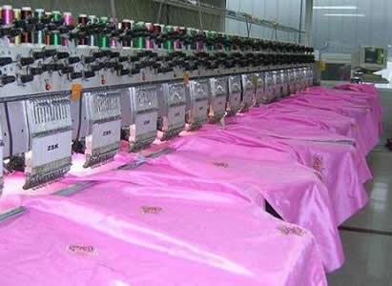
Scheme of interest subsidy on long-term loans linked to the Centrally sponsored TUF scheme.

Slide 207
For the purpose of this scheme:-
A] Either 12.5% OR
B] Banks’ prime lending rate OR
C] The rate of interest actually charged,
D] Whichever rate is less, will be taken as applicable rate
of interest.
The benefit under the said scheme will be admissible for :-
1] Newly set up textile units in the State
2] Modernization of existing textile units.
3] Expansion of existing textile units.
4] Rehabilitation of existing textile units.

Slide 208
Duration of the Scheme. :-
Date 1.4.2011 to 31.3.2017.
If Centrally sponsored TUFS scheme is discontinued
THEN
The Scheme can be reviewed by the State Government without adversely affecting the claims of already approved units.

Slide 209


