Slide 1

Goods & Services Tax
Pune Branch of WIRC of ICAI
Gyan Satra
CHETAN V. OSWAL
Chartered Accountant

Slide 2
Flow of Presentation
Payment Provisions & Rules
Chapter X
Return Provisions & Rules
Chapter IX
Registration Provisions & Rules
Chapter VI
© 2017 Chetan Oswal & Associates, Chartered Accountants

Slide 3
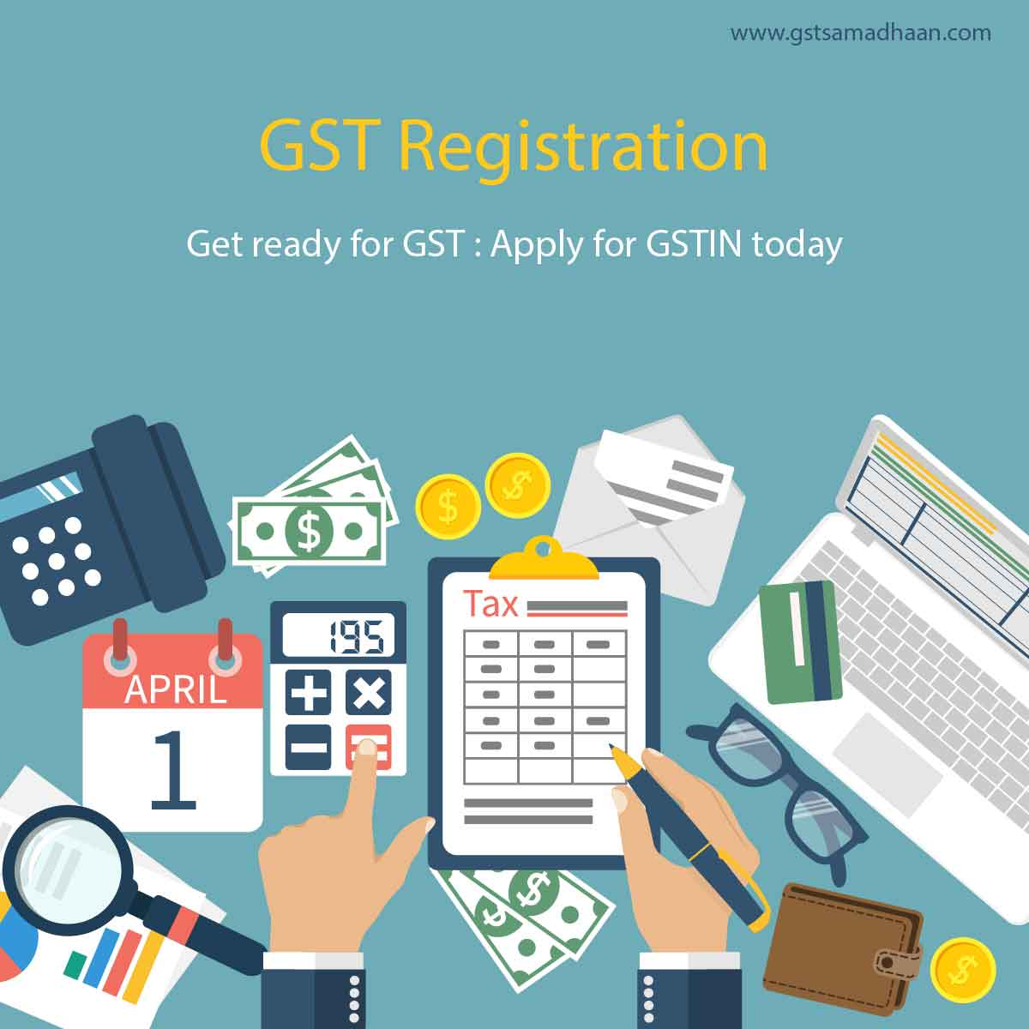
Provisions & Related Rules

Slide 4
Registration - Flow of Contents
Liability to register
Exemption from Registration
Registration Procedures
Provisions related to Casual Taxable Person/NR
Amendment in Registration
Cancellation & Revocation thereof of Registration
Related Rules
Transitional Provisions
© 2017 Chetan Oswal & Associates, Chartered Accountants

Slide 5
Registration - Basics
Fundamental requirement under any law to identify taxpayers.
Benefits:
Legal recognition as supplier,
Legally authorized to collect tax,
Right to claim ITC of taxes paid on goods and services.
Seamless flow of credit to destination state.
© 2017 Chetan Oswal & Associates, Chartered Accountants
Notes:
Entry point for every taxation system.
Unless registration is not taken, difficult for tax administration to monitor business, difficult to have seamless flow of credit.
Currently persons are registrered under various laws, CE, VAT, VAT, LT, ET. Now only one regstration.

Slide 6
Registration - Basics
Who
Where
When
How
© 2017 Chetan Oswal & Associates, Chartered Accountants
Notes:
Entry point for every taxation system.
Unless registration is not taken, difficult for tax administration to monitor business, difficult to have seamless flow of credit.
Currently persons are registrered under various laws, CE, VAT, VAT, LT, ET. Now only one regstration.

Slide 7
Liability to Register
Who
Voluntary
Registration
Exceeding Turnover
Suo moto by officer
Existing Registrants
Compulsory
Optional
© 2017 Chetan Oswal & Associates, Chartered Accountants

Slide 8
Exceeding Turnover
1
Who
Registration on exceeding turnover:
Every supplier
shall be liable to be registered under this Act
in the State or Union territory, other than special category States,
from where he makes a taxable supply of goods or services or both,
if his aggregate turnover in a financial year exceeds Rs. 20 lakh;
Provided that where such person makes taxable supplies of goods or services or both from any of the special category states, he shall be liable to be registered if his aggregate turnover in a financial year exceeds Rs. 10 lakh.
© 2017 Chetan Oswal & Associates, Chartered Accountants
Notes:
1. Arunachal Pradesh
2. Assam
3. Himachal Pradesh
4. Jammu and Kashmir
5. Manipur
6. Meghalaya
7. Mizoram
8. Nagaland
9. Sikkim
10. Tripura
11. Uttarakhand
Only taxable supply.
If
MH: 6
GJ: 4
SIKKIM: 1
LIABLE

Slide 9
Aggregate turnover
Includes
all taxable supplies
all exempt supplies,
exports of goods or services or both,
inter-State supplies of persons having the same PAN,
Excludes
Value of inward supplies on which tax is payable by a person on RCM
Central tax, State tax, Union territory tax, integrated tax and cess;
The supply of goods, after completion of job work, by a registered job worker shall be treated as the supply of goods by the principal and not of registered job worker;
all supplies made by the taxable person, whether on his own account or made on behalf of all his principals (by an Agent)
Includes non taxable supply
to be computed on all India basis
Notes:
Only taxable supply.
If
MH: 6
GJ: 4
SIKKIM: 1
LIABLE

Slide 10
Location of Supplier – Goods Place of Business
a place from where the business is ordinarily carried on,
a place where a taxable person maintains his books of account;
a place where a taxable person is engaged in business through an agent, by whatever name called;
includes a warehouse, a godown or any other place where a taxable person stores his goods, supplies or receives goods or services or both.
Notes:
Only taxable supply.
If
MH: 6
GJ: 4
SIKKIM: 1
LIABLE

Slide 11
Location of Supplier - Services
Supply from registered place of Business
Supply from other unregistered place (a fixed establishment)
Supply from more than one establishment (business or fixed establishment)
The location of such fixed establishment
Location of the establishment most directly concerned with provision of the supply.
Location of such place of business
None of the above
Location of usual place of residence of the supplier.
“Fixed Establishment” means a place (other than the registered place of business) which is characterised by a sufficient degree of permanence and suitable structure in terms of human and technical resources to supply services, or to receive and use services for its own needs;
Notes:
Only taxable supply.
If
MH: 6
GJ: 4
SIKKIM: 1
LIABLE

Slide 12
Liability to Register – Transfer of business
Succession or Otherwise
Transferee
Successor
Date of succession
Transfer of Business as a going concern
Who liable to be registered
When to Register
Date of such transfer
© 2017 Chetan Oswal & Associates, Chartered Accountants
Notes:
Where a business carried on by a taxable person registered under this Act is transferred, whether on account of succession or otherwise, to another person as a going concern, the transferee or the successor, as the case may be, shall be liable to be registered with effect from the date of such transfer or succession.

Slide 13
Liability to Register – Restructuring
In a case of transfer pursuant to sanction of a scheme or an arrangement for amalgamation or, as the case may be, demerger of two or more companies pursuant to an order of a High Court, Tribunal or otherwise, the transferee shall be liable to be registered, with effect from the date on which the Registrar of Companies issues a certificate of incorporation giving effect to such order of the High Court or Tribunal.
© 2017 Chetan Oswal & Associates, Chartered Accountants

Slide 14
Voluntary Registration
2
Who
A person, though not liable to be registered under section 22 or section 24 may get himself registered voluntarily, and all provisions of this Act, as are applicable to a registered person, shall apply to such person.
WHY?
Voluntary registered dealer can not apply for cancellation within 1 year of date of registration.
© 2017 Chetan Oswal & Associates, Chartered Accountants

Slide 15
Suo moto Registration
3
Who
Where a person who is liable to be registered under this Act fails to obtain registration, the proper officer may, proceed to register such person.
Where, pursuant to any survey, enquiry, inspection, search or any other proceedings under the Act, the proper officer finds that a person liable to registration under the Act has failed to apply for such registration, such officer may register the said person on a temporary basis.
The registration granted shall be effective from the date of order granting registration.
Such person to apply for registration within 90 days from above registration date.
ITC
© 2017 Chetan Oswal & Associates, Chartered Accountants

Slide 16
Compulsory Registration
4
Who
Notwithstanding anything contained in sub-section (1) of section 22, the following categories of persons shall be required to be registered under this Act,
persons making any inter-State taxable supply;
casual taxable persons making taxable supply;
persons who are required to pay tax under reverse charge;
person who are required to pay tax under sub-section (5) of section 9 (specified categories);
non-resident taxable persons making taxable supply;
persons who are required to deduct tax under section 51, whether or not separately registered under this Act;
© 2017 Chetan Oswal & Associates, Chartered Accountants

Slide 17
Compulsory Registration
4
Who
An agent;
Input Service Distributor;
persons who supply goods or services or both, through such electronic commerce operator;
every electronic commerce operator;
every person supplying online information and database access or retrieval services from a place outside India to a person in India, other than a registered person; and
Notified persons or class of persons.
© 2017 Chetan Oswal & Associates, Chartered Accountants

Slide 18
Optional Registration
5
Who
A person having multiple business verticals in a State or Union territory may be granted a separate registration for each business vertical.
“Business Vertical” means a distinguishable component of an enterprise that is engaged in the supply of individual goods or services or a group of related goods or services which is subject to risks and returns that are different from those of the other business verticals.
Factors to be considered include––
(a) the nature of the goods or services;
(b) the nature of the production processes;
(c) the type or class of customers for the goods or services;
(d) the methods used to distribute the goods or supply of services; and
(e) the nature of regulatory environment (wherever applicable), including banking, insurance, or public utilities;
© 2017 Chetan Oswal & Associates, Chartered Accountants

Slide 19


Examples
X Ltd. | Plant | Pune | 130 Lakh | Exceeding AT
 | Depot | Nagpur | 20 Lakh | Optional as Vertical
 | Warehouse | Surat | 70 Lakh | Exceeding AT
 | Service Center | Delhi | 10 Lakh | Exceeding AT
X | Milk/Pulses | Pune | 10 Lakh
 | Cheese/Oil | Pune | 5 Lakh
 | Rent | Goa | 2 Lakh
 | Services | Pune | 4 Lakh
AT: 21 Lakh
X | Goods | Pune Shop | 10 Lakh
 | Goods | Amazon | 1 Lakh
X | Goods | Pune Shop | 10 Lakh
 | Goods | To Goa | 5 Lakh
© 2017 Chetan Oswal & Associates, Chartered Accountants

Slide 20
Not liable to Register
Persons not liable to registration:
Any person engaged exclusively in the business of supplying goods or services or both:
- that are not liable to tax or
(Schedule III)
- wholly exempt from tax;
An agriculturist, to the extent of supply of produce out of cultivation of land;
Specified category of persons as may be notified by GST Council.
© 2017 Chetan Oswal & Associates, Chartered Accountants

Slide 21
Liability to Register
Summary
Are you carrying on a Business?
NO REGISTRATION
NO
YES
Is it taxable supply?
NO REGISTRATION
NO
YES
NO
AT exceed limit?
Compulsory Required to get Registered?
NO
YES
YES
NO
REGISTER
Voluntary?
YES
© 2017 Chetan Oswal & Associates, Chartered Accountants

Slide 22
Procedure for Registration
Where
When
Provisions related to application for registration:
Every person
who is liable to be registered
shall apply for registration
in every such State or Union territory in which he is so liable
within thirty days from the date on which he becomes liable to registration.
Application by person in territorial waters:
Every person who
makes a supply from the territorial waters of India
shall obtain registration
in the coastal State or Union territory
where the nearest point of the appropriate baseline is located.
Effective Date
© 2017 Chetan Oswal & Associates, Chartered Accountants

Slide 23
Procedure for Registration
A person seeking registration under this Act shall be granted a single registration in a State or Union territory.
Business Verticals shall be treated as distinct persons in case seperate registration is taken.
SEZ/Developer shall make separate application for registration as a business vertical distinct from its other units outside SEZ.
There shall be separate registration for ISD.
No pre registration visit. Post registration visits only in specific cases.
© 2017 Chetan Oswal & Associates, Chartered Accountants
Notes:
(18) “business vertical” means a distinguishable component of an enterprise
that is engaged in the supply of individual goods or services or a group of related
goods or services which is subject to risks and returns that are different from those of
the other business verticals.
Explanation.––For the purposes of this clause, factors that should be considered
in determining whether goods or services are related include––
(a) the nature of the goods or services;
(b) the nature of the production processes;
(c) the type or class of customers for the goods or services;
(d) the methods used to distribute the goods or supply of services; and
(e) the nature of regulatory environment (wherever applicable), including
banking, insurance, or public utilities;

Slide 24
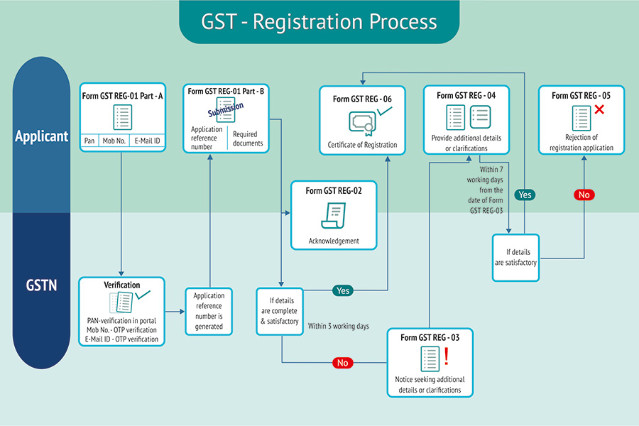
Picture Courtesy: Tally Solutions
© 2017 Chetan Oswal & Associates, Chartered Accountants

Slide 25
Registration under the Act
15 Digit Format of GSTIN
22 AAAAA0000A 1 Z 5
State Code
PAN
Entity
No.
Blank
Check
Digit
Display Rules: - Display his certificate of registration in a prominent location,
- Display his GSTIN on the name board exhibited at the entry.
© 2017 Chetan Oswal & Associates, Chartered Accountants

Slide 26
Unique Identity Number
Following category of persons shall be granted a Unique Identity Number:
Any specialised agency of the United Nations Organisation or any Multilateral Financial Institution and Organisation notified under the United Nations (Privileges and Immunities) Act, 1947;
Consulate or Embassy of foreign countries and
Any other person or class of persons, as may be notified by the Commissioner,
Rule 9 registration rules: Manner of obtaining UIN
© 2017 Chetan Oswal & Associates, Chartered Accountants

Slide 27
Casual Taxable Person, Non Resident
“Casual taxable person” means a person who occasionally undertakes transactions involving supply of goods or services or both in the course or furtherance of business, whether as principal, agent or in any other capacity, in a State or a Union territory where he has no fixed place of business;
Casual taxable person or a non-resident taxable person shall apply for registration at least five days prior to the commencement of business.
The certificate of registration issued to a casual taxable person or a non resident taxable person shall be valid for the period specified in the application for registration or ninety days from the effective date of registration, whichever is earlier and such person shall make taxable supplies only after the issuance of the certificate of registration.
Extension of further period of 90 days.
At the time of registration application make an advance deposit of tax in an amount equivalent to the estimated tax liability.
© 2017 Chetan Oswal & Associates, Chartered Accountants

Slide 28
Amendment in Registration
Change in any details furnished at the time of registration shall be informed to proper officer within 15 days by submitting application (REG-13) with documents.
For following changes approval of proper office is required within 15 days:
Change in legal name of business;
Change in address of the principal place of business or any additional place of business; or
addition, deletion or retirement of partners or directors, Karta, Managing Committee, Board of Trustees, Chief Executive Officer or equivalent, responsible for day to day affairs of the business,
Rule of Natural Justice there.
Rejection under central act deemed as rejection under state act.
© 2017 Chetan Oswal & Associates, Chartered Accountants

Slide 29
Cancellation of Registration
Cancellation of Registration
By registered taxable person
By the tax authority
By the legal heirs, in case of death of registered taxable person
© 2017 Chetan Oswal & Associates, Chartered Accountants

Slide 30
Cancellation of Registration
Cancellation by Person
there is any change in the constitution of the business; or
the taxable person, other than the person voluntarily registered, is no longer liable to be registered.
the business has been discontinued,
transferred fully for any reason including death of the proprietor,
amalgamated with other legal entity,
demerged or otherwise disposed of;
© 2017 Chetan Oswal & Associates, Chartered Accountants

Slide 31
Cancellation of Registration
Tax authority may cancel registration from retrospective date in following cases:
Contravention of provision or rules
Composition dealer not filing 3 consecutive returns.
Regular dealers not filing 6 continuous returns.
Voluntary dealer not starting business within 6 months from the date of registration
Registration has been obtained by means of fraud, wilful misstatement or suppression of facts:
The registration granted to a person is liable to be cancelled if the said person—
does not conduct any business from the declared place of business; or
issues invoice or bill without supply of goods or services in violation of the provisions of this Act, or the rules made there under.
© 2017 Chetan Oswal & Associates, Chartered Accountants

Slide 32
Cancellation of Registration
Application for cancellation of registration
A registered person making an application should provide details of:
- inputs held in stock
- inputs contained in semi-finished or
- finished goods held in stock
- capital goods held in stock on the date
- liability thereon
- details of the payment made against such liability
along with documents within thirty days of occurrence of the event warranting cancellation.
© 2017 Chetan Oswal & Associates, Chartered Accountants

Slide 33
Cancellation of Registration
On cancellation, registered taxable person to pay higher of ,
In case of Inputs:
ITC in respect of
inputs held in stock and
inputs contained in semi-finished or
finished goods held in stock or
2. Output tax payable on such goods.
b. In case of capital goods:
Amount of ITC taken reduced by prescribed percentage points;
Tax on transaction value.
© 2017 Chetan Oswal & Associates, Chartered Accountants

Slide 34
Revocation of Cancellation
Application for revocation:
In case any registration is cancelled by the officer on his own, the registered person may apply for revocation within 30 days from the date of service of cancellation order.
Actions to be taken before making application:
If the cancellation is for non filing of returns, the person need to pay all tax, interest, penalties and then file all returns before making application.
Officer has right to accept such application or reject it within 30 days.
© 2017 Chetan Oswal & Associates, Chartered Accountants

Slide 35
Penal Provisions
Failure to Register
Furnishing false information for registration
Penalty (higher of):
Rs. 10,000 or
Tax evaded
Non availability of ITC.
© 2017 Chetan Oswal & Associates, Chartered Accountants

Slide 36

Migration of Existing Persons
Every person who, on the day immediately preceding the appointed day, is registered or holds a licence under an existing law, shall be liable to be registered under this Act with effect from the appointed day.
On and from the appointed day, every person registered under any of the existing laws and having a valid permanent Account Number shall be issued a certificate of registration on provisional basis (PRC).
Such person to submit an application along with the information and documents in the said application within three months. If information found correct and complete, registration certificate will be issue (FRC).
© 2017 Chetan Oswal & Associates, Chartered Accountants

Slide 37
Liability to Register – Existing Persons
A taxable person who has been granted multiple registrations under the existing law on the basis of a single PAN shall be granted only one provisional registration under the Act.
A person having centralized registration shall be granted only one provisional registration in the State or Union territory in which he is registered under the existing law.
If person registered under existing law, is not liable to be registered under this Act, he may, within thirty days from the appointed day, at his option, submit an application for cancellation of the registration granted to him and the proper officer shall, after conducting such enquiry as deemed fit, cancel the said registration.
© 2017 Chetan Oswal & Associates, Chartered Accountants

Slide 38

TAX PAYMENTS UNDER GST

Slide 39
Payment of Tax
Payment of Tax precedes filing of return.
Various user friendly options to pay taxes.
Features of Payment Process:
Electronically generated challans from GSTN;
Anytime, anywhere payment;
Paperless transactions;
Faster payment, accounting and reporting;
Electronic reconciliation of all receipts;
Simplified procedures for banks;
Warehousing of digital challans.
© 2017 Chetan Oswal & Associates, Chartered Accountants

Slide 40
Modes of Payment
Amount of tax, interest, penalty, fees or any other amount shall be paid through:
Internet Banking;
Using Debit or Credit Card
NEFT/RTGS
OTC upto Rs. 10000
© 2017 Chetan Oswal & Associates, Chartered Accountants

Slide 41

Electronic Ledgers
Electronic Ledgers will be maintained on dashboard of a taxpayer by GSTN.
Electronic Ledgers will be updated in real time.
Details in these ledger will get auto populated from previous tax period return.
GST PMT-01
GST PMT-05
GST PMT-02
Electronic Tax Liability Ledger
Electronic Credit Ledger
Electronic Cash Ledger
© 2017 Chetan Oswal & Associates, Chartered Accountants

Slide 42
Electronic Ledgers
Electronic Tax Liability Ledger
Electronic Credit Ledger
Electronic Cash Ledger
Credited by
Amount deposited through
Debited with
Net Banking
Debit/Credit Card
NEFT/RTGS
OTC upto Rs. 10000
Tax, Interest, Penalty, Fees, Any other amount.
Credited with
Input Tax Credit as self assessed in return
Debited to
discharge only tax liability
Priority of utilization of credit
Priority to discharge liability
Self assessed tax etc of previous period
Self assessed tax etc of current period
Other Demand
Debited with
Tax, Interest, Late fees, other dues
As per return
As ascertained by officer
Tax, interest arising due to mismatch
Credited with amount of TDS/TCS
Credited with
payment either through ITC or Cash
For payment of TDS/TCS/Composition Tax, Interest, Fee, Penalty only electronic cash ledger can be debited.
© 2017 Chetan Oswal & Associates, Chartered Accountants

Slide 43
Payment of Tax
Interest for delayed payment:
Failure to pay tax within time prescribed: not be more than 18%.
In case of excess claim of ITC or excess reduction of outward tax liability: not be more than 24%.
© 2017 Chetan Oswal & Associates, Chartered Accountants

Slide 44
Tax Deduction at Source
Who can be the deductor:
A department or establishment of the Central Government or State Government; or
Local authority; or
Governmental agencies; or
Such persons or category of persons as may be notified by the Government on the recommendations of the Council
© 2017 Chetan Oswal & Associates, Chartered Accountants

Slide 45
Tax Deduction at Source
Rate of TDS:
Value for TDS
If total value under contract above Rs. 2.50 Lacs
Payment of TDS & Return
Within 10 days after the end of the month in which such deduction is made
1% CGST/SGST each
Certificate
Within 5 days from date of crediting TDS to govt.
IGST 2%
© 2017 Chetan Oswal & Associates, Chartered Accountants

Slide 46
Tax Deduction at Source
Certificate to Deductee:
The deductor shall furnish to the deductee a certificate mentioning therein:
- contract value,
rate of deduction,
amount deducted,
amount paid to the Government
Penalty for non furnishing of certificate:
Rs. 100 per day up to Rs. 5000.
Claim of credit of TDS by Deductee:
Deductor is required to file return and provide details of amount of TDS in his return.
Deductee to claim credit of TDS in his electronic cash ledger.
© 2017 Chetan Oswal & Associates, Chartered Accountants

Slide 47
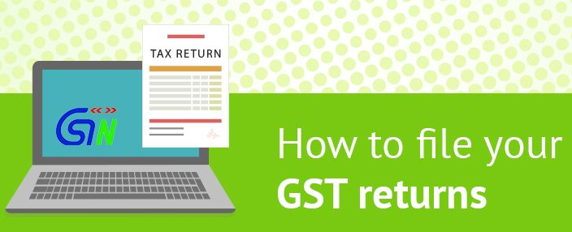
Picture Courtesy: Tally Solutions

Slide 48
Returns under GST
Submission of return is important and critical link between taxpayer and tax administration.
Formal mode for submission of information in structured and time bound manner.
Higher importance to GST returns because GST is self assessed destination based taxation system.
Check on compliance by taxable persons.
Consolidated Information
Invoice Level Information
© 2017 Chetan Oswal & Associates, Chartered Accountants
Notes:
GST is consumption based tax.
Flow to the state where GS are consurmed.
Credit should flow side by side.
How to ensure this.
Only when registered person file information.
Information to go in structured and time bound manner.

Slide 49
Returns under GST
By every registered person.
For each GSTIN. (State, Vertical) separately.
To be filed electronically through GTSN.
Common return for all acts CGST/SGST/UTGST/ IGST.
Auto population of information on the basis of sales and purchases returns filed by various RTP.
Facility to rectify the return.
No specific provision of revision.
Return to be filed sequentially.
Multiple returns to facilitate online matching of credit.
© 2017 Chetan Oswal & Associates, Chartered Accountants

Slide 50
Returns under GST
Type | Form No. | Due Date
Return of Outward Supply | GSTR 1 | 10th of Next Month
Return of Inward Supply | GSTR 2/2A | 15th of Next Month
Monthly Return | GSTR 3 | 20th of Next Month
Return for Composition Levy | GSTR 4/4A | 18th of Next Quarter
© 2017 Chetan Oswal & Associates, Chartered Accountants

Slide 51
Returns under GST
Type | Form No. | Due Date
Return by Non resident taxable person | GSTR 5 | 20th of Next Month
Return by ISD | GSTR 6/6A | 13th of Next Month
Return of TDS | GSTR 7 | 10th of Next Month
Return of TCS by e commerce operator | GSTR 8 | 10th of Next Month
Annual Return | GSTR 9/9A | 31 Dec. of next year.
Audited Annual Accounts & Reconciliation | GSTR 9B | 31 Dec. of next year.
Final Return | GSTR 10 | 3 months from cancellation date
© 2017 Chetan Oswal & Associates, Chartered Accountants

Slide 52
Returns of Outward Supplies
GSTR 1
Statement of outward supplies of goods/services for the month.
To be filed by 10th of next month.
Not allowed to furnish above details from 11 – 15th.
Option to upload invoice level details on continuous basis.
Sales details can be uploaded
online or
with offline utility
With help of GSP utilities.
Option to rectify error or omission on payment of tax with interest.
© 2017 Chetan Oswal & Associates, Chartered Accountants

Slide 53
Returns of Outward Supplies
GSTR 1
Information to be captured in GSTR1 besides basic details:
B2B supplies, invoice level details;
B2C transaction:
If interstate with invoice value more than 2.50 Lakh, then invoice level details
For invoice value less than Rs. 2.50 lakh, state wise consolidated summary
HSN Codes & accounting codes for services.
Details of advance received against future supplies.
Details of taxes already paid on advance for which invoices are issued in current tax period.
Details of exports.
Separate table for submitting revision in invoices of previous tax periods.
Separate table for correcting errors in earlier returns.
Separate table for details of NIL rated, exempted, non taxable supplies
Credit notes and debit notes issued;
Goods dispatched and received challan details in case of job work.
© 2017 Chetan Oswal & Associates, Chartered Accountants

Slide 54
Returns of Inward Supplies
GSTR 2
For every registered person, details of inward supplies are auto populated in form GSTR 2A.
Part A: Details of Inward Supplies
Part B: ISD
Part C: TDS
Part D: TCS
He shall verify, validate, modify or delete, if required, the details relating to outward supplies and credit or debit notes.
He may add details of inward supplies, credit or debit notes not declared by suppliers.
He shall furnish electronically the return of inward supply for a tax period from 11 to 15th of succeeding month in GSTR 2.
© 2017 Chetan Oswal & Associates, Chartered Accountants

Slide 55
Returns of Inward Supplies
GSTR 2
Information to be captured in GSTR 2 besides basic details:
Invoice level inward supply of goods and services for the month.
Details of import of goods, services, capital goods to be furnished.
Selection by taxpayer of invoice wise eligibility of ITC.
Separate table to furnish information where partial credit is availed earlier.
Separate table for submitting details of revision or correction of errors in earlier returns.
Table for details of NIL rated, exempted, non taxable supplies (both intra state & inter state)
Separate table for ISD credit and TDS/TCS credit.
© 2017 Chetan Oswal & Associates, Chartered Accountants

Slide 56
Returns of Inward Supplies
GSTR 2
If supplies are added, modified or deleted in return of inward supply, the same should be communicated to supplier after 15th in form GSTR 1A.
The supplier should either accept or reject the details so communicated from 16 to 17^{th.}
In case the difference is accepted, the original return of outward supply stand amended accordingly.
In case the difference is rejected, the unmatched credit is added to outward tax liability of supplier in the return of next tax period.
The unmatched details can be rectified by the supplier on discovery of error or omission by payment of tax along with interest.
© 2017 Chetan Oswal & Associates, Chartered Accountants

Slide 57
Furnishing of Return
GSTR 3
Return for previous month has to be filed by every registered person by 20th of next month.
Information of inward and outward supplies of goods and services is auto populated on the basis of GSTR – 1 & 2 filed in form GSTR-3.
Credits are available on provisional basis in electronic credit ledger.
Liabilities are discharged by debiting electronic credit/cash ledger.
If eligible for refund, person can claim in GSTR -3 only. No separate application for refund
Return is then submitted to common portal electronically.
© 2017 Chetan Oswal & Associates, Chartered Accountants

Slide 58
Returns under the Act
Goods
Service
Anil
Mukesh
Anil to submit Return of Outward Supply in GSTR-1 by 10th of next month.
Auto populated GSTR 2A will be made available online to Mukesh.
Mukesh to file GSTR 2 before 15th of next month.
If Mukesh amend or make additions in GSTR-2A, it will be displayed to Anil in GSTR-1A
If Anil accept changes in GSTR-1A before 17th, original GSTR-1 stand amended.
Mukesh can accept/amend/add the details in GSTR-2A from 11th to 15th
Auto populated GSTR-3 generated. Provisional credit given.
Both to file return by 20th
Both to pay tax etc. as determined by 20th only.
Mismatch report will go in GST MIS 1 & MIS2 to both by month end.
If Anil do not accept changes made by Mukesh
If not rectified in the next return, credit will denied to Mukesh and will be added to his output tax liability in next month GSTR 3
© 2017 Chetan Oswal & Associates, Chartered Accountants

Slide 59
Matching of claim
Details to be matched to allow claim of ITC:
GSTIN of the supplier;
GSTIN of the recipient;
Invoice/ or debit note number;
Invoice/ or debit note date;
taxable value; and
tax amount:
If ITC claimed is less than or equal to tax paid by supplier, it is treated as matched.
© 2017 Chetan Oswal & Associates, Chartered Accountants

Slide 60
Returns under the Act
Return to be filed even for NIL supplies.
Rectification of returns:
Omission or;
Furnishing of incorrect particulars
Not as a result of scrutiny, audit, inspection or enforcement activity by the tax authorities.
Tax along with interest is required to be paid.
Allowed before due date of filing return for the month of September of next financial year or actual date of filing of annual return, whichever is earlier.
The recipient shall be eligible to reduce the tax added earlier along with interest.
Return is valid only if self assessed tax is paid in full.
Late Fee: -Regular Return: Rs 100/day (Max Rs. 5000)
-Annual Return: Rs 100/day (0.25% of TO)
© 2017 Chetan Oswal & Associates, Chartered Accountants

Slide 61
First & Final Return
First Return
Final Return
Registered Person who made outward supplies between date of liability to date of grant of registration,
Furnish return GSTR 10 within 3 months of date of cancellation or date of order of cancellation, whichever is later.
Submit details in the first return filed after grant of registration
© 2017 Chetan Oswal & Associates, Chartered Accountants

Slide 62
Annual Return
Annual Return
GSTR 9
31st December
Registered Person
Person not liable to file Annual Return:
Input Service Distributor,
Person paying tax under section 51 or section 52,
A casual taxable person and
Non-resident taxable person,
© 2017 Chetan Oswal & Associates, Chartered Accountants

Slide 63

Provisions & Related Rules

Slide 64


E-COMMERCE
MARKET PLACE
Service Tax
Order
Listing
Third Party Sellers/Service Providers
Shipping
CUSTOMERS
VAT/CST
Octroi
Entry Tax
Service Tax
Notes:
The turnover on ecommerce website increased manifold. Currently, these e commerce transactions are not properly taxed under state VAT laws, or service tax law. The segment was largely unregulated.
GST has extensively covered this ecommerce segment and now will be closely regulated. Each and every transactions on these marketplaces will be reported with GSTN.

Slide 65
WHAT IS E-COMMERCE ?
Electronic Commerce
Supply of goods or services or both, including digital products over digital or electronic network
E-commerce Operator
Any person who:
Digital or electronic facility or platform for e-commerce
Owns, Operates or Manages
© 2017 Chetan Oswal & Associates, Chartered Accountants

Slide 66
Higher Regulations
Mandatory Registration
No Composition Scheme
TCS Provisions
Filing of returns and matching
Requirement to furnish information about supplies and stock
Taxability of stock transfers
Penalty of Rs. 10,000 or TCS amount for failure to collect or pay.
© 2017 Chetan Oswal & Associates, Chartered Accountants

Slide 67
Registration Requirements
E-commerce operator must register, irrespective of turnover. Benefit of basic threshold not available.
Supplier, supplying through e-commerce operator must also register, irrespective of threshold.
Both operator and suppliers are not eligible for composition.
© 2017 Chetan Oswal & Associates, Chartered Accountants

Slide 68
Collection of Tax
Every electronic commerce operator
not being an agent
shall collect an amount at such rate not exceeding 1%
of the net value of taxable supplies made through it
where the consideration is to be collected by the operator.
‘Net value of taxable supplies’ means the aggregate value of taxable supplies other than services notified under sub-section (5) of section 9, made during any month by all registered persons through the operator reduced by the aggregate value of taxable supplies returned to the suppliers during the said month.
© 2017 Chetan Oswal & Associates, Chartered Accountants

Slide 69
Duties of an e-Commerce Operator
Rate of TCS:
Payment of TCS
Pay by 10th of succeeding month.
Return of TCS
File return of outward supplies by 10th of succeeding month.
1% CGST/SGST each
Supplier to Claim Credit
Supplier to claim credit of tax collected at source.
IGST 2%
Collect TCS @
© 2017 Chetan Oswal & Associates, Chartered Accountants

Slide 70
Matching of details
Details of outward supplies in electronic statement of operator and of actual supplier will be matched.
in case of mismatch in details - discrepancy shall be communicated to both (e-com operator & supplier)
if mismatch not rectified by actual supplier or operator - output liability of supplier to be enhanced.
© 2017 Chetan Oswal & Associates, Chartered Accountants

Slide 71
Payment of Taxes
Pay Tax on:
Its own supplies of goods/services to customers/suppliers
Supplies by other persons of certain notified services through e-commerce operator (similar to an aggregator under Service Tax)
If e-com operator does not have physical presence in taxable territory, then representative of e-commerce operator liable to pay tax
If no physical presence and also no representative, then a person must be appointed by e-commerce operator and this person liable to pay tax
© 2017 Chetan Oswal & Associates, Chartered Accountants

Slide 72
Furnishing of Information
Furnish additional information within time bound manner relating to:
Supplies of goods or services effected through such operator during any period;
Stock of goods of suppliers held in operator managed godowns.
Information to be furnished within 15 working days.
Failure will be liable with penalty up to Rs. 25,000.
© 2017 Chetan Oswal & Associates, Chartered Accountants

Slide 73



CHETAN OSWAL & ASSOCIATES Chartered Accountants ca.chetanoswal@gmail.com 9890828242 twitter: cachetanoswal

