Slide 1
Goods And Service Tax
in India
Presented by:
Ca. Jayesh Gogri

Slide 2

Kind Attention
GST Law has not been formulated yet
  No Confirmation
  No Act/Rules
Views may not be absolute/perfect

Slide 3
Taxes in India
All
Income tax
Business men
Customs Duty, Excise Duty
Service tax, VAT, LBT
Professionals
Profession Tax, Service tax
At Home
Stamp Duty
Electricity Duty
Travelling
Toll Tax
Entertainment
Entertainment Tax

Slide 4
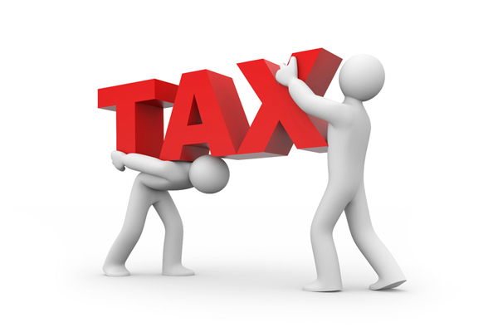
Existing structure of indirect taxes in India

Slide 5
Features of
Indirect Taxes
Affects top line of Business
Recoverable from Customers
Transaction based
Premise based
Procedural
Frequent Amendments
Eligibility of Set Off

Slide 6
Issues
Multi tier System
Taxable Event
Goods vs. Services
Threshold Limit
Multiple Rates
Composition Schemes
Tax on Tax
Taxable Values
Exemptions

Slide 7
Three tier Taxation System
Central Government
(Union List)
Income Tax
Customs Duties
State Government
(State List)
Stamp Duty
Local bodies
(State List – Delegated to Local Bodies)
Entertainment Tax
Service Tax
Central Excise
State Excise
Entertainment Tax
Sales Tax/VAT
Land Revenue
Octroi
Profession Tax
Local Body Tax
Security Transaction Tax

Slide 8

Multiple Taxable Events
Import into or export out of India
Excise Duty
Manufacture of goods
Service tax
VAT/CST
Sale of goods
Entry tax
Import into the State for sale, use or consumption
LBT/Octroi
Import into local limits
Customs Duty
Stamp Duty
On execution of documents
Profession tax
On carrying on Profession, Trade
for sale, use or consumption
Receipt of advance
Invoice
Provision of services
Crossing the Customs frontiers

Slide 9
Different Threshold Limits
Tax law | Threshold limit
Customs | NO *Baggage = General: 45000/-
Central Excise | 1.5 Crores
Service tax | 10 lakhs
VAT | 10 lakhs (Varies from State to State)
LBT | 50 Crores per City

Slide 10

Multiple Rates
12.5%
14%
1%
7.5%+12.5%+(2%+1%)+4%
12.5%
2%
6%
5%
20%
5%
2%

Slide 11



Litigation Issues
Supreme Court
Commissioner (Appeals)
Tribunal
High Court

Slide 12
Multiple Taxable Values
Service
Tax
Reimbursements - Intercontinental Consultants & technocrats Pvt. Ltd. vs. Union of India admitted in 2014 (35) STR J99 (SC)
Excise
Transaction Value vs. Assessable Value- CCE, Mumbai vs. Fiat India Pvt. Ltd. 2012 (283) ELT 161 (SC)
Customs
price actually paid or payable but inclusive of incidental costs
VAT
Inclusive of Central Excise Duty and Customs Duty
Stamp Duty
Market value or the transaction value whichever is higher

Slide 13


Goods v/s Services
Infotech Software Dealers Association vs. Union of India 2010 (20) STR 289 (Mad.)
AGS Entertainment Pvt. Ltd. vs. Union of India 2013 (32) STR 129 (Mad.)

Slide 14


VAT v/s Service Tax
Kerala Bar Hotels Association 2014 (36) STR 1205 (Ker)
Indian Hotels & Restaurant Association 2014 (34) STR 522 (Bom)
Hotel East Park 2014 (35) STR 422 (Chhattisgarh)

Slide 15
Exemptions, exclusions etc.
Service Tax
Mega Exemptions
Negative List
M-VAT
Central Excise
Service Provided outside India
Schedule ‘A’
Exemptions for SSI
Sector wise Exemptions

Slide 16

Frequent Amendments
ST
Cus
CE
LBT
VAT

Slide 17
Composition Schemes
Numerous Composition Schemes
  MVAT
    Developer, Restaurants, Bakers, Retailers
  Central Excise
    Compounded levy Scheme
  LBT
    Lesser turnover, Construction
Valuation

Slide 18
TAX on TAX??
Constitutional Issues
  State List/Union List
    Objective of Revenue Collection
VAT + Excise/Customs Duty
  Cascading Effect
VAT on Service Tax?
  Article 366(29A) : Deemed Sales
VAT on Service?
  Freight Charges
    Anything done by the dealer?

Slide 19
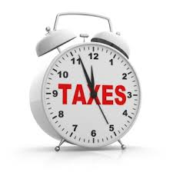
Procedures…
Registration
Payments
Returns
Refunds

Slide 20
…Procedures
ACES
MAHAVAT
ICEGATE
NMMCONLINE

Slide 21
is gst a solution ?

Slide 22
TAX
SUPPLY of goods, or
services or
both
except taxes on the supply of the alcoholic liquor for human consumption
GST
Complete Integration of Goods and Services in one Legislature
Consumption based destination tax

Slide 23
Supply??
Free Distribution
Branch Transfer
Theft
Barter

Slide 24
Definitions
Services
(Proposed)
Other than Goods
-UK
-New Zealand
What is ‘other than Goods?’
Goods
Includes all materials, commodities and articles

Slide 25
Goods Outside GST
Alcohol for Human Consumption
Petroleum Crude
High Speed Diesel
Motor Spirit
Aviation Turbine fuel
Natural Gas
Tobacco and Tobacco products

Slide 26
Proposed Taxation of Goods outside GST Purview
Goods | Production | Sale
Alcohol – Completely Outside GST | State Excise | VAT
Petroleum Crude | Central Excise | VAT
High Speed Diesel | Central Excise | VAT
Motor Spirit | Central Excise | VAT
Natural Gas | Central Excise | VAT
Aviation Turbine fuel | Central Excise | VAT
Tobacco and Tobacco products | Central Excise | GST

Slide 27
Models of GST across Globe
GST
Central GST
State GST
Dual GST
Concurrent Dual GST
Non Concurrent Dual GST

Slide 28
GST Model adopted by India

Slide 29
Components
CGST
SGST
IGST
Additional Tax
(on goods)

Slide 30
CGST
Central Excise Duty
Additional Excise Duty
Excise Duty under Medical and Toilet Preparations Act, 1955
Additional Customs Duties
Service Tax
Central surchages and Cesses

Slide 31
Continuing Taxes
Central Government
Basic Customs Duty
Central Excise on: petroleum crude, petrol, diesel, natural gas, aviation turbine fuel, tobacco and tobacco products
Stamp Duty
State Government
Profession Tax
State Excise
Sale of petroleum crude, high speed diesel, petrol, natural gas, aviation turbine fuel
Stamp Duty
Land revenue
Octroi/LBT
CST

Slide 32
SGST
VAT
CST
Octroi/
Entry tax
LBT
Purchase Tax
Luxury Tax
State surcharges and Cesses
Entertainment Tax (other than levied by local bodies)
Taxes on lottery, betting and gambling

Slide 33
CST
Additional Tax

Slide 34
Additional Tax
Additional Tax not exceeding 1%
Supply of goods
For a period of 2 years or such other period as the Goods and Services Tax Council may recommend
Tax to be assigned to States from where the supply originates
Set off of the Additional Tax?
  Cascading effect

Slide 35
CST
IGST

Slide 36
IGST

Slide 37
IGST
Present
CST
No set off
Proposed
IGST
Set off mechanism available
Exporting State
Consuming State
Separate Enactment (may be)

Slide 38
Set off
CGST
CGST
IGST
SGST
SGST
IGST
IGST
IGST
CGST
SGST

Slide 39
Rate of Tax (RNR)
Sub-committee Report
Select Committee Report
13.91%
12.77%
26.78%
14%
20%

Slide 40
GST Rate Structure
Lower rate
Higher rate
For goods of basic importance and necessary items
Goods in general
Special rate for precious metals
No tax on exempted items

Slide 41
Essentials for levying GST
GST
SUPPLY
Goods or Services or
Both
TAXABLE PERSON
CONSIDERATION
In The Course Of Business

Slide 42
Threshold for Taxability of GST?
Threshold limit (Gross Annual Turnover)
Taxes
Goods
Services
CGST
150 lakhs
25 lakhs
SGST
10 lakhs
10 lakhs

Slide 43
Composition Scheme?
Gross Annual Turnover
Less than 50 lakhs
Tax=0.5% of Gross Annual Turnover

Slide 44
GST on Exports
Exports would be zero rated
SEZ
EOU
Merchant Exporters

Slide 45
GST on Imports
Existing
  BCD
  CVD
  SAD
Proposed
  BCD
  IGST
Import of goods or services in India shall be treated as deemed supply of goods or services for the purpose of GST
  inter-state supply of goods and services

Slide 46
122nd Constitutional Amendment Bill

Slide 47
Integration of goods and services?
Insertion of article 246A:
“(1) Notwithstanding anything contained in articles 246 and 254,Parliament, and, subject to clause (2) The Legislature of every State, have power to make laws with respect to goods and services tax imposed by the Union or by such State.
  Legislature of every state has power?
    Can there be different State Laws?
    Different Rates just like Present System?
(2) Parliament has exclusive power to make laws with respect to goods and services tax where the supply of goods, or of services, or both takes place in the course of inter-State trade or commerce
  Only Parliament has powers for levying IGST

Slide 48
Goods and Service Tax Council
President to form a GSTC within 60 days from Commencement of Constitutional Amendment
Earlier 115th Amendment Bill
  Goods and Service Tax Council (Same)
Powers to recommend
  Taxes to be subsumed
  Exemption
  Model of GST, Principles of Levy
  Apportionment of IGST
  Threshold Limit
  Rates
  Special Provisions for certain States

Slide 49
Goods and Service Tax Council
Consists of Union FM & Union MOS (Rev)
Consists of all State Ministers of Finance
Quorum is 50% of total members
Decisions by majority of 75% of weighted votes of members present & voting
1/3rd weighted votes for Centre & 2/3rd for all States together

Slide 50
Joint Committee reports

Slide 51
Joint committee reports on Business processes
Business Reports
Registration
Return
Refund
Payment

Slide 52
Registration
Only Online Registration
Multiple Registration in one go
Transfer from existing database

Slide 53
GSTIN
Blank for Future Use
PAN
1
2
3
4
5
6
7
8
9
10
11
12
13
14
15
State Code
Registration of vertical of businesses
0-9 and A-Z

Slide 54
GST Challan
14 Digit Unique CPIN
10digit + yymm
Data frozen and cannot be modified
Valid for 7 days
Need to specify the mode of payment

Slide 55
Payment Process
Pre-Registration of cards required
Two time rejection - Debarred
Payment
Online
RTGS/NEFT
Credit/Debit Cards
Over the Counter
Challan not more than Rs. 10,000
One time cheque bounce - Debarred

Slide 56
Reasons for Refund
Excess payment due to mistakes
Finalization of Provisional Assessment
Export
Payment during Investigation
Pre-Deposit
Tax Free Supplies
Volume based incentives

Slide 57
Returns
Sales
Purchases
Monthly returns
Annual returns
Composition dealers
Foreign taxpayers
ISD return
TDS returns

Slide 58
GSTR 1
  Monthly interval
  Outward suppleis
  Invoice level information for B2B supplies (inter state as well as intra state supplies)
  B2C (inter state supplies) invoice level information if suplies >= 2,50,000
  B2C Intra state consolidated figures
  Balance Statewise summary
Invoices
  4 digit HSN codes for persons having TO >= 5 Crores
  2 Digit HSN codes for persons having TO>= 1.5 Crores but <=5 crores
  TO based on previous year
  Service codes to be prefixed with ‘s’
  Service accounting codes
  6/8 digit optional
  Mandatory for services having POPS based on destination
  Import/export of services 8 digit compulsory

Slide 59
GSTR 1
No revision
Table for corrections
Debit/credit notes
NIL/exempted/non GST supplies
Due date: 10th of next month

Slide 60
GSTR-2
Inward supplies
Monthly
Invoice level details
Separate details for import of goods, capital goods and services
Partial credit
ISD credit
TDS credit
Revisions/corrections for the past period
17th of the next month

Slide 61
GSTR 3
Monthly return
To comprise of inward/outward/tax/credit/payment details
Details to be auto populated from GSTN 1 and 2
Details of tax calculations and tax payments
CGST, SGST, IGST, additional tax
Interest, penalty , late fees
Refund-bank account number
To be filed by 20th of next month

Slide 62
GSTR 4
Compounding dealers
  Inward supplies details to be provided
  Quarterly
  Only tax paid purchases
  If form unregistered dealers-tax under reverse charge

Slide 63
GSTR 5
Non resident foreign tax payers
Monthly
Or within 7 days of expiry of registrtion

Slide 64
GSTR 6
ISD return
Monthly
15th of next month
Inward supplies- invoice wise
Outward distribution TIN wise

Slide 65
GSTR 7
TDS returns
Monthly
10th of next month
Details of Tax deduction
Invoice wise

Slide 66
GSTR 8
Annual return
31st Decmber
Reconciliation statement
To be certified by CA

Slide 67
impact

Slide 68
Illustration…
Mr. A (Maharashtra)
Sale of goods to Mr. B
IGST 27%
Additional 1% IGST
Mr. B (Madhya Pradesh)
Sale of goods to Mr. C
CGST 13%
SGST 14%
Mr. C (Madhya Pradesh)

Slide 69
…Illustration…
Mr. A (Maharashtra)
IGST 27%
Use Credits
SGST
CGST
SGST used for payment of IGST
To be transferred to Centre
Additional 1% IGST
To be paid in cash??? No clarity
Mr. B (Madhya Pradesh)
CGST 13%
SGST 14%
Use Credits
IGST
IGST used for payment of SGST
To be transferred to Consuming State
Mr. C (Madhya Pradesh)

Slide 70
…Illustration…
Central Government to get CGST
Importing State (Madhya Pradesh) to get SGST for consumption of goods
Additional 1% IGST to be assigned by Centre to Exporting State (Maharashtra)

Slide 71
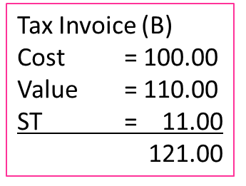
Present Taxation System (Inter-State-Services)
Tax Invoice (A)
Value = 100.00
ST = 10.00
110.00
Input service provider A (State X)
Agent (StateY)
Consumer (Y)
Service tax = 11 (-) 10 (ITC) = 1
Service tax = 12.10 (-) 11 (ITC) = 1.10
Output service provider (X)
Service tax= 10
Tax Invoice (C)
Cost = 111.00
Value = 121.00
ST = 12.10
133.10
Centre = 12.10
(10 + 1 + 1.1)
State (X) = 0
State (Y) = 0

Slide 72
GST Model (Inter-State-Services)
Tax Invoice (A)
Value = 100.00
CGST = 10.00
SGST = 10.00
120.00
Input service provider (X)
Agent(Y)
Consumer(Y)
Output service provider(X)
IGST = 22 (-) 10 (CGST) (-) 10 (SGST) = 2
CGST = 12.10 (-) 12.10 (IGST) = 0
SGST = 10
CGST = 10
SGST = 12.10 (-) 9.90 (IGST) = 2.20
Tax Invoice (B)
Cost = 100.00
Value = 110.00
IGST = 22.00
132.00
Tax Invoice (C)
Cost = 110.00
Value = 121.00
CGST = 12.10
SGST = 12.10
145.20
State (X) = 0
(10 - 10)
Centre = 12.10
(10 + 2 + 10 – 9.90)
State (Y) = 12.10
(2.20 + 9.90)

Slide 73
Summary – Services
Particulars | Inter-State
 | Present Scenario | GST Model
Value | 121.00 | 121.00
Centre’s taxes | 12.10 | 12.10
State (X)’s taxes | - | -
State (Y)’s taxes | - | 12.10
State’s Totals | - | 12.10
Total tax paid to Govt. | 12.10 | 24.20
Pure Cost taxes | - | -
Total tax paid by Consumers | 12.10 | 24.20
Final value paid by consumers | 133.10 | 145.20

Slide 74
Branch Transfer
Inter-State & Intra-State
Leviable to GST?
Stocks maintained at each State vs. Centralised Stocking System
The Input Tax Credit available at the credit of one unit of registered dealer in one state shall be transferable to its other unit at another State for using the same to pay the output IGST there.

Slide 75
Present Taxation System (Inter-State-Goods)
Input manufacturer (State X)
Dealer (State Y)
Consumer (State Y)
VAT = 11
Excise = 11 (-) 10 (ITC) = 1
VAT = 13.91
Output manufacturer (State X)
Excise = 10
CST = 2.42 (-) 2.42 (ITC) = 0
Tax Invoice (A)
Value = 100.00
Excise = 10.00
VAT = 11.00
121.00
Tax Invoice (B)
Cost = 100.00
Value = 110.00
Excise = 11.00
CST = 2.42 123.42
Entry Tax = 3
State (X) = 11
Tax Invoice (C)
Cost = 123.42
Value = 135.76
VAT = 13.56
149.32
Centre = 11
(10 + 1)
State (Y) = 16.56
(13.56 + 3)

Slide 76
GST Model (Inter-State-Goods)
Tax Invoice (A)
Value = 100.00
CGST = 10.00
SGST = 10.00
120.00
Input manufacturer
Dealer
Consumer
Output manufacturer
IGST = 22 (-) 10 (CGST) (-) 10 (SGST) = 2
CGST = 12.22 (-) 12.22 (IGST) = 0
SGST = 10
CGST = 10
SGST = 12.22 (-) 9.78 (IGST) = 2.44
Tax Invoice (B)
Cost = 100.00
Value = 110.00
IGST = 22.00
Adl. IGST = 1.10 133.10
Addl. IGST = 1.10
Tax Invoice (C)
Cost = 111.10
Value = 122.21
CGST = 12.22
SGST = 12.22
146.65
State (X) = 1.10
(10 – 10 + 1.10)
Centre = 12.22
(10 + 10 + 2 – 9.78)
State (Y) = 12.22
(9.78 + 2.44)

Slide 77
Summary – Goods
Particulars | Inter-State
 | Present Scenario | GST Model
Value | 139.06 | 122.21
Centre’s taxes | 11.00 | 12.22
State (X)’s taxes | 11.00 | 1.10
State (Y)’s taxes | 13.91 | 12.22
State’s Totals | 24.91 | 13.32
Total tax paid to Govt. | 41.33 | 25.54
Pure Cost taxes | 12.42 | 1.10
Total tax paid by Consumers | 13.91 | 24.44
Final value paid by consumers | 149.32 | 146.65

Slide 78
Destination based tax-Impact on STates

Slide 79
Origin Based
Consumption Based Destination Tax

Slide 80
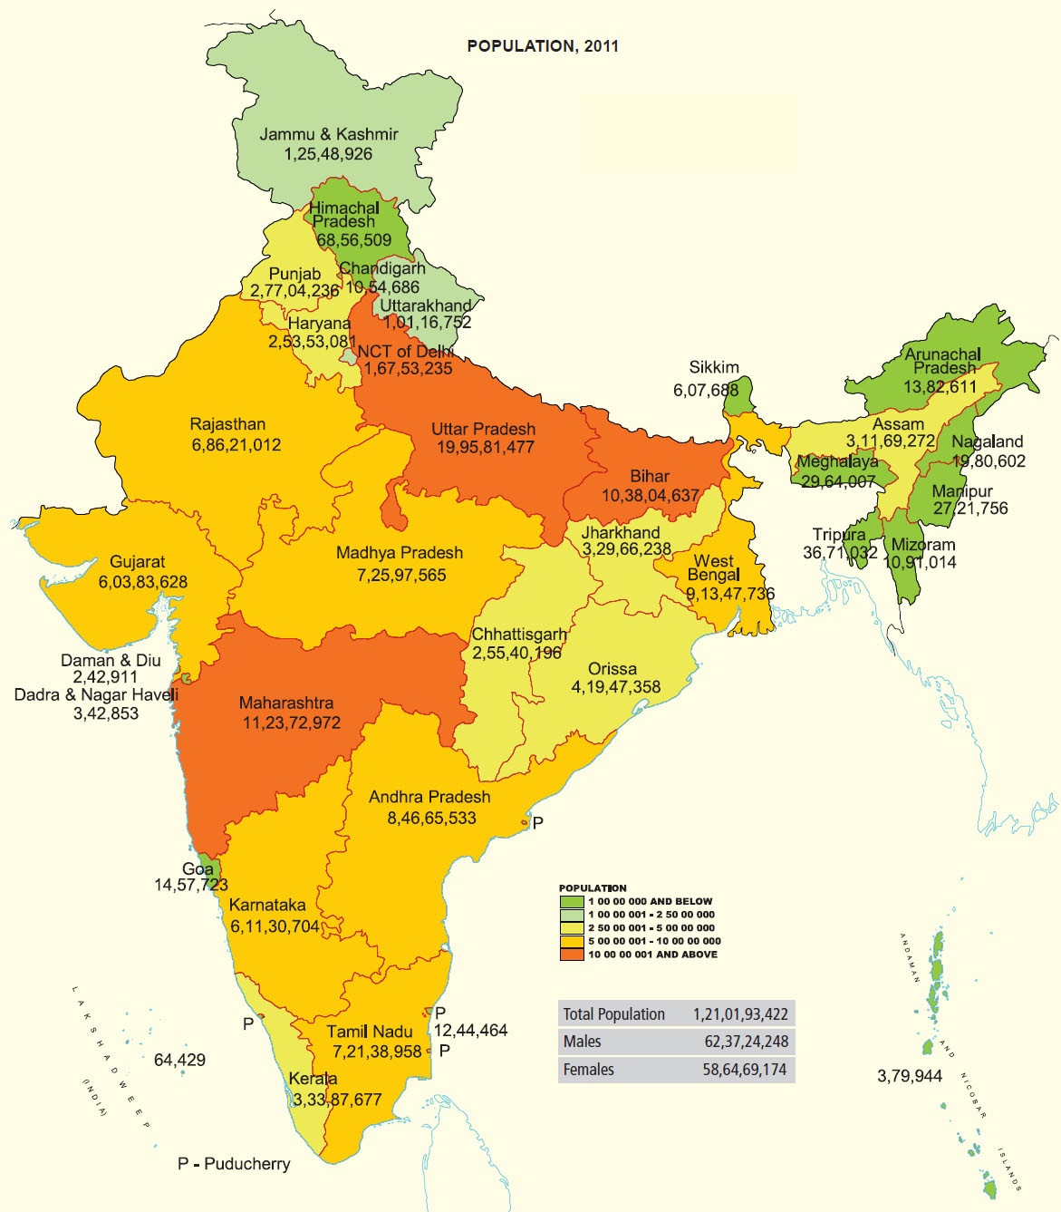
Population of India

Slide 81
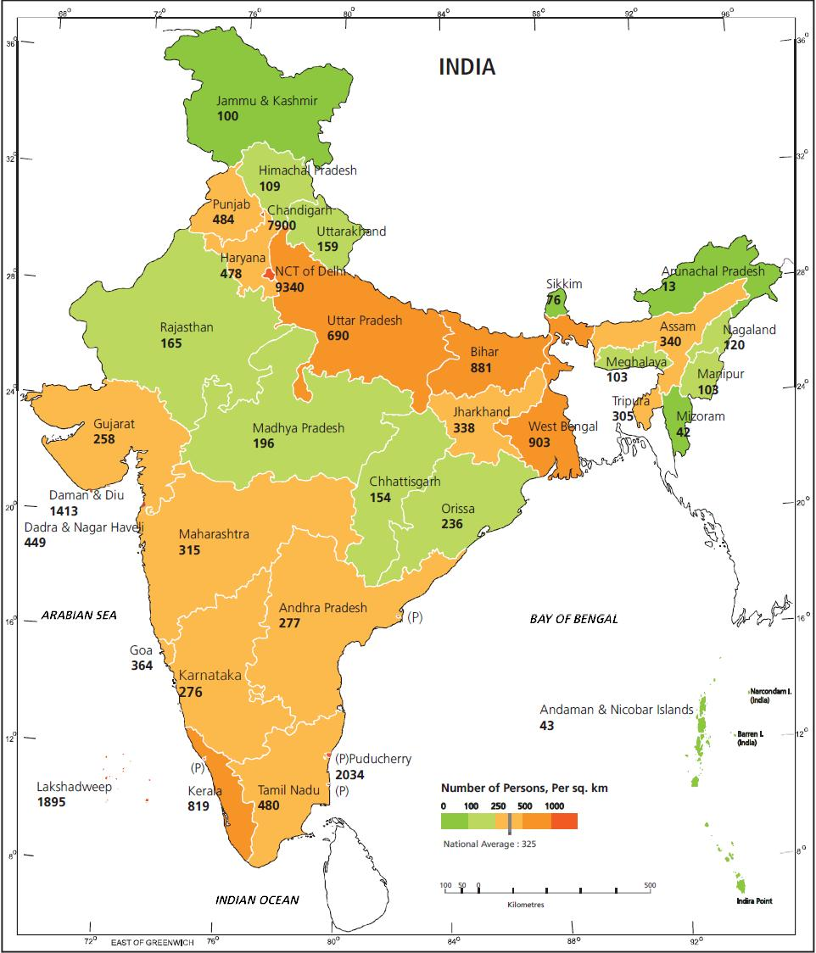
Density of Population in India

Slide 82
Destination based tax
Impact of Consumption based
  B to B transactions
    Transfer of Set-off
  B to C transactions
    No effect
E-Commerce Transactions

Slide 83
Current taxation system-goods
Type of transaction | Applicable Tax | Rate | Remarks | Collected by
Inter state B2B | CST | 2% 0% | C form H from | Selling State -
Inter state Branch/consignment | CST | 0% | F from | -
Further Inter state movement | CST | 0% | E1/E2 forms | -
Inter state B2C | CST | Prevalent rate of VAT in the selling state | - | Selling State
Import from abroad | Customs CST | Varying 0% | - High seas | Union -
Export aborad | Customs CST | Mostly Nil 0% | - H form | Union -

Slide 84
Proposed taxation system-goods
Type of transaction | Applicable tax | Rate | Remarks | Collected by
Inter state B2B | IGST | 27% (Hypothetical) | Buying state to get credit | Union
Inter state branch/consignment | IGST | 27% | Buying state to get credit | Union
Further movement | IGST | 27% | Final buying state to get the credit | Union
Inter state B2C | IGST | 27% | Buying state to get credit?? | Union
Import from abroad | Customs + IGST | Customs+27% | Buying state to get credit?? | Union
Export | Customs + IGST | 0+0 | Buying state to get credit?? | -

Slide 85
Current taxation system-services
Type of transaction | Applicable tax | Rate | Remarks | Collected by
Inter state movement | Service tax | 14% | - | Union
Import from abroad | Service tax | 14% | POPS | Union
Export | Service tax | 0% | POPS, STR | -

Slide 86
Proposed taxation system-services
Type of transaction | Applicable tax | Rate | Remarks | Collected by
Inter state B2B | IGST | 27% (Hypothetical) | Buying state to get credit | Union
Inter state B2C | IGST | 27% | Buying state to get credit?? | Union
Import from abroad | IGST | 27% | Buying state to get credit?? | Union
Export | IGST | 0% | - | -

Slide 87
Current set off system
Type of tax | Set off availability | Against which tax | Can not be set off against
CST | No | - | Any State or Central taxes
Customs | Yes ( With limitations) | Central Excise, Service tax, SAD refund if VTA/CST paid | State taxes (Except SAD refund)
VAT | Yes | VAT, CST | Central taxes
Service tax | Yes | Service tax, Central Excise | State taxes

Slide 88
Proposed set off system
Type of tax | Availability | Against which Tax | Can not be set off against
SGST | Yes | IGST, SGST | CGST
CGST | Yes | IGST, CGST | SGST
IGST | Yes | IGST, CGST, SGST | -
Customs | No | - | IGST, CGST, SGST

Slide 89
Impact
Impact
No. of Taxes
Cascading Effect
Seamless Credit
Multiple Threshold
Taxable Events
Taxable Values
Notifications
Rates of Taxes
Tax on Tax
Tax v/s Tax
Compliances

Slide 90
Impact
For Manufacturers: 10 to 4
For Traders/Service Providers: 1 to 2
Impact
No. of Taxes
Cascading Effect
Seamless Credit
Multiple Threshold
Taxable Events
Taxable Values
Notifications
Rates of Taxes
Tax on Tax
Tax v/s Tax
Compliances

Slide 91
Impact
From 2 to 1 to 0
Impact
No. of Taxes
Cascading Effect
Seamless Credit
Multiple Threshold
Taxable Events
Taxable Values
Notifications
Rates of Taxes
Tax on Tax
Tax v/s Tax
Compliances

Slide 92
Impact
Still a Dream
Impact
No. of Taxes
Cascading Effect
Seamless Credit
Multiple Threshold
Taxable Events
Taxable Values
Notifications
Rates of Taxes
Tax on Tax
Tax v/s Tax
Compliances

Slide 93
Impact
To Reduce
Impact
No. of Taxes
Cascading Effect
Seamless Credit
Multiple Threshold
Taxable Events
Taxable Values
Notifications
Rates of Taxes
Tax on Tax
Tax v/s Tax
Compliances

Slide 94
Impact
Impact
No. of Taxes
Cascading Effect
Seamless Credit
Multiple Threshold
Taxable Events
Taxable Values
Notifications
Rates of Taxes
Tax on Tax
Tax v/s Tax
Compliances
Only 1 – “SUPPLY”

Slide 95
Impact
Impact
No. of Taxes
Cascading Effect
Seamless Credit
Multiple Threshold
Taxable Events
Taxable Values
Notifications
Rates of Taxes
Tax on Tax
Tax v/s Tax
Compliances
Still a Grey Area
But Still to Reduce

Slide 96
Impact
Impact
No. of Taxes
Cascading Effect
Seamless Credit
Multiple Threshold
Taxable Events
Taxable Values
Notifications
Rates of Taxes
Tax on Tax
Tax v/s Tax
Compliances
Lesser Variety

Slide 97
Impact
Impact
No. of Taxes
Cascading Effect
Seamless Credit
Multiple Threshold
Taxable Events
Taxable Values
Notifications
Rates oF Taxes
Tax on Tax
Tax v/s Tax
Compliances
Few Commodities

Slide 98
Impact
  May Continue if Different Rates of Taxes prescribed for Goods and Services
Impact
No. of Taxes
Cascading Effect
Seamless Credit
Multiple Threshold
Taxable Events
Taxable Values
Notifications
Rates oF Taxes
Tax on Tax
Tax v/s Tax
Compliances

Slide 99
Impact
- State Wise Registrations
- Invoice Details
- Exception – Manufacturing Units
Impact
No. of Taxes
Cascading Effect
Seamless Credit
Multiple Threshold
Taxable Events
Taxable Values
Notifications
Rates oF Taxes
Tax on Tax
Tax v/s Tax
Compliance

Slide 100
Impact
May Fall Down
Impact
No. of Taxes
Cascading Effect
Seamless Credit
Multiple Threshold
Taxable Events
Taxable Values
Notifications
Rates oF Taxes
Tax on Tax
Tax v/s Tax
Compliances

Slide 101
Impact
Lesser Issues in Long Run
Higher Working Capital
No forms
Cost increase
Higher Tax Net
New POPS
Traders
Service providers
CGST in all value addition
Services to suffer more tax

Slide 102
Preparing for GST
GST
Supply chain management systems
Transitional issues
Compliances
Restructuring of transactions
Restructuring of business
Pricing policy
IT Systems Set up
Training to employees

Slide 103


Contact us…
Right advice at right time…
2/19 Nityanand Nagar, Sahar Road, Andheri (East), Mumbai-400 069.
+91 22 2683 6519
+91 98210 12151
jayeshgogri@gscintime.com
info@gscintime.com
www.gscintime.com

