Slide 1
Lecture meet on IndAS
Day 3
Presented by
CA Kusai Goawala
For Pune Branch of WIRC
6th to 8th July 2015

Slide 2


IndAS-36
IMPAIRMENT
OF
ASSETS
CA KUSAI GOAWALA

Slide 3
Not applicable to :
Inventories
Construction Contracts
Deferred Tax Assets
Investment Property at FV
Financial Assets
Biological assets at FV
Non Current Assets under disposal group
Impairment vs Depreciation
Depreciation is amortization based on useful life
Impairment is value based
CA KUSAI GOAWALA

Slide 4
Existence of Symptoms - Test for impairment
External Factors
Internal Factors
External Source of Information
Substantial decline in market value
Technological and other changes impacting adversely
Interest rates – increased
CA is more than market capitalization
Internal Source of Information
Obsolence of assets or physical damage of assets
Internal plans to re-organise / discontinue operations
Economic performance of asset worst than expected
Some items where impairment to be tested annually even though no symptoms
Goodwill
Intangibles with infinite lives
CA KUSAI GOAWALA

Slide 5
Cash Generating Unit (CGU) : Smallest independent source of revenue
(Product of CGU has active market even though consumed internally)
Impairment Loss = CA – Recoverable Amount
First apply to individual asset.
If not RA for individual asset cannot be worked out use CGU.
Recoverable Amount is :
Higher of : FV less cost to sell & Value in Use
Value in Use = PV of future cash flows of CGU
CA KUSAI GOAWALA

Slide 6
Factors for calculating VIU :
Cash Flows
Based on Supportable assumptions
Maximum for five years
Current Conditions - Do not consider future expenditure and its
revenue
Residual Value
No financial activities
Before tax impacts
Forex – PV as per foreign currency translated on valuation date.
Restructuring only if committed
Discounting rate – current market risk free rate pre-tax.
Goodwill/Intangibles – IFRS vs AS
Goodwill to be allocated to each of the CGU
Lowest level of CGU – monitored for internal management
In case of Business Combination – can be allocated within one
year.
CA KUSAI GOAWALA

Slide 7
In AS – top down or bottoms up test.
Treatment of Impairment Loss :
CA-RA = P&L
If CA is revalued – first reduce Revaluation reserve to that extent and balance to P&L
If RA is negative = provide a liability
Reversals of Impairment
No reversals for impairment loss on goodwill – earlier version allowed.
Corporate Assets
If possible to allocate to a unit – allocate
If not possible go to CGU – allocate
If not possible exclude Corporate Assets
CA KUSAI GOAWALA

Slide 8
Impairment Loss in case of CGU with Goodwill
First impact Goodwill then balance distribute to assets in CGU on pro-rata
The value cannot reduce below zero
Reversals
Tested on an annual basis or earlier when there is an impairment indication.
If external/internal sources favorable, check for reversals.
Reversals to be given effect only if there is a change in
estimates since last impairment loss.
Change due to reduction in period of cash flow cannot reverse impairment.
Cannot exceed Carrying Amount if Impairment loss was not recognized
Impairment reversals (other than on Goodwill) to be taken to P&L except in case of revaluation impact.
CA KUSAI GOAWALA

Slide 9
Sr. No. | Point for Consideration | AS 28 (Impairment of Assets) | IndAS 36 (Impairment of Assets)
1 | Goodwill | Tested for impairment by allocating its carrying amount to CGU. | Allocated to the lowest level at which goodwill is internally monitored by management.
2 | impairment test for Goodwill and Intangibles | On indication Also AS-26 requires intangibles that are not available for use and that are amortized over a period exceeding 10 years to be assessed for impairment every F.Y and even if there is no indication of impairment. | Tested on an annual basis or earlier when there is an impairment indication.
3 | Reversal of impairment loss for goodwill | Favorable external events have occurred. | Reversal is prohibited (even in subsequent interim periods).
CA KUSAI GOAWALA

Slide 10
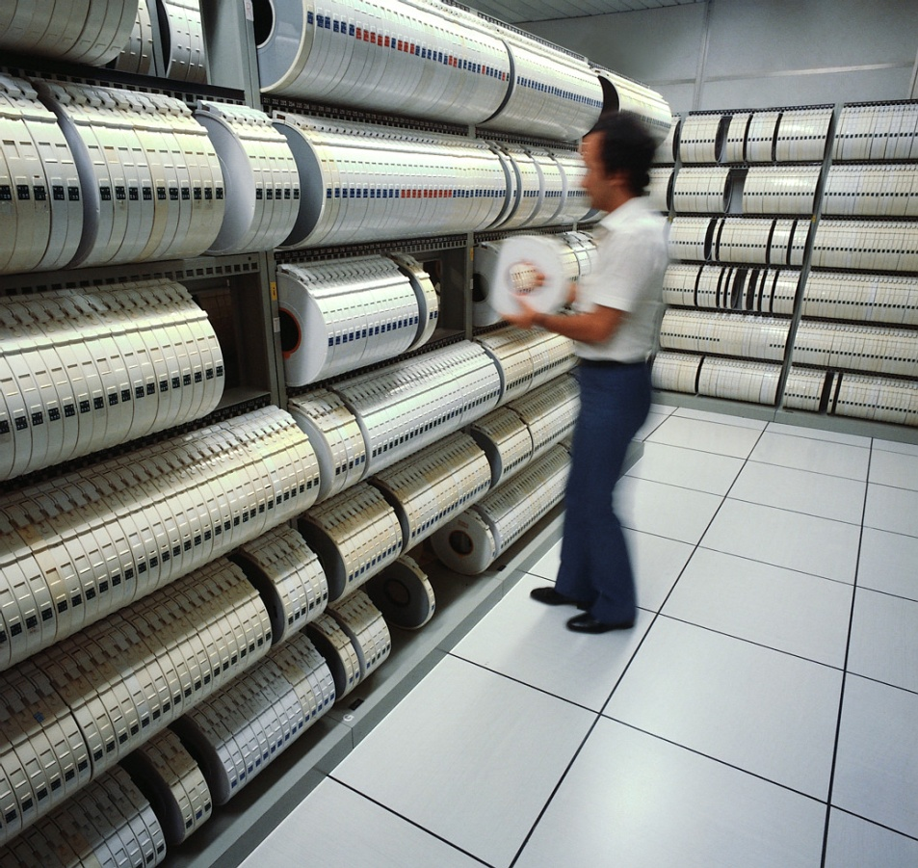
IndAS-37
PROVISIONS,
CONTINGENT
LIABILITIES &
CONTINGENT ASSETS
CA KUSAI GOAWALA

Slide 11
IAS 37 : Provisions, Contingent Liabilities and Contingent Assets
Excludes :
Financial Instruments, Executary Contracts (except onerous contracts)
Actual liabilities vs Provisions vs Contingent Liabilities
Actual Liability : Bills received – expenses/income booked based on
certainty
Provision :
More than probable :
Past event – Present obligation
Outflow of resources will be required
Reliably measurable
Contingent Liabilities :
Less than probable provisions due to some event whose occurrence
inot in the control of the entity.
CA KUSAI GOAWALA

Slide 12
Provision to be made for warranties, returns, money back offers, claims etc.
High level of estimates required.
Not necessary to know the identity of the payee.
Provision to be made on the present value of the liability to be incurred.
Contingent Liability to be given in notes. If chances of such liability is remote
– no need to disclose in notes.
Joint and Several Liabilities – Contingent Liabilities – share of other joint
parties.
Contingent Assets : Do not recognize unless realization virtually certain
Disclose in Notes
CA KUSAI GOAWALA

Slide 13
Key differences
Constructive Obligations vs Legal Obligations
Discounting of provision
Restructuring provision – constructive vs legal obligation
Onerous contracts – IndAS – discounting and impairment
Contingent Assets - Disclosure

Slide 14
Measurement :
Best estimate
Provisions are before taxes
Risks and uncertainties – not required to create excessive provision out of abundant precaution.
Future events :
Amount to be provided – technological changes / legislation may not be
passed (eg environmental requirements)
End use as per provision made : adjust such provision only.
Future operating losses no need to provide.
Onerous contracts : Unavoidable cost exceeds benefits – to provide.
Reimbursements – recognize as a separate asset : virtual certain – to receive –
not to exceed the provision
CA KUSAI GOAWALA

Slide 15
Comparisons
Sr. No. | Point for Consideration | IAS 37 (Provisions, Contingent Liabilities and Contingent Assets) | AS 29 (Provisions, Contingent Liabilities and Contingent Assets)
1 | Recognition of Provisions | Constructive obligation considered only if arising from customary practice | In case of Legal or Constructive obligation
2 | Discounting of Provisions | If more than 12 months, then PV | Not permitted
3 | Recognition of Contingent Assets | Disclosed in FS if an inflow of economic benefits is probable | Not disclosed in FS but disclosed in BOD report
CA KUSAI GOAWALA

Slide 16

IndAS-29
FINANCIAL REPORTING IN
HYPERINFLATIONARY
ECONOMIES
CA KUSAI GOAWALA

Slide 17
What is indication of hyperinflation :
When cumulating price index over three years nears 100%.
People prefer dealing in stable currencies
People invest in Non monetary assets/other stable currencies
Sales/Purchase credits built in inflationary cost
Interest/Wages linked to price index.
CA KUSAI GOAWALA

Slide 18
Non monetary assets/liabilities, income and expenditure are indexed from the date of transaction to reporting date (Measuring Unit Current)
Monetary items are already at MUC and hence not required to be indexed.
Restate FS of current as well as previous year.
Recognize Gain or loss in P&L
CA KUSAI GOAWALA

Slide 19
Money loses purchasing power and hence comparing the transactions on absolute terms is not meaningful.
How to index :
Equity – Capital movements to be indexed
Retained earnings will automatically get adjusted due to changes in P&L
Revaluation Reserve – Eliminate
Monetary Assets/Liabilities – Assets/liabilities at carrying amount
Non Monetary Assets/Liabilities – Indexed by Measuring Unit Current vs index on the date of transaction.
Assets/Liabilities under a contract where it provides linked to index – as per agreement.
CA KUSAI GOAWALA

Slide 20
In case of exact date of acquisition of FA not available – first date of restatement.
In case of price index not available for a period – use movements in stable currency as guiding factor.
CA KUSAI GOAWALA

Slide 21

IndAS-38
INTANGIBLE
ASSETS
CA KUSAI GOAWALA

Slide 22
Intangible Asset :
Identifiable
Non Monetary Asset
Without physical substance
Controlled due to past event
Future economic benefits will flow
CA KUSAI GOAWALA

Slide 23
Recognise only if :
Control over asset – deny access to others – legal right.
Identification of asset – can be sold separately
Economic Benefits will flow – increase in revenue/reduce cost
Cost can be measured reliably
Insignificant tangible asset to carry intangibles is also intangible – CD/Films
Intangible used for operating Significant tangible – part of tangible
Internally generated brands, goodwill cannot be recognized
Acquired goodwill, brands can be recognized provided all criteria met
CA KUSAI GOAWALA

Slide 24
Cannot recognize :
Start up cost
Mastheads
Marketing or promotional cost – brand building
Administration costs
Research vs Development
Research cost – expense w/off
Development – can recognize if criteria met
CA KUSAI GOAWALA

Slide 25
Development cost can be capitalize only if :
Criteria for recognition is met
Entity has intention and resources to complete
Has ability to apply
Done technical studies
Existence of market for the product developed.
Development starts when research ends.
Research involves :
Obtain knowledge
Evaluating alternatives
Options for selection
CA KUSAI GOAWALA

Slide 26
Development involves
Application of research
Alternative already selected
Making prototype
Ends on commencement of commercial production/use
If research and development phase cannot be distinguished – Consider as Research phase.
Expenditure once written off cannot be subsequently capitalized.
When recognition criteria is met at a later stage – capitalize from that date.
Intangibles acquired under Business Combination
Recognize even if internally generated by acquiree
Assess recognize criteria
To recognize separately from Goodwill
Initial recognition always at cost
CA KUSAI GOAWALA

Slide 27
Cost includes
cost of acquisition
direct cost incurred for making it capable for operating as intended
deferred price consideration – imputed interest to be segregated
Borrowing cost as per IAS 23
Cannot include : Marketing, administration, abnormal wastages etc
Grant : Assets allotted without considering – Airport landing rights, license to operate radio stations etc. – Take Fair Value on both sides – Asset and Government Grant
CA KUSAI GOAWALA

Slide 28
Exchange of Assets – Barter :
At FV of assets acquired
If no FV – cost of the asset given up.
Subsequent recognition :
Cost model
Revaluation model
Option to be considered for all assets of similar class.
CA KUSAI GOAWALA

Slide 29
Cost model – Cost less amortization less impairment
Revaluation to be done regularly.
Active market : taxi licences, fishing licences, production quotas
No active market – brands, patents or trademark – since assets are unique
If active market cease – it indicates - check for impairment.
Effect of revaluation :
When revalued asset is disposed off, revaluation surplus transferred to
retained earnings directly without routing through P&L.
Test for impairment
CA KUSAI GOAWALA

Slide 30
Intangibles
Having finite lives
Having Infinite lives (no foreseeable limit to generate cash inflows)
For assets having finite lives – Apply IndAS 36
For assets having infinite lives – Check annually and on indication of impairment.
Indefinite does not mean infinite. Estimate on prudent basis.
Amortization :
-- For Finite lives :
On straight line over the period of useful life.
No amortization for intangibles having infinite lives
Goodwill/brand once impaired – cannot reverse.
CA KUSAI GOAWALA

Slide 31
Intangibles purchased on deferred payment terms – imputed interest to be segregated
Expenditure on advertisement and publicity expenses – Fee paid to an actor in a promotional film is charged to PL when he shoots the film. The charge is not delayed till release of the film.
In case of toll roads, revenue model of amortisation not permitted.
CA KUSAI GOAWALA

Slide 32
Comparisons
Sr. No. | Point for Consideration | IndAS 38 (Intangible Assets) | AS 26 (Intangible Assets)
1 | Measurement | Either at Cost or Revalued Amt | Only at Cost
2 | Useful life | Either finite or infinite | Cannot be infinite (rebuttable presumption max 10 years)
3 | Goodwill | Not amortised but subject to annual impairment test | Arising on amalgamation in the nature of purchase : amortized over 5 years Arising on acquisition : not amortised but tested for impairment
CA KUSAI GOAWALA

Slide 33

IndAS-40
INVESTMENT
PROPERTY
CA KUSAI GOAWALA

Slide 34
Investment Property
Properties that are held :
for renting/already rented
for capital appreciation
vacant – future use not decided
Not held for administrative purposes or for sale in ordinary course of business
Investment properties during construction period is to be dealt with as PPE.
Property let out to Group Companies – Standalone vs CFS
CA KUSAI GOAWALA

Slide 35
Services rendered in relation to property – dominant or ancillary – PPE or
IP Hotel or Rented Property
Part PPE / IP : Segregate relevant portions. Possible to sell independently.
If not possible – If OOP very negligible compared to total, then treat as IP.
Conditions for recognition :
If Future Economic benefits will flow to entity
Cost can be measured reliably
CA KUSAI GOAWALA

Slide 36
Measurement at recognition
At cost plus transaction costs.
Cannot add : start up cost, abnormal wastages, operating losses etc.
Interest component to be segregated for deferred payment consideration
IP under Finance Lease – Lower of FV of property & PV of minimum lease payments– equivalent liability.
In case of exchange of assets : FV of assets acquired unless lack commercial substance. If FV cannot be determined – apply cost of asset given up.
CA KUSAI GOAWALA

Slide 37
Measurement after recognition
Only one method available:
Cost model (Fair Value model option in IFRS)
CA KUSAI GOAWALA

Slide 38
Disposals and Retirements :
When sold or permanently withdrawn from use : no future benefit available
When replacement of one part – apply method used in PPE.
On sale – Consideration – Carrying amount = P&L
If consideration deferred – compute imputed interest revenue.
CA KUSAI GOAWALA

Slide 39
Investment Property
Basis Of Comparison | IndAS 40 Investment Property | AS 13 Accounting for Investments
Definition of investment property | Land or building held to earn rentals or for capital appreciations or both. Does not apply to owner occupied property or property held for sale or that is leased to another entity under financial lease. | An investment in land or buildings that are not intended to be occupied substantially for use by, or in the operations of the investing enterprise.
Measurement of investment property | Permits only cost model. | Classified as long term investments and measured at cost less impairment.
CA KUSAI GOAWALA

Slide 40

IndAS-41
AGRICULTURE
CA KUSAI GOAWALA

Slide 41
Biological assets – livestock, crops, plantations.
Bearer Plants – living plant – expected to bear produce for more than one period.
Except – plant grown as lumber
Agricultural Produce – harvested produce
Process – Agricultural transformation/Deterioration/
Procreation.
Recognised only if :
Control over assets.
Cash flow can be estimated – economic benefits.
Cost or FV can be reliably determined.
CA KUSAI GOAWALA

Slide 42
Initial Recognition at Fair Value as per present location and condition minus point of sale costs.
Changes in value – P&L.
If FV cannot be ascertained – cost minus depreciation minus impairment as per PPE.
If harvested – the crop is to be considered as Inventories.
Once taken at FV cannot change back to Cost method.
Gain or loss from initial recognition – take to P&L
If land and standing crops are combined - deduct land value to determine value for crops.
In case of Government Grant – When FV used – take it to P&L when becomes receivable.
If contingent on fulfilling conditions – recognize only when conditions met.
CA KUSAI GOAWALA

Slide 43
Fair Value to be determined for Biological assets as well as Agricultural Produce.
Do not consider forward sale price to determine FV as the same is not indicative of the current FV
Group similar assets according to significant attributes etc
Gains or losses on initial recognition to P&L
Subsequent measurement changes – recognise to PL
CA KUSAI GOAWALA

Slide 44
Biological Assets | Agricultural Produce | Products as a result of processing harvesting
Sheep | Wool | Yarn Carpet
Dairy Cattle | Milk | Cheese
Cotton Plants | Cotton | Thread clothing
Sugarcane | Harvested cane | Sugar
Tea Bushes | Picked leaves | Tea
Fruit Trees | Picked Fruit | Processed fruit
CA KUSAI GOAWALA

Slide 45
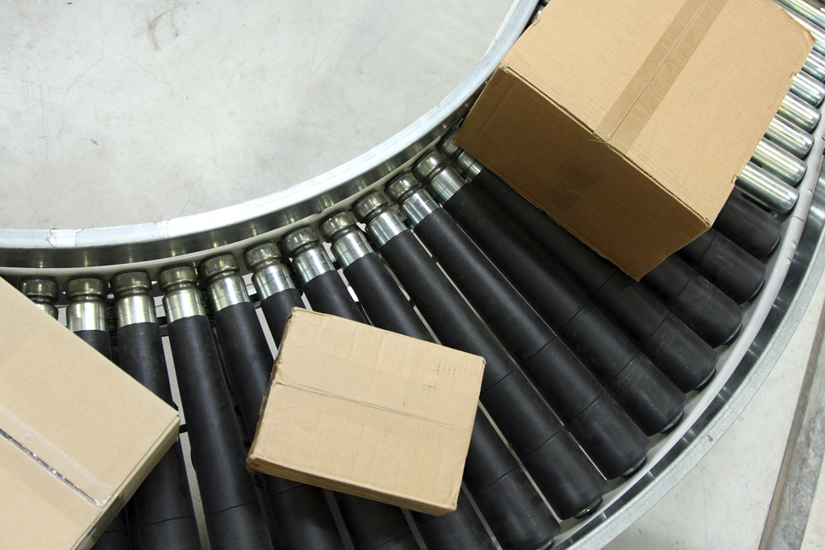
IndAS-2
INVENTORIES
CA KUSAI GOAWALA

Slide 46
Comparisons
Sr. No. | Point for Consideration | IAS 2 (Inventories) | AS 2 (Valuation of Inventories)
1 | Deferred Settlement Terms | Purchase price under normal credit terms (–) amt paid for deferred settlement = interest expense (imputed interest) | Cost is the purchase price
CA KUSAI GOAWALA

Slide 47

IAS-20
ACCOUNTING FOR
GOVERNMENT GRANTS
AND DISCLOSURE OF
GOVERNMENT ASSISTANCE
CA KUSAI GOAWALA

Slide 48
Forgivable loans considered as grant
Government loans at below market interest to be accounted as per IFRS 109 (initial carrying amount – amount as determined under IFRS 109)
Grants relating to assets to be accounted as deferred Income
Non monetary grant at fair value – vs nominal value
Refund of Grant – prohibition to be classified as Extraordinary Item
CA KUSAI GOAWALA
Notes:
to

Slide 49
Comparisons
Sr. No. | Point for Consideration | IAS 20 (Accounting for Government Grants and Disclosure of Government Assistance) | AS 12 (Accounting for Government Grants)
1 | Recognition | Only Income approach | Capital or Income approach
2 | Trf to Shareholder’s Funds | Nil | In the nature of Promoter’s contribution
3 | Repayment - Cumulative additional depreciation | Immediately recognized as an expense ; prohibited to classify as an extra-ordinary item | Recognized over the remaining useful life of the asset ; classified as an extra-ordinary item
CA KUSAI GOAWALA

Slide 50

IndAS-27
CONSOLIDATED & SEPARATE
FINANCIAL STATEMENTS
CA KUSAI GOAWALA

Slide 51
IndAS 27 - Consolidated and Separate
Financial Statements
CFS is the primary FS.
Single Economic Entity.
Separate Financial Statement only if statute requires
For an entity having no subsidiary/JV/Associate – SFS is the FS
Subsidiary :
a. 50% or more voting power or control
b. Able to appoint or remove majority of Directors.
c.Cast the majority of votes at board meeting.
Subsidiary may be company or non-corporate
Control - govern Operating & Financial Policies.
Potential voting rights (PVR) – to consider for determining
control
CA KUSAI GOAWALA

Slide 52
PVR to be considered in totality for determining Control.
However PVR not considered for computing profits/losses
Minority Interest – Non Controlling Interests
Consolidation is compulsory
Exceptions: All of the following conditions satisfied.
Parent has a parent who has agreed
Not listed
not a potential - listing
Intermediate or ultimate Parent - prepares CFS.
No exemption
A subsidiary under severe long-term restriction for transfer of funds.
All subsidiaries to be included except those acquired and held for sale.
CA KUSAI GOAWALA

Slide 53
Group A Standalone
 | Holdco
Sales | 0
PAT | 0
Equity Capital | 3000
Reserves | 0
 | 3000
Investments | 3000
Operating Assets
 | 3000

Slide 54
Group A Standalone
 | Holdco | SPV1 | SPV2 | SPV3
Sales | 0 | 1000 | 1000 | 1000
PAT | 0 | 200 | 200 | 200
Equity Capital | 3000 | 1000 | 1000 | 1000
Reserves | 0 | 200 | 200 | 200
 | 3000 | 1200 | 1200 | 1200
Investments | 3000
Operating Assets |  | 1200 | 1200 | 1200
 | 3000 | 1200 | 1200 | 1200

Slide 55
Standalone
 | Co A | Co B
Sales | 0 | 2500
PAT | 0 | 500
Equity Capital | 3000 | 3000
Reserves | 0 | 500
 | 3000 | 3500
Investments | 3000 | 0
Operating Assets | 0 | 3500
 | 3000 | 3500

Slide 56
CFS
 | A | B
Sales | 3000 | 2500
PAT | 600 | 500
Equity | 3000 | 3000
Reserves | 600 | 500
 | 3600 | 3500
Operating Assets | 3600 | 3500
 | 3600 | 3500

Slide 57
Acquisition Cost:
Add : Cost of acquisition of share.
Add : All other cost associated with acquisition is cost of acquisition.
Deduct : Dividends received in respect of income prior to acquisition –
reduce cost
Consolidation is compulsory till Subsidiary ceases to be subsidiary.
Eliminate intra group transactions/unrealized profits
Deferred tax implication on such eliminations
Intra group Losses may indicate impairment – test for impairment
Three months gap allowed between reporting dates of Parent &
Subsidiaries F.S.
Minority Interest disclose under Equity.
Recognition of Goodwill in CFS (100% / Parent Co. Share)
Uniform Accounting Policies to be followed.
Line by line consolidation.
CA KUSAI GOAWALA

Slide 58
Step disposal:
Substance of chain transactions is to lose control – take total transactions as
one.
Accounting for disposal – results in –
No loss of control :
Account for changes in Equity – owner with owner
Loss of control
Derecognise asset/liabilities from the date control is lost
Derecognise non controlling interest
Recognise consideration
Retained investment at FV
Recognise any profit/loss in P&L
Transfer incomes held under OCI to P&L
Transfer Revaluation Reserve directly to Retained Earnings
In case of retained investment without control – Apply IAS 39
FV on date of loss of control is FV on initial recognition
In Separate FS : Account either at cost or as per IAS 39
CA KUSAI GOAWALA

Slide 59
Comparisons
Sr. No. | Point for Consideration | IAS 27 Consolidated & Separate FS | AS-21 Consolidated FS
1 | Consolidation | Mandatory | Mandatory to Listed/in the process of listing
2 | Control | Power to govern the Financial & Operating Policies of an entity | 1.If voting power more than 50% 2. Able to remove major Board of Directors
3 | If Dual Control | Company which has control will consolidate | Both entities will consolidate
4 | Potetial Voting Rights (PVR) – control | Only currently exercisable PVR considered for assessing control | Not considered in assessing control
5 | Partial Disposal
 | - Control retained | Accounted as equity basis | No Specific Guidance
 | - Loss of Control | Remeasure of residual holding to fair value. Difference between carrying value & fair value is recognise in Profit & Loss Account | No Specific Guidance
6 | Accounting in Separate FS | Cost less impairment Loss or IAS 39 – AFS | Cost less impairment loss.
7 | Minority Interest | Under Equity | Between own fund & Loan fund
8 | Goodwill | Either for 100% or parents holding. | Only in relation to parents share
9 | Special purpose entity | If control exist then consolidate | Not prescribed
CA KUSAI GOAWALA

Slide 60

CA Kusai Goawala
kusai@gkdj.in
9823140520

