Slide 1
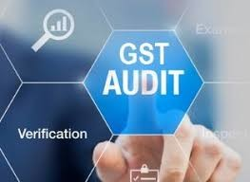
Reverse Charge & Time of Supply under GST
- CA Ravi Kumar Somani

Slide 2
Reverse Charge

Slide 3
Levy under RCM
“Reverse charge” means the liability to pay tax by the recipient of supply of goods or services or both instead of the supplier of such goods or services or both under sub-section (3) or sub-section (4) of section 9, or under sub-section (3) or subsection (4) of section 5 of the Integrated Goods and Services Tax Act.

Slide 4
Levy under RCM
Section 9(3) The Government may, on the recommendations of the Council, by notification, specify categories of supply of goods or services or both, the tax on which shall be paid on reverse charge basis by the recipient of such goods or services or both and all the provisions of this Act shall apply to such recipient as if he is the person liable for paying the tax in relation to the supply of such goods or services or both.

Slide 5
Levy under RCM
Section 9(4) The central tax in respect of the supply of taxable goods or services or both by a supplier, who is not registered, to a registered person shall be paid by such person on reverse charge basis as the recipient and all the provisions of this Act shall apply to such recipient as if he is the person liable for paying the tax in relation to the supply of such goods or services or both.

Slide 6
Levy under RCM
Section 9(4) Amended: The Government may, on the recommendations of the Council, by notification, specify a class of registered persons who shall, in respect of supply of specified categories of goods or services or both received from an unregistered supplier, pay the tax on reverse charge basis as the recipient of such supply of goods or services or both, and all the provisions of this Act shall apply to such recipient as if he is the person liable for paying the tax in relation to such supply of goods or services or both.”

Slide 7
REVERSE CHARGE MECHANISM - SERVICES

Slide 8
RCM - GTA
Supplier of service:
Goods transport agency (GTA) in respect of transportation of goods by road
Recipient of service liable to pay tax under RCM:
Any registered factory;
Any registered society;
Any Co-operative Society established under any law;
Any body corporate established under any law;
Any partnership firm;
Any casual taxable person located in taxable territory;
Any person registered under GST Act.

Slide 9
RCM - GTA
Note 1: RCM is not applicable to services provided by a GTA , by way of transport of goods in a goods carriage by road, to, -
    A Department or Establishment of the CG, SG or UT; or
    Local authority; or
    Governmental agencies,
Who have taken registration under CGST only for deducting tax u/s 51 and not for making a taxable supply.

Slide 10
RCM - Advocate
Supplier of service:
An individual advocate including a senior advocate or firm of advocates
Recipient of service liable to pay tax under RCM:
Any business entity located in the taxable territory
Scope of service:
Legal services to a business entity directly or indirectly.

Slide 11
RCM - Government
Supplier of service
CG, SG, UT or local authority
Recipient of service liable to pay tax under RCM:
Any business entity located in the taxable territory.

Slide 12
RCM - Government
Scope of services:
All services supplied by CG, SG, UT or local authority excluding the following:
Renting of immovable property, and
Services by the Department of Posts (speed post, express parcel post, life insurance, and agency services) provided to a person other than Govt.
Services in relation to an aircraft or a vessel
Transport of goods or passengers.
Note: In case service of renting of immovable property has been provided by the Government to any registered person under CGST, then such registered person is liable to pay tax under RCM w.e.f. 25.01.2018

Slide 13
RCM - Security
Supplier of service:
Any person other than a body corporate
Recipient of service liable to pay tax under RCM:
A registered person, located in the taxable territory
Scope of service:
Security services (services provided by way of supply of security personnel) provided to a registered person

Slide 14
RCM - Security
Note: RCM is not applicable to, -
A Department or Establishment of the CG, SG or UT; or
Local authority; or Governmental agencies,
Who have taken registration under CGST only for deducting tax u/s 51 and not for making a taxable supply.
A registered person paying tax under section 10 of the said Act.

Slide 15
RCM - Others
Sr. No | Supplier of Service | Recipient of Service - Person liable to pay tax under RCM | Description
1 | An arbitral tribunal. | Any business entity | Services supplied by an arbitral tribunal to a business entity
2 | Any person providing sponsorship service | Any body corporate or partnership firm | Services provided by way of sponsorship
3 | A director of a company/body corporate | The company or a body corporate | Services by a director of a company/body corporate to the said company/ body corporate.

Slide 16
RCM - Others
Sr. No | Supplier of Service | Recipient of Service - Person liable to pay tax under RCM | Description
4 | An insurance agent | Any person carrying on insurance business. | Services by an insurance agent to any person carrying on insurance business.
5 | A recovery agent | A banking company or a financial institution or a NBFC | Services by a recovery agent to a banking company/ financial institution or a NBFC
6 | Author or music composer, photographer, artist, or the like | Publisher, music company, producer or the like. | Supply by way of transfer or permitting the use or enjoyment of a copyright relating to original literary, dramatic, musical or artistic works to a publisher, music company, producer or the like.

Slide 17
RCM - Others
Sr. No | Supplier of Service | Recipient of Service - Person liable to pay tax under RCM | Description
7 | Any person Located in a non-taxable territory | Any person located in the taxable territory other than non-taxable online recipient. | Any service by any person is located in non-taxable territory to any person other than non-taxable online recipient.
8 | A person located in non-taxable territory | Importer as u/s 2(26) of Customs Act located in taxable territory. | Services by way of transportation of goods by vessel from a place outside India up to customs station of clearance in India.*
* Note: If the value of ocean freight is not available it shall be taken as 10% of CIF Value.

Slide 18
RCM - Others
Sr. No | Supplier of Service | Recipient of Service - Person liable to pay tax under RCM | Description
9 | Members of Overseeing Committee to RBI | RBI | Any service by members of overseeing committee to RBI
10 | Business facilitator (BF) | A banking company, located in the taxable territory | Services by BF to a banking Company.
11 | An agent of business correspondent (BC) | A business correspondent, located in the taxable territory. | Services by an agent of BC to BC.

Slide 19
RCM - Others
Sr. No | Supplier of Service | Recipient of Service - Person liable to pay tax under RCM | Description
12 | Any Person other than a body corporate | Any registered person, located in the taxable territory. | Security services (services by way of supply of security personnel) provided to a registered person
13 | Any person other than a body corporate paying tax @ 5% with ITC only of input service in the same line of business | Any body corporate located in the taxable territory | Services provided by way of renting of motor vehicles to a body corporate
14 | Lender who deposits the securities | Borrower who borrows under this scheme. | Services of lending securities lending scheme, 1987 of SEBI

Slide 20
RCM – Real Estate
Sr. No | Supplier of Service | Recipient of Service - Person liable to pay tax under RCM | Description
1 | Any Person | Promoter | Services by any person by way of TDR or Floor Space Index (FSI) (including additional FSI) for construction of a project by a promoter.
2 | Any Person | Promoter | Long term lease of land (30 yrs or more) by any person against consideration in the form of upfront amount (called as premium, salami, cost, price, etc. ) and/or periodic rent for construction of a project by a promoter.

Slide 21
REVERSE CHARGE MECHANISM - GOODS

Slide 22
RCM - GOODS
Sr. No | Description | Supplier of Goods | Recipient of Goods - Person liable to pay tax under RCM
1 | Cashew Nuts (not shelled or peeled), bidi wrapper leaves (tendu), tobacco leaves & raw cotton | Agriculturist | Any registered person
2 | Silk Yarn | Any person who manufactures silk yarn from raw silk or silk worm cocoons | Any registered person
3 | Lottery | SG, UT or local authority | Lottery Distributor or selling agent

Slide 23
RCM - GOODS
Sr. No | Description | Supplier of Goods | Recipient of Goods - Person liable to pay tax under RCM
4 | Used vehicles, seized and confiscated goods, old and used goods, waste and scrap | CG, SG, UT or local authority | Any registered person
5 | Priority Sector Lending Certificate | Registered Person | Recipient who is registered person.

Slide 24
Other Important Aspects in RCM
Particulars | Procedure
Input Tax Credit (ITC) | Input tax credit of the GST paid on the goods and services under reverse charge mechanism shall be available if such goods and/or services are used in the furtherance of business., and subject to Section 17(5)
Registration | All persons procuring goods or services notified under Section 9(3) are mandatorily required to obtain GST Registration.
Tax Invoice | Recipient of supply in such cases may issue a consolidated invoice at the end of a month for all the supplies made for unregistered persons.
Payment Voucher | a registered person who is liable to pay tax under RCM shall issue a payment voucher at the time of making payment to the supplier
Records | Every registered person shall keep and maintain an the Accounts/records as may be prescribed

Slide 25
Other Important Aspects in RCM
Particulars | Procedure
Due date of Payment | GST levied under the Reverse Charge mechanism should be deposited with the Govt by the 20th of the next month
Returns | GST paid under Reverse Charge Mechanism (RCM) would not be auto-populated in the GSTR 2A and these details would be required to be manually furnished in GSTR-2
RCM to be paid in Cash only | Input Tax Credit with the recipient cannot be used for payment of Reverse Charge to the Govt.
Composition Scheme dealers | Even persons registered under the Composition Scheme shall also discharge liability under Reverse Charge. No Credit of RCM is available in such cases.
Advance Payment | RCM is levied on advance payments as well.

Slide 26
RCM – Other Key Points
Tax paid under forward charge by the service provider;
Accounting entries for taxes paid under RCM;
Time of Supply under RCM;
Place of supply under RCM;
Self – invoicing for taxes paid under RCM;
Time-limit for availing ITC for taxes paid under RCM;
Treated as an exempt supply – Requires reversal of ITC

Slide 27
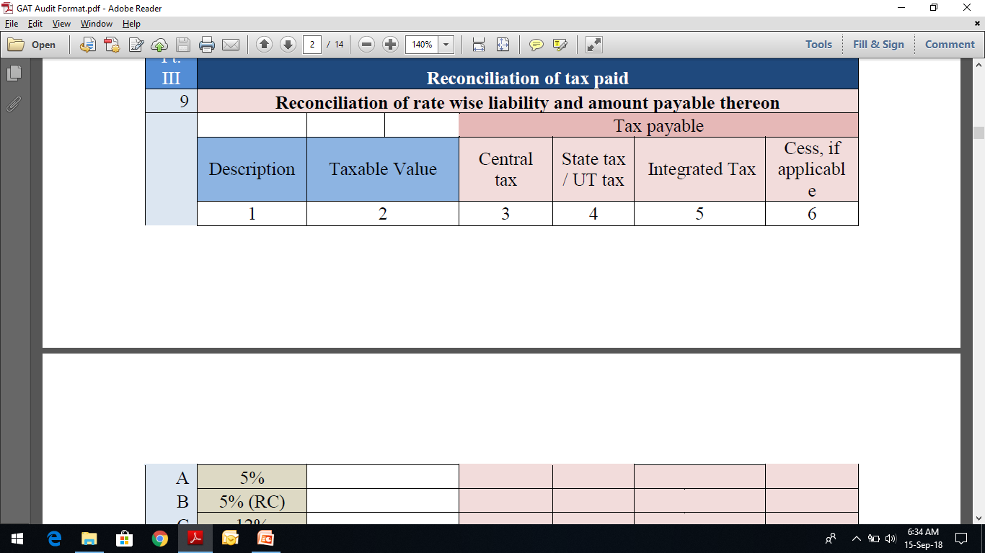
RCM GST Audit

Slide 28
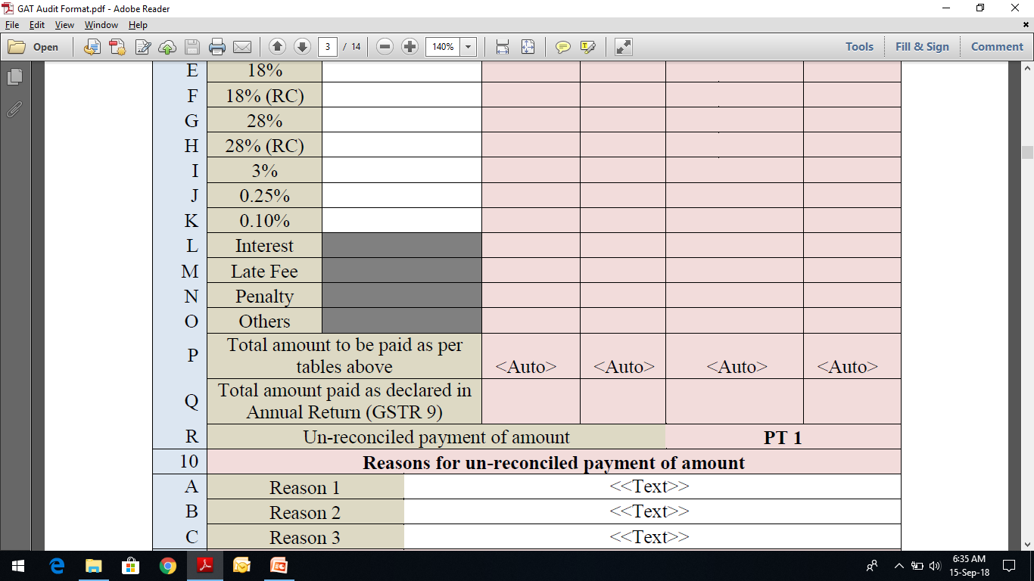
RCM GST Audit

Slide 29
Time of Supply

Slide 30

Why Time of Supply? – Relevance..
To know the point of time when tax to be charged
Uniformity in levy and collection of taxes.

Slide 31
Time of Supply – section 12 and 13 of CGST Act,2017
Sec.12(2): Time of Supply of Goods
As per Section 12(2) of CGST ACT, time of supply of goods shall be earlier of invoice/ payment, i.e., –
Date on which payment is credited to the supplier’s bank a/c
Date on which payment is entered in the books of supplier
Due date for issue of invoice by the supplier [Section 31*]:
- Supply involves movement: Time of removal of goods for supply
- Sale on approval basis: Earlier of time at which it becomes known that the supply has taken place OR 6 months from date of removal
- Other cases: Delivery of goods/ making available to the recipient or
- Notified categories of supplies: Time to be specified by Rules
Actual date of issue of invoice by the supplier
*Where payment is received in advance, the Supplier shall issue a receipt voucher, and NOT a tax invoice

Slide 32
Time of Supply – section 12 and 13 of CGST Act,2017
Sec.12(2): Time of Supply of Goods paid or liable to be paid on reverse charge
As per Section 12(3) of CGST ACT, time of supply of goods shall be earliest of following dates, i.e., –
Where it is not possible to determine the TOS from above clause, TOS shall be the date of entry in BOA of recipient of supply.
Date immediately following thirty days from the date of issue of invoice or any other document, by whatever name called, in lieu thereof by the supplier
Date on which payment is as entered in BOA of recipient or Date on which payment is debited in his bank a/c whichever is earlier.
Actual date of receipt of goods
*Where payment is received in advance, the Supplier shall issue a receipt voucher, and NOT a tax invoice

Slide 33
Time of Supply of Goods – Sec 12(2)
Excess payment of upto Rs. 1,000/- is received in respect of any invoice
Time of supply shall at option of the supplier is date of issue of invoice in respect of such excess amount. (Proviso to Sec 12(2))
No tax on advance received against the supply of goods
As per Notification No. 40/2017- CT dated 13-10-2017, suppliers of goods having aggregate turnover of upto Rs 1.50 crores in the last year or current year have been exempted to pay tax upon receipt of advance (w.e.f 13-10-2017) as the time of supply in such cases would be the date of invoice or due date of issue of invoice in light of Clause (a) of Section 12(2). Subsequently this exemption has been extended w.e.f. 15-11-2017 to all tax payers vide Notification No 66/2017-CT dated 15-11-2107.
This benefit is not available to person covered under Composition Scheme.

Slide 34
Time of Supply of Goods – Sec 12(2)
In summary, the taxability of the consideration received in advance in respect of goods for non-composition dealers would be as follows:
Period | Taxability of consideration received in advance
 | Aggregate turnover less than Rs 1.50 crores | Aggregate turnover more than Rs 1.50 crores
01.07.2017 to 12.10.2017 | Taxable | Taxable
13.10.2017 to 14.11.2017 | Not taxable | Taxable
15.11.2017 and onwards | Not taxable | Not taxable

Slide 35
Time of Supply of Goods – Sec 12(2) Illustrations
SNO | Non continuous supply of goods Section 12(2) r/w Section 31(1) | Invoice date | Due date of issue of invoice | Payment entry in supplier's books | Credit in bank account | Time of supply
1 | Invoice raised before removal | 10-Mar-18 | 20-Mar-18 | 26-Mar-18 | 30-Mar-18 | 10-Mar-18
2 | Advance received | 30-Mar-18 | 20-Mar-18 | 10-Feb-18 | 25-Feb-18 | 20-Mar-18
3 | Advance received (Composition Dealer) | 10-Feb-18 | 20-Feb-18 | 25-Jan-18 | 28-Jan-18 | 25-Jan-18

Slide 36
Time of Supply of Goods – Sec 12(2) Illustrations
SNO | Non continuous supply of goods | Invoice/ document date | Due date of issue of invoice | Receipt of payment | Time of supply
 | Section 12(2) r/w Section 31(1)
4 | Delayed issue of invoice | 26-Mar-18 | 20-Mar-18 | 28-Mar-18 | 20-Mar-18
5 | Inter-State stock transfer | 20-Mar-18 | 20-Mar-18 | - | 20-Mar-18
6 | Advance received, invoice for full amount issued on same day (40% advance, 60% post supply payment) | 10-Mar-18 | 12-Mar-18 | 10-March-18 (40%) | 10-Mar-18
 |  |  |  | 20-March-18 (60%) | 10-Mar-18
36

Slide 37
Time of Supply of Goods – Sec 12(2) Illustrations
SNO | Continuous supply of goods | Invoice date | SoA/ payments due date | Receipt of payment | Time of supply
 | Section 12(2) r/w Section 31(4)
7 | Contract provides for successive statements of account/ successive payments | 01-Mar-18 | 05-Mar-18 | 03-Mar-18 | 01-Mar-18
 |  | 11-Apr-18 | 05-Apr-18 | 13-Apr-18 | 05-Apr-18
 |  | 08-Apr-18 | 05-Apr-18 | 01-Apr-18 | 01-Apr-18
37

Slide 38
Time of Supply of Goods – Sec 12(2) Illustrations
SNO | Sale on approval basis | Removal of goods | Issue of invoice | Accepted by recipient | Receipt of payment | Time of supply
 | Section 12(2) r/w Section 31(7)
10 | Acceptance communicated within 6 months of removal | 01-Feb-18 | 25-Feb-18 | 15-Feb-18 | 25-Feb-18 | 15-Feb-18
11 | Acceptance not communicated within 6 months of removal | 01-Oct-17 | 15-May-18 | 15-May-18 | 18-Apr-18 | 01-04-2018 (end of 6 months from date of removal of goods)
38

Slide 39
Time of Supply of Services – Sec 13(2)
If invoice issued within prescribed time u/s 31(2) - 30 days (45 days in case of Banking, Insurance, Financial Institution or NBFC company)- Clause (a)
Date of issue of Invoice or receipt of payment(Earlier of entry in books or credit in bank account), whichever is earlier
If invoice not issued within 30 days
(45 days in case of Banking, Insurance, Financial Institution or NBFC company)- Clause (b)
Date of provision (completion) of service or receipt of payment, whichever is earlier
If both the above clauses do not apply
Date on which recipient shows the receipt of services in his books of accounts
*Where payment is received in advance, the Supplier shall issue a receipt voucher, and NOT a tax invoice
*Where payment of Rs. 1000/- is received in excess, then time of supply for goods or services at the option of supplier is date of issue of invoice (Proviso to section 13(2)).
39

Slide 40
Time of Supply of Services – Sec 13(2) Illustrations
SNO | Section 13(2) | Invoice date | Invoice due date | Payment entry in supplier's books | Credit in bank account | Time of supply
1 | Invoice raised before completion of service | 10-Mar-18 | 20-Mar-18 | 26-Mar-18 | 30-Mar-18 | 10-Mar-18
2 | Advance received | 30-Apr-18 | 20-Apr-18 | 10-Apr-18 | 30-Apr-18 | 10-Apr-18
40

Slide 41
Time of Supply of Services – Sec 13(2) Illustrations
SNO | Based on due date for invoicing Section 13(2) r/w Section 31(2) r/w CGST rule 47 | Invoice date | Commencement of service | Completion of service | Receipt of payment | Time of supply
3 | Delayed issue of invoice | 26-Mar-18 | 20-Jan-18 | 16-Feb-18 | 28-Apr-18 | 16-Feb-18
4 | Advance received, invoice for full amount issued on same day (40% advance, 60% post supply payment) | 30-Apr-18 | 30-Mar-18 | 03-Apr-18 | 30-Apr-18 | 30-Apr-18
 |  |  |  |  | 04-May-18 | 30-Apr-18
41

Slide 42
Time of Supply of Services – Sec 13(2) Illustrations
SNO | Continuous supply of servicesSection 13(2) r/w Section 31(5) | Invoice date | Date as per contract | Receipt of payment | Time of supply
5 | Section 31(5)(a) Contract provides for payments monthly on the 10th of succeeding month | 02-Feb-18 | 10-Feb-18 | 15-Feb-18 | 02-Feb-18
 |  | 17-Feb-18 | 10-Feb-18 | 15-Feb-18 | 10-Feb-18
 |  | 10-Jan-18 | 10-Jan-18 | 06-Jan-18 | 06-Jan-18
 |  | 12-Feb-18 | 10-Feb-18 | 25-Feb-18 | 10-Feb-18
42

Slide 43
Time of Supply of Goods / Services - Reverse Charge – Sec 12(3) / 13(3)
Where tax liable to be paid on reverse charge basis, the time of supply of goods/services shall be earliest of
Date of receipt of Goods (applicable only for goods)
Date on which payment is entered in the books of recipient or debited to the recipient’s bank a/c (whichever is earlier)
31st day (in case of goods) / 61st day (in case of services) from the date of issue of invoice by supplier
Note: This factor is not relevant in case of import of services from an associated enterprise outside India
Where it is not possible to determine time of supply in the 3 other cases: Date of entry in the books of account of the recipient
Note: This factor is relevant in case of import of services from an associated enterprise outside India
  In case of import of services from an associated enterprises the time of supply is the date of entry in the books of account of recipient of supply OR date of payment, whichever is earlier. (2nd proviso to Section 13(3) of CGST Act).
43

Slide 44
Time of Supply of Goods / Services - Reverse Charge – Sec 12(3) / 13(3)
SNO | Reverse charge Section 12(3) | Date of invoice issued by supplier | Removal of goods | Receipt of goods | Payment by recipient | Time of supply
1 | General | 31-Oct-17 | 31-Oct-17 | 20-Nov-17 | 30-Nov-17 | 20-Nov-17
2 | Advance paid | 31-Oct-17 | 31-Oct-17 | 20-Nov-17 | 05-Nov-17 | 05-Nov-17
3 | No payment made for the supply | 31-Oct-17 | 30-Dec-17 | 05-Jan-18 | - | 30-Nov-17
44

Slide 45
Time of Supply of Goods / Services - Reverse Charge – Sec 12(3) / 13(3)
SNO | Reverse charge Section 13(3) | Date of invoice issued by supplier | Date of completion of service | Payment by recipient | Entry of receipt of services in recipient's books | Time of supply
4 | General | 31-Oct-17 | 31-Aug-17 | 20-Nov-17 | 30-Nov-17 | 20-Nov-17
5 | Advance paid | 31-Oct-17 | 31-Oct-17 | 05-Nov-17 | 31-Oct-17 | 05-Nov-17
6 | Delay in payment (Max. 60 days from date of invoice) | 31-Oct-17 | 31-Oct-17 | 10-Feb-18 | 31-Oct-17 | 31-Dec-17
7 | Service received from associated enterprise located outside India | 31-Oct-17 | 30-Nov-17 | 05-Apr-18 | 31-Mar-18 | 31-Mar-18
8 | Service by unregistered person, no payment made | - | 30-Nov-17 | - | 05-Dec-17 | 05-Dec-17

Slide 46
Time of Supply of Vouchers – Sec 12(4)/13(4)
Time of supply in case of supply of voucher–
Date of issue – If supply is identifiable at the point of issue of voucher
Date of redemption of voucher – Other cases
  Note: Voucher – can be for goods or services
46

Slide 47
Time of Supply of Vouchers – Sec 12(4)/13(4)
SNO | Issue of vouchers Section 13(4) [or Section 12(4)] | First service/ delivery of goods | Issue of voucher | Redemption of voucher | Last date for acceptance of voucher | Time of supply
1 | Voucher issued to a recipient after supply of a service [or specific goods], for the same service - valid for 1 year | 01-Nov-17 | 01-Nov-17 | 14-Dec-17 | 30-Oct-18 | 01-Nov-17
2 | Voucher issued to a recipient of machinery along at the time of delivery, for availing repair services [or specific goods] worth Rs. 5,000 - valid for 1 year | 01-Nov-17 | 01-Nov-17 | 14-Dec-17 | 30-Oct-18 | 01-Nov-17
47

Slide 48
Time of Supply of Vouchers – Sec 12(4)/13(4)
SNO | Issue of vouchers Section 13(4) [or Section 12(4)] | First service/ delivery of goods | Issue of voucher | Redemption of voucher | Last date for acceptance of voucher | Time of supply
3 | Voucher issued to a recipient after supply of a service, for any other services or goods across India, - valid for 1 year | 01-Nov-17 | 01-Nov-17 | 14-Dec-17 | 30-Oct-18 | 14-Dec-17
4 | Gift voucher for Rs. 1,500 for services [or goods]- valid for 6 months | - | 01-Nov-17 | 25-Dec-17 | 31-Mar-18 | 01-Nov-17
48

Slide 49
Residual Provision – Sec 12(5) / 13(5)
Where it is not possible to determine the time of supply under any of the circumstances discussed, it shall be determined as:
Due date for filing of such return – If periodical return has to be filed
Date on which the Tax is paid – Other cases
49

Slide 50
Time of Supply of Goods / Services - Value Addition – Sec 12(6) / 13(6)
Time of supply for value addition by way of
Interest,
Late Fees,
Penalty
For Delayed payment of Consideration shall be
Date on which the supplier receives such addition in value
  As per Section 15(2)(d) of CGST Act the value of supply shall include interest or late fee or penalty for delayed payment of any consideration for any supply.
50

Slide 51
Tax Invoice – Sec 31
Before / at the time of :-
Removal of goods for supply (supply involves movement of goods)
Delivery of goods/ making available to the recipient (other cases)
Supply of taxable goods
Registered taxable person shall issue tax invoice
Supply of taxable services
Before / after provision of service but within prescribed period
Revised invoices may be issued against the invoice already issued during the period starting from the effective date of registration till the date of issuance of certificate of registration within one month from date of issuance of certificate of registration.

Slide 52
Tax Invoice – Sec 31
No invoice required if value of goods or services or both < Rs. 200
Composition dealers and Person supplying exempted goods or services to issue a bill of supply instead of tax invoice
For receipts of advances on supply of goods / services: Receipt voucher/ other prescribed document
In case of RCM or if goods / services are received from an unregistered person, the registered taxable person shall issue an invoice
Refund of advance received in case of no supply of goods / services: Refund voucher against such advance
In case of RCM or if goods / services are received from an unregistered person: Registered person to issue payment voucher at the time of making payment

Slide 53
Tax Invoice – Sec 31
In case of continuous supply of goods where successive statements of accounts/ payments are involved, invoice shall be issued before or at the time of each such statements/ payment.
In case of continuous supply of services
  Due date ascertainable – invoice to be issued before / after payment is liable to be made by recipient but within prescribed period (whether or not payment received)
  Due date not ascertainable – invoice to be issued before / after each such time supplier receives payment but within prescribed period
  Payment linked to completion of an event – invoice to be issued before / after time of completion of that event but within prescribed period

Slide 54
  Credit / Debit Notes – Sec 34
Where Taxable value and/or tax
Charged in Tax Invoice > Amount Payable or goods returned by recipient or services found deficient
Taxable Person to issue CREDIT Note any time
Charged in Tax Invoice < Amount Payable
Taxable Person to issue DEBIT Note
A Credit Note can be declared in GST return upto30th September following end of FY of supply or date of annual return whichever is earlier
No Credit Note if incidence of tax and interest on supply has been passed to any other person
* Registered taxable person issuing Debit / Credit notes to declare its details in the return for the month during which such notes are issued / received or in the return for any subsequent month but not later than September following the end of FY of supply, or the date of filing of the relevant annual return, whichever is earlier, and the tax liability shall be adjusted in the manner specified in this Act.

Slide 55
Change in rate of tax in respect of supply of goods or services – Sec 14
Date of supply of goods or services | Date of invoice | Date of receipt of payment | Time of supply | Rate of tax
(1) | (2) | (3) | (4) | (5)
Before | After | After | Earlier of (2) and (3) | New
Before | Before | After | (2) | Old
Before | After | Before | (3) | Old
After | Before | After | (3) | New
After | Before | Before | Earlier of (2) and (3) | Old
After | After | Before | (2) | New
55

Slide 56
Change in rate of tax in respect of supply of goods or services – Sec 14- Illustration
  Suppose there is change in rate of tax from 01/10/2017. The TOS and rate of tax applicable is as under in various situations.
Date of supply of goods or services | Date of invoice | Date of receipt of payment | Time of supply | Rate of tax
10.09.2017 | 05.10.2017 | 08.10.2017 | 05.10.2017 (Earlier of (ii) and (iii)) | New Rate
10.09.2017 | 25.09.2017 | 08.10.2017 | 25.09.2017 (date of invoice) | Old rate
10.09.2017 | 05.10.2017 | 27.09.2017 | 27.09.2017 (date of receipt of payment) | Old rate
06.10.2017 | 25.09.2017 | 08.10.2017 | 08.10.2017 (date of receipt of payment) | New rate
06.10.2017 | 25.09.2017 | 27.09.2017 | 25.09.2017 (Earlier of (ii) and (iii)) | Old rate
06.10.2017 | 05.10.2017 | 27.09.2017 | 05.10.2017 (date of invoice) | New rate
56

Slide 57
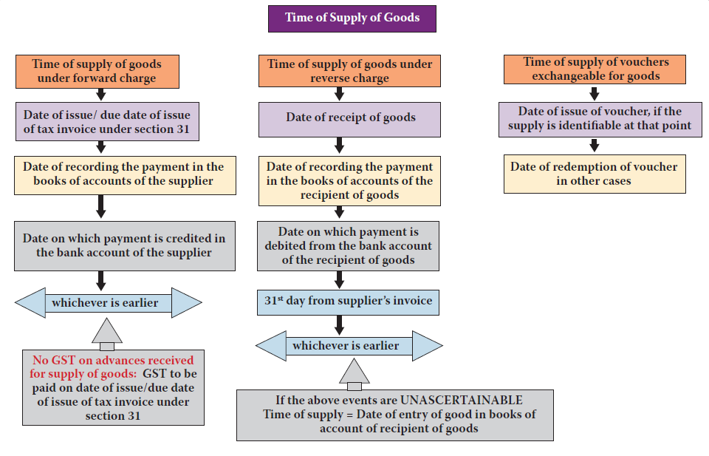
Time of Supply of Goods

Slide 58
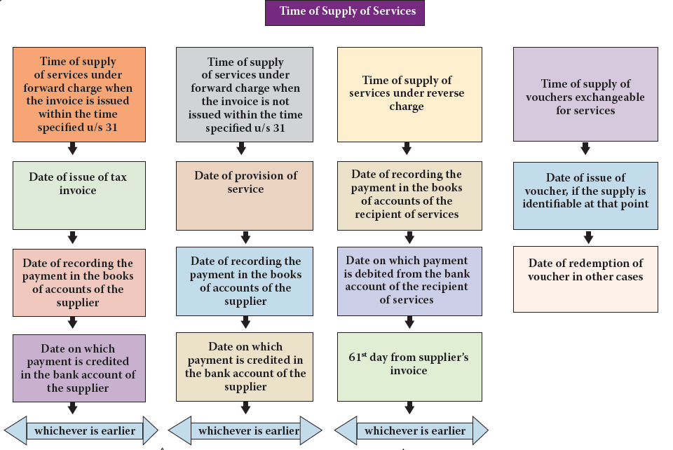
Time of Supply of Services

Slide 59
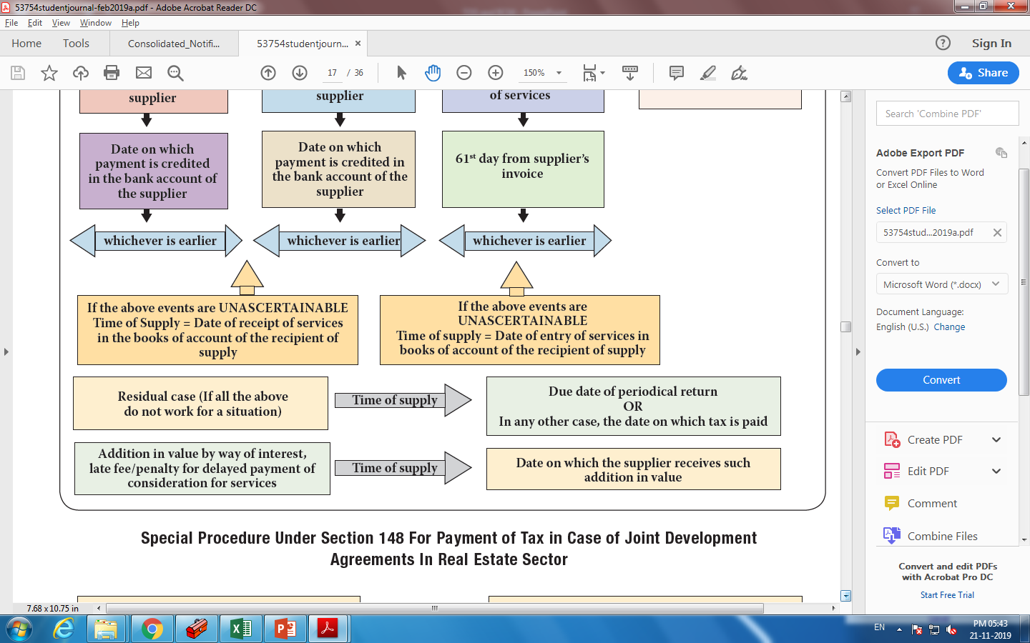
Where it is not possible to determine the TOS under the above provisions :

Slide 60
Summary of all rules
Section | Coverage | Summary
Sec 31 (1) | Time of issuance of invoice for goods | Before or at the time of removal
Sec 31 (2) | Time of issuance of invoice for services
Sec 31 (3) (a) | Revised invoice | Within 1 month from date of registration
Sec 31 (3) (b) | Relaxation from issuance of invoice when supply is less than Rs. 200 | Read with Proviso 4 of Rule 46 (Slide 9)

Slide 61
Summary of all rules
Section | Coverage | Summary
Sec 31 (3) (c) | Bill of supply for supply of exempt supply and for composition dealer
Sec 31 (3) (d) | Receipt Voucher by recipient of advance | Read with Rule 50 (Slide 14)
Sec 31 (3) (e) | Refund voucher if advance is returned without supply and invoice | Read with Rule 51 (Slide)
Sec 31 (3) (f) | Invoice for purchase from unregistered supplier | 9(4) provisions are postponed
Sec 31 (3) (g) | Payment voucher at the time of making payment to supplier covered u/s 9(3),9(4)

Slide 62
Summary of all rules
Section | Coverage | Summary
Sec 31 (4) | When successive statement and payment are involved | Before or at the time of statement or payment.
Sec 31 (5)(a) | When due date of payment is ascertainable from contract | Due date of payment
Sec 31 (5)(b) | When due date is not ascertainable | When supplier receives payment
Sec 31 (5)(c) | When payment is linked to completion of an event | Completion of event

Slide 63
Summary of all rules
Section | Coverage | Issuance of invoice
Sec 31(6) | When supply of services cease before completion | At the time of and to the extent of cessation
Sec 31(7) | Goods sent or taken on approval | Before or at the time of removal of goods

Slide 64
Summary of all rules
Section | Coverage | Issuance of invoice
Sec 31(6) | When supply of services cease before completion | At the time of and to the extent of cessation
Sec 31(7) | Goods sent or taken on approval | Before or at the time of removal of goods

Slide 65

Thank you
For any clarification
ravikumar@hiregange.com

