Slide 1


GST on Automobile Industry
CA. Ravi Kumar Somani
20.03.2023

Slide 2
Classification of vehicle parts/ components
HS Code | Description | Rate of Tax (GST)
87 | Electrically operated vehicles, including two and three wheeled electric vehicles. | 5%
8713 | Carriages for disabled persons, whether or not motorised or otherwise mechanically propelled | 5%
87 | Fuel Cell Motor Vehicles | 12%
8701 | Tractors (except road tractors for semi-trailers of engine capacity more than 1800 cc) | 12%
8710 | Tanks and other armoured fighting vehicles, motorised, whether or not fitted with weapons, and parts of such vehicles | 12%
8712 | Bicycles and other cycles (including delivery tricycles), not motorized | 12%
8702 | Buses for use in public transport which exclusively run on Bio-fuels | 18%
8704 | Refrigerated motor vehicles | 18%
8705 | Special purpose motor vehicles, other than those principally designed for the transport of persons or goods (for example, breakdown lorries, crane lorries, fire fighting vehicles, concrete-mixer lorries, road sweeper lorries, spraying lorries, mobile workshops, mobile radiological unit) | 18%

Slide 3
Classification of vehicle parts/ components
HS Code | Description | Rate of Tax
8709 | Works trucks, self-propelled, not fitted with lifting or handling equipment, of the type used in factories, warehouses, dock areas or airports for short distance transport of goods; tractors of the type used on railway station platforms; parts of the foregoing vehicles | 18%
8715 | Baby carriages and parts thereof | 18%
8716 | Trailers and semi-trailers; other vehicles, not mechanically propelled; parts thereof [other than Self-loading or self-unloading trailers for agricultural purposes, and Hand propelled vehicles (e.g. hand carts, rickshaws and the like); animal drawn vehicles] | 18%
8702 | Motor vehicles for the transport of ten or more persons, including the driver | 28%
8703 | Motor cars and other motor vehicles principally designed for the transport of persons (other than those of heading 8702), including station wagons and racing cars [other than Cars for physically handicapped persons | 28%
8704 | Motor vehicles for the transport of goods other than Refrigerated motor vehicles | 28%

Slide 4
Classification of vehicle parts/ components
HS Code | Description | Rate of Tax (Cess)
8702 10, 8702 20, 8702 30, 8702 90 | Motor vehicles for the transport of not more than 13 persons, including the driver, other than the vehicles of the description mentioned in S. No. 50 and 51. | 15%
8703 40, 8703 60 | Vehicles, with both spark-ignition internal combustion reciprocating piston engine and electric motor as motors for propulsion | 15%
8702, 8703 21 or 8703 22 | Petrol, Liquefied petroleum gases (LPG) or compressed natural gas (CNG) driven motor vehicles of engine capacity not exceeding 1200cc and of length not exceeding 4000 mm. | 1%
8702, 8703 31 | Diesel driven motor vehicles of engine capacity not exceeding 1500 cc and of length not exceeding 4000 mm. | 3%
8703 | Motor vehicles of engine capacity not exceeding 1500 cc | 17%
8703 | Motor vehicles of engine capacity exceeding 1500 cc other than motor vehicles specified against entry at S. No 52B | 20%
8703 | Motor vehicles of engine capacity exceeding 1500 cc, popularly known as Sports Utility Vehicles (SUVs) including utility vehicles. Explanation: For the purposes of this entry, SUV includes a motor vehicle of length exceeding 4000 mm and having ground clearance of 170 mm. and above. | 22%
8711 | Motorcycles of engine capacity exceeding 350 cc. | 3%

Slide 5
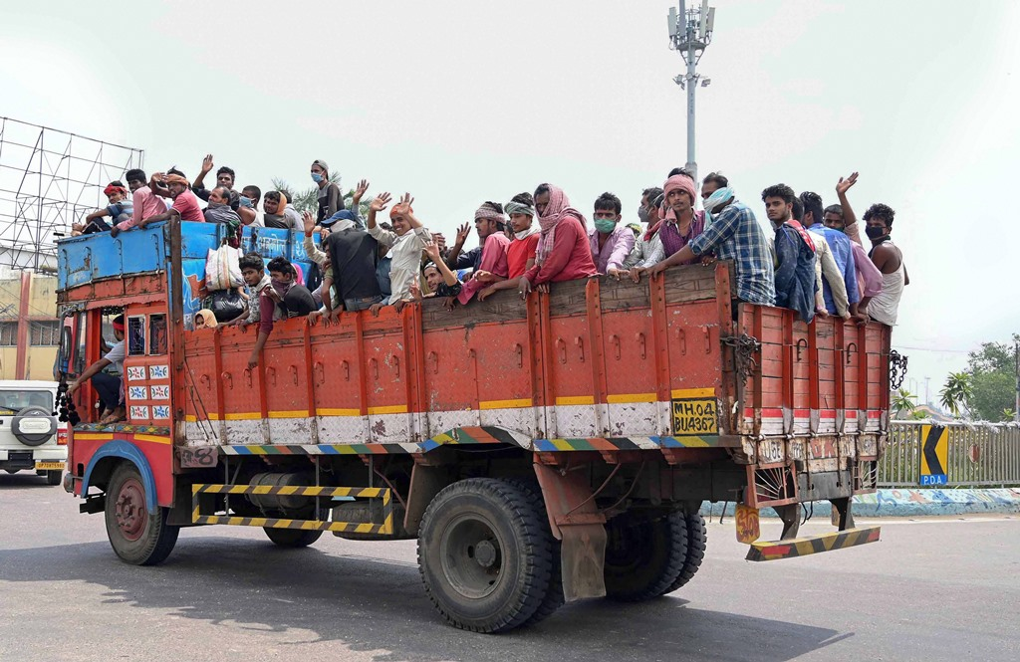
Classification of Passenger vs Goods Vehicle
Ambiguity
Whether the classification should be determined based on the intent for which the car was designed
Or should one also consider the actual purpose for which the said vehicle is being used

Slide 6
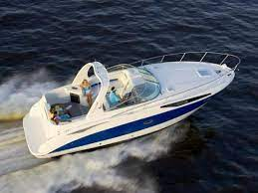
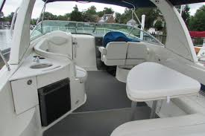
Excursion Boat/ Cruise Vs. Pleasure Yacht

Slide 7
Excursion Boat/ Cruise Vs. Pleasure Yacht
Kingsway Travel Agencies Pvt. Ltd 2019 (367) ELT A14 (SC):
CH 8901 10 30 - CRUISE SHIPS, EXCURSION BOATS, FERRY-BOATS, CARGO SHIPS, BARGES AND SIMILAR VESSELS FOR THE TRANSPORT OF PERSONS OR GOODS
CH 8903 99 90 - YACHTS AND OTHER VESSELS FOR PLEASURE OR SPORTS; ROWING BOATS AND CANOES
Facts:
The respondent is registered, recognized and accredited travel agency and the import in question was for the purpose of undertaking excursions for the tourists. the catalogue reveals that the boat imported is not an ordinary “excursion boat” intended for transport of persons for a short while but a luxury boat for high end pleasure travel.
The boat is registered with Cochin Port Trust as “Tourist Port” and the Kerala Irrigation Department has also registered the same and the Chief Inspector of Boats has certified that that is a boat.
The boat is a well-furnished with accessories like carpets, tables, cots with mattresses, refrigerators, heater, microwave oven, ice boxes, CD players and power generators. The vessel was designed for leisure or pleasure boating.

Slide 8
Excursion Boat/ Cruise Vs. Pleasure Yacht
We find that the impugned boat imported by the respondents is equipped with modern amenities like swiveling helm seat, Stove, Stainless steel sink, microwave, fridge, coffeemaker and solid surface counter tops; it also contains arrangement for shower, sleep and relaxation; it is no important as to the manner in which the impugned boat is used, it is rather important as to how the boat is built which should be a guideline for determining the classification of boat; in fact, we find that the catalogue describes the impugned boat as “Bayliner 325 Cruiser” and the Bayliner have claimed themselves to be manufacturers and marketers of recreation boats and Cruisers; there is a prima facie evidence that the boat is intended for the luxury uses.
We find that Heading 8901 covers the vessels for transport of persons or goods that vessels design primarily for the conveyance of persons or goods are covered by this Heading; it is not the case of the respondents that it was for the conveyance of persons or goods and looking into the fittings available in the boat and the amenities it offers, there is no doubt to believe that the boat is intended to a “pleasure boat”. Therefore, whatever be the actual use of the said boat, it is required to classify as per the making of the vessel; it is seen that the impugned boat is not principally designed and manufactured for the purpose of transport of persons and goods, it cannot be classify under Heading 8901;

Slide 9
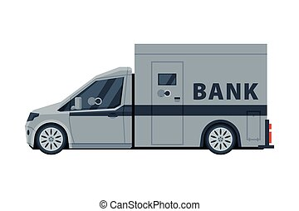
Issue of Classification of Passenger Vs. Goods Vehicle
Nicholas D'Souza Garage 2015 (320) ELT A251 (SC):
The Hon'ble Supreme Court maintained the ruling of the Tribunal on the question of classification of Cash Delivery Vans (CDV), held that it cannot be said to be specifically designed for passenger transportation or carriage of persons and cannot be held to be a vehicle designed for the carriage of passengers.
The finding of the Commissioner that security guards travel in the same vehicle and thus CDV is not exclusively for the transport of cash and can carry six such persons cannot be a reason to call the subject vehicles to be understood to be a vehicle designed for passengers.

Slide 10
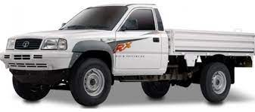
Tata Mobile 207 Model Crew Cab (pick-up truck)
Facts:
"Tata Mobile 207 Model Crew Cab" (pick-up truck).
NOW MORE SPACE FOR YOUR FAMILY MEMBERS” - “Introducing Tata Mobile double cab. This vehicle carries more people with comfort. Two models have capacity to carry 1+9 persons with soil top and 1+5 persons and for carrying personal baggage load body has been provided. The modern design is so built to provide utility and comfort. Now don’t care for rough roads because strong suspension and anti-role bars have been provided with 5 speed gear box with over drive engine and with assurance of Tata’s name, visit nearest TELCO dealer - Bring double cab, no wonder your family members would like it.”

Slide 11
Tata Mobile 207 Model Crew Cab (pick-up truck)
TELCO Limited 2003 (152) ELT A259 (SC)
If vehicle weight is used up in the design, in favour of the passengers inasmuch as a major portion of the same is used for the passengers transportation, then the vehicle would be classified as one which is ‘principally designed for transport of persons’. If, on the other hand, this gross vehicle weight is so distributed by designing features on a major portion of difference is used for transportation of goods then the vehicle would not classify in the classification Heading 8303, but would classify in the classification as classified for transportation of goods i.e. under Heading 8704.
Ultimate usage of a product, mentioned in the entry is not relevant, when the entry refers to no such end use. In case of 8703 the term “Other motor vehicles principally designed for the transport of not more than six persons”, may imply reading of an ‘end use’ stipulation to mean that Design of the vehicle for purpose of transport of passengers and not cargo.
That farm labour/crew/family members could travel in relative comfort of a Tractor/Trolley one encounters in the Rural Indian Scene, will not contribute to be a factor to determine those transports as ‘principally designed for persons’.

Slide 12
Tata Mobile 207 Model Crew Cab (pick-up truck)
TELCO Limited 2003 (152) ELT A259 (SC)
In view of the fact that neither the Automotive Research Association of India and nor the Bureau of Indian Standards are statutorily capable of opining or effectively laying down any descriptional character of the impugned vehicle for the application of appropriate Excise Tariff Entry, the only statutory provision which defines the character of the impugned vehicle must be accepted as the effective guide for determination of the applicable tariff under the Central Excise Act.”

Slide 13
Indicative list of design features
Vehicle for Transportation of Persons | Vehicle for Transportation of Goods
Presence of permanent seats with safety equipment for each person | Presence of bench-type seats without any safety equipment
Presence of rear windows along the two side panels | Absence of rear windows along the two side panels
Presence of doors with windows on the side panels or in the rear | Presence of a separate cabin for the driver and passenger and a separate-open platform with side panels and a drop-down tailgate (pick-up vehicles)
Absence of a permanent panel or barrier between the area for the driver and the rear area | Presence of a permanent panel or barrier between the area for the driver and the rear area
Presence of comfort features and interior finish & fittings | Absence of comfort features and interior finish & fittings

Slide 14
Classification of Motor Vehicles vs Machinery/Equipment
The term automobile started with a car to carry few persons
As on date extends to a whole range of motor vehicles in as much as that today, we have medical clinics, ice-cream parlours, eating joints, fuel dispensers etc. on the wheels
Certain types of machinery are mounted onto a motor vehicle or the said machine itself works on a self-propelled wheelbase, for its functioning
The following are the Chapters under the Customs Tariff Act which are relevant for this discussion:
Chapter 84: Nuclear reactors, boilers, machinery and mechanical appliances; parts thereof
Chapter 87: Vehicles other than railway or tramway rolling-stock, and parts and accessories thereof

Slide 15
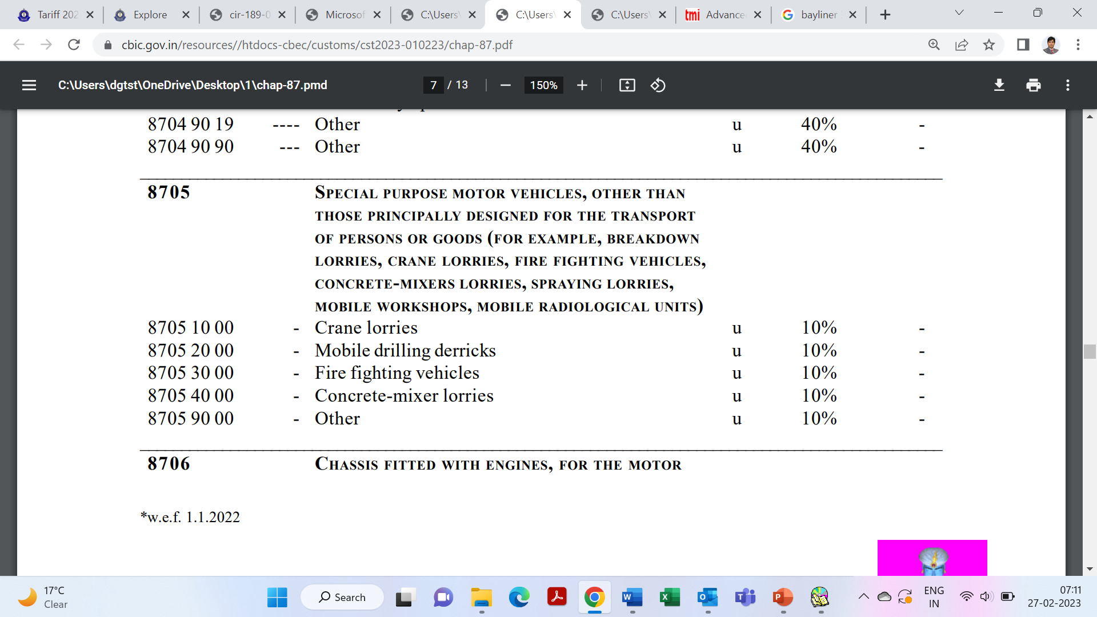
Special Purpose Motor Vehicles – 8705

Slide 16
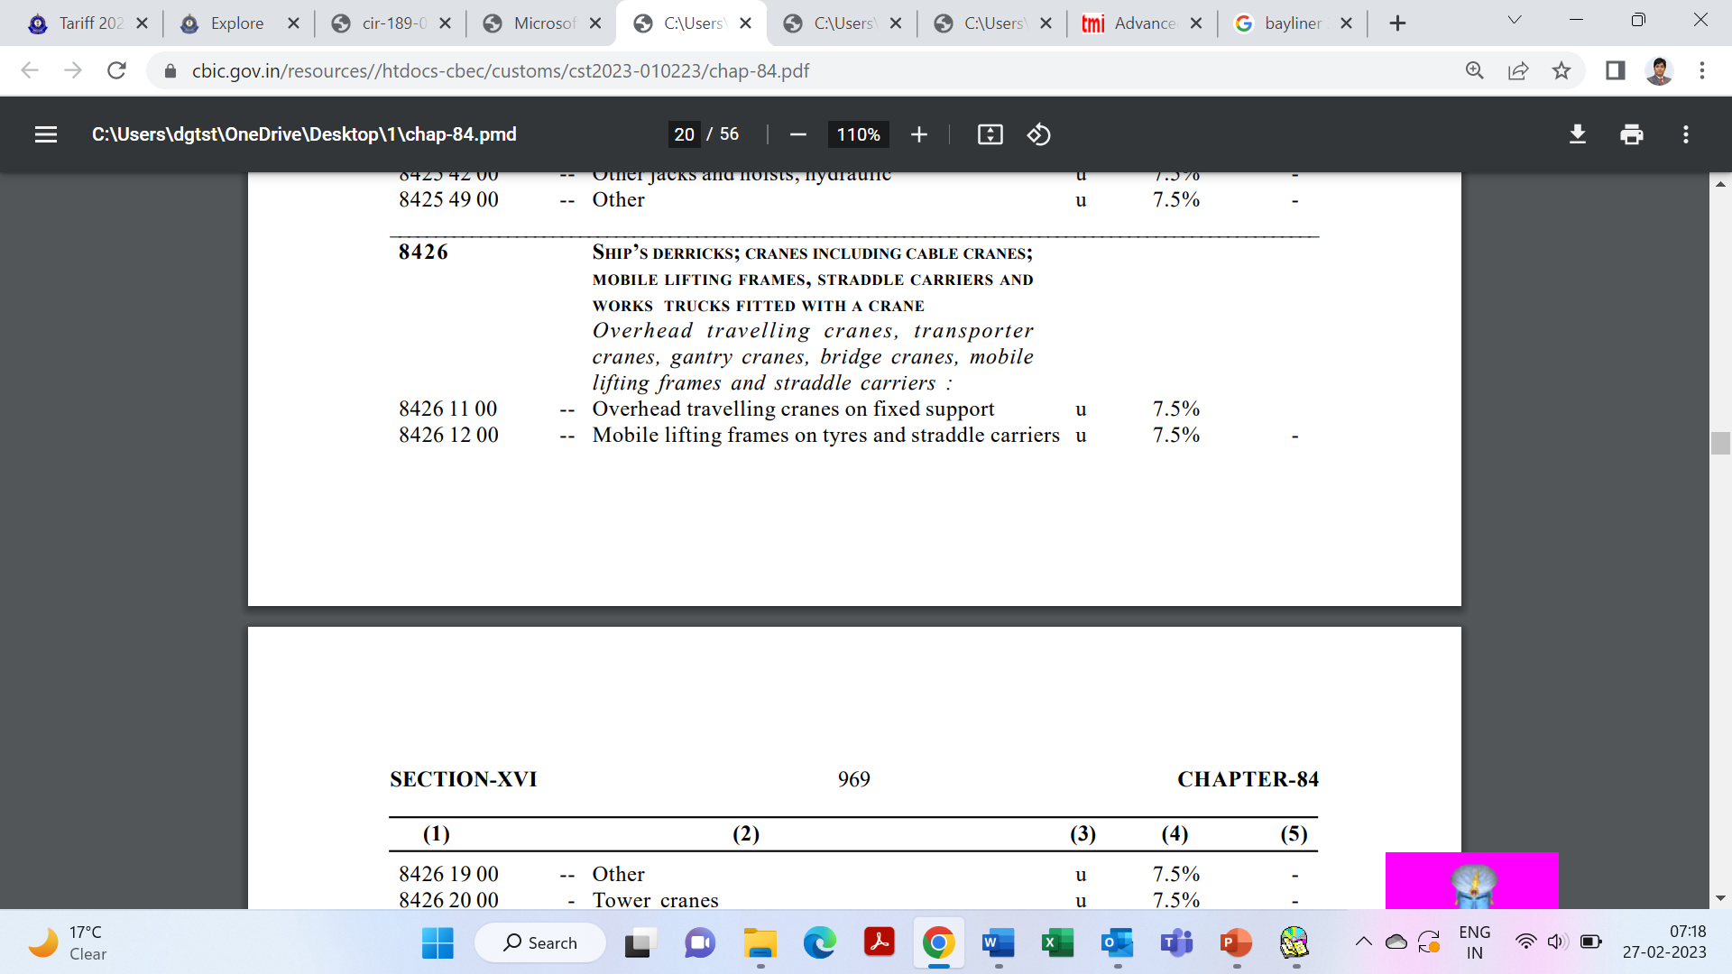
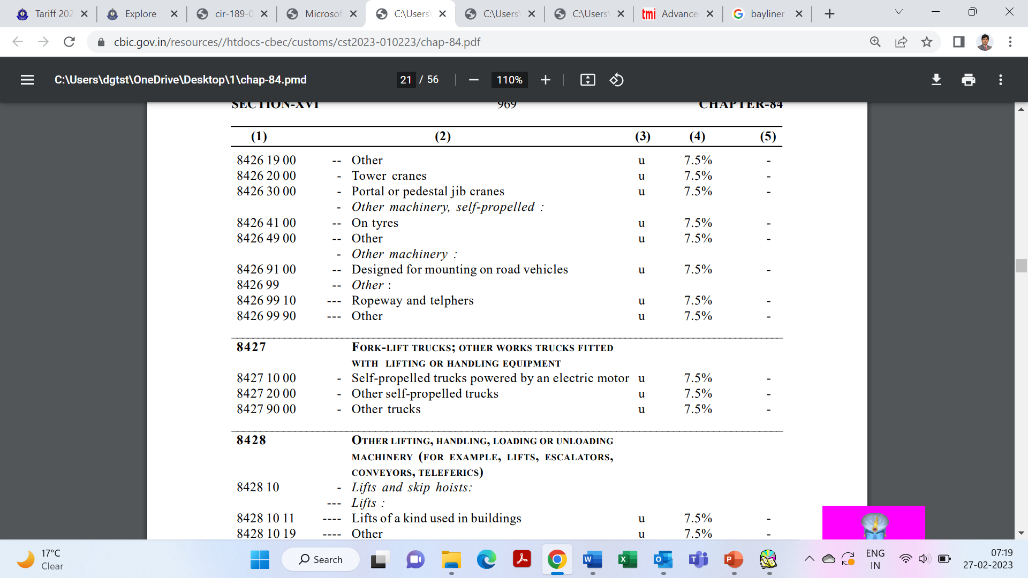
Special Purpose Motor Vehicles – 8705

Slide 17
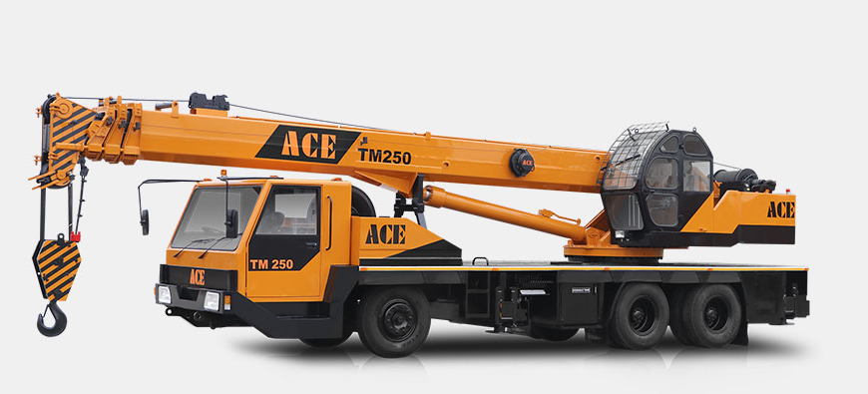
Special Purpose Motor Vehicles – 8705
Facts:
Used Hydraulic Truck Mounted Mobile Cranes. The goods under discussion consist of a self-propelled chassis on which a lifting machine is integrated technologically and operationally. The chassis is designed for accommodating the machine permanently by facilitating the circular movement of the machine while lifting and shifting the heavy objects in operation.
The lifting machine is not simply joint with the chassis by nut and bolts, but made to rest as well as rotate on a heavy axle held firmly integrated with the chassis.
Chassis resting on tyres will not to bear the weight of the load lifted while in operation and thus has made provision for hydraulic outriggers which get ejected out of the chassis from both the ends.

Slide 18
Special Purpose Motor Vehicles – 8705
Sanghvi Movers Ltd. 2008 (223) E.L.T. 641 (Tri. - Ahmd.)
The product imported is not just a crane. It also cannot be considered simply as a vehicle. This product is capable of mobility from one place to another and to that extent it does the functions of a motor vehicle and somewhat resembles a motor vehicle. Having been moved to the place of operation, “the vehicle” gets immobilized with the help of outriggers before it can undertake the functions as a crane.
The special purpose vehicle specifically referred in 8705 are ‘crane lorries, mobile drilling derricks, fire fighting vehicles, concrete mixture lorries. They continue to have mobility as a very significant function.
As the chassis was manufactured to integrate with the working machine (i.e., crane), it was immaterial whether the power to the crane came from chassis or separately therefor.
The product in question is an integrated product and that the predominant functions are that of a crane, Therefore, we are inclined to consider this product as a member of a crane family and not a member of a Special Purpose Vehicle.

Slide 19
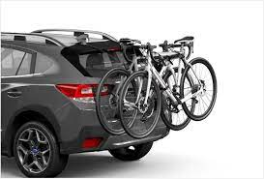
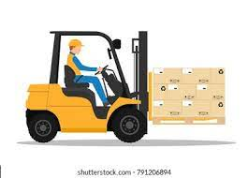
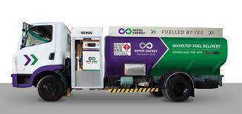
Other classification issues

Slide 20
Rate of GST on E-Vehicles
Circular No. 179/11/2022-GST - Recommendations based on 47th GST Council meeting:
The explanation of ‘Electrically operated vehicles’ in entry 242A of Schedule I of notification No. 1/2017-Central Tax (Rate) reads as: ‘Electrically operated vehicles which run solely on electrical energy derived from an external source or from one or more electrical batteries fitted to such road vehicles and shall include E-bicycles.’
As is evident from the explanation above, electrically operated vehicle including three wheeled electric vehicle means vehicle that runs solely on electrical energy derived from an external source or from electrical batteries. Therefore, the fitting of batteries cannot be considered as a concomitant factor for defining a vehicle as an electrically operated electric vehicle.
WCO’s HSN Explanatory notes have also not considered batteries to be a component, whose absence changes the essential character of an incomplete, unfinished or unassembled vehicle.

Slide 21
Rate of GST on E-Vehicles
In view of the above, it is clarified that electrically operated vehicle is to be classified under HSN 8703 even if the battery is not fitted to such vehicle at the time of supply and thereby attract GST at the rate of 5% in terms of entry 242A of Schedule I of notification No. 1/2017-Central Tax (Rate).

Slide 22
Compensation Cess
HS Code | Description | Cess Rate
8702 10, 8702 20, 8702 30, 8702 90 | Motor vehicles for the transport of not more than 13 persons, including the driver, other than the vehicles of the description mentioned in S. No. 50 and 51. | 15%
8703 40, 8703 60 | Vehicles, with both spark-ignition internal combustion reciprocating piston engine and electric motor as motors for propulsion | 15%
8702, 8703 21 or 8703 22 | Petrol, Liquefied petroleum gases (LPG) or compressed natural gas (CNG) driven motor vehicles of engine capacity not exceeding 1200cc and of length not exceeding 4000 mm. | 1%
8702, 8703 31 | Diesel driven motor vehicles of engine capacity not exceeding 1500 cc and of length not exceeding 4000 mm. | 3%
8703 | Motor vehicles of engine capacity not exceeding 1500 cc | 17%
8703 | Motor vehicles of engine capacity exceeding 1500 cc other than motor vehicles specified against entry at S. No 52B | 20%
8703 | Motor vehicles of engine capacity exceeding 1500 cc, popularly known as Sports Utility Vehicles (SUVs) including utility vehicles. Explanation: For the purposes of this entry, SUV includes a motor vehicle of length exceeding 4000 mm and having ground clearance of 170 mm. and above. | 22%
8711 | Motorcycles of engine capacity exceeding 350 cc. | 3%

Slide 23
Cess on Sports Utility Vehicles (SUV’s)
S. No. | Tariff Item | Description of Goods | Rate of Cess
52B | 8703 | Motor vehicles of engine capacity exceeding 1500 cc, popularly known as Sports Utility Vehicles (SUVs) including utility vehicles. Explanation: For the purposes of this entry, SUV includes a motor vehicle of length exceeding 4000 mm and having ground clearance of 170 mm. and above. | 22%
Explanation to entries 47 to 51:
"For the purposes of this entry, the specification of the motor vehicle shall be determined as per the Motor Vehicles Act, 1988 (59 of 1988) and the rules made there under.“
Issues:
Whether the condition of engine capacity is also applicable for SUV’s?
Whether tail needs to be considered for the computation of the length?
Whether the ground clearance is to be considered based on laden or unladen basis?
Whether the specifications of the motor vehicle shall be determined as per the Motor Vehicles Act, 1988?

Slide 24
Recent Clarification - Cess
Circular No. 189/01/2023-GST dated 13.01.2023
No specific explanation has been provided in Entry 52B for the basis of determination of specification, which creates a doubt on whether one should refer to the Motor Vehicles Act to determine the basis of arriving at the length and ground clearance of the said motor vehicle. (other entries from 47 to 51 have reference to the Motor Vehicles Act)
The GST Council in 48th meeting held on 17.12.2022 clarified on the definition of sports utility vehicles (SUVs) that would attract the highest cess of 22 per cent, over and above the GST rates on cars.
Accordingly, it is clarified that Compensation Cess at the rate of 22 percent is applicable on motor vehicles, falling under heading 8703, which satisfy all four specifications, namely – these are popularly known as SUVs, the engine capacity exceeds 1500 cc, the length exceeds 4,000 mm, and the grounds clearance is 170 mm and above.
Thus, in the case of SUVs, the clarification provides that the higher rate of compensation cess of 22 per cent is applicable to a motor vehicle fulfilling all four conditions –
It is popularly known as SUV;
Has engine capacity exceeding 1,500cc;
Length exceeding 4,000 mm;
Has a ground clearance of 170 mm and above.

Slide 25
Standards of measurement – Length of Motor Vehicle
Rule 93(3) of the Central Motor Vehicle Rules, 1989
Any tail or indicator lamp or number plate fixed to a vehicle to be excluded;
Any sphere wheel or sphere wheel bracket or bumper fitted to a vehicle; any towing hook or other fitments to be excluded; and
Any operational attachment on front, rear or carrier chassis of construction equipment vehicle in travel mode is to be excluded.
No specific reference to the Motor Vehicles Act under entry 52B - can it be considered that the explanation in Central Motor Vehicle Rules, 1989 is not to be considered and therefore the length of the vehicle is calculated from end to end including the bumper and other fittings?

Slide 26
Standards of measurement – Length of Motor Vehicle
The Courts placing reliance on the certificate issued by institutions such as ARAI and Vehicle Research Development Establishment, for the purpose of classification of the motor vehicle.
JCBL Ltd.-2019 (367) E.L.T. 283 (Tri.-Chan.)
Mann Tourist Transport Service (P) Ltd. - 2015 (319) E.L.T. 153 (Tri.- Mum.)
Scooter India Ltd. - 2003 (156) E.L.T. 535 (Tri.-Del.)

Slide 27
Standards of measurement – Ground Clearance
No definition or scope provided under the Motor Vehicle Act, 1988 or the relevant rules.
Whether the ground clearance should be computed with laden weight or without laden weight?
ARAI certifies each motor vehicle on its ground clearance.
Tata Motors Limited 2019 (31) GSTL 544 (App ARR-GST) –
To fall under Entry 52B for attracting Compensation Cess Vehicle's ground clearance in laden state should be 170 mm or above.

Slide 28
Classification of Vehicle Parts
Heading 8708 provides for “Parts and Accessories of the Motor Vehicles of Headings 8701 TO 8705”.
8708 10 - Bumpers and parts thereof:
8708 10 10 --- For tractors
8708 10 90 --- Other
- Other parts and accessories of bodies (including cabs):
8708 21 00 -- Safety seat belts
8708 29 00 -- Other
8708 30 00 - Brakes and servo-brakes; parts thereof
8708 40 00 - Gear boxes and parts thereof
8708 50 00 - Drive-axles with differential, whether or not provided with other transmission components, non-driving axles; parts thereof
8708 70 00 - Road wheels and parts and accessories thereof
8708 80 00 - Suspension systems and parts thereof (including shock absorbers)
- Other parts and accessories:
8708 91 00 -- Radiators and parts thereof
8708 92 00 -- Silencers (mufflers) and exhaust pipes; parts thereof
8708 93 00 -- Clutches and parts thereof
8708 94 00 -- Steering wheels, steering columns and steering boxes; parts thereof
8708 95 00 -- Safety airbags with inflater system; parts thereof
8708 99 00 -- Other
On a plain and isolated reading of heading 8708 alone, one might conclude that all parts of motor vehicles merit classification under heading 8708

Slide 29
Classification of Vehicle Parts
However, to arrive at appropriate classification, it is of paramount importance to decipher the various section notes, chapter notes along with interpretative rules.
Chapter 87 is covered under Section XVII and one also needs to carefully examine the various Section and Chapter notes which apply to the said Chapter.
Note 2 to Section XVII
The expressions “parts” and “parts and accessories” do not apply to the following articles, whether or not they are identifiable as for the goods of this Section:
(a) joints, washers or the like of any material (classified according to their constituent material or in heading 8484) or other articles of vulcanised rubber other than hard rubber (heading 4016);
(b) parts of general use, as defined in Note 2 to Section XV, of base metal (Section XV), or similar goods of plastics (Chapter 39);
(c) articles of Chapter 82 (tools);
(e) machines and apparatus of headings 8401 to 8479, or parts thereof
(f) electrical machinery or equipment (Chapter 85);
(k) lamps or lighting fittings of heading 9405

Slide 30
Classification of Vehicle Parts
Under note 2 of Section XV, the expression “parts of general use” means:
articles of headings 7307, 7312, 7315, 7317 or 7318 and similar articles of other base metal;
springs and leaves for springs, of base metal, other than clock or watch springs (heading 9114); and
articles of headings 8301, 8302, 8308, 8310 and frames and mirrors, of base metal, of heading 8306.
Note 3 of Section XVII provides as under:
References in Chapters 86 to 88 to “parts” or “accessories” do not apply to parts or accessories which are not suitable for use solely or principally with the articles of those Chapters. A part or accessory which answers to a description in two or more of the headings of those Chapters is to be classified under that heading which corresponds to the principal use of that part of accessory parts.
Explanatory Notes – Harmonised Commodity Description & Coding System (WCO)
Parts and accessories of motor vehicles would be classified under heading 8708 if both the following conditions are satisfied:
They must be identifiable as being suitable for use solely or principally with vehicles covered in heading 8701 to 8705; and
They must not be excluded by the provisions of the Notes to Section XVII

Slide 31

Classification of Vehicle Parts
Recently, in the case of Westinghouse Saxby Farmer Limited the Larger Bench of the Hon’ble Supreme Court held that while the exclusion under Note 2(f) may be of goods which are capable of being marketed independently as electrical machinery or equipment, for use otherwise than in or as Railway signaling equipment, those parts which are suitable for use solely or principally with an article in Chapter 86 cannot be taken to a different Chapter as the same would negate the very object of group classification.
This is made clear by Note 3. Therefore, the invocation of Note 2(f) in Section XVII, overlooking the “sole or principal user test” indicated in Note 3, is not justified.
It is pertinent to note that the judgment in the case of Westinghouse Saxby Farmer Limited ibid was in favor of the assessee, who wanted classification under Chapter 86, and hence the arguments of the assessee were to merit the classification under Chapter 86.

Slide 32
Classification of Vehicle Parts
G.S. Auto International Ltd (SC): Hon’ble Supreme Court after referring to both the notes of Section XVII, ignored the exclusion under note 2(b) and without referring to the explanatory notes to the HSN classification concluded that fasteners used for the vehicles must be classified under CTH 8708.
Uni Products India Limited (SC) - Car mats are specifically excluded from the scope of CTH 8708, hence they are appropriately classifiable under CTH 5703, even though they are used solely and principally in motor vehicles.
In the said case, the following important guidelines were laid down by the Supreme Court:
Even though HSN Explanatory Notes have persuasive value only, but the level or quality of such persuasive value is very strong, as observed in numerous judgments.
Section Notes and Chapter Notes are of utmost importance to determine classification.
The most specific description shall be preferred to headings providing general description as per Rule 3(a) to General Rules of Interpretation.
Intel Design Systems (India) Pvt. Limited (SC): Hon’ble Supreme Court held that contactors, switches, control box, etc., fall under the category of excluded goods under the chapter notes thus, even though they are used specifically, solely, or principally with the armored vehicles of the chapter heading 8710, they are classifiable under chapter heading 8536.90 only.

Slide 33
Classification of Vehicle Parts
Comments:
The decision of Westinghouse is in the favour of the taxpayer – view of the department clearly comes out;
If accepted, it makes entire Chapter Note 2 to Section XVII redundant and otiose;
Note 3 only provides for a negative condition for exclusion;
Does not take into consideration the explanatory notes to the HSN classification;
Decision only makes a passing reference to the Section/ Chapter Notes;
Cannot be taken as a 'ratio' or a 'principle of interpretation' to be applied universally.

Slide 34
Classification of Child parts / Accessories
Child parts are smaller parts that are assembled to create a parent part. In other words, a child part means an item that features in the BOM of a main part of the vehicle. For e.g., Steering Unit comprises of the following child parts:
Rake & pinion
Tie rods
Tie rod ends.
two nuts and two quarter pins to lock the nuts.
Shiroki Auto Components India Pvt. Ltd. (SC): Classification of parts of vehicle seats are not classifiable under tariff heading 8708 since they find these parts find a specific entry in tariff heading 9401.
Hero Electric Vehicles Pvt. Ltd (SC): DC Motors for e-bike which had the essential character of motor having principal function of electric motor as rotor is fixed on electric motor and becomes rear wheel only after mounting tyre without which it cannot perform as part of e-bike, is classifiable as electric motor under Tariff Item 8501 31 19 of Customs Tariff Act, 1975 and not under Tariff Item 8714 10 90 ibid.

Slide 35
Classification of Child parts / Accessories
Transenergy Ltd. and Sagas Autotec Pvt. Ltd (CESTAT): CNG conversion kits are engine parts since these provide alternate fuel charging system to the one in-built in IC engines. Though IC engine parts are parts of motor vehicles of Heading 8708 of Central Excise Tariff, Heading 8409 ibid is more specific entry for these kits.
Best Cast (P) Limited (SC): Gear Box parts and clutch are not parts of motor vehicle by commercial parlance and would be classifiable under Heading 8483.00 of Central Excise Tariff Act, 1985 as parts of gear box and not under Heading 87.08 as parts of motor vehicle.
Mehra Bros. v. Joint Commercial Officer (SC): An accessory of an automobile does not have to be an accessory for the whole automobile. The accessory of a part of an automobile would also qualify to be used as an automobile accessory.
Insulation Electricals Pvt. Ltd (SC): The seat being complete without rail assembly or other impugned goods, such goods are not essential parts of it. The item is used for varying the positions of the driver and does not become essential pieces of the seats. They are only adjuncts, additions to the seat for their better, convenient, comfortable enjoyment/use. Chapter Heading 8708 is wider in its scope as to cover all accessories of motor vehicles

Slide 36
Job Work vis-à-vis Manufacturing
Section 2(68) of the CGST Act, 2017 –
"Job work" means any treatment or process undertaken by a person on goods belonging to another registered person and the expression "job worker" shall be construed accordingly.
Job work charges i.e., labour charges taxable under GST –
Supply of services as per Schedule II of CGST Act.

Slide 37
Job Work vis-à-vis Manufacturing
Sl. No. | Chapter, Section, Heading | Description of services | Rate of tax (%)
26 | Heading 9988 (Manufacturing services on physical inputs (goods) owned by others) | (ic) Services by way of job work in relation to bus body building; Explanation- For the purposes of this entry, the term “bus body building” shall include building of body on chassis of any vehicle falling under chapter 87 in the First Schedule to the Customs Tariff Act, 1975. | 18
 |  | (id) Services by way of job work other than (i), (ia), (ib), (ic) and (ica) above | 12
 |  | iv) Manufacturing services on physical inputs (goods) owned by others, other than (i), (ia), (ib), (ic), (ica), (id), (ii), (iia) and (iii) above. | 18

Slide 38
Job Work vis-à-vis Manufacturing
Job worker is a person who contributes mainly their labour and skill done with the help of tools, gadgets, or machinery, but can add or apply only minor items. [In Prestige Engineering (India) Ltd, 1994 (73) ELT 497 (S.C.)]
Job worker can use his own goods in addition to the goods received from the Principal for providing the services of job work. [Circular No. 38/12/2018 dated 26.03.2018]
A tailor stitching a shirt or suit out of the cloth supplied by his customer may use his own buttons, thread and lining cloth and such activity would amount to job work.
Similarly, a factory may be supplied the shoe uppers, soles etc. by the customers and the factory applies its own thread or bonding material and manufactures shoes therefrom and returns them back to the customer, charging only for its work, amounts to job work.
Powder coating/ Galvanizing/ Electrocoating/ Electroplating etc. amounts to job work even though minor goods and consumables are used in the process.

Slide 39
Bus Body Building – Whether Goods or Service?
Position under the erstwhile Central Excise law:
Levy under the erstwhile Central Excise law was on ‘manufacture’. The important question came into consideration was whether the activity of body building would be levied as a manufacture of a motor vehicle or as a manufacture of a body of a vehicle.
Collector Of Central Excise vs. Ram Body Builders 1997 (94) ELT 442 SC, JT 1998 (4) SC 425, (1997) 8 SCC 482 – the bodies which are built on chassis supplied by customers would fall under Heading No. 87.07 of the Central Excise Tariff. i.e., the activity of body building or fabrication or mounting or fitting of structures or equipment on the chassis shall amount to “manufacture’ of motor vehicle”.
An amendment was made under Central Excise Tarriff Act in Chapter Note 4 (now chapter Note 3) to rest the issue by bringing a deeming fiction in the law clearly stating that the activity of body building or fabrication or mounting etc. on the chassis shall amount to manufacture of a motor vehicle and it cannot be said to be a manufacture of merely a body of the vehicle.

Slide 40
Bus Body Building – Whether Goods or Service?
Position under the present GST law:
In the case of bus body building there is a supply of goods and services. Thus, classification of this composite supply, as goods or service would depend on which supply is the principal supply which may be determined on the basis of facts and circumstances of each case. [Circular No. 34/8/2018-GST Dated 01.03.2018]
Body Building on the chassis owned by the Body Builder:
In a case where the Bus body builder builds a bus, working on the chassis owned by him and supplies the built-up bus to the customer, and charges the customer for the value of the bus, then the supply made is that of bus, and accordingly, supply would attract GST @ 28%. [Circular No. 52/26/2018-GST, dated 9-8-2018]

Slide 41
Bus Body Building – Whether Goods or Service?
Body Building on the chassis owned by the Customer:
The fabrication of buses may involve the following two situations:
Bus body builder builds a bus, working on the chassis owned by him and supplies the built-up bus to the customer, and charges the customer for the value of the bus.
Bus body builder builds body on chassis provided by the principal for body-building and charges fabrication charges (including certain material that was consumed during the process of job-work).
In the above context, it is hereby clarified that in the case as mentioned at Para (a) above, the supply made is that of bus, and accordingly, supply would attract GST @ 28%.
In the case, as mentioned at Para (b) above, fabrication of body on chassis provided by the principal (not on account of bodybuilder), the supply would merit classification as service, and 18% GST as applicable would be charged accordingly.
[Circular No. 52/26/2018-GST, dated 9-8-2018]

Slide 42
Bus Body Building – Whether Goods or Service?
Bus body builder builds body on the chassis supplied by the principal, but the job worker performs multiple activities including addition of significant material, consumables and labour. In this case, the activity of job worker is not merely restrictive to fabrication or mounting.
Favourable AAR - Mounting or fabrication of bus/truck/ ambulance body on chassis supplied by OEMs/Principal on delivery challan or any other owner of chassis by collecting job work charges including inputs required for such fabrication work without transferring the ownership of chassis to job worker - Activity amounted to job work. [SANGHI BROTHERS (INDORE) PRIVATE LIMITED 2019 (27) G.S.T.L. 136 (A.A.R. - GST)]
Standard vehicle body based on fixed dimension is built and kept ready by the body builder and later upon receipt of chassis, the said standard body is simply mounted on the chassis, the supply in this case would amount to supply of goods i.e., Body and it would be classifiable under CH 8707 being taxable @ 28%. [Tata Marcopolo Motors Ltd. 2019 (27) G.S.T.L. 283 (A.A.R. - GST)]

Slide 43
Bus Body Building – Whether Goods or Service?
M/s. VE COMMERCIAL VEHICLES LTD. 2020 TIOL – 199 (A.A.R. - GST)
Body mounted on the chassis and both supplied together amounts to supply of Bus/ vehicle;
Chassis supplied to the dealer along with road tax, insurance etc. and later dealer undertakes the body building activity through an independent body builder;
Chassis supplied to the dealer along with road tax, insurance etc. and later dealer undertakes the body building activity through the manufacturer/ OEM;
Chassis supplied by the chassis manufacturing unit to the customer who in turn provides the chassis to the body building unit of the same company for mounting/ fabricating body on the said chassis;
Chassis supplied by some other chassis manufacturing company to the customer who in turn provides the chassis to the body building unit of a different company for mounting/ fabricating body on the said chassis;

Slide 44
Valuation of Designs, Moulds, Tools etc.
Sec 15(2)(b) - Any amount that the supplier is liable to pay in relation to such supply but which has been incurred by the recipient of the supply and not included in the price actually paid or payable for the goods or services or both.
The Central Excise levy is on the activity of manufacture, the true valuation factor, therefore, should be the value towards manufacturing. The Hon’ble Supreme Court in the case of Moriroku UT India (P) Ltd. has distinguished the valuation mechanism under Excise Law and Sales Tax Law. The Court had held that Excise Duty is leviable on "Value“.
Lear Automotive India Pvt. Ltd. Mah AAR: Cost of tools supplied by the OEM customer on FOC basis to the Appellant is not required to be added to the value of the components supplied by the Appellant. However, in case the contractual obligation is cast upon the component manufacturer to provide moulds/dies but the same have been provided by the OEM on FOC basis, then the amortized cost of the moulds/dies is required to be added to the value of the components supplied.

Slide 45
Valuation of Designs, Moulds, Tools etc.
Issue: Whether moulds and dies owned by Original Equipment Manufacturers (OEM) that are sent free of cost (FOC) to a component manufacturer is leviable to tax and whether OEMs are required to reverse input tax credit in this case?
Clarification:
1.2 It is further clarified that while calculating the value of the supply made by the component manufacturer, the value of moulds and dies provided by the OEM to the component manufacturer on FOC basis shall not be added to the value of such supply because the cost of moulds/dies was not to be incurred by the component manufacturer and thus, does not merit inclusion in the value of supply in terms of section 15(2)(b) of the Central Goods and Services Tax Act, 2017 (CGST Act for short)
1.3 However, if the contract between OEM and component manufacturer was for supply of components made by using the moulds/dies belonging to the component manufacturer, but the same have been supplied by the OEM to the component manufacturer on FOC basis, the amortised cost of such moulds/dies shall be added to the value of the components. In such cases, the OEM will be required to reverse the credit availed on such moulds/ dies, as the same will not be considered to be provided by OEM to the component manufacturer in the course or furtherance of the former’s business.
[Circular No. 47/21/2018-GST, dated 08.06.2018]

Slide 46
Other issues in Tooling transactions
OEM owns tool and supplies free of cost to component manufacturer. The contract between OEM and component manufacturer is for supply of components made by using the moulds / dies belonging to the component manufacturer, but the same is supplied by the OEM to the component manufacturer on FOC basis:
Tool manufactured by the component manufacturer on behalf of the OEM:
Transfer of title to the tools as a standalone supply – Inter-state, intra-state and cross border transactions;
Tool manufactured by the job worker on behalf of the component manufacturer;
Transfer of tool on leasing basis;
No separate billing for the tool but included in the price charged for the components supplied;
OEM and component manufacturer are related parties.
Tool designed for the Component manufacturer and billed as design and development charges;
Tool obligated to be developed by the Component manufacturer but actually developed by OEM and issued on FOC to the Component manufacturer.

Slide 47
Other Issues faced by the OEM’s/ Component manufacturers
Supply of parts/ components on FOC basis to related/ unrelated parties – Samples, Warranty replacements, testing etc. - Domestic removals & outside India – Implication of ITC reversal
Liquidated damages charged by OEM’s to the component manufacturer - Amount of compensation/liquidated damage received towards the compensation for non-supply of the agreed quantity of goods, cannot be treated as a consideration for service - Amit Metaliks Limited.
Interest implication in case of Debit / Credit notes for the price difference – Impact in case of change in the rate of taxes –
The Larger Bench of the Hon’ble Supreme Court on the matter referred in the case of Steel Authority of India had held that interest would be applicable on subsequent price escalations and approved the rulings in the case of SKF India Ltd. and International Auto Limited.
Explanation 1.––For the purposes of clauses (a) and (b), ―supply shall be deemed to have been made to the extent it is covered by the invoice or, as the case may be, the payment.
Stock transfer of parts/ components in a warehouse within same/ other state.
Cross border material processing transactions.

Slide 48
Transactions with Automobile dealers
Repairs of vehicles covered under warranty – Internal Cross Charge;
Rebates, Discounts & Incentives offered to the end customers:
Discounts against non-moving stock, aged stock,
Corporate / loyal customers special discounts,
Exchange car discount,
Trade Discount, Cash discounts, quantity discounts, volume discounts etc.
Year-End Discounts etc.
Discounts including ‘Buy more, save more’ offers,
Secondary Discounts.
Treated as incentive by the dealer – whether tax rate to be 18% or 28% plus cess..??
Treated as discount by the manufacturer –
Issued a GST credit note or adjustment from the subsequent tax invoice as a trade discount;
Issued a financial credit note – Reversal of ITC to the dealer – Ballooning of the Input Tax credits.

Slide 49
Transactions with Automobile dealers
Target based incentives against various schemes issued by the manufacturers - Achieving performance targets in respect of sales /purchases, Adherence to KPI’s, quality;
Cost sharing between manufacturers and dealers-
Advertisement cost incurred by OEM and part of such cost distributed among all dealers
Advertisement cost incurred by dealer and OEM reimburses partial percentage of the costs as agreed on case to case basis
Ultratech Cement Ltd. (Bom. HC) –
Once Service tax borne by ultimate consumer of service, namely the worker, the manufacturer cannot take credit of that part of the service tax which is borne by the consumer.
Hence, manufacturer would need to reverse the proportionate credit to the extent of recoveries made.
Goodies & other promotional material issued to the dealers;
Input Tax credit on Demo vehicles – Capitalised as fixed asset, Recorded as inventory, Margin scheme treating as a used vehicle – Chowgule Industries (P.) Ltd.

Slide 50
Other Key issues
Goods lost, stolen, destroyed, written off or disposed off by way of free gift or samples;
Manufacturing loss, batch failures, weighment loss, transit loss etc. – Insurance claim..??
Issue of promotional samples to the customers on FOC basis;
Manufactured samples/ traded samples – 17(5) vis-à-vis schedule I;
Issued as a part of main supply towards promotional activities;
Expenses towards Corporate Social Responsibility activities;
ITC on price difference debit notes - Invoice or invoice relating to the debit note;
Timing of availing credit on the vehicles received – Actual receipt of the vehicles;
Payment beyond 180 days in case of Tools, dies etc. – whether ITC to be reversed;

Slide 51
Other Key issues
Events, promotions & advertisements etc. – Partial costs being borne by the OEM;
Financial credit notes issued by the manufacturer – Issue of reversal of credit in the hands of the dealer.
Proportionate recovery/ deduction of expenses on account of deficiency in supplies;
Employee recoveries towards canteen, transportation, insurance etc. Notice pay recoveries;
RCM liability in case of free of charge supplies from the holding company - research & development, brand marketing, region wise marketing initiatives, central procurements;
Exports with payment of tax for suppliers procuring under advance license or EOU;
Deferment in payment of duty/ IGST – MOOWR scheme.

Slide 52

Thank you
CA Ravi Kumar Somani
- ravikumar@hiregange.com

