Slide 1

Provisions for Directors & Managerial Remuneration
Pune Branch of ICAI 21 April 2017
CS Niraj Modi
nirajnmodi@gmail.com

Slide 2
Content
Directors:
Chapter XI Appointment and Qualifications of Directors
Composition of Board
Number of Directorship
Types of Directors
Provisions for appointment
Retire by rotation
Disqualification
Duties of Directors
Vacation of office of Director
Resignation of director
Removal of directors
Register & Return
Managerial Remuneration:
Chapter XIII Appointment and Remuneration of Managerial Personnel
Conditions for appointment of WTD/MD
Disqualification
Appointment Process
Returns
Exemptions
Remuneration Limits
Schedule V conditions

Slide 3
Meaning of Director
Section 2 (34) - “director” means a director appointed to the Board of a company.
Section 2 (10) “Board of Directors” or “Board” - in relation to a company, means the collective body of the directors of the company
The persons in charge of the management of the affairs of a company
Collectively known as Board of Directors or the Board
Directors are the brain of a company
Directors take the decision regarding the management of a company collectively in their meetings

Slide 4
Composition of Board of Directors
BoD
Pvt. Ltd.
Unlisted Public Co.
Listed Co.
Min.2 Directors
Min. 3
Directors
1 Resident Director
ID & WD,
if applicable
Min. 3 / 6* Directors
1 Resident Director
At least 50% NED
WD & ID
1 Resident Director
OPC
Min. 1 Director
1 Resident Director
*Top 2000 listed entities
Max. 15 Dir.
Spl. Resolution for > 15 Dir.

Slide 5
Maximum Directorship
Max. 20 companies at the same time
Includes any Alternate directorship
Max. 10 public companies
Max. 7 Listed companies
(includes NED & ID)
If person is WTD / MD in listed co. – can be ID in max. 3 listed co.
Public co. includes - Private co. that are either holding or subsidiary company of a public company
Directorship in a dormant company not included in 20
Company can specify any lesser no. by passing a special resolution

Slide 6
Types of Director
Additional Director
Alternate Director
Nominee Director
Independent Director
Woman Director
Resident Director
Director

Slide 7
Types of Director
First Director
Person named as Director in AoA
If Article does not provide, then individual subscribers to MoA shall be deemed to be the first directors
Resident Dir. [S.149(3)]:
Every company must have at least one director
Proportionate for newly incorporated companies
resides in India for at least 182 days in a FY

Slide 8
Types of Director
Additional Director:
BoD can appoint anytime during the year
AoA of the Company shall confer such power
Person who fails to get appointed as a director in a general meeting cannot be appointed as an Additional Director
Same powers and duties as the any other director
Holds office upto next AGM or the last date on which the AGM should have been held
Regularization by members in general meeting
Nominee director:
the Board may appoint
AoA of the Company shall confer such power to BoD
Nominee director shall not be treated as an independent director
person nominated by any institution

Slide 9
Types of Director
Alternate director:
Alternate for a director during his absence from India for a period of not less than 3 months
AoA of the Company shall confer such power to BoD
Eligibility: shall be qualified to be appointed as a director of the company
Same powers and duties as the original director
Vacates office when the original director returns to India
A person shall not be alternate director for more than one person in a company
Alternate Director shall not be director in the same company
Tenure: same as the original director
Notice of Board Meeting shall be given to both – original director and alternate director

Slide 10
Types of Director
Managing Director
Director entrusted with substantial powers of management of the affairs of the Company
Power entrusted by virtue of AoA / agreement / resolution passed in general meeting or by BoD
includes a director occupying the position of MD by whatever name called
"Whole-time director" a director in the whole-time employment of the company [Sec. 2(94)]
“Executive Director” means a whole-time director as defined in clause (94) of section 2 of the Act

Slide 11
Woman Director
Applicability:
Every listed company;
Every other public company having -
(a) paid–up share capital of INR 100 crore* or more; or
(b) turnover of INR 300 crore* or more:
Top 1,000^ listed co. shall have at least one independent woman director
New incorporated co. covered under provisions - shall comply with within 6 months
Intermittent vacancy - be filled-up by the Board in immediate next Board meeting or 3 months from the date of such vacancy whichever is later.
*as on the last date of latest audited financial statements.
^As per market capitalization as at the end of the immediate previous financial year

Slide 12
Independent Director
Independent Director
Applicability
Private Co.
All Listed Co.
Unlisted Public Co.
Paid up cap – 10 Cr or more
Turnover - 100 Cr or more
Χ
Loans, debentures, deposits - exceeding 50 Cr

Slide 13
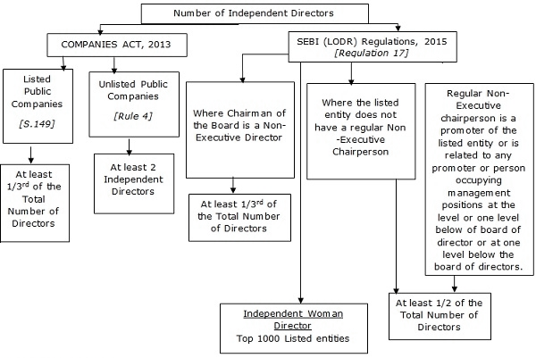

Slide 14
Independent Director
Exempted Companies:
Joint venture
Wholly owned subsidiary
Dormant company as defined u/s 455
Intermittent vacancy - fill-up not later than immediate next Board meeting or 3 months from, whichever is later
Discontinuation: If company ceases to fulfil any of 3 conditions for 3 consecutive years.

Slide 15
Independent Director
Meaning :
An independent director in relation to a company, means a director
is not a MD or WTD or a nominee director
is a person of integrity
possesses relevant skills, experience and knowledge in one or more fields of finance, law, management, sales, marketing, administration, research, corporate governance, technical operations or other disciplines related to the company’s business

Slide 16
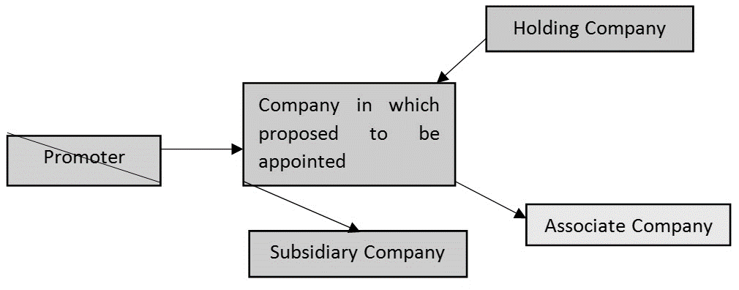
Independent Director
Person is or was not a promoter of the company or its holding, subsidiary or associate company

Slide 17
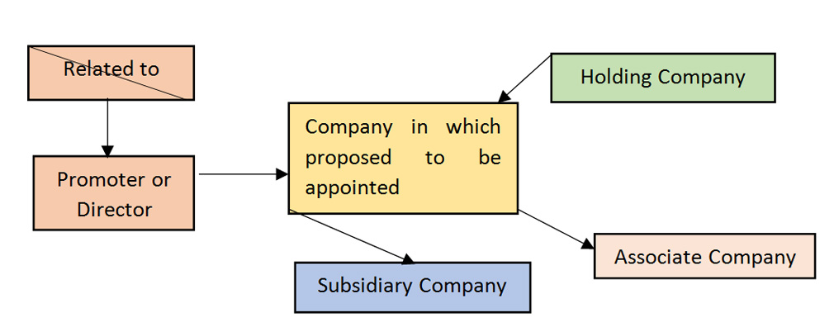
Independent Director
Person is not related to promoter or director of company or of its holding company, subsidiary company or associate company

Slide 18
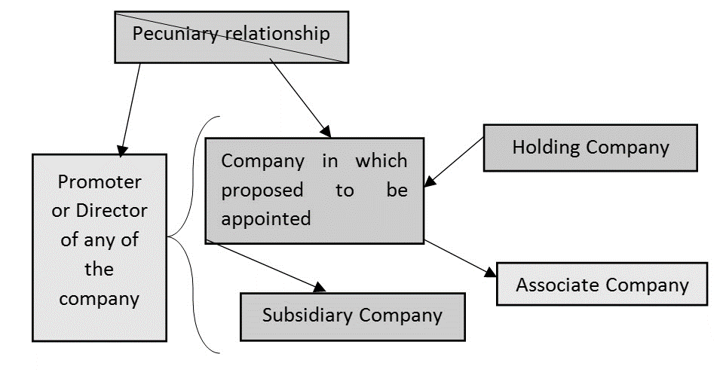
Independent Director
Person does not have pecuniary relationship
with the company, its holding, subsidiary or associate company, or their promoters, or directors,
during preceding 2 FY or during the current FY
Exempted Transactions :
not exceeding 10% of total income of such person
Remuneration as ID shall not be included in computing total income

Slide 19
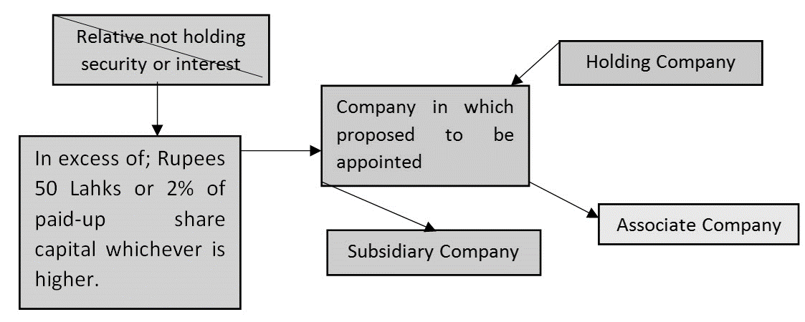
Independent Director
Who’s relative are not holding security or interest in excess of:
INR 50 Lahks or 2% of paid-up share capital whichever is higher; or
during the immediately preceding 2 FY or during the current FY
in company or its holding company or subsidiary company or associate company
None of his relative is indebted
The amount shall not exceed INR 50 Lahks
to company its holding, subsidiary or associate company or their promoters, or directors
during the immediately preceding 2 FY or during the current FY.

Slide 20
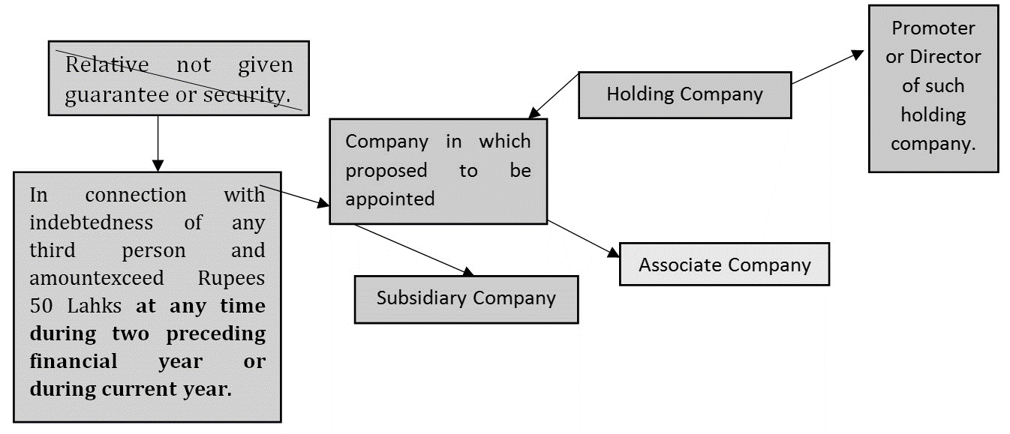
Independent Director
No relative has given guarantee or security
in connection with indebtedness
of any third person
to the company, its holding, subsidiary or associate company or their promoters, or directors of such holding company.
The amount shall not exceed INR 50 Lahks at any time during preceding 2 FY or during current year
Relative shall not have any other pecuniary relationship with the company or its subsidiary, or its holding or associate company
amount exceeding 2% of its gross turnover.
Singly or in combination of above 3 transaction

Slide 21
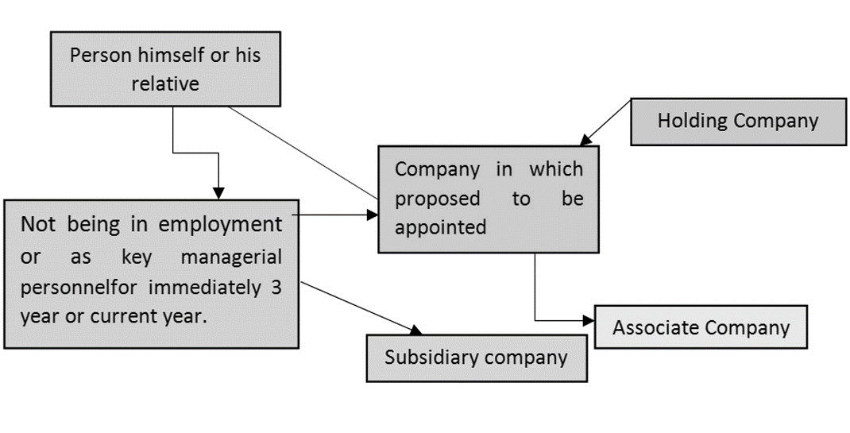
Independent Director
Person himself or his relative shall not be KMP or employee
of company or its holding, subsidiary or associate company
for immediately 3 previous FY
Exception:
Relative may be employee of company in immediately 3 preceding FY

Slide 22
Independent Director
Person or his relative
not be employee or proprietor or a partner
auditors or cost auditors or CS in practice
legal or consulting firm (having transaction amounting to 10% or more of gross turnover of such firm)
of the company or its holding company, subsidiary or associate company
for any of the 3 preceding FY
Not an employee / proprietor /partner of:
Auditor or Cost Auditor or PCS
any legal or a consulting firm (T/o >10%)
for any of the 3 preceding FY

Slide 23
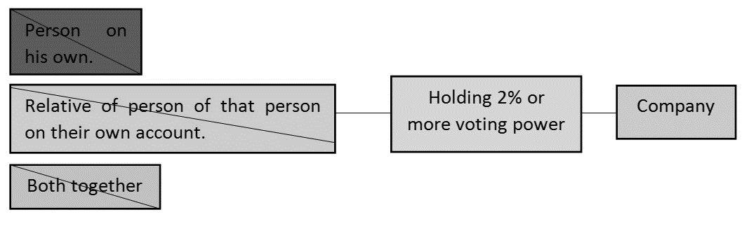
Independent Director
Person or together with his relatives
Holds 2% or more of the total voting power
of the company.

Slide 24
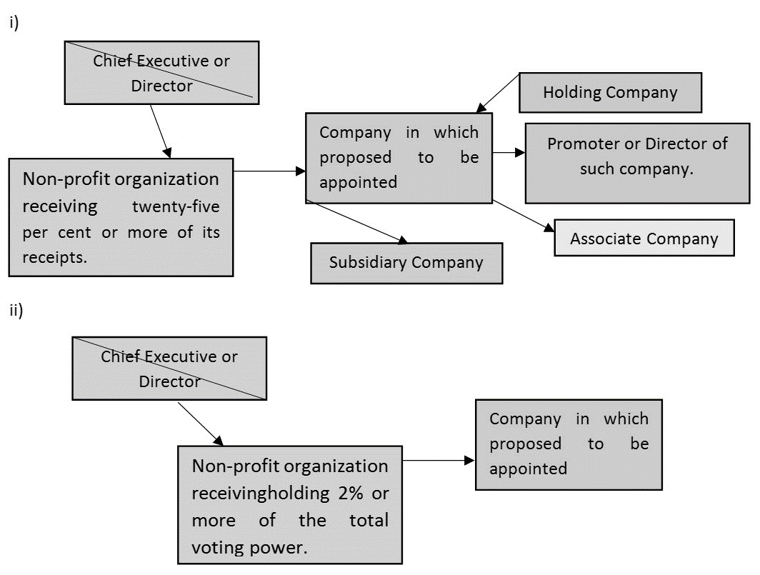
Independent Director
Person or his relative shall not be
Chief Executive or Director of any non-profit organization which:
Receives 25% or more of its receipts
holds 2% or more of the total voting power of the company
from the company, any of its promoters, directors or its holding, subsidiary or associate company

Slide 25
Declaration confirming independence:
At first BM in which he participates
at first BM in every financial year or
Upon any change in the circumstances which may affect his status as an independent director
Code for independent directors
IDs shall abide by the provisions specified in Schedule IV.
The Code is a guide to professional conduct for IDs
Adherence to these standards by IDs promote confidence of the investment community, minority shareholders and regulators
Independent Director

Slide 26
Independent Director
Term of Independent Director:
upto 5 consecutive years
Eligible for re-appointment on passing of a special resolution and disclosure in the Board's report.
Maximum 2 consecutive terms of 5 years
Cooling off period:
Eligible for re-appointment after the expiration of 3 years.
Independent Director shall not be appointed in or be associated with the company in any other capacity, either directly or indirectly.

Slide 27
Independent Director
Remuneration:
Sitting fees & reimbursement of expenses
Profit related commission as may be approved by the members
Not entitled to any stock option.
Retire by Rotation:
Independent Director is not liable to retire by rotation
Immunity:
An independent director shall be held liable only in respect of such acts of omission or commission by a company which had occurred with his knowledge or connivance or for failure to exercise due diligence [Section149(12)]

Slide 28
Independent Director
Appointment & Independent Director's Databank:
Appointment shall be approved by members in a General meeting
Explanatory statement annexed to the notice must indicate justification for such appointment
Independent directors may be selected from a data bank of eligible and willing persons maintained by the agency.
Company must exercise due diligence before selecting a person from the data bank

Slide 29
Small Shareholders Director
Meaning: “small shareholders” means a shareholder holding shares of nominal value of not more than INR 20,000/- or such other sum as may be prescribed.
Applicable: only to listed companies (not mandatory)
Maximum 1 small shareholder director
Election:
Voluntarily by the listed company
Receipt of notice from:
1,000 small shareholder or
1/10th of the total number of such shareholders,
whichever is lower

Slide 30
Small Shareholders Director
Notice: At least 14 days before the meeting
Disclosure by the proposed director: DIN, consent (DIR-2), declaration that he is not disqualified to become a director
Small shareholders’ director to be an independent director [Subject to eligibility u/s 149(6) and he gives declaration of his independence]
Not liable to retire by rotation
Tenure as small shareholders’ director shall not exceed 3 years.
Not eligible for re-appointment
Cooling off period of 3 year [not be directly / indirectly associated with Company ]
Max. 2 companies at the same time as Small shareholders’ director [Non-conflicting businesses]

Slide 31
General provisions for appointment
Every director shall be appointed in general meeting (Except otherwise provided)
DIN is mandatory
Declaration that he is not disqualified to become a director under the Act (DIR-8)
Consent to hold the office of director in form DIR-2
Company shall file Form DIR-12 within 30 days of the appointment of a director
Casual Vacancy:
Vacancy caused by death or resignation of a director appointed by the shareholders
Before expiry of his term,
BoD can appoint a director to fill up such vacancy
The appointed director shall hold office only up to the term of the director in whose place he is appointed

Slide 32
General provisions for appointment
Appointment of directors to be voted individually [Section 162(1)]
A single resolution shall not be moved for the appointment of two or more persons as directors
unless a proposal to move such a motion has first been agreed to at the meeting without any vote being cast against it
A resolution moved in contravention of aforesaid provision shall be void, whether or not any objection was taken when it was moved

Slide 33
Right of persons other than retiring directors
Individual who is not a retiring director
Can be nominated as a candidate by himself or by any member
At least 14 days notice before the meeting, with particulars of the proposed candidate
Consent to act as director from the candidate
Deposit of INR 100,000.
Deposit to be refunded in case the candidate is elected or secures 25% or more votes
Requirements of deposit shall not apply:
appointment of an independent director or
director recommended by the Nomination and Remuneration Committee (NRC) or
director recommended by the BoD where the Company is not required to have NRC

Slide 34
Right of persons other than retiring directors
Notice of candidature:
The company shall inform its members of the candidature or intention of member to appoint director
At least 7 days notice before the general meeting
Written Notice shall be served individually to members
Place notice on the website, if any
Individual notice is not required if company publishes it in newspaper in English and a vernacular newspaper

Slide 35
Retire by rotation
Section 152(6) is applicable on public companies only
AoA may provide for the retirement of all directors at every AGM
2/3rd directors are liable to determination for retirement by rotation
1/3rd of such directors are liable to retire
at every general meeting after the meeting at which first directors are appointed
Any fraction in 1/3rd will be rounded off to nearest number
The retiring directors can be re-appointed by members
Independent directors and Nominee directors are excluded from the calculation of 2/3rd.
A small shareholder director shall be a non-rotational direction.
1/3rd directors which are liable to retire will be decided by FIFO method.
If 2 or more directors are appointed on same day then it will be decided by draw of lot

Slide 36
Disqualification (Sec.164)
Undischarged insolvent or declared by a competent court to be of unsound mind
He has applied to be adjudicated as an insolvent and his application is pending
He has been convicted by a court for an offence involving moral turpitude
Sentenced for imprisonment for 7 years or more
Convicted of Offence under RPT during last 5 Years
An order has been passed by a court or tribunal disqualifying him for appointment as Director
Not obtained DIN
Company in which he is a director has defaulted in filing financial statement or Annual Returns for continuous period of 3 FY
Company in which he is a director has failed to pay dividend declared, repay deposit or redeem debentures or pay Interest thereon for a period of 1 year or more
A Private company may provide in its AoA any additional disqualifications

Slide 37
Disqualification (Sec.164)
Disqualified director shall not be eligible for a period of 5 years for:
re-appointment as a director of that company or
appointment in other company
DIR-8: Disqualified Director [u/s 164 (2]), shall inform to the company concerned in Form DIR-8
DIR-9 (within 30 days)
a) Company to file upon receipt of the Form DIR-8
DIR-10: application for removal of disqualification of directors shall be made in Form DIR-10 and filed before the RD
b) Whenever a company fails to file the financial statements/annual returns/fails to repay any deposit, interest, dividend/fails to redeem its debentures

Slide 38
Duties of Directors (Sec.166)
Directors hold a fiduciary position and a position of trusteeship to protect the interest of shareholders. CA 2013 provides for specific duties of Director as follows:
Director of a company shall act in accordance with the AoA of the company
Director shall act in good faith to promote the objects of the company in the best interest of the stakeholders, the community and protection of the environment
Director exercise his duties based on due and reasonable care, skill and diligence
Shall not involve in a situation in which he may have a direct or indirect interest that conflicts, or possibly may conflict, with the interest of the company
Shall not achieve or attempt to achieve any undue gain or advantage either to himself or to his relatives, partners, or associates
Director shall not assign his office in favour of anyone else. Such assignment shall be void

Slide 39
Vacation of office of Director (Sec. 167)
Absents for all the Board Meetings during 12 Months period with or w/o leave of absence
Contravention in RPT and fails to disclose interest in the same
Disqualified by order of the Court or tribunal
Convicted by a Court of any offence & imprisonment for 6 Months or more
He is removed from Directorship
He resigns from the office
He incurs any of the disqualifications specified in Section 164
Where he incurs disqualification u/s 164(2), the office of the director shall become vacant in all the companies, other than the company which is in default under that sub-section
Private company may, by its articles, provide any other ground for the vacation of the office of Director
Where all the directors of a company vacate their offices under any of the disqualifications specified above the promoter or, in his absence, the Central Government shall appoint the required number of directors who shall hold office till the directors are appointed by the company in the general meeting

Slide 40
Resignation of director (Sec. 168)
Director may resign by giving a notice in writing
Board shall:
intimate the Registrar in Form DIR-12 within 30 days
Place the fact of such resignation in the report of directors in next AGM
post the information on its website, if any
Director may also file Form DIR-11 within 30 days
Effective date: receipt of notice or the date specified, if any, in the notice, whichever is later
Liable for offence during his tenure
If all the directors resigns - promoter or in his absence CG shall appoint

Slide 41
Removal of directors (Sec. 169)
A company may, remove a director before the expiry of the period of his office
Reasonable opportunity of being heard to be given to such director
Resolution:
Special resolution – for removal of an independent director re-appointed for second term u/s 149(10)
Ordinary resolution – for removal of director other than (a) above
Not applicable for:
director appointed by NCLT
Director appointed for proportional representation - where company has availed option u/s 163 to appoint 2/3rd of directors

Slide 42
Removal of directors (Sec. 169)
Special notice required for removal or to appoint somebody in his place
Notice by members holding 1% or more of total voting power or holding paid up capital of INR 5 Lakh or more, on the date of the notice (Sec. 115)
At least 14 days before meeting but not earlier than 3 months.
Company to send a copy of notice to the concerned director
Director shall be entitled to be heard on the resolution at the meeting
Where the concerned director makes representation in writing to the company and requests its notification to members, the company shall, if the time permits it to do so:
a) state the fact of representation so made in notice to members and
b) send a copy of the representation to every member and
if a copy of the representation is not sent as aforesaid, the representation shall be read out at the meeting
Notes:
No. of days for notice - Exclude day on which the notice is given and the day of the meeting

Slide 43
Removal of directors (Sec. 169)
Removal of directors (Sec. 169)
Exception for sending copy of representation to members or reading out in meeting:
If the Tribunal is satisfied that the rights conferred by this sub-section are being abused to secure needless publicity for defamatory matter
Vacancy created due to removal of director:
May be filled by the appointment of another director in his place at the meeting at which he is removed
Special notice of the intended appointment be given
Shall hold office till the date up to which his predecessor would have held office if he had not been removed
If the vacancy is not filled as above, it may be filled as a casual vacancy as per this Act
The director who was removed - shall not be re-appointed as a director by the Board of Directors
The director so removed shall not be deprived of any compensation payable to him as per the contract or term of his appointment

Slide 44
Register & Return
Register:
Every company shall keep a register of its directors and KMP
The register shall contain the details of director / KMP as prescribed under Rule 17 of the Companies (Appointment and Qualifications of Directors) Rules, 2014
Register shall be maintained at registered office of the company
Register shall be open for inspection during business hours
Members shall have right to take extracts / copies thereof
Return:
Company shall file a return for appointment of director or KMP and changes therein
Form DIR-12 within 30 days

Slide 45

Managerial Remuneration

Slide 46




Key Terms
Managerial remuneration : Remuneration paid to Managerial Personnel.
Managerial Personnel: Directors including managing director and whole-time director, and manager.
Remuneration : Sec 2(78) : Any money or its equivalent given for services rendered (includes perquisites as per IT Act)

Slide 47

Section 196
No company shall appoint or re-appoint any person as its managing director, whole-time director or manager for a term exceeding 5 years at a time
No company shall appoint or employ at the same time a managing director and a manager.
01
02
03
no re-appointment shall be made earlier than 1 year before the expiry of his term

Slide 48
Disqualifications
Age – 21 to 70
Beyond 70 Special Resolution
CG Approval, if Ordinary is passed
an undischarged insolvent or has at any time been adjudged as an insolvent
01
02
03
any time suspended payment to his creditors or makes, or has at any time made, a composition with them
Convicted by a court of an offence and sentenced for a period of more than 6 months
04

Slide 49
Section 196 – Appointment Process
Subject to provisions of section 197 and schedule V
Approval at the Board Meeting and Resolution at Next General Meeting
Central Government Approval if not in compliance of Part – I of Schedule V
Terms and Conditions, Remuneration interest, etc. to be given in Notice of Board and General Meeting

Slide 50
Return to be filed
Return in the prescribed form shall be filed within sixty days of such appointment with the Registrar
Rule 3 of the Companies (Appointment and Remuneration of Managerial Personnel) Rules, 2014: -
A company shall file a return of appointment of a Managing Director, Whole Time Director or Manager, within 60 days of the appointment, with the Registrar in Form MR-1

Slide 51
What if the resoluton is not passed by members
Section 196(5):
Subject to the provisions of this Act, where an appointment of a managing director, whole-time director or manager is not approved by the company at a general meeting, any act done by him before such approval shall not be deemed to be invalid.
Whether acts of MD/Manager/WTD shall be invalid, if member does not pass the special resolution?

Slide 52
Exemption to Companies
Private Companies
Sub-sections (4) and
Section 196
01
(5) of
Government Companies
02
Sub-sections (2), (4) and (5) of Section 196 shall not apply
03
IFSC Public Companies
Sub-section (4) of section 196 shall not apply

Slide 53
Overall Remuneration
By a Public Company: Overall 11% of net profit to its Directors including MD/WTD/Manager
It is in respect of a financial year
Net profit is to be calculated as per section 198 of the Act
In section 198, the remuneration of the directors shall not be deducted from the gross profit

Slide 54
Whether more than 11% possible?
Yes, it is possible: resolution passed by members in general meeting
Compliance of Schedule V
No Central Government Approval except Part I of Schedule V

Slide 55
Limits u/s 197
Overall Limit 11%
MD/Manager/WTD
Other than
MD/Manager/WTD
If there is
If no
One
More than One
MD/Manager/WTD
MD/Manager/WTD
5%
10% together
1%
3%

Slide 56
Whether M.R. more than the individual limits possible?
> Overall limit (i.e., 11%) : Ordinary Resolution
> Individual limit (5%, 10%, 1 & 3%) : Special Resolution
Company that has defaulted in payment of dues: Prior approval of Banks/PFI/Secured Creditors/NCD
Limits specified under sec 197 shall be exclusive of sitting fees
payable to directors.

Slide 57
Part I |  | Appointment |  | 4 conditions
Schedule V
Section I
Having Profits
Section II
Not having Profits
Part II |  | Remuneration
Section III
Special Circumstances
Part III |  | Provisions applicable to Part I and II
Section IV
Perquisite
Part IV |  | Exemptions
Section V
Two Companies

Slide 58
Imprisonment for any period
Conviction of offence in 19 Acts
Fine of Rs. 1000 more
Detention of any period under COFEPOSA
Part I
Completed 21 years
Appointments
Age Restrictions
Not attained 70 years
(no further approval if SR)
Resident of India
Preceding 12 months
Notes:
Conservation of Foreign Exchange and Prevention of Smuggling Activities Act, 1974
12 months Resident – not applicable to companies in SEZ

Slide 59
List of 19 Acts
the Indian Stamp Act, 1899 (2 of 1899);
the Central Excise Act, 1944 (1 of 1944);(Repealed)
the Industries (Development and Regulation) Act, 1951 (65 of 1951);
the Prevention of Food Adulteration Act, 1954 (37 of 1954);
the Essential Commodities Act, 1955 (10 of 1955);
the Companies Act, 2013 or any previous company law;
the Securities Contracts (Regulation) Act, 1956 (42 of 1956);
the Wealth-tax Act, 1957 (27 of 1957); (Repealed)
the Income-tax Act, 1961 (43 of 1961);
the Customs Act, 1962 (52 of 1962);
the Competition Act, 2002 (12 of 2003);
the Foreign Exchange Management Act, 1999 (42 of 1999);
the Sick Industrial Companies (Special Provisions) Act, 1985 (1 of 1986); (Repealed)
the Securities and Exchange Board of India Act, 1992 (15 of 1992);
the Foreign Trade (Development and Regulation) Act, 1922 (22 of 1922);
the Prevention of Money-Laundering Act, 2002 (15 of 2003);
the Insolvency and Bankruptcy Code, 2016 (31 of 2016)
the Goods and Services Tax Act, 2017 (12 of 2017)
the Fugitive Economic Offenders Act, 2018 (17 of 2018)

Slide 60
Section I |  | Companies having profits – section 197
Part II
Table giving details
Section II |  | No Profit/Inadequacy of Profit
Professional Directors
Section III |  | Remuneration in certain special circumstance
Section IV |  | Perquisite not to be included
Section V
Remuneration in two companies

Slide 61
Para - A
Effective capital | Limit yearly remuneration in Rs. MD/WTD/Manager | Limit yearly remuneration in Rs. Other Directors
Negative or less than 5 crore | 60 lakhs | 12 lakhs
5 crores and above but less than 100 crores | 84 lakhs | 17 lakhs
100 crores and above but less than 250 crores | 120 lakhs | 24 lakhs
250 crores and above | 120 lakhs plus 0.01% of effective capital in excess of Rs. 250 crore | 24 Lakhs plus 0.01% of the effective capital in excess of Rs.250 crores
Note
Limits can be increased by passing SR
Proportionate remuneration to be paid if a Director has worked for less than a year.
Effective Capital = PSC + SP + Reserves + Long Term Loans and deposits – Investments – Losses – Preliminary expenses – Revaluation Reserve

Slide 62
Managerial Person in Professional capacity
Remuneration as per Para (A) may be paid to the Director(s) who:
Possesses graduate level qualification with expertise and specialized knowledge in the field in which the company operates.
Not having any interest directly or indirectly in the capital of the company or its H. Co. or any of its S. Co. through any other statutory structures
Not having any direct or indirect interest or related to the directors or promoters of the company or its H. Co. or any of its S. Co. at any time during the last 2 years before or on or after the date of appointment.
Exemption: Employee holding 0.5% of its paid-up capital under any scheme including ESOP or by way of qualification
“Statutory Structure” means any entity which is entitled to hold shares in any company formed under any statute.
PARA (B)

Slide 63
Other Conditions
Conditions
Approval of Board/NRC
Prior approval of lenders
Details in Notice
Resolution
Professional Director
Other Director
General Information
Beyond ceiling
Information about appointee
Special
Within ceiling
Ordinary
Special
Other Information
Disclosures

Slide 64
Section III- MR when no profit or inadequate profit: Special circumstances
S1 – Payment by foreign company or any another company with SH approval, if total MR of such other company is within limits of section 197.
S2 – Pay without any limit
Newly incorporated company for 7 years from date of incorporation, or
Sick co undergoing revival ordered by the BIFR, for 5 yrs from the date of sanction of scheme
Co for whom Resolution plan approved by NCLT, for 5 yrs from the date of sanction of scheme
S 3 - Remuneration fixed by BIFR/NCLT is in excess of Section II limits subject to:
Not drawing remuneration from any other company (except in Scenario 1)
Auditor/CS/PCS certificate of Secured creditors/ term lenders no objection for remuneration in writing ; also certificate of no default in payment to creditors/ deposits

Slide 65
Section IV- Perquisites not included in MR
Components NOT considered as Remuneration:
PF, superannuation fund to the extent not taxable under the IT Act.
Gratuity not exceeding half a month’s salary for each completed year of service.
Leave encashment at the end of the tenure.
Children’s education allowance
Holiday passage for children studying outside India or family staying abroad
Leave travel concession
Note: For the purposes of this Schedule, ‘‘family’’ means the spouse, dependent children and dependent parents of the managerial person.

Slide 66
Section V- Remuneration from 2 companies
Where an individual is holding the position of a managerial person in 2 companies, he can draw remuneration from 1 or both companies
The total remuneration to that person shall not exceed the higher maximum limit admissible from any one of the companies of which he is a managerial person

Slide 67
Remuneration can be paid to any director for providing
professional services
There are no limits for such remuneration.
The director should possess the requisite qualification for the rendering such services.
Such remuneration can be paid subject to approval of Board, ( also, NRC and AC where applicable)
Comply with provisions of Section 188 with respect to availing of services and office or place of profit.
If the service rendered is in the ordinary course of business and in the arms length basis, then Board approval is not required.
In case of IDs, payment for professional services can’t exceed 10% of their total income during a financial year : Section 149
(6) ( c )
Remuneration to Directors for Professional Services

Slide 68
No or inadequate profits : Sec 197 (11)
Any provision in the MOA, AOA or agreement entered into by the Company or in any resolution passed by the Company in GM or by the BoD, which has effect of effect of increasing the MR, such provision shall not have any effect unless such increase is also in accordance with the conditions specified in Schedule V of the Act.

Slide 69
Sitting Fees and other Remuneration [197(5)]
Shall not exceed Rs. 1 lakh per meeting of the Board or Committee
For IDs and WDs, the sitting fee shall not be less than the sitting fee payable to other Directors
Fees may be paid to its Directors for attending any special meeting (such as investor meeting), general meetings or joining in a teleconference.
Sitting fees shall not form part of managerial remuneration limits.

Slide 70
How can remuneration be paid?
Mode
Monthly
% of Net Profit
Partly by one or Partly by other

Slide 71



Other conditions
Stock Options to Independent Directors
The company shall
not waive
the
recovery of any sum refundable to it under sub-section
Net Profit as per section 198
(9) unless approved by the company by
special resolution within two years
Excess within
remuneration
from the date the sum becomes
two years or
such lesser period as
refundable.
may be allowed by
(if default, then
the company
approval)

Slide 72
Refund/ Waiver of excess MR: Sec 197 (9) (10)
Excess remuneration paid to Directors without approval required u/s 197 shall be refunded to Company and until then the Director shall hold it in trust for the Company
Such refund can be waived by passing SR within 2 years from the date the sum becomes refundable
Prior approval of Banks/PFI/Secured Creditors/NCD - If the company has defaulted in payment of dues

Slide 73
Refund and Waiver of excess remuneration
Drawing excess remuneration is NOT an offence though
remuneration requires approval.
Quantum of “Net Profit” cannot be precisely estimated at the time of fixation of remuneration.
“Net Profits” are computed at the end of the FY, hence during the year estimates may vary from actual
CS /Auditors to find out the excess remuneration and notify duly the refund if any to be made by a Director.

Slide 74
Refund and Waiver of excess remuneration
197 (9) : No reference to excess remuneration drawn by Manager.
It should be therefore made a part of the terms of appointment so that there is a contractual obligation to refund the excess remuneration drawn or received by Manager.
197 (10) : SR required to waive the refund of excess remuneration.
197 (16) : Auditors to ascertain the same
If director fails to make the refund, the amount could be recovered by the Company from any “Sitting Fee” or any other remuneration or any other amount payable to such director.

Slide 75
Disclosure in Audit Report – 197 (16)
Auditor of the Company shall, in his report under Section 143, make a statement as to:
- whether
remuneration paid is in accordance with the
provisions of Section 197,
- whether remuneration paid to any director is in excess of the limits

Slide 76
Policy of Insurance – 197 (13) – D & O Liability Policy
The premium paid to EDs/KMP/CS: NOT part of remuneration, unless such personnel is proved to be guilty.
If premium is added to the remuneration paid (when held guilty), the actual remuneration paid to such person might exceed the limits

Slide 77

Q & A

Slide 78
Thank you !

