Slide 1
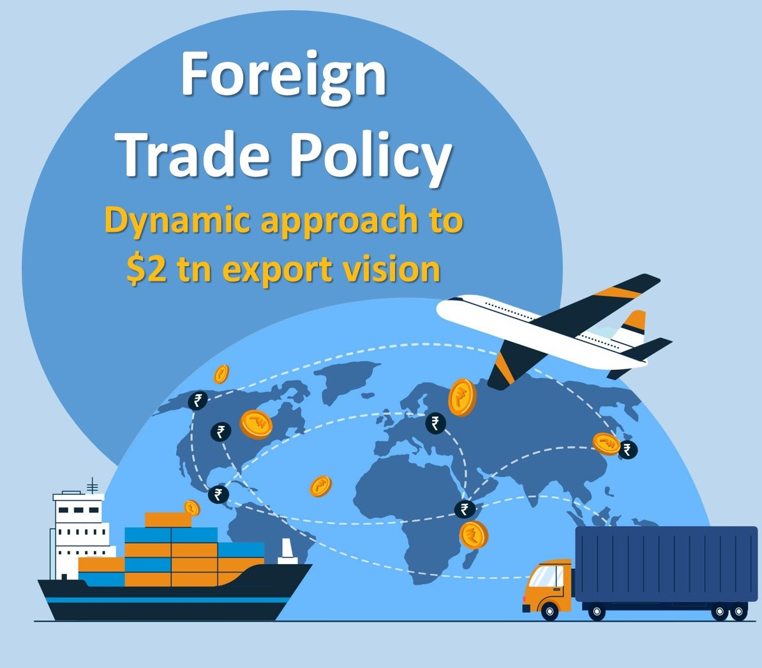

FOREIGN TRADE POLICY 2023
CA Shailesh Rathi
Partner
Rathi Rathi and Co.
Chartered Accountants, Pune

Slide 2
Table of Contents
What is Foreign Trade Policy -Legal Framework
New FTP-23 Approach
Merchandising Trade
Amnesty Scheme
Streamlining SCOMET Policy
Duty exemption/ Remission Scheme
Other important policies / rules affecting FTP

Slide 3
What is Foreign Trade Policy

Slide 4
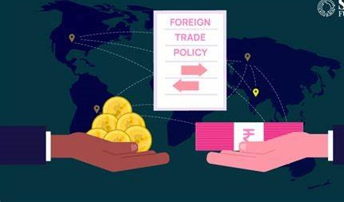
Introduction
Foreign Trade Policy refer to the set of guidelines and measures adopted by a government to regulate its trade relations with other countries.
Foreign Trade Policies are issued by Directorate General of Foreign Trade, Ministry of Commerce and Industry.
These are issued for every five years. However, 2023 policy is issued without any time limitation. This will be continued and modified as and when required.
The main objectives are to promote exports, increase foreign investment, improve the competitiveness of domestic products and stimulate overall economic growth.

Slide 5
Functions of FTP / DGFT
To facilitate foreign trades, DGFT performs following functions
Implementing various policies regarding trade such as Foreign Trade Policy.
licensing authority for exporters, importers, and export and import business.
Prohibit, restrict and regulate exports and imports.
Implementation of the schemes like AA / EPCG etc.

Slide 6
Import Export Code (IEC)
Issue of e-IEC (Electronic-Importer Exporter Code)
IEC is a 10-digit code given to importer/ exporters. This is granted by DGFT.
IEC is mandatory for export/import.
DGFT has started issuance of IEC in Electronic Form.
Now PAN based IECs are issued.
Notes:
Simple Process – most of us are aware of this and its mandatory for getting for Export and Import related activity

Slide 7

Structure of New FTP 2023
The Foreign Trade Policy (FTP) 2023 incorporates provisions relating to export and import of goods and services, and is effective from 1st April, 2023.
This shall be continue to be in operation unless otherwise specified or amended.

Slide 8
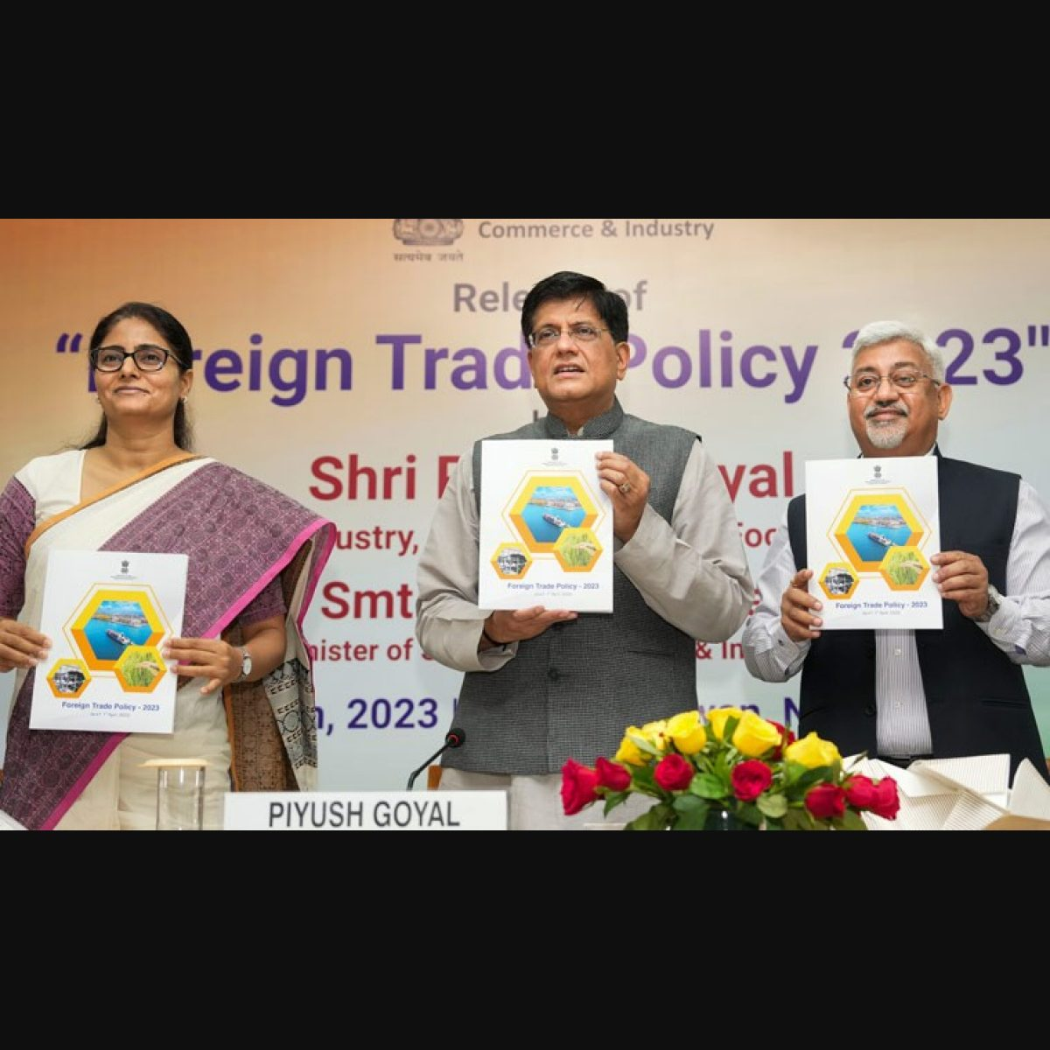
Why FTP 2023
In the FTP 2015-20, changes were done subsequent to the initial release even without announcement of a new FTP responding dynamically to the emerging situations.
Foreign Trade Policy (2023) is a policy document based on continuity of time-tested schemes facilitating exports as well as a document which is nimble and responsive to the requirements of trade.
Incorporating feedback from Trade and Industry would also be continuous to streamline processes and update FTP, from time to time.

Slide 9

Pillars to FTP 2023
1. Incentive to Remission
2. Export promotion through collaboration - Exporters, States, Districts, Indian Missions.
3. Ease of doing business, reduction in transaction cost and e-initiatives
4. Emerging Areas – E-Commerce Developing Districts as Export Hubs and streamlining SCOMET policy.

Slide 10
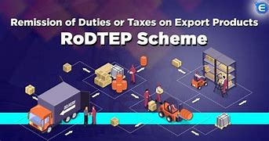
Incentive to Remission
Remission of Duties and Taxes on Exported Products (RoDTEP):
  All products covered under MEIS slowly in phased manner has been shifted to this scheme.
  Duties/ taxes / levies, at the Central, State and local level, borne on the exported product, including prior stage cumulative indirect taxes on goods and services used in the production of the exported product.
  Such indirect Duties/ taxes / levies in respect of distribution of exported product.

Slide 11
Incentive to Remission
Scheme for Rebate of State and Central Taxes and Levies on export of Garments and Made-ups(RoSCLT):
  This scheme has been notified by Ministry of textiles.
  The scheme intends to compensate the State and Central Taxes and Levies in addition to the Duty Drawback Scheme on export of apparent garments and Made-ups by way of rebate.

Slide 12

Capacity Building at District level
Districts as Export Hubs to boost India's foreign trade by decentralizing export promotion.
Capacity building to create new exporters and identification of new markets.
Training, handholding, and outreach programs by DGFT field offices in coordination with District Industries Centers.
Regional Authorities of DGFT working with the States/UTs to prepare District specific Export Plans.
Export promotion outreach programs in districts to focus on branding, packaging, design and marketing of identified product & services.

Slide 13

Promoting exports through E-Commerce
All DGFT policies and schemes shall now be applicable to E-Commerce companies as well
The consignment wise cap on E-Commerce exports through courier has been raised from Rs. 5 Lakh to Rs. 10 Lakh in the FTP 2023
Integration of Courier and Postal exports with ICEGATE.
E-commerce hubs to be created for facilitating all operations at one place.
Setting up of Dak Ghar Niryat Kendras to facilitate cross-border e-commerce exports

Slide 14

Niryat Bandhu Scheme
A scheme implemented by DGFT to:
  Mentor new and potential exporter on the intricacies of foreign trade through counselling, training programmes, and
  Organizing outreach programmes including the ‘Districts as Export Hubs’ initiative with ‘industry partners’, ‘knowledge partners to create vibrant District-Product-Market relevant knowledge ecosystem to promote E-commerce exports.

Slide 15


Ease of Doing Business, Reduction in Transaction Cost and e-Initiatives

Slide 16
Online approvals without Physical Interface
Automatic approval of various permissions under Foreign Trade Policy based on process simplification and technology implementation.
Reduction in processing time and immediate approval of applications under automatic route for exporters:
Permission type | Current processing time | Automatic route processing time
Advance authorization issuance | 3 to 7 days | 1 day
EPCG issuance | 3 to 7 days | 1 day
Revalidation of authorizations | 3 days to 1 month | 1 day
Extension of Export Obligation period | 3 days to 1 month | 1 day

Slide 17
Reduction in user charges for MSMEs under AA and EPCG
Application fee being reduced for Advance Authorization and EPCG Schemes
Will benefit 55-60% of exporters who are MSMEs.
Fee structure as shown below-
Licence Value in Rupees | User charges for non- MSMEs | Reduced User charges for MSMEs
Up to 1 crore | 1 per 1,000 | 100
1 crore to 10 crores | 1 per 1,000 | 5,000
Above 10 crores | Cap at 1,00,000 | 5,000

Slide 18
Duty Exemption / Remission Schemes
Objective is to enable duty free import of inputs for export production, including restoration of inputs or duty remission.
Sr. No. | Type of Scheme | Name of Scheme
1 | Duty Exemption Schemes | Advance Authorization (AA)
 |  | Export Promotion Capital Goods (EPCG)

Slide 19

Advance Authorization Scheme
Issued to allow duty free import of inputs, which are physically incorporated in export product (making normal allowance for wastage).
Fuel, oil, catalyst which is consumed / utilized in the process of production of export product, may also be allowed under AA.
AA is issued for import of Inputs at Zero Rate of Duty
It can be issued either to a manufacturer exporter or merchant exporter tied to supporting manufacturer.

Slide 20
Advance Authorization (AA)
Conditions for Advance Authorization such as:
  Minimum value addition required to be achieved under AA is 15%.
  In case of Spices, minimum value addition shall be 25%.
  Export Obligation has to be completed post Import of Inputs
  AA is issued on actual user condition and can not be transferred.
One can also apply for Advance Authorization for Annual Requirement

Slide 21
Advance Authorization (AA)
Advance Authorization is issued on the following basis:
  As per Standard Input Output Norms (SION) notified OR
  Applicant specific prior fixation of norm by the Norms Committee as per para 4.06 of Handbook Procedures OR
  On the basis of self declaration as per paragraph 4.07 of Handbook of Procedures OR
  On the basis of Self Ratification Scheme in terms of Para 4.06 of FTP.

Slide 22
Key changes in FTP regarding AA Scheme:
Special Advance Authorisation Scheme extended to export of Apparel and Clothing sector under para 4.07 of HBP on self-declaration basis to facilitate prompt execution of export orders – Norms would be fixed within fixed timeframe.
Benefits of Self-Ratification Scheme for fixation of Input-Output Norms extended to 2 star and above status holders in addition to Authorised Economic Operators at present.

Slide 23
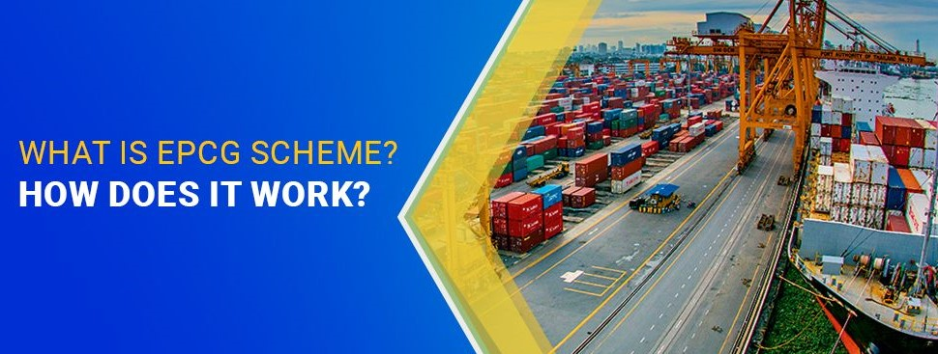
Export Promotion Capital Goods (EPCG)
Objective:
The objective of the EPCG Scheme is to facilitate import of
capital goods for producing quality goods and services and
enhance India’s manufacturing competitiveness.
Allows import of capital goods (except specified in negative list) for pre-production, production and post-production at zero customs duty.

Slide 24
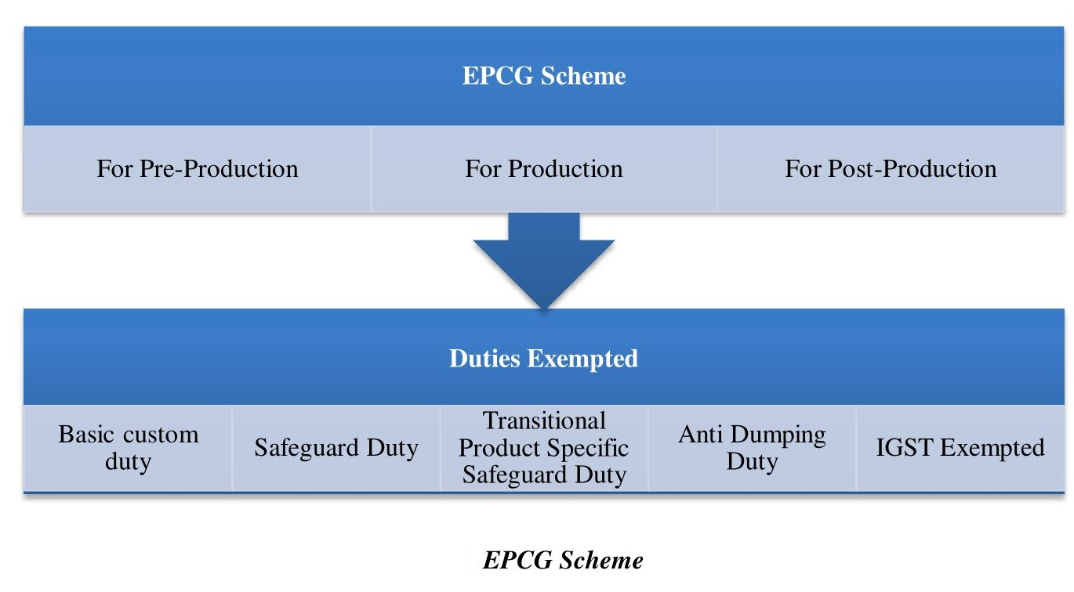
Duties exempted under EPCG

Slide 25
Export Promotion Capital Goods (EPCG)
Import under EPCG Scheme shall be subject to:
  An Export Obligation (EO) equivalent to 6 times of duties, taxes and Cess saved on capital goods. Over and above average export Obligation.
  This EO has to be fulfilled in 6 years from date of issue of Authorization.
Authorization validity has been increased from current 18 months to 24 months after issue. Revalidation not permitted.
EPCG scheme covers manufacturer exporters with or without supporting manufacturer(s), merchant exporters tied to supporting manufacturer(s) and service providers.

Slide 26
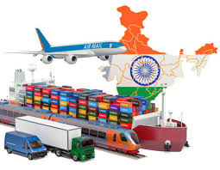
Export Promotional Capital Goods (EPCG)
Conditions for fulfilment of Export Obligation (EO):
  Specific EO condition: EO equivalent to 6 times of duties, taxes and Cess saved on capital goods to be fulfilled in FC as well as INR.
  This EO shall be fulfilled through export of goods for which the EPCG authorization has been granted.
Average EO condition: EO under the scheme shall be, over and above, the average exports achieved by the applicant in the preceding three licensing years for the same and similar products within the overall EO period.

Slide 27
Chapter 5. Export Promotional Capital Goods Scheme (EPCG)
Particulars | Amount (Rs in Lacs)
Average Export for Past 3 Years | 100
Import of Machinery Value | 500
Duty Saved @ 30% | 150
Total Export Obligation 6 Times of above | 900
Export Obligation - within first 4 Years | 450
Export obligation - In Next 2 Years - | 450
Here you are required to export 100 Lacs every year as a average export and extra turnover above 100 Lacs will be treated under specific export for calculation of 450 Lacs

Slide 28
EPCG: Key changes in FTP 2023
Prime Minister Mega Integrated Textile Region and Apparel Parks (PM MITRA) scheme has been added as an additional scheme eligible to claim benefits under CSP (Common Service Provider) Scheme of Export Promotion capital Goods Scheme(EPCG).
Dairy sector to be exempted from maintaining Average Export Obligation – to support dairy sector to upgrade the technology
Battery Electric Vehicles (BEV) of all types, Vertical Farming equipment, Wastewater Treatment and Recycling, Rainwater harvesting system and Rainwater Filters, and Green Hydrogen are added to Green Technology products – will now be eligible for reduced Export Obligation requirement under EPCG Scheme.

Slide 29

SCOMET Policy
India has regulated the exports of dual use items, nuclear related items, including software and technology.
SCOMET policy is an integral part of India’s export control system, which ensures that sensitive and dual-use items, including software and technology, are traded only in accordance with India’s international commitments under various export control regimes.
It is either prohibited or is permitted under an Authorization unless specifically exempted.
SCOMET is an acronym for Special Chemicals, Organisms, Materials, Equipment and Technologies.

Slide 30
SCOMET Policy
The FTP 2023 places special emphasis on SCOMET policy and aims to consolidate all policies related to the export of dual-use items under SCOMET at one place to simplify the process and make it easier for industry compliance.
The policy aims to make it easier for industry to export goods such as UAV/Drones, Cryogenic Tanks, and certain chemicals, by simplifying the licensing process and reducing the bureaucratic hurdles that can make it difficult for industry to comply with export regulations.
The FTP 2023 aims to make India a more competitive player in the global market for high-end goods and technology.

Slide 31

Towns of Export Excellence
Towns of Export Excellence is a status provided to those towns which produce and export goods worth a minimum value in a specific sector. Sectors include handicraft, handloom, seafood, pharmaceutical, fisheries, apparels, coir, leather products etc.
Qualification for TEE:
    Towns producing goods of minimum value Rs. 750 Cr.
    Threshold limit for handloom, handicraft, Agriculture and Fisheries sector is Rs. 150 Cr.

Slide 32
Benefits offered in the scheme
Financial assistance as a part of Market Access Initiative (MAI) scheme
Under this scheme recognized association focusing on specific country or a target market will receive financial assistance for activities like market surveys, setting up of warehouses/ showrooms, campaigns for brand promotions, participation in international trade fairs, reimbursement of registration charges etc.
Authorization under Export Promotion Capital Goods (EPCG) Scheme
EPCG scheme allows an exporter to import capital goods that is required for pre-production, production, and post-production at zero customs duty. To qualify for the scheme the manufactured commodity should be exported.

Slide 33
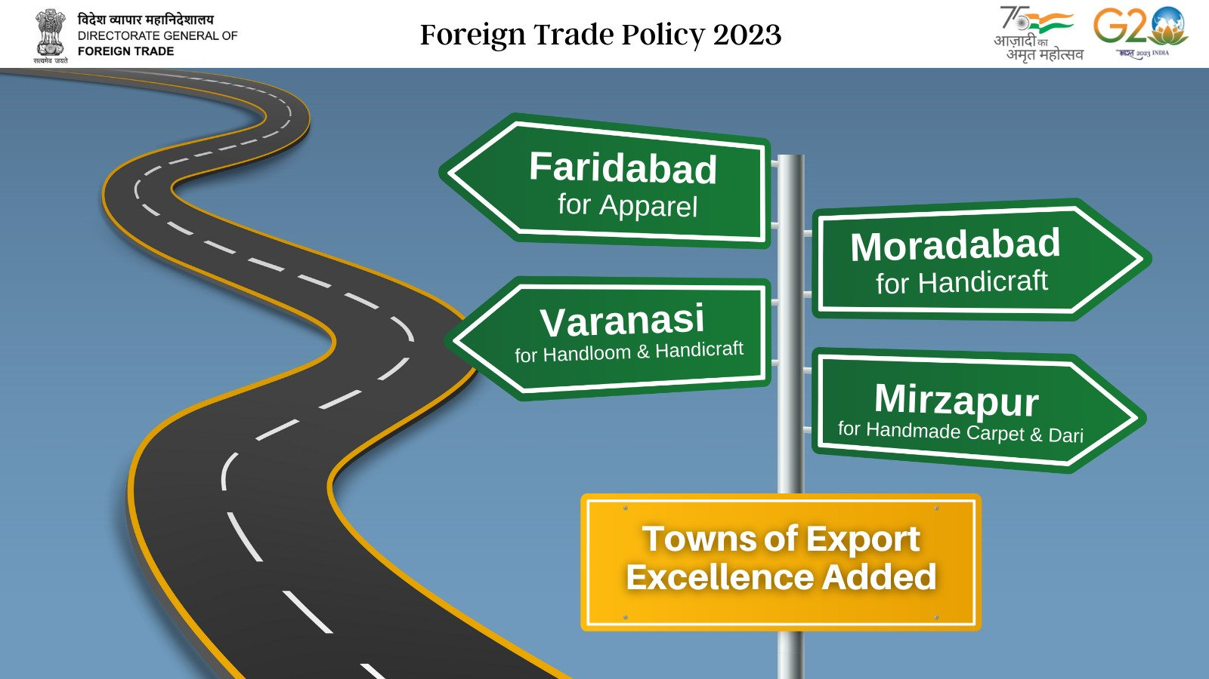
Additions to TEE
4 new towns of export excellence (TEE) are in addition to the already existing 39 towns of export excellence:
Town of Export Excellence | Product Category
Faridabad | Apparel
Moradabad | Handicrafts
Mirzapur | Handmade carpet and Dari
Varanasi | Handloom and Handicraft

Slide 34

Status Holder Certificate
Status Holders
  Status Holders are business leaders who have excelled in international trade and have successfully contributed to country’s foreign trade.
  Expected to contribute towards India’s exports.
  Also to provide guidance and handholding to new entrepreneurs.

Slide 35
Status Holder Certificate
Export performance threshold for Recognition of Exporters as Status Holders rationalized.
Enabling more exporters to achieve higher status and reduced transaction cost for exports.
In USD Million
Status House Category | Existing Export Performance Threshold | Revised Export performance Threshold
One Star | 3 | 3
Two Star | 25 | 15
Three Star | 100 | 50
Four Star | 500 | 200
Five Star | 2,000 | 800

Slide 36



Status Holder Certificate
Many privileges are awarded to the Status Holders such as,
Exemption for furnishing Bank Guarantee,
Priority in fixation of SION,
Authorization and Customs Clearances granted on Self-declaration,
Permission to establish Export Warehouses, etc.

Slide 37
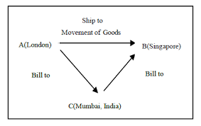
Merchanting trade
Merchanting trade involves shipment of goods from one foreign country to another foreign country without touching Indian ports, involving an Indian intermediary.
This will be subject to compliance with RBI guidelines and won’t be applicable for goods/items classified in the CITES and SCOMET list.

Slide 38

Amnesty Scheme
In line with "Vivaad se Vishwaas" initiative, which sought to settle tax disputes amicably, the government is introducing a special one-time Amnesty Scheme under the FTP 2023 to address default on Export Obligations.
This scheme is intended to provide relief to exporters who have been unable to meet their obligations under EPCG and Advance Authorizations, and who are burdened by high duty and interest costs associated with pending cases.
All pending cases of the default in meeting Export Obligation (EO) of authorizations mentioned can be regularized on payment of all customs duties that were exempted in proportion to unfulfilled Export Obligation.

Slide 39
Amnesty Scheme
The interest payable is capped at 100% of these exempted duties under this scheme.
However, no interest is payable on the portion of Additional Customs Duty and Special Additional Custom Duties and this is likely to provide relief to exporters as interest burden will come down substantially.
Application needs to be filed before DGFT by 30th June 2023 and payment of duties to be made by 30th September 2023.

Slide 40
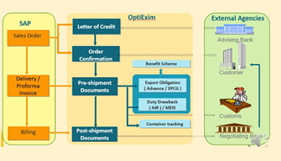
Importance of E-BRC’s
e-BRC (Electronic Bank Realization Certificate)
BRC is a certificate which is a proof of export realizations.
BRC is issued by Banks based on realization of payment against export by an Exporter.
Manual BRCs are not allowed and E-BRCs are now mandatory.

Slide 41

EDMPS / IDMPS
EDI (Electronic Data Interchange)
EDI is a secured message exchange system for various documentation related activities including import and export Authorizations established with other administrative departments, namely, Customs, Banks and EPCs .
Reduced the physical interface of exporters and importers with the Government Departments
A significant measure in the direction of reduction of transaction cost
EDPMS / IDPMS – Banks are issuing Notices and caution list notices to companies

Slide 42
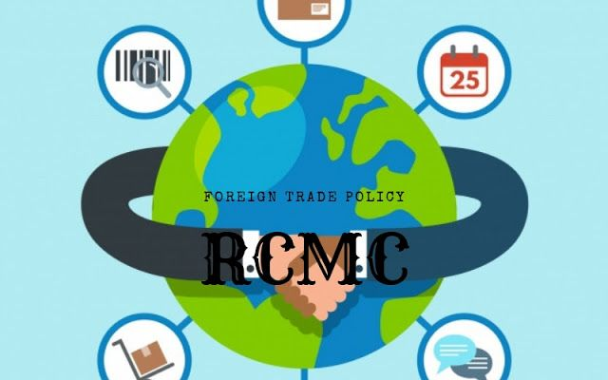
RCMC
Registration-cum-Membership Certificate (RCMC)
Granted by Export Promotional Councils on application.
Mandatory for any benefit or concession under FTP.
Also mandatory for an Authorization to ‘’import/export (except items)’’ listed as ‘Restricted’ items in ITC (HS)

Slide 43

Bonded Manufacturing
Exiting or new manufacturing units can register as Bonded Manufacturing
Under this you can import the raw material / capital goods without payment of customs duty
You are required to maintain specified
registers for input/Output/ Manufactured goods etc.
Manufactured Product Sold in India | Pay Duty
Manufactured Product Exported | No Duty Payable
Notes:
Here CA Certificate is required

Slide 44

Q & A

Slide 45

Thank You.
Rathi Rathi and Co.
Chartered Accountants
Walk In :
Office No. 501-504, 5th Floor, Akshay Landmarks
Opp. Pu-La Deshpande Garden
Sinhgad Road, Pune – 411030
Phone : 020 – 2425 4288/2425 4388
Mobile : +91 99224 12667
Website : www.rathiandrathi.com
E-Mail : info@rathiandrathi.com
Branch office : Mumbai, Hyderabad

