Slide 1

GST –
SCN and Assessments - Provisions, Challenges and Solutions!
[9th June 2022]
CA Pritam Mahure and Associates
https://pmaconsulting.in/

Slide 2
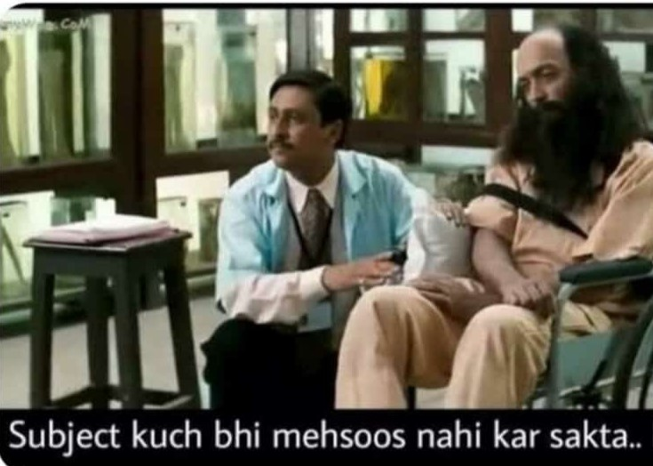
After attending numerous webinars!

Slide 3
If self-assessment then why?
SECTION 59. Self-assessment
Every registered person shall self-assess the taxes payable under this Act and furnish a return for each tax period as specified under section 39.
Section 2
(11) “assessment” means determination of tax liability under this Act and includes self-assessment, re-assessment, provisional assessment, summary assessment and best judgment assessment
Notes:
That’s why

Slide 4
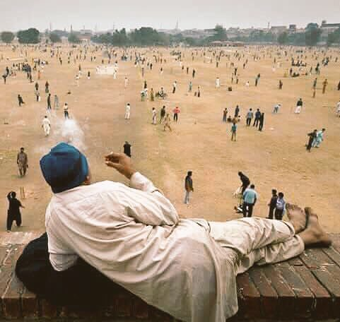
analyzing the taxpayers!
Notes:
I know what you did last summer!

Slide 5
From ‘informer’ based to ‘IT’ based!
Earlier regime
Excise
ST
VAT
Income Tax
Others
MCA, SEBI, Stock Exchanges
News
Agencies
ED/ CBI/ Cyber
PMLA/ SFIO
Notes:
Two sets of data – not expected to match – if matching then check again

Slide 6
CBIC & CBDT sign MoU to facilitate smoother bilateral exchange of data [PIB 21.07.2020]
A Memorandum of Understanding (MoU) was signed between the Central Board of Direct Taxes (CBDT) and the Central Board of Indirect Taxes and Customs (CBIC) today, for data exchange between the two organisations. …
This MoU will facilitate the sharing of data and information between CBDT and CBIC on an automatic and regular basis. In addition to regular exchange of data, CBDT and CBIC will also exchange with each other, on request and spontaneous basis, any information available in their respective databases which may have utility for the other organisation.

Slide 7
Surge in cases!
Service Tax, VAT and Excise
GST
ASAP before time-barring!
Nascent stage!
GST Audits started!
Menace of fake invoicing and declining Tax Revenue!

Slide 8
Real time data being captured!
E-Invoicing
E-way Bill
RFID Tag
Data Analytics
Scrutiny of GST Returns
QR Code

Slide 9

Are all these same?

Slide 10
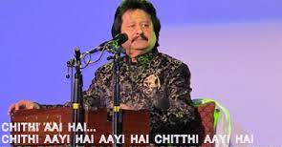
Chithi aayi hai!
Excise/ ST/GST
Letters
SCN
Summons
Recovery

Slide 11
What?
Letters
Request for information (data, documents, etc.)
Summons
Communication for Tax dues!
Generally for lapses!
Intimation to specified person!
To appear, to give or produce documents etc.
SCN

Slide 12


Letter?

Slide 13
ST/ Excise
ST /Excise
FY 1617
Upto 30 June 2017
More than 5 years
15th August 2022

Slide 14
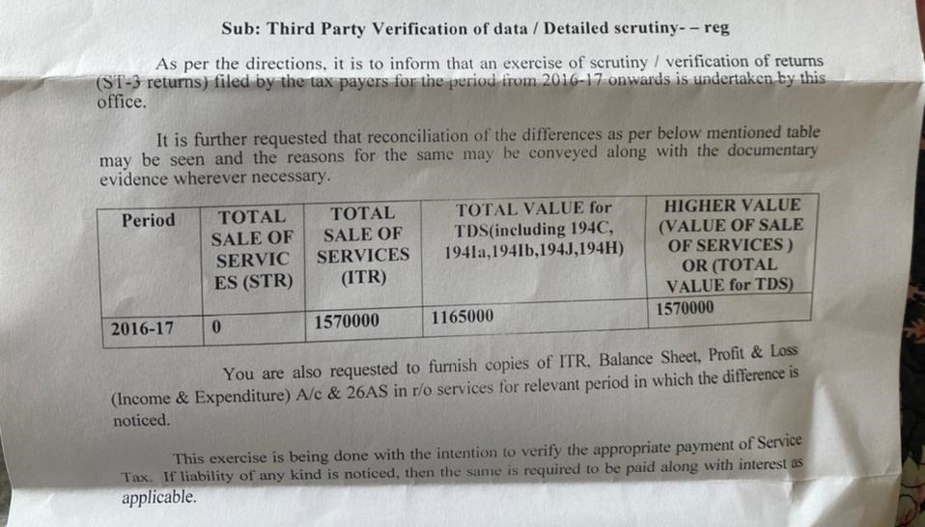

ST - Data Analytics notices!

Slide 15
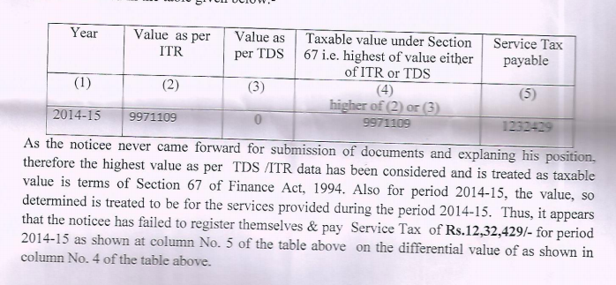
ST - SCN!

Slide 16
Mis-match!
Export!
Works contract!
Centralised or premises based!
Advances!
RCM!
Accounting system!
Exempt!

Slide 17
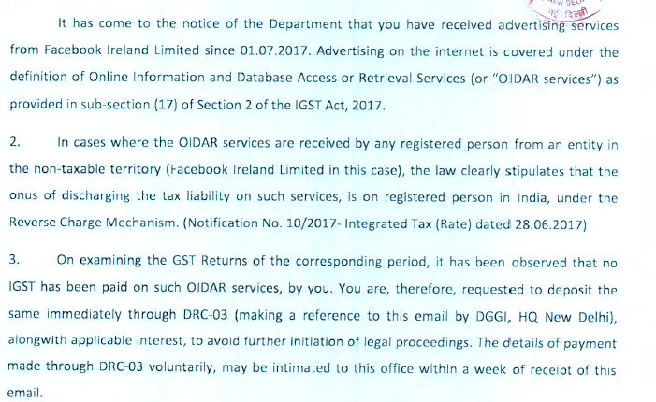
GST - Data Analytics notices!

Slide 18
Mismatch letters/SMS!
TDS and GST!
GSTR-1 and GSTR-3B!
GSTR-2A and GSTR-3B!
E-way Bill!
Notes:
Difference?
TDS data
Centralised registration
Exempt income

Slide 19
Surge in SCNs/Letters?
GST
Excise
ST

Slide 20
DIN
CGST
  Mandatory!
SGST?

Slide 21
DIN – To be implemented by States as well!
Pradeep Goyal [2022 (63) GSTL 286 (SC)]*
Para 7
We impress upon the concerned States to consider to implement the system for electronic (digital) generation of a DIN for all communications sent by the State Tax Officers to taxpayers and other concerned persons so as to bring in transparency and accountability in the indirect tax administration at the earliest.
CA Pritam Mahure and Associates
* GST

Slide 22

Legal Provisions
Notes:
Rights and obligations

Slide 23
Legal Provision!
Act
Rules
CCR
Notifications
Circulars
Case law
SGST Act
UTGST Act
CGST Act
SGST Rules
Supreme Court
High Court
AR
AAR
Cess Act etc
IGST Rules
NAPA
Erstwhile cases
Others
Press Notes
GSTC Minutes
IGST Act
Finance Act
Excise Act
State VATs
Valuation Rules
CGST Rules
PoPSR Rules
POT Rules

Slide 24
Legal Provision!
CGST Act
CGST Rules
Rule 142
DRC-01A
Section 73
CGST Forms
Section 74
Section 75
Section 169
Section 76
Section 79
Rule 143
Rule 144
Rule 145
Rule 147
Rule 149
DRC-01
…….
DRC-22

Slide 25
Forms!
Notes:
Rights and obligations

Slide 26
Summary of Forms
Sr. No. | Name of Form | Particulars
1 | DRC-01A (Part A) | Summary issued before SCN having details of Tax, Interest and Penalty
1(ii) | DRC-01A (Part B) | Paying partial liability or making additional submissions before issue of SCN
2 | DRC-01 | Summary of SCN issued, on GST Portal
3 | DRC-02 | Statement issued, which is deemed to be SCN (Refer Sec 73(3))
4 | DRC-03 | Intimation of payment by Taxpayer to Officer, before issue of SCN or after issue SCN
5 | DRC–04 | Acceptance of Payment by Officer, in response to DRC-03
6 | DRC-05 | Acceptance of Payment and concluding of Proceedings
7 | DRC-06 | Summary uploaded on GST portal for representations / reply made against the Notice

Slide 27
Summary of Forms
Sr. No. | Name of Form | Particulars
8 | DRC-07 | Summary of Order passed with Tax, Interest and Penalty amount
9 | DRC-08 | Summary of Order withdrawn or modified
10 | DRC-08A | Details of Demand against order withdrawn or modified or quashed including appeals
11 | DRC-09 | Recovery of amount through any money owned by Government to Such Taxpayer, say refund pending to be disbursed
12 | DRC-10 | Details of Goods belonging to defaulting Taxpayer to be auctioned
 | DRC-11 | Notice to successful bidder of Goods or Immovable Property to make payment to Government
 | DRC-12 | Certificate of Payment and order of transfer of possession of goods or Immovable Property to Successful bidder

Slide 28
Summary of Forms
Sr. No. | Name of Form | Particulars
13 | DRC-13 | Notice to third person to make payment of amount due to the defaulting taxpayer say Debtors
 | DRC-14 | Certificate to such third person on making of payment
14 | DRC-16 | Order of Attachment and Notice for Sale of Immovable Property
 | DRC-17 | Notice for Action for selling such Immovable Property
16 | DRC-22 | Provisional Attachment of Property or Bank Account

Slide 29
Summons?

Slide 30
Section 70 Power to summon persons to give evidence and produce documents.
(1) The proper officer under this Act shall have power to summon any person whose attendance he considers necessary either to give evidence or to produce a document or any other thing in any inquiry in the same manner, as provided in the case of a civil court under the provisions of the Code of Civil Procedure, 1908 (5 of 1908).
(2) Every such inquiry referred to in sub-section (1) shall be deemed to be a “judicial proceedings” within the meaning of section 193 and section 228 of the Indian Penal Code (45 of 1860).

Slide 31
Summons!
CGST!
SGST!
DGGI
Local
India!
Notes:
Difference?
TDS data
Centralised registration
Exempt income

Slide 32
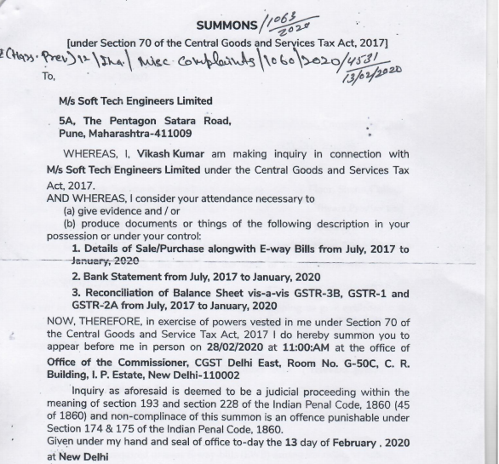

Slide 33
SCN?

Slide 34
GST!
GST?
Letter demanding payment of tax etc
Summon
Letter for payment from recipient
Notice
Letter demanding information
Audit Objection
Pre-SCN
SCN

Slide 35
Section 73 Determination of tax not paid or short paid
(1) Where it appears to the proper officer that any tax has not been paid or short paid or erroneously refunded, or where input tax credit has been wrongly availed or utilized for any reason, other than the reason of fraud or any wilful misstatement or suppression of facts to evade tax, he shall serve notice on the person chargeable with tax which has not been so paid or which has been so short paid or to whom the refund has erroneously been made, or who has wrongly availed or utilised input tax credit, requiring him to show cause as to why he should not pay the amount specified in the notice along with interest payable thereon under section 50 and a penalty leviable under the provisions of this Act or the rules made thereunder.

Slide 36
Show Cause
Erroneously refunded
Short paid
Eg. Treated as exempt
Eg. Treated as liable for 18% whereas it should be 28%
Any tax has not been paid
Where input tax credit has been wrongly availed or utilized
Eg. Not export
Eg. personal expenses/ car
Value

Slide 37
TRAN Notices!
Excise/ ST regime
GST regime

Slide 38
ITC
2( 62) “input tax” in relation to a registered person, means the central tax, State tax, integrated tax or Union territory tax charged on any supply of goods or services or both made to him and includes —
(a) integrated tax or Union territory tax charged …

Slide 39
SCN/ Statement

Slide 40

How?
SCN
First time
Statement
(if on same ground)
If already issued
Detailed SCN

Slide 41
Options!

Slide 42
Option I – No Notice
Section 73 (5) Before service of notice
  Under sub-section (1) or, as the case may be, the statement under sub-section (3),
Pay the amount of tax along with interest payable thereon under section 50
On the basis of
  His own ascertainment or
  Tax as ascertained by the proper officer
And inform the proper officer in writing of such payment

Slide 43
Option I – No Notice
(6) The proper officer, on receipt of such information, shall not serve any notice under sub-section (1) or, as the case may be, the statement under sub-section (3), in respect of the tax so paid or any penalty payable under the provisions of this Act or the rules made thereunder.
(7) Where the proper officer is of the opinion that the amount paid under sub-section (5) falls short of the amount actually payable, he shall proceed to issue the notice as provided for in sub-section (1) in respect of such amount which falls short of the amount actually payable.

Slide 44
Option II – SCN but no Penalty
(8) Where any person chargeable with tax under sub-section (1) or sub-section (3) pays the said tax along with interest payable under section 50 within thirty days of issue of show cause notice, no penalty shall be payable and all proceedings in respect of the said notice shall be deemed to be concluded.

Slide 45
Option III – SCN and 10% Penalty
(9) The proper officer shall, after considering the representation, if any, made by person chargeable with tax, determine the amount of tax, interest and a penalty equivalent to ten per cent. of tax or ten thousand rupees, whichever is higher, due from such person and issue an order.
(11) Notwithstanding anything contained in sub-section (6) or sub-section (8), penalty under sub-section (9) shall be payable where any amount of self-assessed tax or any amount collected as tax has not been paid within a period of thirty days from the due date of payment of such tax.

Slide 46
Option III – SCN and 10% Penalty
(10) The proper officer shall issue the order under sub-section (9) within three years from the due date for furnishing of annual return for the financial year to which the tax not paid or short paid or input tax credit wrongly availed or utilised relates to or within three years from the date of erroneous refund.

Slide 47
Section 73 – Other critical points
Order must be passed within three years from the due date for furnishing of annual return for the financial year or within three years from the date of erroneous refund!
Notice must be issued at least three months prior to the time limit specified in sub-section (10) for issuance of order!
Statement would be deemed to be notice in case where SCN for same matter is already issued earlier
If tax paid along with interest, no such notice would be issued
If tax paid along with interest within 30 days of SCN, no penalty is payable and proceeding would be concluded
Penalty is maximum 10% of the tax amount

Slide 48
Time limit?

Slide 49
When?
Section 73 (2) :The proper officer shall issue the notice under sub-section (1) at least three months prior to the time limit specified in sub-section (10) for issuance of order.
Example
FY | Final date AR | Normal Order (3 Years) | Extended Order (5 Years)
2017-18 | 5th /7th.02.2020 | 5th /7th.02.2023 [*31.12.2023] | 5th /7th.02.2025
2018-19 | 31.12.2020 | 31.12.2023 | 31.12.2025
2019-20 | 31.03.2021 | 31.03.2024 | 31.03.2026
Notes:
Whether date extended or Late fee waived?

Slide 50
Fraud, or
Wilful misstatement or
Suppression of facts!

Slide 51
Section 74
By reason of
Fraud, or any
Wilful misstatement or
Suppression of facts
To evade tax

Slide 52
Meaning of ‘Suppression’
Explanation 2. — For the purposes of this Act, the expression “suppression” shall mean non-declaration of facts or information which a taxable person
Is required to declare in the return, statement, report or any other document furnished under this Act or the rules made thereunder, or
Failure to furnish any information on being asked for, in writing, by the proper officer

Slide 53
Section 74 – Other critical points
Order must be passed within five years from the due date for furnishing of annual return for the financial year or within three years from the date of erroneous refund
Notice must be issued at least six months prior to the time limit specified in sub-section (10) for issuance of order.
Statement would be deemed to be notice in case where SCN for same matter is already issued earlier
If tax paid along with interest and 15% penalty , no such notice would be issued
If tax paid along with interest and penalty of 25% within 30 days of SCN, proceeding would be concluded
If tax paid along with interest and penalty of 50% within 30 days of SCN, proceeding would be concluded

Slide 54
Section 74 - Penalty
15%
Before SCN
25%
Within 30 days of SCN
Within 30 days of OIO
50%
100%
Penalty
Notes:
Tax and Interest will remain same – Only penalty amount differs

Slide 55
Penalty - COmparison

Slide 56
Penalty – Decision Matrix!
Particulars | Sec. 73 (A) | Incremental (B) | Sec. 74 (C) | Incremental (D) | Sec. 73 vs. Sec. 74 (A vs. C)
Before | Nil | - | 15% | - | 15%
Within 30 days of SCN | Nil | Nil | 25% | 10% | 25%
Within 30 days of Order | 10% | 10% | 50% | 25% | 40%
Afterwards | 10% | Nil | 100% | 50% | 90%
Notes:
Tax + Interest remains as it is

Slide 57
Other provisions

Slide 58
SECTION 75. General provisions relating to determination of tax
(10) The adjudication proceedings shall be deemed to be concluded, if the order is not issued within three years as provided for in sub-section (10) of section 73 or within five years as provided for in sub-section (10) of section 74.

Slide 59
Whether SCN is mandatory?
Section 11A of the Central Excises and Salt Act, 1944 clearly proceeds that prior Show Cause Notice must be issued to the person against whom any demand on ground of short-levy or non-levy of payment of excise duty is proposed to be made. Therefore a post facto Show Cause Notice cannot be regarded as adequate in law
  MADHUMILAN SYNTEX PVT. LTD. 1988 (35) E.L.T. 349 (S.C.)

Slide 60
LC Infra Projects 2020-TIOL-827-HC-KAR-GST
Issuance of show Cause Notice is sine qua non to proceed with the recovery of interest payable
Before recovery of interest payable in accordance with Section 50 of the GST Act, a show Cause Notice is required to be issued

Slide 61
Interest – Self-imposed and automatic!
ORISSA STEVEDORES LTD. [2022 (67) GSTL 284 (Ori.)]*
Para 7
…it is clear that the liability to pay interest under Section 50 is not only self-imposed but also automatic without any requirement for determination by any other …
CA Pritam Mahure and Associates
* GST

Slide 62
Amount should be specified?
This is because of the fact that issuance of a show cause notice in a particular format is a mandatory requirement of law. The law requires the said notice to be issued under a specific provision of law and not as a correspondence or part of an order. The said notice must also indicate the amount demanded and call upon the assessee to show cause if he has any objection for such demand. The said notice also will have to be served on the assessee within the said period which is either 6 months or 5 years as the facts demand. Therefore, it will be futile to contend that each and every communication or order could be construed as a show cause notice.
  METAL FORGINGS 2002 (146) E.L.T. 241 (S.C.)

Slide 63
Can SCN be waived?
Mandatory requirement of a statute whether can be waived by the party concerned
Even though a provision of law is mandatory in its operation if such provision is one which deals with the individual rights of a person concerned and is for his benefit, the said person can always waive such a right
  VIRGO STEELS 2002 (141) E.L.T. 598 (S.C.)

Slide 64
SCN is foundation!
It is well settled that unless the foundation of the case, is made out in the show-cause notice, Revenue cannot in Court argue a case not made out in its show-cause notice
  CHAMPDANY INDUSTRIES LTD. 2009 (241) E.L.T. 481 (S.C.)
The Department cannot be travel beyond the show cause notice.
  TOYO ENGINEERING INDIA LIMITED 2006 (201) E.L.T. 513 (S.C.)
Notes:
You have ticket upto Pune then travel to Pune only

Slide 65
Put to notice!
Unless the assessee is put to notice, the assessee would have no opportunity to meet the case of the department. The defaults enumerated in the proviso to the said sub-section are more than one and if the excise department places reliance on the proviso it must be specifically stated in the show cause notice which is the allegation against the assessee falling within the four corners of the said proviso.
  HMM Ltd 1995 (76) E.L.T. 497 (S.C.)

Slide 66
Vague SCN?
If the allegations in the show cause notice are not specific and are on the contrary vague, lack details and/or unintelligible that is sufficient to hold that the noticee was not given proper opportunity to meet the allegations indicated in the show cause notice
  BRINDAVAN BEVERAGES (P) LTD. 2007 (213) E.L.T. 487 (S.C.)

Slide 67
Demand cannot be raised on assumptions!
Now, these calculations certainly involve some assumptions. If any of these assumptions breaks down, then the ultimate conclusion will have to be rejected as incorrect
  OUDH SUGAR MILLS LTD. 1978 (2) E.L.T. (J 172) (S.C.)

Slide 68
Not every SCN is valid!
The show cause notice issued prior to passing of the impugned order does not stipulate even basic details such as the date and time of hearing and merely states DD/MM/YYYY at HH/MM, without filling in the fields.
The requirement of passing a speaking order has been entirely frustrated in so far as in the field marked 'speaking order', there are no reasons set out for the conclusion arrived at by the authority. Manifest non application of mind is evident.
Authorities directed to issue fresh notice, hear the assessee & pass a speaking order
  Tarmal Industrial Supply Company (2021-TIOL-1004-HC-MAD-GST)

Slide 69
Not every SCN is valid!
The SCN was completely vague and did not even point out as to what ground the reply was proposed to be sought
A perusal of the said show cause notice clearly highlights the fact that serious quasi-adjudicatory functionaries are being discharged by persons who do not have a legally trained mind and are entrusted in discharging functions affecting huge revenues.
Consequently, the order cancelling the registration stands revoked from the date of filing of the application before the respondent no. 2.
In view of the specific findings recorded above to the effect that the petitioner was unnecessarily harassed, the writ petition is allowed with a cost of Rs. 10,000/- to be paid to the petitioner within 30 days by the respondent no. 2 from his own salary.
  M/s Ansari Construction (2020-TIOL-2107-HC-ALL-GST)

Slide 70
Excise or Customs?
Duty to be paid by a 100% export oriented unit for clearance in the Domestic Tariff Area is the duty of excise and not customs duty. There is merit in the above contention. The duty in question is excise duty and not customs duty. Even the investigations were made under the Central Excise Act, 1944. Therefore, the show cause notice was defective in law and since it was defective notice the demand was not maintainable.
  SURESH SYNTHETICS 2007 (216) E.L.T. 662 (S.C.)

Slide 71
DRC-01A?

Slide 72
Rule 142 Notice and Order for demand of amounts payable under the Act
(1) The proper officer shall serve, along with the
(a) notice issued under section 52 or section 73 or section 74 or section 76 or section 122 or section 123 or section 124 or section 125 or section 127 or section 129 or section 130, a summary thereof electronically in FORM GST DRC-01,
(b) statement under sub-section (3) of section 73 or sub-section (3) of section 74, a summary thereof electronically in FORM GST DRC-02, specifying therein the details of the amount payable.
(1A) The proper officer may, before service of notice to the person chargeable with tax, interest and penalty, under sub-section (1) of Section 73 or sub-section (1) of Section 74, as the case may be, communicate the details of any tax, interest and penalty as ascertained by the said officer, in Part A of FORM GST DRC-01A
Notes:
“May” substituted vide Notf No. 79/2020-CT dt.15.10.2020 for the words ‘proper officer shall’

Slide 73
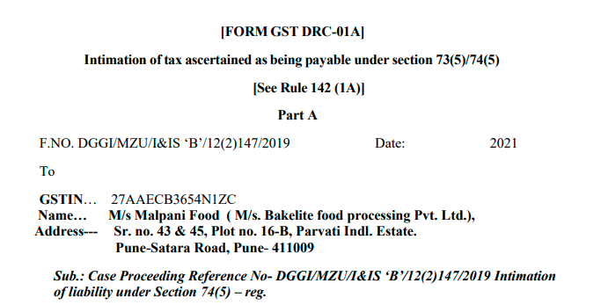
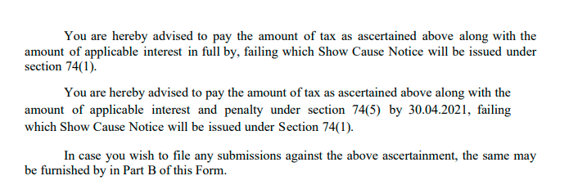

Slide 74
Section 16 Eligibility and conditions for taking input tax credit
(4) A registered person shall not be entitled to take input tax credit in respect of any invoice or debit note for supply of goods or services or both after the due date of furnishing of the return under section 39 for the month of September following the end of financial year to which such invoice or invoice relating to such debit note pertains or furnishing of the relevant annual return, whichever is earlier.

Slide 75
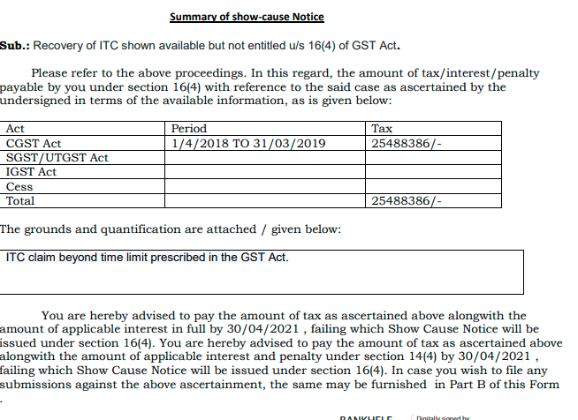

Slide 76
Serve?

Slide 77
Shall be “served”!
Section 169 Service of notice in certain circumstances:
  Any decision, order, summons, notice or other communication under this Act or the rules made thereunder shall be served by any one of the following:

Slide 78
Manner!
Directly or by messenger / courier
Courier
Digital
Common portal
Print-media
Affixing
By RP or Speed Post or courier with AD
In-person
Email
Newspaper

Slide 79
Manner of serving!
Directly or by messenger / courier
Courier
Digital
Common portal
Print-media
Affixing
By RP or Speed Post or courier with AD
In-person
Email
Newspaper

Slide 80
In-person!
To
Addressee
His manager
Person regularly employed by him in connection with the business
Taxable person
AR or Advocate or TP holding authority to appear
Adult member of family residing with the taxable person
Notes:
Sign with date and what received

Slide 81
Courier!
By
RP or Speed Post or Courier with AD
To
The person for whom it is intended or his AR, if any, at his last known place of business
Notes:
Preserve envelop

Slide 82
Digital!
By sending a communication to his e-mail address provided at the time of registration or as amended from time to time; or
By making it available on the common portal; or
Notes:
Email from? Gmail/ Gov.in
SPAM

Slide 83
Print-media!
By publication in a newspaper
Circulating in the locality in which
Taxable person or the person to whom it is issued
Is last known to have resided, carried on business or personally worked for gain

Slide 84
Affix!
If none of the modes aforesaid is practicable,
Then by affixing copy on notice board of office of concerned officer / authority who or which passed such decision / order or issued such summons / notice
By affixing it in some conspicuous place at his last known place of business or residence and
If such mode is not practicable for any reason,

Slide 85
ST regime – AD required!
… whereas in the present case, the order is said to have been sent by speed post and there is no evidence of tendering the decision to the assessee.
As per Section 37C(1)(a) of the Central Excise Act, 1944, it was obligatory on the part of the Revenue, either to tender a copy of the decision to the assessee or to sent it by registered post with acknowledgment due to the assessee or its authorized agent. In the present case, neither of the above have been complied with by the Revenue.
  Amidev Agro Care Pvt. Ltd. [2012 (26) STR 299 (Bom.)]

Slide 86
Rule 142 Notice and Order for demand of amounts payable under the Act
(1) The proper officer shall serve, along with the
(a) notice issued under section 52 or section 73 or section 74 or section 76 or section 122 or section 123 or section 124 or section 125 or section 127 or section 129 or section 130, a summary thereof electronically in FORM GST DRC-01,
(b) statement under sub-section (3) of section 73 or sub-section (3) of section 74, a summary thereof electronically in FORM GST DRC-02, specifying therein the details of the amount payable.
(1A) The proper officer may, before service of notice to the person chargeable with tax, interest and penalty, under sub-section (1) of Section 73 or sub-section (1) of Section 74, as the case may be, communicate the details of any tax, interest and penalty as ascertained by the said officer, in Part A of FORM GST DRC-01A
Notes:
Why not section 51?

Slide 87
Yet to be specified modes!
SMS
Whats App
Telegram
Consultant’s email

Slide 88
RAJU ARORA
[2018 (361) E.L.T. 270 (Del.)]
It was, however, not ascertained as to when and to whom the summonses were delivered. No efforts were made by the Investigating Agency to serve the summonses personally upon the respondent. It was specifically denied by the respondent that no such summonses were received by him. It was further informed that during the relevant period he was admitted in the hospital.
The impugned judgment records that the summons dated 6-9-2016 sent by speed post was delivered as per tracking report on 14-9-2016. The date of appearance mentioned therein was 13-9-2016. The trial court committed no error to observe that before initiating criminal proceedings against the respondent, the prosecution/Investigating Agency was expected to ensure that the summonses were duly served upon the respondent and he avoided to appear before it deliberately or intentionally.

Slide 89
KAUSHAL CONSTRUCTIONS
[2020 (37) G.S.T.L. 235 (Tri. - Chan.)]
… as per the records the impugned order was sent to the appellant by way of speed post on 26-7-2016 and the same has not been returned back to the Department but there is no contradiction to that stand of the Revenue by the appellant, moreover, as per the application, it is contended by the appellant that they had written several letters to the Department for supply of the order but none of the letters are having any receipt from the Department which shows that the appellant has never approached to the Department for supply of the copy of the order. In that circumstances, we do not find any merits in the application for condonation of delay, …

Slide 90
SHAGIRD DECORATORS
2020 (33) G.S.T.L. 204 (Tri. - Mumbai)
There is no doubt that the impugned order had been dispatched by speed post but that does not necessarily imply service on the addressee as the signature on the delivery manifest does not bear any resemblance to the names of the employees listed in certificate of the Chartered Accountant. It would appear that the mail intended for the applicant had been delivered to an individual whose connection with the applicant is not decipherable. While dispatch suffices to evidence service, it is open to the addressee to rebut the presumption with circumstantial evidence of non-delivery.

Slide 91
RAM NIVAS SINGH CONTRACTOR
2019 (24) G.S.T.L. 451 (Tri. - All.)
There is no attempt to serve the notice in the normal process by registered post or speed post. … Straightaway upon receiving the notice it has been served by affixture. Thus, it is writ large on the face of the record that the show cause notice has not been served upon the appellant-assessee and only so-called record of service of show cause notice has been prepared, which is against the provisions of law and the rules. I hold that there is no valid service of show cause notice. Accordingly, the impugned order cannot be sustained and the same is set aside.

Slide 92
Other aspects!

Slide 93
All Proceedings!
Explanation 1. — For the purposes of section 73 and this section, —
the expression “all proceedings in respect of the said notice” shall not include proceedings under section 132;
[Section 132 – Punishment for certain offenses]

Slide 94
Adjudication and Prosecution – Independent of each other!
Manoj Kumar Arora [2018 (15) GSTL 323 (All.)]*
Para 7
…every person who at the time, the offence was committed was in charge shall be severally and jointly liable for being prosecuted …Two proceedings are quite independent. Both can go on simultaneously and finding in the adjudication proceedings is not binding on the criminal proceedings. A prosecution can be launched even after the completion of adjudication.
CA Pritam Mahure and Associates
* Central Excise Act

Slide 95
All Proceedings!
Explanation 1. — For the purposes of section 73 and this section, —
(ii) where the notice under the same proceedings is issued to the main person liable to pay tax and some other persons, and such proceedings against the main person have been concluded under section 73 or section 74, the proceedings against all the persons liable to pay penalty under [sections 122 and 125] are deemed to be concluded.

Slide 96
SECTION 75. General provisions relating to determination of tax
(2) Where any Appellate Authority or Appellate Tribunal or court concludes that the notice issued under sub-section (1) of section 74 is not sustainable for the reason that the charges of fraud or any wilful misstatement or suppression of facts to evade tax has not been established against the person to whom the notice was issued, the proper officer shall determine the tax payable by such person, deeming as if the notice were issued under sub-section (1) of section 73.

Slide 97
Facts and Basis needed!
Section 75 (6)
  The proper officer, in his order, shall set out the relevant facts and the basis of his decision.

Slide 98
Order cannot exceed demand!
Section 75 (7)
  The amount of tax, interest and penalty demanded in the order shall not be in excess of the amount specified in the notice and no demand shall be confirmed on the grounds other than the grounds specified in the notice

Slide 99
Interest to follow!
(9) The interest on the tax short paid or not paid shall be payable whether or not specified in the order determining the tax liability.

Slide 100
Self-assessed Tax can be recovered!
(12) Notwithstanding anything contained in section 73 or section 74, where any amount of self-assessed tax in accordance with a return furnished under section 39 remains unpaid, either wholly or partly, or any amount of interest payable on such tax remains unpaid, the same shall be recovered under the provisions of section 79.
Explanation. — For the purposes of this sub-section, the expression “self-assessed tax” shall include the tax payable in respect of details of outward supplies furnished under section 37, but not included in the return furnished under section 39.

Slide 101
Double jeopardy!
(13) Where any penalty is imposed under section 73 or section 74, no penalty for the same act or omission shall be imposed on the same person under any other provision of this Act.

Slide 102
Opportunity
Sc. 75 (4)
  An opportunity of hearing shall be granted where a request is received in writing from the person chargeable with tax or penalty, or where any adverse decision is contemplated against such person!

Slide 103
What to reply?

Slide 104
Reply!
Not to worry
Take a deep breath!
Allegations / foundation
Drafting
Section
Rule
Contentions
Research
Italics
Vague!
Summary

Slide 105
PH?

Slide 106
Reply!
On-line/ Off-line!
Dress well
PoA
Summary

Slide 107
Thank You
We would love to hear your suggestions or queries!
CA Pritam Mahure and Associates
Office : 103, Fortune House, Next to Regent Plaza, Baner-Pashan Link Road, Pashan, Pune- 411 021
Pritam.mahure@lawgical.in/+91 9920644648/ https://pmaconsulting.in/
PMA Office- 020-29524913

Slide 108
Remark Flour Mills Pvt Ltd 2018-TIOL-28-HC-AHM-GST
Two SCNs issued
  First under 73 (1) and subsequently under 74
Powers under sub-section (3) of section 74 of the CGST Act, 2017 cannot be exercised for expanding or enlarging the liability arising out of show-cause notice issued under sub-section (1) for the same period

