Slide 1
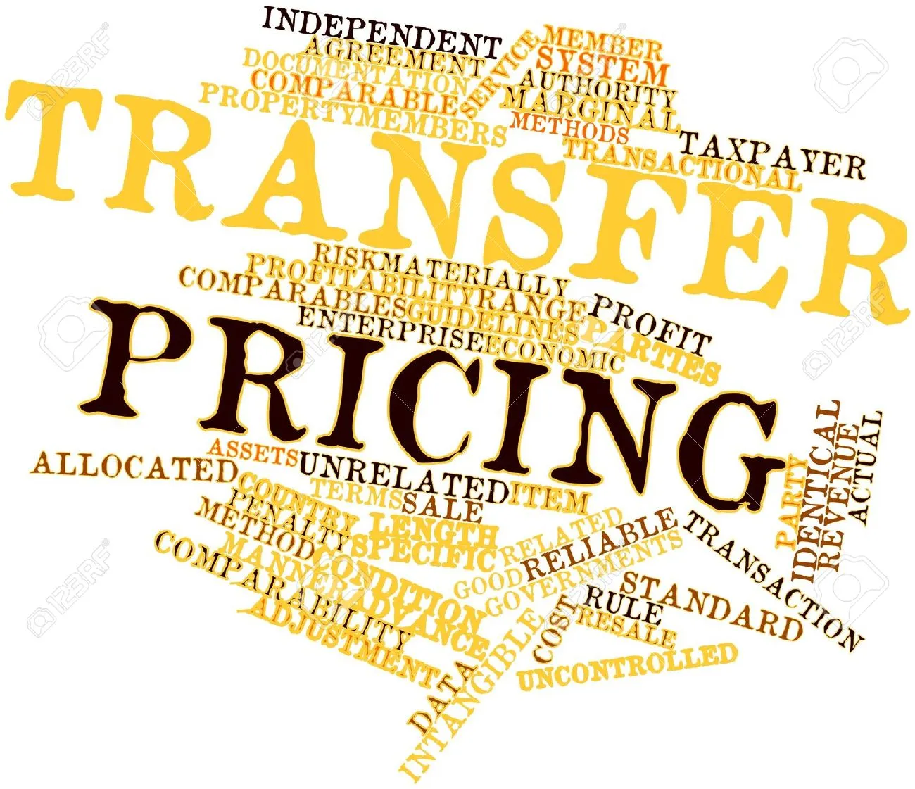
Transfer Pricing Methods
Narendra Joshi
Partner
M. P. Chitale & Co.

Slide 2
Index
Introduction
Methods of transfer pricing
Most appropriate method
Case laws on methods

Slide 3
Introduction

Slide 4
Introduction to Transfer Pricing
Transfer pricing is the practice of determining the prices at which goods, services, or intellectual property are exchanged between entities within the same multinational corporation or group i.e. associated entities.
This principle dictates that transactions between related parties should be priced as if they were independent, unrelated entities engaging in similar transaction

Slide 5
Introduction to Transfer Pricing
ALP : Arm’s Length Price (‘ALP’) means a price which is applied or proposed to be applied in a transaction between persons other than associated enterprises, in uncontrolled conditions.
ALP is determined by selecting most appropriate method (’MAM’) out the methods prescribed (Rule 10C)
ALP computation is highly subjective

Slide 6
Introduction to Transfer Pricing
Applicability
Other than International Transactions
Effective from AY 12-13
Rs. 20 Crores and above
International Transactions
Applicable to all
Either one or both AEs are Non-residents
Domestic Transactions

Slide 7
Methods of transfer pricing

Slide 8
Methods of Transfer Pricing
Methods
Traditional Transaction Methods
Comparable Uncontrolled Price Method
Resale Price Method
Transactional Profit Methods
Transactional Net Margin Method
Cost Plus Method
The Profit Split Method
Other Method

Slide 9
Methods of Transfer Pricing
Methods | US | OCED | UN | INDIA
CUP | a | a | a | a
RPM | a | a | a | a
CPM | a | a | a | a
TNMM | a | a | a | a
PSM | a | a | a | a
OTHERS | a | r | r | a

Slide 10
Comparable Uncontrolled Price (‘CUP’) Method
Comparable Uncontrolled Price method, by which:
the price charged or paid for property transferred or services provided in a comparable uncontrolled transaction, or a number of such transactions, is identified;
such price is adjusted to account for differences, if any, between the transaction and the comparable uncontrolled transactions or between the enterprises entering into such transactions, which could materially affect the price in the open market;
the adjusted price arrived at under sub-clause (ii) is taken to be an arm’s length price in respect of the property transferred or services provided in the transaction.

Slide 11
Strengths and Weaknesses of CUP Method
Strengths
Two-sided analysis
Involves direct transactional comparison
Weaknesses
Difficulty in finding comparable uncontrolled transactions
Avoids the choice of the tested related party

Slide 12
CUP method
Internal
Available when the taxpayer enters into a similar transaction with unrelated parties, as is done with related party.
External
External CUP is available if a transaction between two independent enterprises takes place under comparable conditions involving comparable goods or services. (Examples – Royalty and Technical fees, purchase/sale of goods where prices are available in open market or financing transactions)

Slide 13
When to use the CUP Method
Where comparable controlled transactions can be found, the CUP method is usually a very reliable method.
CUP method may be used in case of interest on loans, provision of services, royalty for use of intangibles, transfer of tangibles, sale and purchase of goods/ commodities, etc.

Slide 14
CUP Method Application – Key factors
Duration
Intangibles associated
Foreign currency risk
Contractual terms
Level of market
Alternative

Slide 15
Resale Price Method (‘RPM’)
Resale price method, by which,—
The price at which property purchased or services obtained by the enterprise from an AE is resold or are provided to an unrelated enterprise, is identified;
such resale price is reduced by the amount of a normal gross profit margin accruing to the enterprise or to an unrelated enterprise from the purchase and resale of the same or similar property
the price so arrived at is further reduced by the expenses incurred by the enterprise in connection with the purchase of property or obtaining of services;
the price so arrived at is adjusted to take into account the functional and other differences, including differences in accounting practices, if any, between the transactions or between the enterprises entering into such transactions, which could materially affect the amount of gross profit margin in the open market;
the adjusted price arrived at under sub-clause (iv) is taken to be an arm’s length price

Slide 16
Case Study
AE1 Ltd, is an Indian company. The shareholding pattern of AE1 Ltd, is as follows;
AE2 Ltd | Foreign Company | 30
AE3 Ltd | Indian Company | 30
Financial Institutions | Indian Company | 10
Public |  | 30
AE1 Ltd, trades in compact disc (CD) writers. AE1 Ltd, procures CD writers both locally and in the international market. Its imports consist of CD writers purchased from AE2 Ltd as well as other manufacturers (Non-AEs).
AE1 Ltd, during the year purchased 100 CD writers from AE2 Ltd at INR 2,900 per unit.
These are resold to A Ltd, an unrelated party, at a price of INR 3,000 per unit.
AE1 Ltd, has also purchased similar products from an unrelated supplier, viz. K Ltd, and has resold the same to M Ltd, who is also an unrelated party and has earned a gross profit of 15% on sales
Normal gross profit ratio after adjustments is 12% on sales.
Quantity discount allowed by AE2 Ltd is Rs 15/unit. The Purchase freight (on transaction with AE2 Ltd) is of Rs 10/unit and the Customs Duty is Rs 25/unit

Slide 17
Details | INR /unit
Price paid to AE2 Ltd.(FOB) | 2,900
Quantity | 100
Purchase cost(Actual)(A) | 2,90,000
Actual GP Margin on sales to M Ltd.(%) | 15
Normal GP Margin on sales to M Ltd.(%) | 12
Price charged to A Ltd. | 3,000
Less: Normal GP margin | 360
Balance | 2,640
Less: Expenses connected with purchase (freight & customs duty paid) | 35
Price before adjustment | 2,605
Add: Freight incurred in case of purchase from AE2 Ltd. | 10
Less: Quantity discount allowed by AE2 Ltd. | 15
Arm’s length price | 2,600
Adjusted purchase cost (B) | 2,60,000
Income increases by (A-B) | 30,000

Slide 18
Strengths and Weaknesses of RPM
Strengths
Demand-driven method
Weaknesses
Difficulty in finding comparable data
One-sided analysis
Inappropriate profit-making is avoided

Slide 19
When to use RPM Method
The CUP Method is not applicable;
The sales companies do not own valuable intangible properties; and
Reliable comparisons can be made on COGS.

Slide 20
RPM Application – Key factors
Reselling function
Less or no value addition
Suitable for trader/distributor model
Availability of similar transactions
Intangible assets

Slide 21
Cost Plus Method(CPM)
Under CPM method-
the direct and indirect costs of production incurred by the enterprise to an AE, are determined;
the amount of a normal gross profit mark-up to such costs (computed according to the same accounting norms) arising from the transfer or provision of the same or similar property or services by the enterprise, or by an unrelated enterprise, is determined;
the normal gross profit mark-up referred to in sub-clause (ii) is adjusted to take into account the functional and other differences, if any, between the transactions, or between the enterprises entering into such transactions, which could materially affect such profit mark-up in the open market;
the costs referred to in sub-clause (i) are increased by the adjusted profit mark-up arrived at under sub-clause (iii);
the sum so arrived at is taken to be an arm’s length price

Slide 22
Case Study
AE1 Ltd., is an Indian company. The shareholding pattern of AE1 Ltd., is as follows;
Shareholder | Status | % Holding
AE2 Ltd | Foreign Company | 30
AE3 Ltd | Indian Company | 30
Financial Institutions | Indian Company | 10
Public |  | 30
AE1 Ltd., an unrelated party, develops software for various customers, who include AE2 Ltd. and M Ltd. AE1 Ltd., during the year billed AE2 Ltd. INR 2,00,000.
The total cost (direct and indirect) for executing this work was INR 1,75,000. AE1 Ltd., provided similar services to M Ltd., and earned a gross profit (GP) of 50% on costs.
Technology Support (10% of cost) has been received from AE2 which won’t be received otherwise.
Discount given to AE2 is 5% of cost.
Additional expenses incurred by AE1 had they sold to M Ltd were 7.5% of cost.
Cost of Credit provided to AE2 Ltd is 1.5% of cost.

Slide 23
Determination of arm’s length gross profit mark up
Details | Amount/%
Gross profit mark up in case of M Ltd. | 50.00%
Less
1. Technology support from AE2 Ltd. | 10.00%
2. Quantity discount to AE2 Ltd not to M Ltd. | 5.00%
3. Marketing functions performed by AE1Ltd., in respect of M Ltd. | 7.50%
Add
1. Cost of credit to AE2. Ltd. | 1.50%
Arm’s length gross profit mark up | 29.00%
Determination of arm’s length price
Direct and indirect costs incurred by AE1 Ltd. in respect of transactions with AE2 Ltd. | 1,75,000.00
Arm’s length gross profit mark up | 29.00%
Arm’s length income (A) | 2,25,750.00
Actual price charged to AE2 Ltd. (B) | 2,00,000.00
Income increases by (A-B) | 25,750.00

Slide 24
Strengths and Weaknesses of CPM
Strengths
Based on internal costs which is available
Weaknesses
Accounting consistency required
Weak link between costs and market price
One-sided analysis
Availability of cost data

Slide 25
When to use CPM Method
Provision of services
Intra group services
Joint facility arrangements/long term buy and supply agreements
Intercompany manufacturing arrangements
Transfer of semi finished goods

Slide 26
Profit Split Method(PSM)
Profit split method, which may be applicable mainly in transactions involving transfer of unique intangibles or in multiple transactions which are so interrelated that they cannot be evaluated separately for the purpose of determining the arm's length price of any one transaction, by which
the combined net profit of the AEs arising from the transactions in which they are engaged, is determined;
the relative contribution made by each of the AEs to the earning of such combined net profit, is then evaluated on the basis of various factors and on the basis of reliable external market data in similar circumstances;
the combined net profit is then split amongst the enterprises in proportion to their relative contributions, as evaluated under sub-clause (ii);
the profit thus apportioned to the assessee is taken into account to arrive at an arm’s length price

Slide 27
Profit Split Method(PSM)
Provided that the combined net profit referred to in sub-clause (i) may, in the first instance, be partially allocated to each enterprise so as to provide it with a basic return appropriate for the type of transaction in which it is engaged, with reference to market returns achieved for similar types of transactions by independent enterprises,
and thereafter,
the residual net profit remaining after such allocation may be split amongst the enterprises in proportion to their relative contribution in the manner specified under sub-clauses (ii) and (iii), and in such a case the aggregate of the net profit allocated to the enterprise in the first instance together with the residual net profit apportioned to that enterprise on the basis of its relative contribution shall be taken to be the net profit arising to that enterprise from the transaction

Slide 28
Profit Split Method
Methods to allocate or split the profits
Contribution analysis
Residual analysis

Slide 29
Case Study
AE1 Ltd, is an Indian company. Shareholding is as per previous example. AE1 Ltd, is an investment advisory company, which in association with AE2 Ltd assists its clients with foreign acquisitions.
AE3 Ltd is based in USA. AE1 Ltd is approached by M, an unrelated party for identifying potential target companies for acquisitions in the USA. In order to serve M, AE1 Ltd and AE3 Ltd, have each contributed integrally to identification of potential target and assisting M with the acquisition process. For the above, AE1 Ltd, received consideration of US$ 50,000.The financials are as follows;
Particulars | AE1 | AE3
Cost | 20,000 | 8,000
Profit | 10,000 | 12000
All amounts in USD

Slide 30
Case Study
The relative contribution may be taken at 70%, 30% for AE1 Ltd and AE3 Ltd, respectively.
The basic return for AE1 and AE3 is 15% and 10% respectively. The normal basic return for AE1 Ltd in India for the aforesaid operation is US$ 3,000. The similar returns for AE3 Ltd, US$ 800. The total basic return, thus, is US $ 3,800.

Slide 31
As per Total Profit Split Method
Details | US$
Price charged by AE1 Ltd from M Ltd | 50,000
AE3 Ltd share of revenue | 20,000
AE1 Ltd share of revenue | 30,000
Combined total profits | 22,000
Evaluation of relative contribution
AE1 Ltd : India return – 70% | 15,400
AE3 Ltd : US return – 30% | 6,600
Total return for AE1 Ltd | 15,400
Total cost of AE1 Ltd | 20,000
Income of AE1 Ltd on arm’s length price (A) | 35,400
Actual revenue (B) | 30,000
Increased income (A-B) | 5,400

Slide 32
As per Residual Profit Split Method
Details | US$
Combined total profits(as per previous slide) | 22,000
1. Basic return
AE1 Ltd : India return (15% on cost) | 3,000
AE3 Ltd : US return (10% on cost) | 800
Total | 3,800
2. Residual net profit (22,000 – 3,800) | 18,200
AE1 Ltd: India return – 70% | 12,740
AE3 Ltd: US return – 30% | 5,460
Total return for AE1 Ltd (12740 + 3,000) | 15,740
Total cost of AE1 Ltd | 20,000
Income of AE1 Ltd on arm’s length price (A) | 35,740
Actual revenue (B) | 30,000
Increased income (A-B) | 5,740

Slide 33
Strengths and Weaknesses of PSM
Strengths
Highly integrated operations
Weaknesses
Theoretical weakness of second step
Suitable where traditional methods are inappropriate
Returns to synergies and economies of scale
Dependance on access to data
Certain measurement problems

Slide 34
When to use PSM Method
Complex industries
Both sides own valuable intangible property.
Integrated services provided by more than one enterprise,
Transfer of unique intangibles,

Slide 35
Transactional Net Margin Method(TNMM)
Under the TNMM method
the net profit margin realized by the enterprise from a transaction entered into with an AE is computed in relation to costs incurred or sales effected, or assets employed or to be employed by the enterprise or having regard to any other relevant base;
the net profit margin realised by the enterprise or by an unrelated enterprise from a comparable uncontrolled transaction is computed having regard to the same base;
the net profit margin referred to in sub-section (ii) arising in comparable uncontrolled transactions is adjusted to take into account the differences, if any, between the transaction and the comparable uncontrolled transactions, which could materially affect the amount of net profit margin in the open market;
the net profit margin realised by the enterprise and referred to in sub-clause (i) is established to be the same as the net profit margin referred to in sub-clause (iii);
the net profit margin thus established is then taken into account to arrive at an arm’s length price

Slide 36
Case Study
AE1 Ltd, is an Indian company. Shareholding is as per previous example.
AE1 Ltd., manufactures compact disc (CD) writers and sells the same to AE2 Ltd, which is an AE of AE1 Ltd.
As AE1 Ltd, does not have similar transaction with a non AE, no internal CUP is available. As AE1 Ltd, does not have information and data to identify a comparable company, it has used the databases in public domain for carrying out the search.

Slide 37
Case Study
The result of the search may be summarised as follows
Search based on keywords | No of Companies
Computer | 800
Computer hardware | 250
Computer peripherals | 66
Sub total | 1,116
Elimination process | No of Companies
Companies with different activities | 800
Companies with duplication when multiple database are used | 75
Companies with no financials | 90
Companies having significant operations like sales or purchases with related party | 100
Companies reporting no operations | 50
Sub total | 1,115
Company/companies selected – Z Ltd. | 1

Slide 38
Case Study
Financials | AE1 Ltd | Z Ltd
Sales | 130 | 200
Other Income | 5 | 10
Total Income | 135 | 210
Operating Expenses | 85 | 120
Interest | 5 | 7
Depreciation | 10 | 12
Loss on sale of undertaking | 5 | 0
Expenses relating to non operating income | 1 | 3
Total expenditure | 106 | 142
Net profits | 24 | 58

Slide 39
Case Study
Financials | AE1 Ltd | Z Ltd
Sales | 130 | 200
Gross revenue | 130 | 200
Operating expenses | 85 | 120
Interest | 5 | 7
Depreciation | 10 | 12
Operating profit | 30 | 61
Operating margin (before interest and depreciation) | 52.94 | 66.67
Operating margin (after depreciation but before interest) | 36.84 | 51.52

Slide 40
Strengths and Weaknesses of TNMM
Strengths
Product and functional differences are less critical
Weaknesses
Non pricing factors
Information/Measurement challenges
Difficult to work-back
Less Complex functional analysis
Applicable to either side
Modified RPM or CPM
One-sided approach

Slide 41
When to use TNMM Method
Provision of services;
Distribution of finished products where RPM cannot be applied;
Transfer of semi-finished goods where CPM cannot be applied;
Transactions involving intangibles where PSM cannot be applied

Slide 42
Other Method
The CBDT has inserted a Rule 10AB by notifying the “Other Method” apart from the five methods already prescribed.
the Other Method for determination of the arms' length price in relation to a transaction shall be any method which takes into account the price which has been charged or paid, or would have been charged or paid, for the same or similar uncontrolled transaction, with or between non-AEs, under similar circumstances, considering all the relevant facts.
it is relevant to note that the text of Rule 10AB does not describe any methodology but only provides an enabling provision to use any method that has been used or may be used to arrive at price

Slide 43
Case Study
AE1 Ltd is an Indian Company. AE1 Ltd owns certain registered patents which it has developed by undertaking research and development. It is a subsidiary of AE2 Ltd, a foreign company.
AE1 Ltd has sold its registered patents to AE2 Ltd, for Rs. 50 crores. The price has been determined based on a valuation report obtained from an independent valuer.
The sale of patents is a unique transaction and AE1 Ltd or AE2 Ltd has not entered into similar transactions with third parties and hence no internal or external CUP is available.
AE1 Ltd may select the Other Method as the most appropriate method and use the independent valuation report for comparability purposes.

Slide 44
Most appropriate method

Slide 45
Most Appropriate Method
The most appropriate method shall be the method which is best suited to the facts and circumstances of each particular transaction and which provides the most reliable measure of an arm’s length price in relation to the transaction.
In selecting the most appropriate method, the following factors shall be taken into account, namely:-
the nature and class of the transaction
the availability, coverage and reliability of data
he degree of comparability existing between the related transaction and the uncontrolled transaction
the extent to which reliable and accurate adjustments can be made to account for differences

Slide 46
Case laws

Slide 47
Case laws on methods
Case | Summary | Method
Swarovski India Pvt Ltd (Delhi ITAT) | Upholds 'cost-plus' for contract manufacturer over TNMM as MAM, but rejects ad-hoc cost- allocation resulting higher profit | CPM over TNMM
The Himalaya Drug Company (Bangalore ITAT) | Rejected CPM considering difference in FAR of the assessee’s domestic and export division | TNMM over CUP
Fulford (India) Limited (Mumbai ITAT) | Prefers CUP over CPM for benchmarking raw material purchased by pharmaceutical manufacturer | CUP over CPM
Gap International Sourcing India Pvt Ltd (SC) | Upholds CPM over commission based model in view of ‘low risk procurement support services | CPM
Star International Movies Ltd (Mumbai ITAT) | Rules on comparables for channel- owner; Upholds combined net-profit under PSM approach following precedent | PSM
Toyota Kirloskar Auto Parts Pvt. Ltd (Bangalore ITAT) | Prefers TNMM to PSM for benchmarking royalty; Follows precedent | TNMM over PSM

Slide 48
Views are personal….Thank you!! Narendra Joshi Partner M. P. Chitale & Co 759/70, Vatsala Bhavan, Prabhat Road, Lane No. 1, Pune - 411 004 98815 36977 narendra.joshi@mpchitale.com

